Slide 1
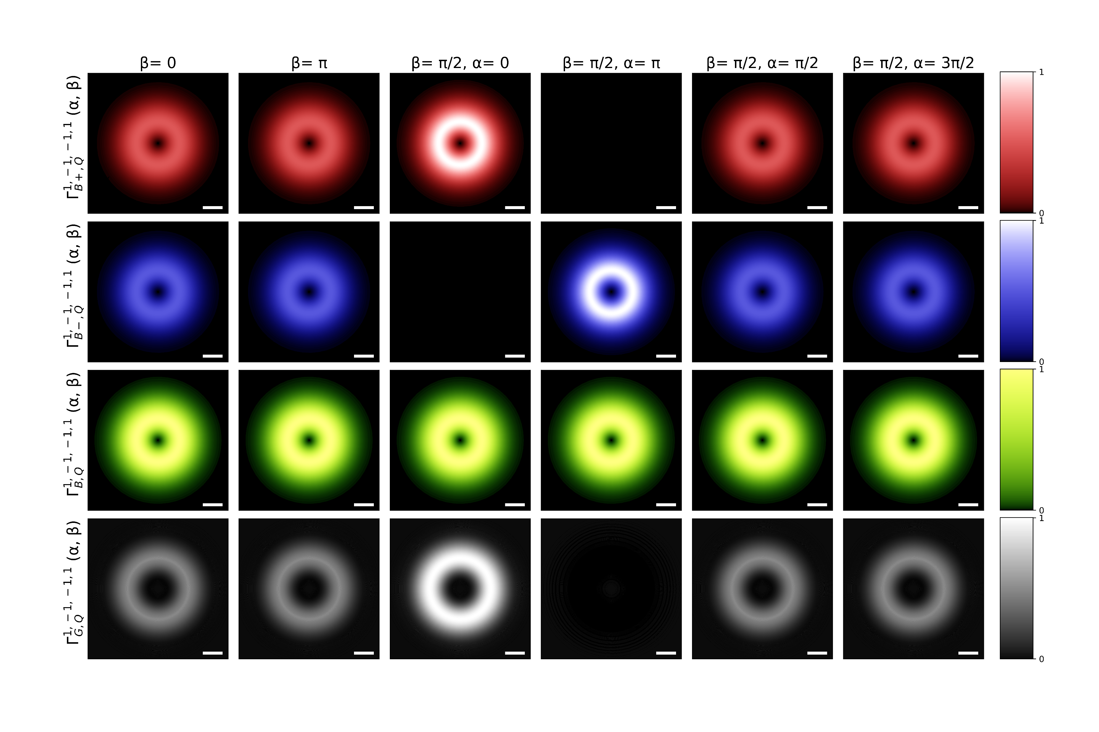
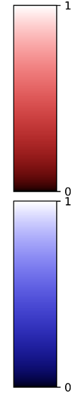
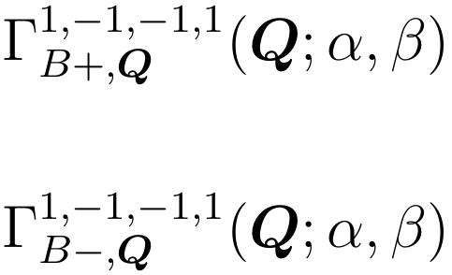
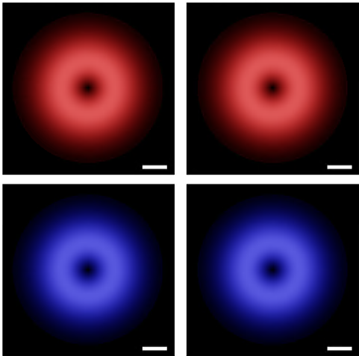






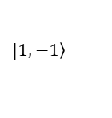





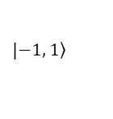




Valley-mixed excitons transition rate
$$Q_{y}$$
$$Q_{x}$$
$${0.1Q}_{c}$$
$$a.u.$$
$$Q_{y}$$
$$Q_{x}$$
$${0.1Q}_{c}$$
$$a.u.$$
$$\left(α, β\right)=\left(0, \text{0}\right)$$
$$|\left.1, −1\right\rangle$$
$$z$$
$$x$$
$$β$$
$$\left(3π/2, π/2\right)$$
$$α$$
$$y$$
$$\left(π,π/2\right)$$
$$|\left.−1, 1\right\rangle$$
$$\left(0, π/2\right)$$
$$\left(π/2,π/2\right)$$
$$\left(0, π\right)$$

Slide 2
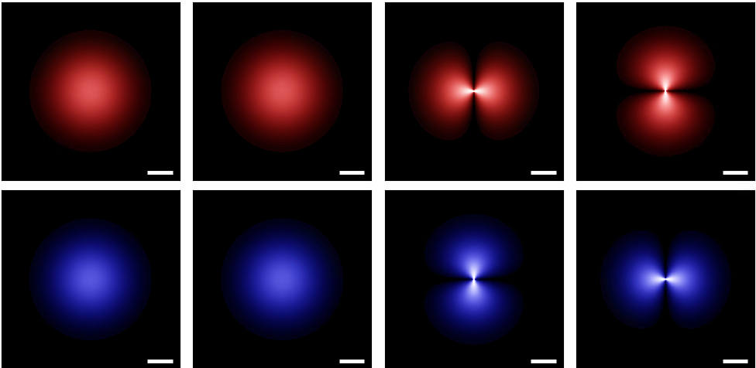

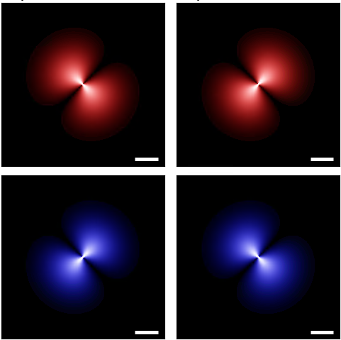
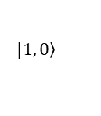
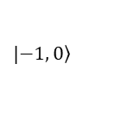
Valley-mixed excitons transition rate
$$Q_{y}$$
$$Q_{x}$$
$${0.1Q}_{c}$$
$$a.u.$$
$$Q_{y}$$
$$Q_{x}$$
$${0.1Q}_{c}$$
$$a.u.$$
$$\left(α, β\right)=\left(0, \text{0}\right)$$
$$|\left.1, 0\right\rangle$$
$$z$$
$$x$$
$$β$$
$$\left(3π/2, π/2\right)$$
$$α$$
$$y$$
$$\left(π,π/2\right)$$
$$|\left.−1, 0\right\rangle$$
$$\left(0, π/2\right)$$
$$\left(π/2,π/2\right)$$
$$\left(0, π\right)$$

Slide 3
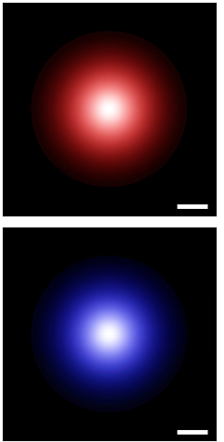

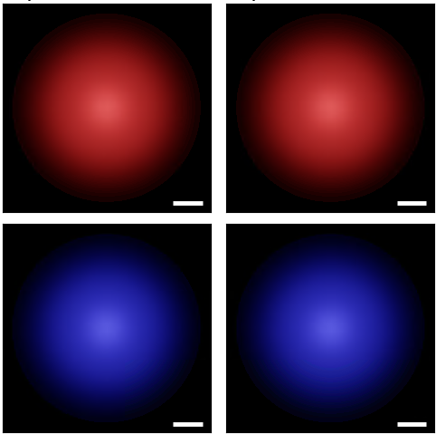
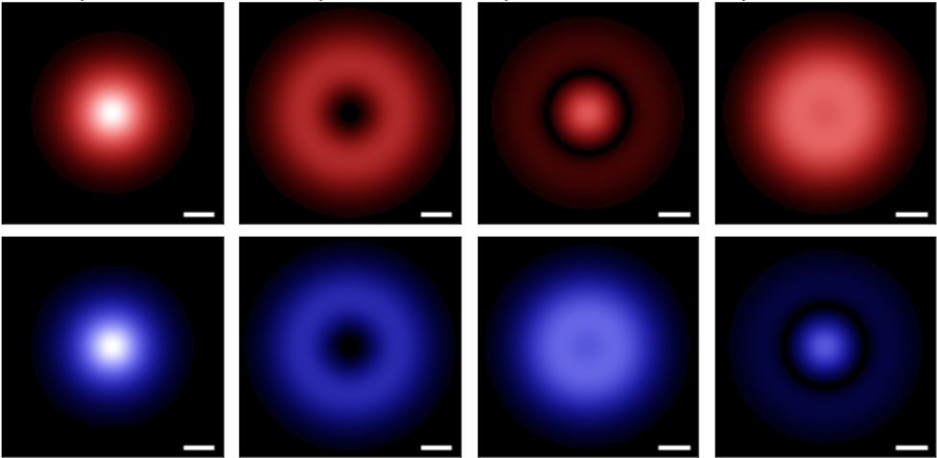
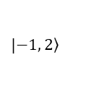
Valley-mixed excitons transition rate
$$Q_{y}$$
$$Q_{x}$$
$${0.1Q}_{c}$$
$$a.u.$$
$$Q_{y}$$
$$Q_{x}$$
$${0.1Q}_{c}$$
$$a.u.$$
$$\left(α, β\right)=\left(0, \text{0}\right)$$
$$|\left.1, 0\right\rangle$$
$$z$$
$$x$$
$$β$$
$$\left(3π/2, π/2\right)$$
$$α$$
$$y$$
$$\left(π,π/2\right)$$
$$|\left.−1, 2\right\rangle$$
$$\left(0, π/2\right)$$
$$\left(π/2,π/2\right)$$
$$\left(0, π\right)$$

Slide 4
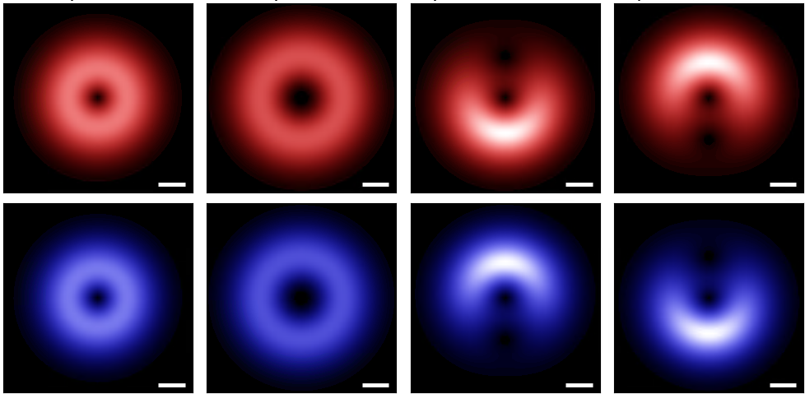

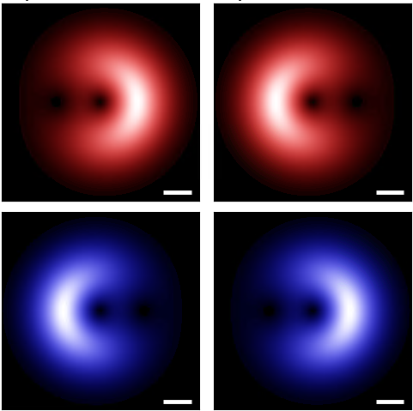
Valley-mixed excitons transition rate
$$Q_{y}$$
$$Q_{x}$$
$${0.1Q}_{c}$$
$$a.u.$$
$$Q_{y}$$
$$Q_{x}$$
$${0.1Q}_{c}$$
$$a.u.$$
$$\left(α, β\right)=\left(0, \text{0}\right)$$
$$|\left.1, −1\right\rangle$$
$$z$$
$$x$$
$$β$$
$$\left(3π/2, π/2\right)$$
$$α$$
$$y$$
$$\left(π,π/2\right)$$
$$|\left.−1, 2\right\rangle$$
$$\left(0, π/2\right)$$
$$\left(π/2,π/2\right)$$
$$\left(0, π\right)$$

Slide 5



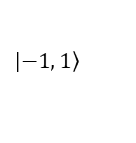


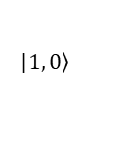















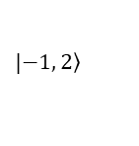


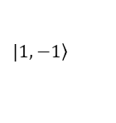


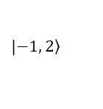






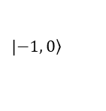


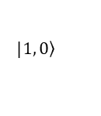










Valley-mixed excitons transition rate
$$Q_{y}$$
$$Q_{y}$$
$$Q_{y}$$
$$Q_{y}$$
$$Q_{x}$$
$$Q_{x}$$
$$Q_{x}$$
$$Q_{x}$$
$${0.1Q}_{c}$$
$$a.u.$$
$${0.1Q}_{c}$$
$$a.u.$$
$${0.1Q}_{c}$$
$$a.u.$$
$${0.1Q}_{c}$$
$$a.u.$$
$$Q_{y}$$
$$Q_{x}$$
$$Q_{y}$$
$$Q_{x}$$
$$Q_{y}$$
$$Q_{x}$$
$$Q_{y}$$
$$Q_{x}$$
$${0.1Q}_{c}$$
$$a.u.$$
$${0.1Q}_{c}$$
$$a.u.$$
$${0.1Q}_{c}$$
$$a.u.$$
$${0.1Q}_{c}$$
$$a.u.$$
$$\left(α, β\right)=\left(0, \text{0}\right)$$
$$\left(α, β\right)=\left(0, \text{0}\right)$$
$$\left(α, β\right)=\left(0, \text{0}\right)$$
$$\left(α, β\right)=\left(0, \text{0}\right)$$
$$|\left.1, −1\right\rangle$$
$$|\left.1, 0\right\rangle$$
$$|\left.1, 0\right\rangle$$
$$|\left.1, −1\right\rangle$$
$$z$$
$$z$$
$$z$$
$$z$$
$$x$$
$$β$$
$$x$$
$$β$$
$$x$$
$$β$$
$$x$$
$$β$$
$$\left(3π/2, π/2\right)$$
$$α$$
$$y$$
$$\left(π,π/2\right)$$
$$\left(3π/2, π/2\right)$$
$$α$$
$$y$$
$$\left(π,π/2\right)$$
$$\left(3π/2, π/2\right)$$
$$α$$
$$y$$
$$\left(π,π/2\right)$$
$$\left(3π/2, π/2\right)$$
$$α$$
$$y$$
$$\left(π,π/2\right)$$
$$|\left.−1, 1\right\rangle$$
$$|\left.−1, 0\right\rangle$$
$$|\left.−1, 2\right\rangle$$
$$|\left.−1, 2\right\rangle$$
$$\left(0, π/2\right)$$
$$\left(π/2,π/2\right)$$
$$\left(0, π/2\right)$$
$$\left(π/2,π/2\right)$$
$$\left(0, π/2\right)$$
$$\left(π/2,π/2\right)$$
$$\left(0, π/2\right)$$
$$\left(π/2,π/2\right)$$
$$\left(0, π\right)$$
$$\left(0, π\right)$$
$$\left(0, π\right)$$
$$\left(0, π\right)$$

Slide 6
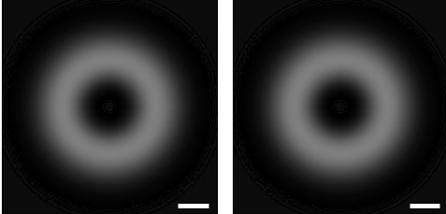


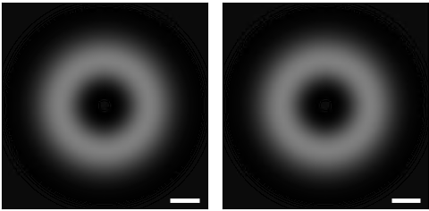
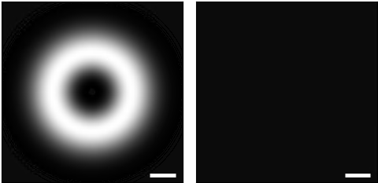






$$1, −1, −1, 2$$
Gray excitons transition rate
$$Q_{y}$$
$$Q_{x}$$
$${0.1Q}_{c}$$
$$a.u.$$
$$\left(α, β\right)=\left(0, \text{0}\right)$$
$$|\left.1, −1\right\rangle$$
$$z$$
$$\left(3π/2, π/2\right)$$
$$x$$
$$β$$
$$\left(π,π/2\right)$$
$$α$$
$$y$$
$$|\left.−1, 1\right\rangle$$
$$\left(0, π/2\right)$$
$$\left(π/2,π/2\right)$$
$$\left(0, π\right)$$

Slide 7
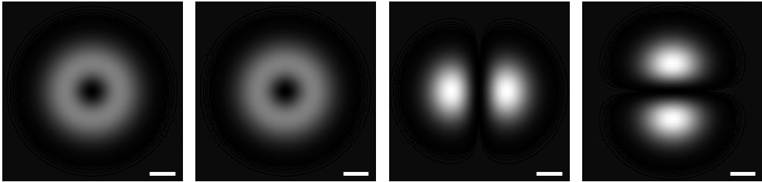

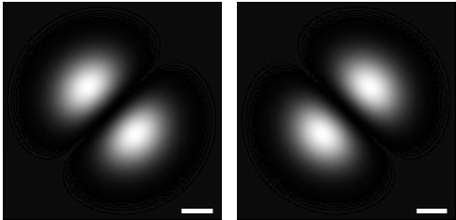
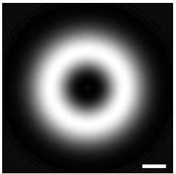




$$1, 0, −1, 0$$
Gray excitons transition rate
$$Q_{y}$$
$$Q_{x}$$
$${0.1Q}_{c}$$
$$a.u.$$
$$\left(α, β\right)=\left(0, \text{0}\right)$$
$$|\left.1, 0\right\rangle$$
$$z$$
$$\left(3π/2, π/2\right)$$
$$x$$
$$β$$
$$\left(π,π/2\right)$$
$$α$$
$$y$$
$$|\left.−1, 0\right\rangle$$
$$\left(0, π/2\right)$$
$$\left(π/2,π/2\right)$$
$$\left(0, π\right)$$

Slide 8
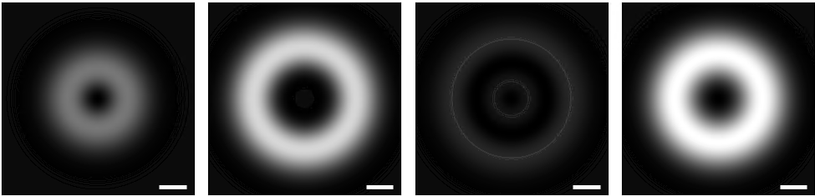

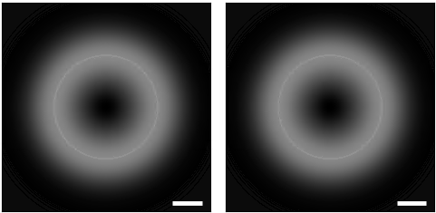



$$1, 0, −1, 2$$
Gray excitons transition rate
$$Q_{y}$$
$$Q_{x}$$
$${0.1Q}_{c}$$
$$a.u.$$
$$\left(α, β\right)=\left(0, \text{0}\right)$$
$$|\left.1, 0\right\rangle$$
$$z$$
$$\left(3π/2, π/2\right)$$
$$x$$
$$β$$
$$\left(π,π/2\right)$$
$$α$$
$$y$$
$$|\left.−1, 2\right\rangle$$
$$\left(0, π/2\right)$$
$$\left(π/2,π/2\right)$$
$$\left(0, π\right)$$

Slide 9
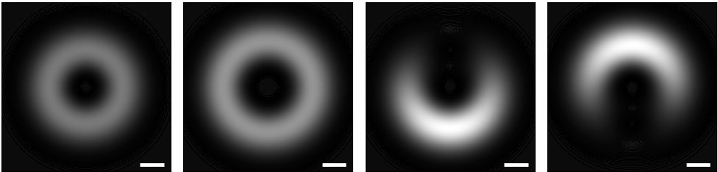
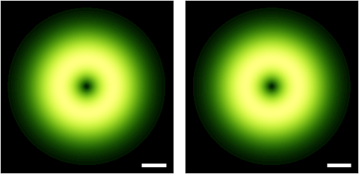
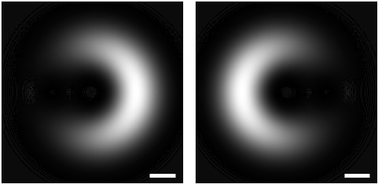


$$1, −1, −1, 2$$
Gray excitons transition rate
$$Q_{y}$$
$$Q_{x}$$
$${0.1Q}_{c}$$
$$a.u.$$
$$\left(α, β\right)=\left(0, \text{0}\right)$$
$$|\left.1, −1\right\rangle$$
$$z$$
$$\left(3π/2, π/2\right)$$
$$x$$
$$β$$
$$\left(π,π/2\right)$$
$$α$$
$$y$$
$$|\left.−1, 2\right\rangle$$
$$\left(0, π/2\right)$$
$$\left(π/2,π/2\right)$$
$$\left(0, π\right)$$

Slide 10

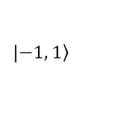









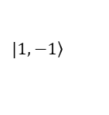





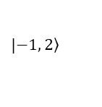









Gray excitons transition rate
$$Q_{y}$$
$$Q_{x}$$
$$Q_{y}$$
$$Q_{x}$$
$$Q_{y}$$
$$Q_{x}$$
$$Q_{y}$$
$$Q_{x}$$
$${0.1Q}_{c}$$
$$a.u.$$
$${0.1Q}_{c}$$
$$a.u.$$
$${0.1Q}_{c}$$
$$a.u.$$
$${0.1Q}_{c}$$
$$a.u.$$
$$\left(α, β\right)=\left(0, \text{0}\right)$$
$$\left(α, β\right)=\left(0, \text{0}\right)$$
$$\left(α, β\right)=\left(0, \text{0}\right)$$
$$\left(α, β\right)=\left(0, \text{0}\right)$$
$$|\left.1, −1\right\rangle$$
$$|\left.1, 0\right\rangle$$
$$|\left.1, 0\right\rangle$$
$$|\left.1, −1\right\rangle$$
$$z$$
$$z$$
$$z$$
$$z$$
$$\left(3π/2, π/2\right)$$
$$x$$
$$β$$
$$\left(π,π/2\right)$$
$$\left(3π/2, π/2\right)$$
$$x$$
$$β$$
$$\left(π,π/2\right)$$
$$\left(3π/2, π/2\right)$$
$$x$$
$$β$$
$$\left(π,π/2\right)$$
$$\left(3π/2, π/2\right)$$
$$x$$
$$β$$
$$\left(π,π/2\right)$$
$$α$$
$$y$$
$$α$$
$$y$$
$$α$$
$$y$$
$$α$$
$$y$$
$$|\left.−1, 1\right\rangle$$
$$|\left.−1, 0\right\rangle$$
$$|\left.−1, 2\right\rangle$$
$$|\left.−1, 2\right\rangle$$
$$\left(0, π/2\right)$$
$$\left(π/2,π/2\right)$$
$$\left(0, π/2\right)$$
$$\left(π/2,π/2\right)$$
$$\left(0, π/2\right)$$
$$\left(π/2,π/2\right)$$
$$\left(0, π/2\right)$$
$$\left(π/2,π/2\right)$$
$$\left(0, π\right)$$
$$\left(0, π\right)$$
$$\left(0, π\right)$$
$$\left(0, π\right)$$

Slide 11
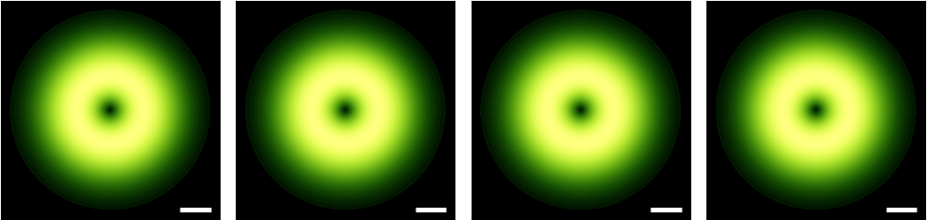

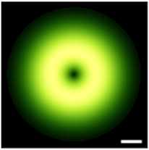



Total valley-mixed excitons transition rate
$$Q_{y}$$
$$Q_{x}$$
$${0.1Q}_{c}$$
$$a.u.$$
$$\left(α, β\right)=\left(0, \text{0}\right)$$
$$|\left.1, −1\right\rangle$$
$$z$$
$$\left(3π/2, π/2\right)$$
$$x$$
$$β$$
$$\left(π,π/2\right)$$
$$α$$
$$y$$
$$|\left.−1, 1\right\rangle$$
$$\left(0, π/2\right)$$
$$\left(π/2,π/2\right)$$
$$\left(0, π\right)$$

Slide 12
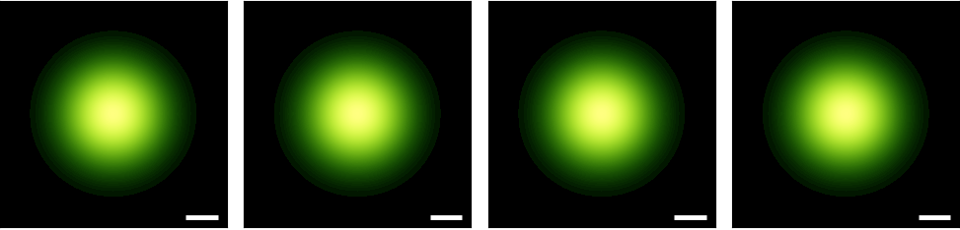
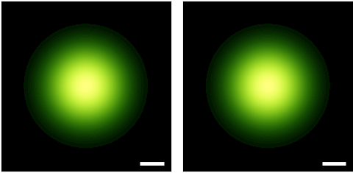




Total valley-mixed excitons transition rate
$$Q_{y}$$
$$Q_{x}$$
$${0.1Q}_{c}$$
$$a.u.$$
$$\left(α, β\right)=\left(0, \text{0}\right)$$
$$|\left.1, 0\right\rangle$$
$$z$$
$$\left(3π/2, π/2\right)$$
$$x$$
$$β$$
$$\left(π,π/2\right)$$
$$α$$
$$y$$
$$|\left.−1, 0\right\rangle$$
$$\left(0, π/2\right)$$
$$\left(π/2,π/2\right)$$
$$\left(0, π\right)$$

Slide 13
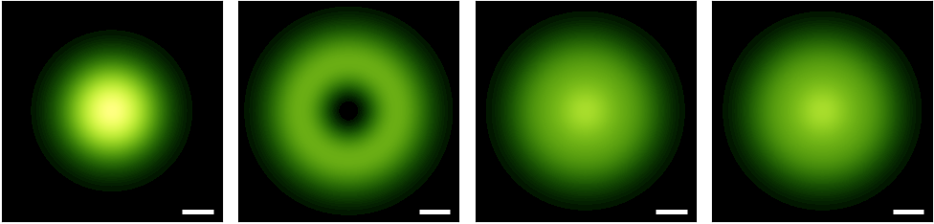
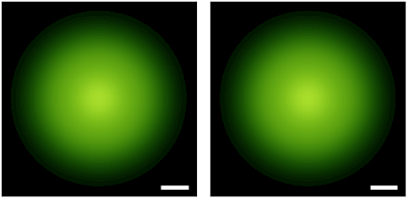





Total valley-mixed excitons transition rate
$$Q_{y}$$
$$Q_{x}$$
$$1, 0, −1, 2$$
$${0.1Q}_{c}$$
$$a.u.$$
$$\left(α, β\right)=\left(0, \text{0}\right)$$
$$|\left.1, 0\right\rangle$$
$$z$$
$$\left(3π/2, π/2\right)$$
$$x$$
$$β$$
$$\left(π,π/2\right)$$
$$α$$
$$y$$
$$|\left.−1, 2\right\rangle$$
$$\left(0, π/2\right)$$
$$\left(π/2,π/2\right)$$
$$\left(0, π\right)$$

Slide 14
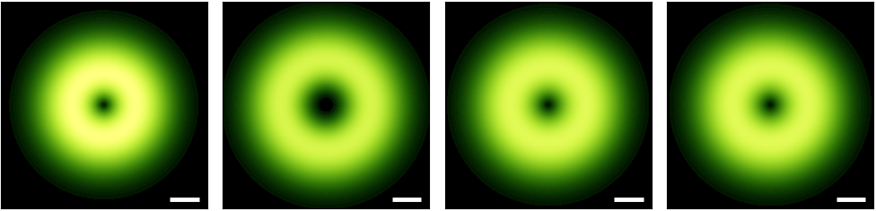
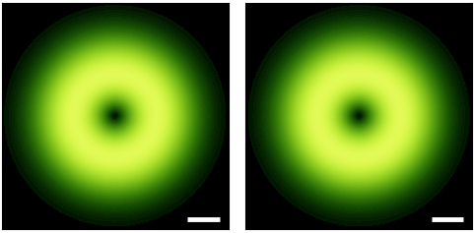



Total valley-mixed excitons transition rate
$$Q_{y}$$
$$Q_{x}$$
$$1, 0, −1, 2$$
$${0.1Q}_{c}$$
$$a.u.$$
$$\left(α, β\right)=\left(0, \text{0}\right)$$
$$ℓ$$
$$|\left.1, −1\right\rangle$$
$$−ℓ$$
$$z$$
$$\left(3π/2, π/2\right)$$
$$x$$
$$β$$
$$\left(π,π/2\right)$$
$$α$$
$$y$$
$$|\left.−1, 2\right\rangle$$
$$\left(0, π/2\right)$$
$$\left(π/2,π/2\right)$$
$$\left(0, π\right)$$

Slide 15










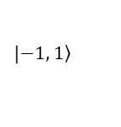






Total valley-mixed excitons transition rate
$$Q_{y}$$
$$Q_{x}$$
$$Q_{y}$$
$$Q_{x}$$
$$Q_{y}$$
$$Q_{x}$$
$$Q_{y}$$
$$Q_{x}$$
$${0.1Q}_{c}$$
$$a.u.$$
$${0.1Q}_{c}$$
$$a.u.$$
$${0.1Q}_{c}$$
$$a.u.$$
$${0.1Q}_{c}$$
$$a.u.$$
$$\left(α, β\right)=\left(0, \text{0}\right)$$
$$\left(α, β\right)=\left(0, \text{0}\right)$$
$$\left(α, β\right)=\left(0, \text{0}\right)$$
$$\left(α, β\right)=\left(0, \text{0}\right)$$
$$|\left.1, −1\right\rangle$$
$$|\left.1, 0\right\rangle$$
$$|\left.1, 0\right\rangle$$
$$|\left.1, −1\right\rangle$$
$$z$$
$$z$$
$$z$$
$$z$$
$$\left(3π/2, π/2\right)$$
$$x$$
$$β$$
$$\left(π,π/2\right)$$
$$\left(3π/2, π/2\right)$$
$$x$$
$$β$$
$$\left(π,π/2\right)$$
$$\left(3π/2, π/2\right)$$
$$x$$
$$β$$
$$\left(π,π/2\right)$$
$$\left(3π/2, π/2\right)$$
$$x$$
$$β$$
$$\left(π,π/2\right)$$
$$α$$
$$y$$
$$α$$
$$y$$
$$α$$
$$y$$
$$α$$
$$y$$
$$|\left.−1, 1\right\rangle$$
$$|\left.−1, 0\right\rangle$$
$$|\left.−1, 2\right\rangle$$
$$|\left.−1, 2\right\rangle$$
$$\left(0, π/2\right)$$
$$\left(π/2,π/2\right)$$
$$\left(0, π/2\right)$$
$$\left(π/2,π/2\right)$$
$$\left(0, π/2\right)$$
$$\left(π/2,π/2\right)$$
$$\left(0, π/2\right)$$
$$\left(π/2,π/2\right)$$
$$\left(0, π\right)$$
$$\left(0, π\right)$$
$$\left(0, π\right)$$
$$\left(0, π\right)$$

Slide 16







Valley-mixed excitons transition rate
$$\left(α, β\right)=\left(0, \text{0}\right)$$
$$Q_{y}$$
$$Q_{y}$$
$$Q_{x}$$
$$Q_{x}$$
$${0.1Q}_{c}$$
$$a.u.$$
$${0.1Q}_{c}$$
$$a.u.$$
$$\left(0, π/2\right)$$
$$|\left.1, −1\right\rangle$$
$$\left(π,π/2\right)$$
$$z$$
$$x$$
$$β$$
$$α$$
$$y$$
$$|\left.−1, 1\right\rangle$$
$$\left(0, π\right)$$

