Slide 1
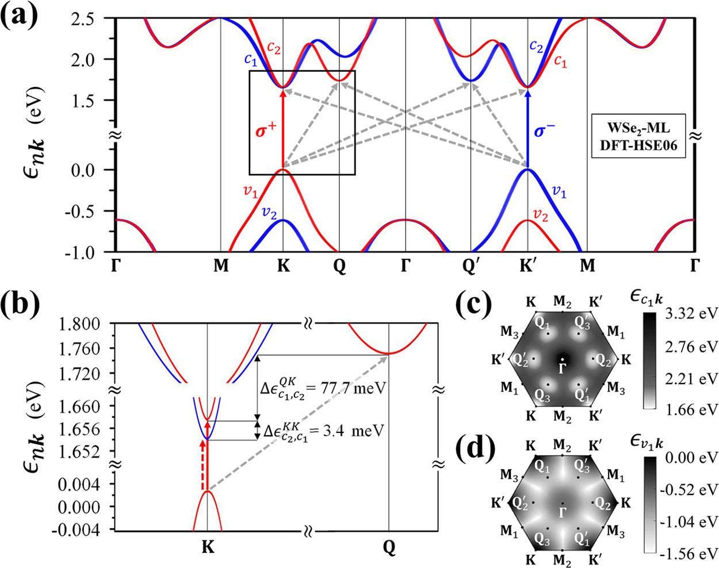

Slide 2


Energy ($eV$)
Energy ($eV$)

Slide 3
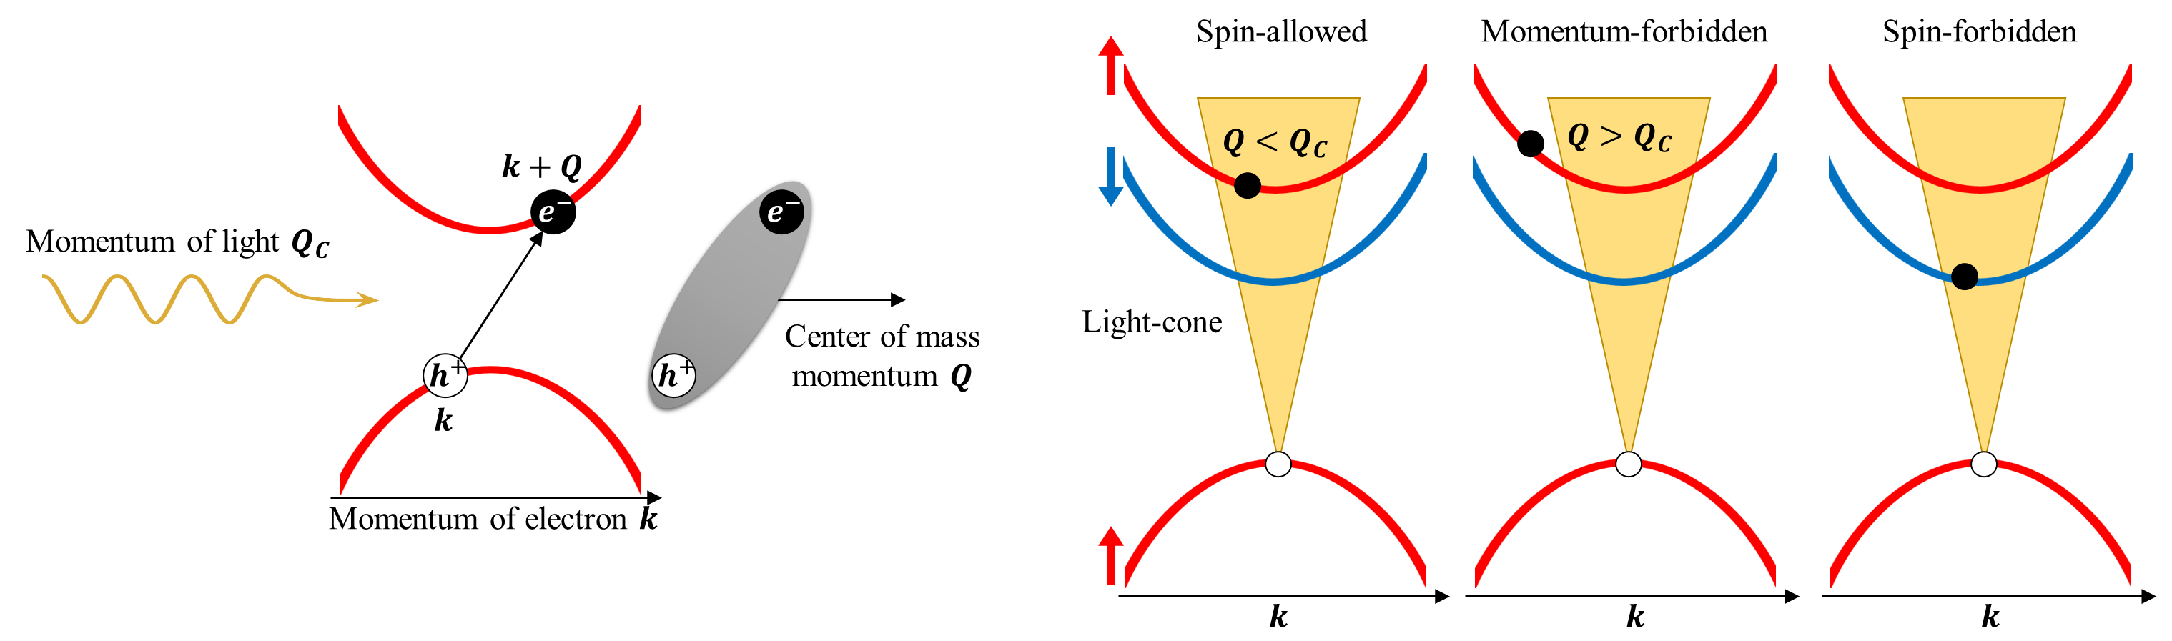
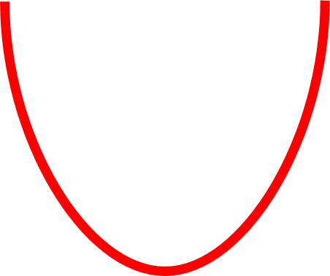


Spin-allowed
BX
Momentum-forbidden
DX
Spin-forbidden
DX
Light-cone
$$k$$

Slide 4


(a)
(b)
Spin-allowed
Momentum-forbidden
Spin-forbidden
Energy ($eV$)
Light-cone
$$k$$

Slide 5
Spin-allowed
Momentum-forbidden
Spin-forbidden
Energy ($eV$)
Light-cone
$$k$$

