Slide 1
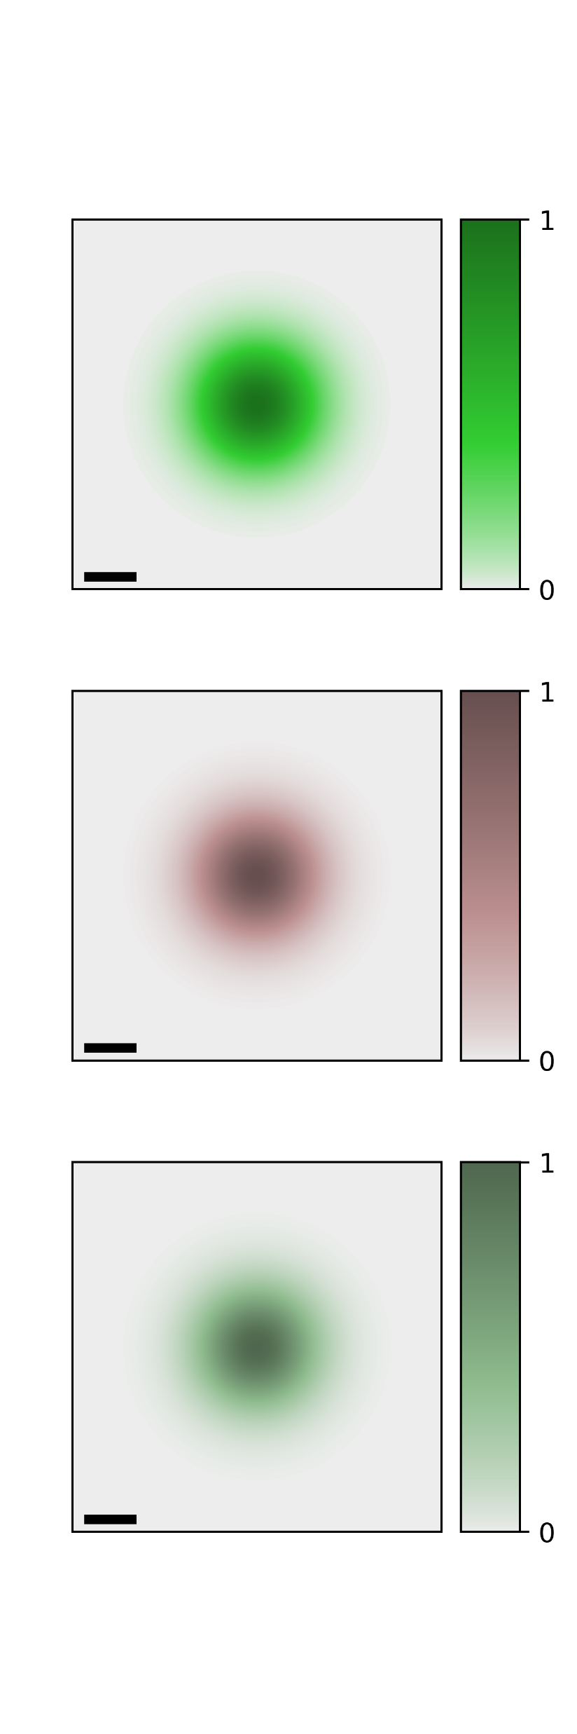
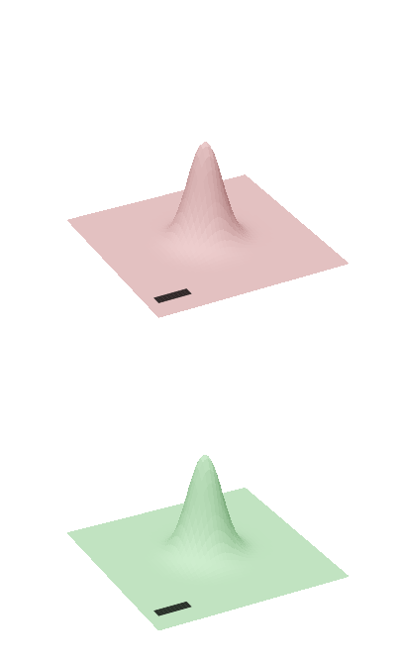
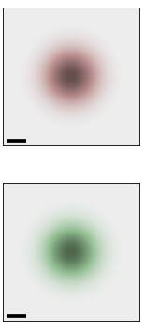
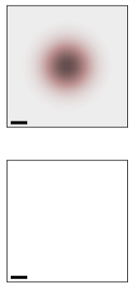
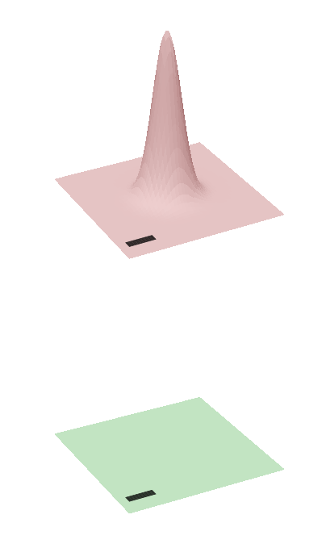
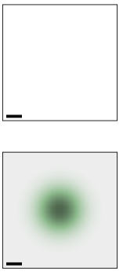
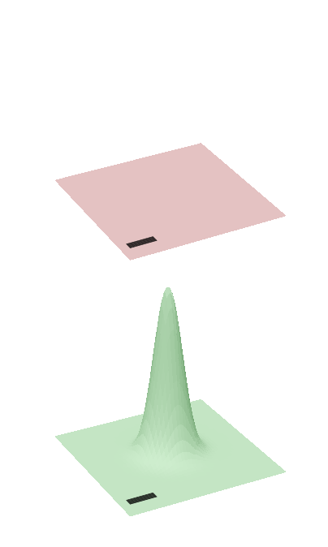
























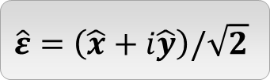


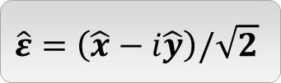


$$\hat{ε}=\hat{x}$$
$$\hat{ε}=\hat{y}$$
$$S$$
$${\left|{\tilde{M}}_{\hat{ε},0}^{S,Q}\right|}^{2}$$
$${\left|Φ_{\hat{ε},0}^{S}\left(R_{c}\right)\right|}^{2}$$
$$S$$
$${\left|{\tilde{M}}_{\hat{ε},0}^{S,Q}\right|}^{2}$$
$${\left|Φ_{\hat{ε},0}^{S}\left(R_{c}\right)\right|}^{2}$$
$$Q_{y}$$
$$K$$
$$Q_{x}$$
$$K$$
$${0.1Q}_{c}$$
$$y$$
$$W_{0}$$
$$x$$
$$K′$$
$$K′$$
$$\hat{ε}=\left(\hat{x}+i\hat{y}\right)/\sqrt{2}$$
$$\hat{ε}=\left(\hat{x}−i\hat{y}\right)/\sqrt{2}$$
$$S$$
$${\left|{\tilde{M}}_{\hat{ε},0}^{S,Q}\right|}^{2}$$
$${\left|Φ_{\hat{ε},0}^{S}\left(R_{c}\right)\right|}^{2}$$
$$S$$
$${\left|{\tilde{M}}_{\hat{ε},0}^{S,Q}\right|}^{2}$$
$${\left|Φ_{\hat{ε},0}^{S}\left(R_{c}\right)\right|}^{2}$$
$$K$$
$$K$$
No
Excitation
$$K′$$
No
Excitation
$$K′$$

Slide 2
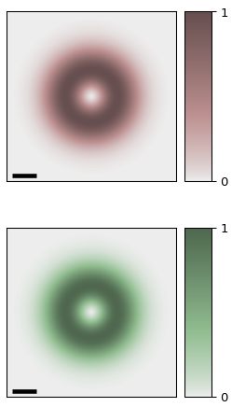
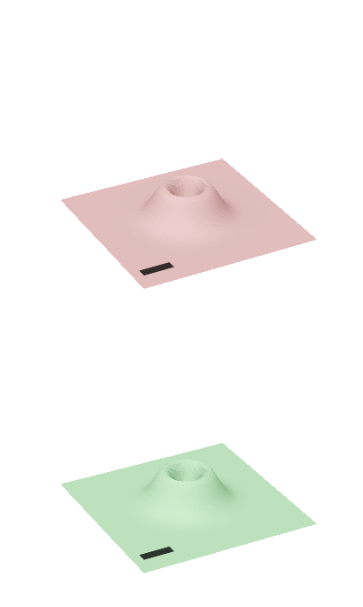
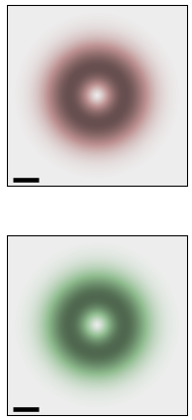
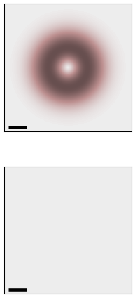
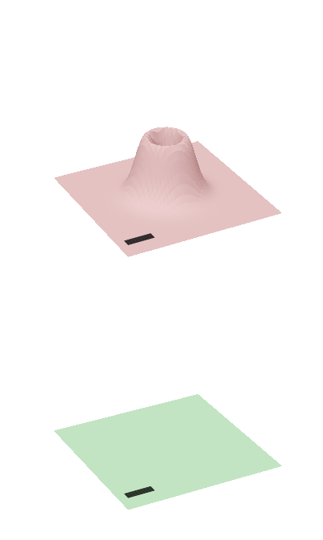
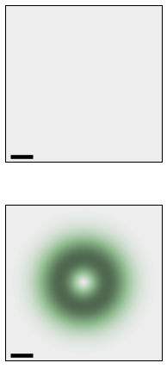
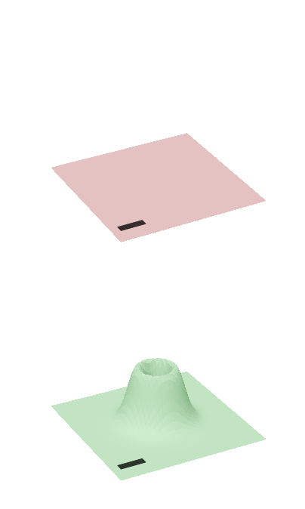















$$\hat{ε}=\hat{x}$$
$$\hat{ε}=\hat{y}$$
$$S$$
$${\left|{\tilde{M}}_{\hat{ε},±1}^{S,Q}\right|}^{2}$$
$${\left|Φ_{\hat{ε},±1}^{S}\left(R_{c}\right)\right|}^{2}$$
$$S$$
$${\left|{\tilde{M}}_{\hat{ε},±1}^{S,Q}\right|}^{2}$$
$${\left|Φ_{\hat{ε},±1}^{S}\left(R_{c}\right)\right|}^{2}$$
$$Q_{y}$$
$$K$$
$$Q_{x}$$
$$K$$
$${0.1Q}_{c}$$
$$y$$
$$W_{0}$$
$$x$$
$$K′$$
$$K′$$
$$\hat{ε}=\left(\hat{x}+i\hat{y}\right)/\sqrt{2}$$
$$\hat{ε}=\left(\hat{x}−i\hat{y}\right)/\sqrt{2}$$
$$S$$
$${\left|{\tilde{M}}_{\hat{ε},±1}^{S,Q}\right|}^{2}$$
$${\left|Φ_{\hat{ε},±1}^{S}\left(R_{c}\right)\right|}^{2}$$
$$S$$
$${\left|{\tilde{M}}_{\hat{ε},±1}^{S,Q}\right|}^{2}$$
$${\left|Φ_{\hat{ε},±1}^{S}\left(R_{c}\right)\right|}^{2}$$
$$K$$
$$K$$
No
Excitation
$$K′$$
No
Excitation
$$K′$$

Slide 3
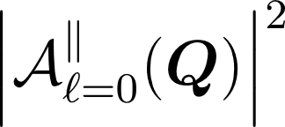
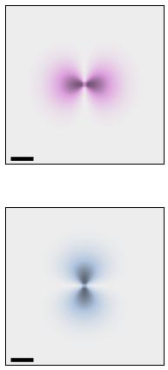
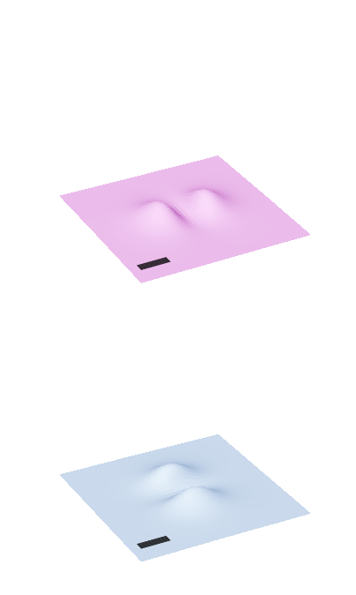
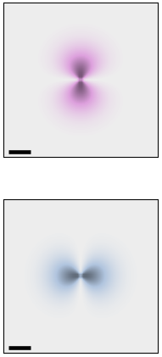
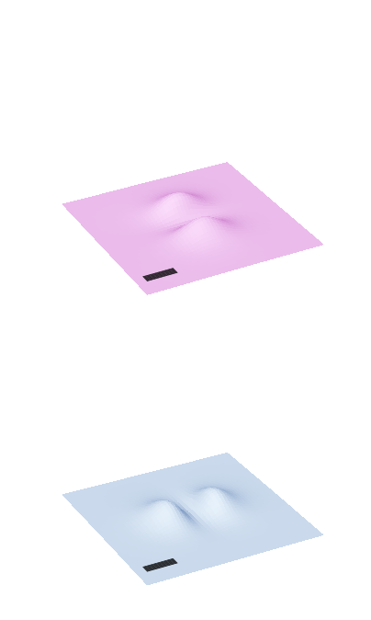
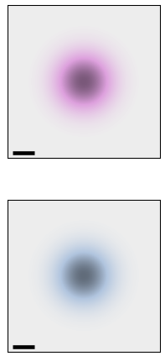
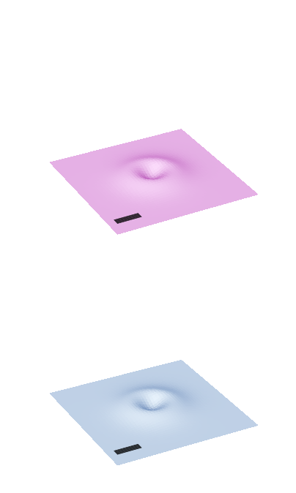
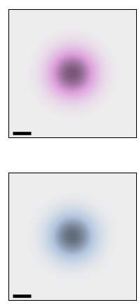






















$$Q_{y}$$
$$Q_{x}$$
$${0.1Q}_{c}$$
$$\hat{ε}=\hat{x}$$
$$\hat{ε}=\hat{y}$$
$$S$$
$${\left|{\tilde{M}}_{\hat{ε},0}^{S,Q}\right|}^{2}$$
$${\left|Φ_{\hat{ε},0}^{S}\left(R_{c}\right)\right|}^{2}$$
$$S$$
$${\left|{\tilde{M}}_{\hat{ε},0}^{S,Q}\right|}^{2}$$
$${\left|Φ_{\hat{ε},0}^{S}\left(R_{c}\right)\right|}^{2}$$
$$Q_{y}$$
$$B+$$
$$Q_{x}$$
$$B+$$
$${0.1Q}_{c}$$
$$y$$
$$W_{0}$$
$$x$$
$$B−$$
$$B−$$
$$\hat{ε}=\left(\hat{x}+i\hat{y}\right)/\sqrt{2}$$
$$\hat{ε}=\left(\hat{x}−i\hat{y}\right)/\sqrt{2}$$
$$S$$
$${\left|{\tilde{M}}_{\hat{ε},0}^{S,Q}\right|}^{2}$$
$${\left|Φ_{\hat{ε},0}^{S}\left(R_{c}\right)\right|}^{2}$$
$$S$$
$${\left|{\tilde{M}}_{\hat{ε},0}^{S,Q}\right|}^{2}$$
$${\left|Φ_{\hat{ε},0}^{S}\left(R_{c}\right)\right|}^{2}$$
$$B+$$
$$B+$$
$$B−$$
$$B−$$

Slide 4
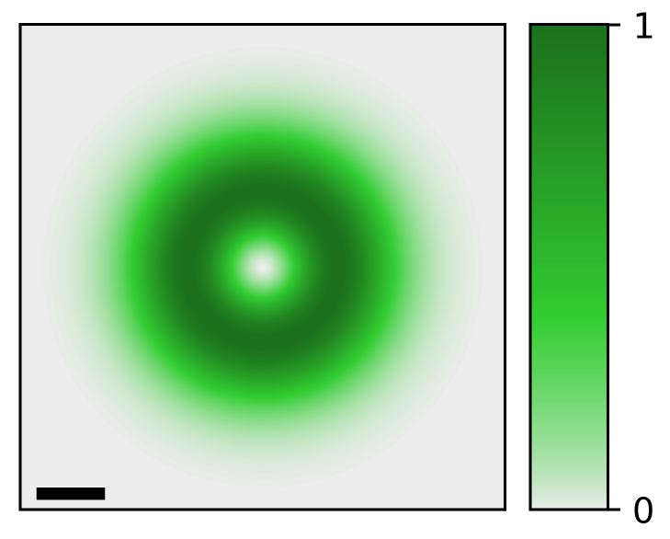
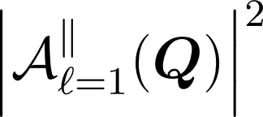
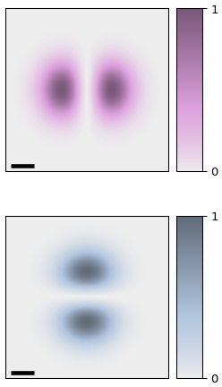
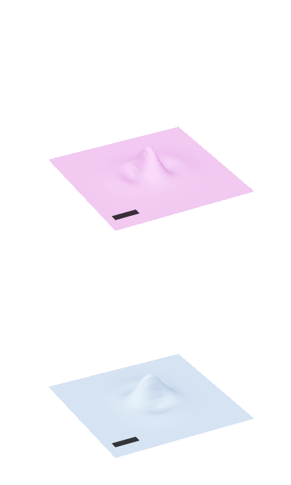
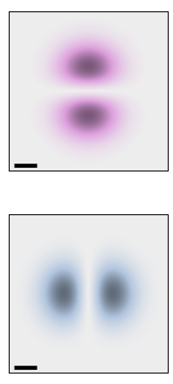
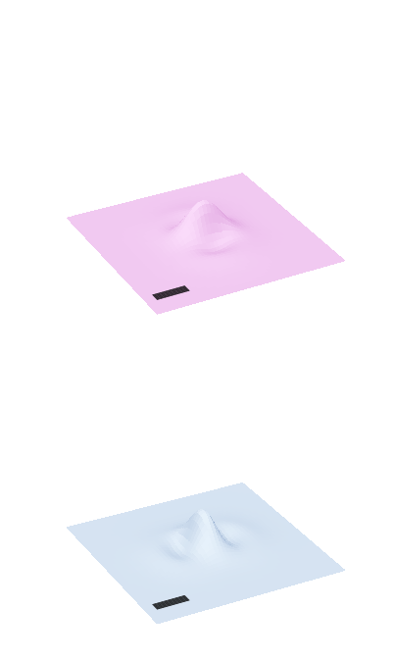
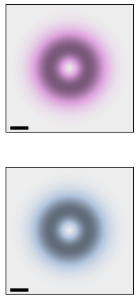

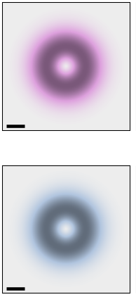
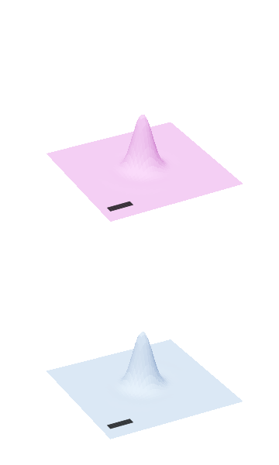











$$Q_{y}$$
$$Q_{x}$$
$${0.1Q}_{c}$$
$$\hat{ε}=\hat{x}$$
$$\hat{ε}=\hat{y}$$
$$S$$
$${\left|{\tilde{M}}_{\hat{ε},1}^{S,Q}\right|}^{2}$$
$${\left|Φ_{\hat{ε},1}^{S}\left(R_{c}\right)\right|}^{2}$$
$$S$$
$${\left|{\tilde{M}}_{\hat{ε},1}^{S,Q}\right|}^{2}$$
$${\left|Φ_{\hat{ε},1}^{S}\left(R_{c}\right)\right|}^{2}$$
$$Q_{y}$$
$$B+$$
$$Q_{x}$$
$$B+$$
$${0.1Q}_{c}$$
$$y$$
$$W_{0}$$
$$x$$
$$B−$$
$$B−$$
$$\hat{ε}=\left(\hat{x}+i\hat{y}\right)/\sqrt{2}$$
$$\hat{ε}=\left(\hat{x}−i\hat{y}\right)/\sqrt{2}$$
$$S$$
$${\left|{\tilde{M}}_{\hat{ε},1}^{S,Q}\right|}^{2}$$
$${\left|Φ_{\hat{ε},1}^{S}\left(R_{c}\right)\right|}^{2}$$
$$S$$
$${\left|{\tilde{M}}_{\hat{ε},1}^{S,Q}\right|}^{2}$$
$${\left|Φ_{\hat{ε},1}^{S}\left(R_{c}\right)\right|}^{2}$$
$$B+$$
$$B+$$
$$B−$$
$$B−$$

Slide 5

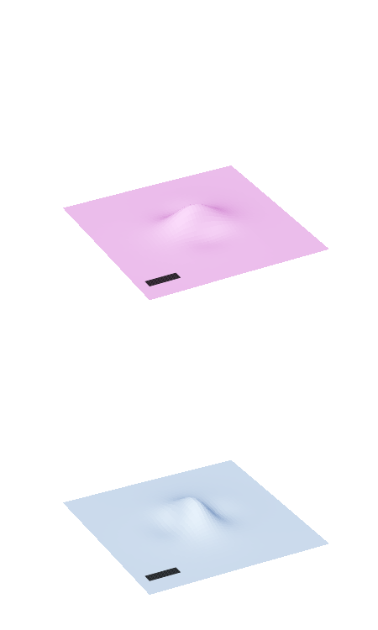






$$Q_{y}$$
$$Q_{x}$$
$${0.1Q}_{c}$$
$$\hat{ε}=\hat{x}$$
$$\hat{ε}=\hat{y}$$
$$S$$
$${\left|{\tilde{M}}_{\hat{ε},0}^{S,Q}\right|}^{2}$$
$${\left|{Φ′}_{\hat{ε},0}^{S}\left(R_{c}\right)\right|}^{2}$$
$$S$$
$${\left|{\tilde{M}}_{\hat{ε},0}^{S,Q}\right|}^{2}$$
$${\left|{Φ′}_{\hat{ε},0}^{S}\left(R_{c}\right)\right|}^{2}$$
$$Q_{y}$$
$$B+$$
$$Q_{x}$$
$$B+$$
$${0.1Q}_{c}$$
$$y$$
$$W_{0}$$
$$x$$
$$B−$$
$$B−$$
$$\hat{ε}=\left(\hat{x}+i\hat{y}\right)/\sqrt{2}$$
$$\hat{ε}=\left(\hat{x}−i\hat{y}\right)/\sqrt{2}$$
$$S$$
$${\left|{\tilde{M}}_{\hat{ε},0}^{S,Q}\right|}^{2}$$
$${\left|{Φ′}_{\hat{ε},0}^{S}\left(R_{c}\right)\right|}^{2}$$
$$S$$
$${\left|{\tilde{M}}_{\hat{ε},0}^{S,Q}\right|}^{2}$$
$${\left|{Φ′}_{\hat{ε},0}^{S}\left(R_{c}\right)\right|}^{2}$$
$$B+$$
$$B+$$
$$B−$$
$$B−$$

Slide 6








$$Q_{y}$$
$$Q_{x}$$
$${0.1Q}_{c}$$
$$\hat{ε}=\hat{x}$$
$$\hat{ε}=\hat{y}$$
$$S$$
$${\left|{\tilde{M}}_{\hat{ε},1}^{S,Q}\right|}^{2}$$
$${\left|{Φ′}_{\hat{ε},1}^{S}\left(R_{c}\right)\right|}^{2}$$
$$S$$
$${\left|{\tilde{M}}_{\hat{ε},1}^{S,Q}\right|}^{2}$$
$${\left|{Φ′}_{\hat{ε},1}^{S}\left(R_{c}\right)\right|}^{2}$$
$$Q_{y}$$
$$B+$$
$$Q_{x}$$
$$B+$$
$${0.1Q}_{c}$$
$$y$$
$$W_{0}$$
$$x$$
$$B−$$
$$B−$$
$$\hat{ε}=\left(\hat{x}+i\hat{y}\right)/\sqrt{2}$$
$$\hat{ε}=\left(\hat{x}−i\hat{y}\right)/\sqrt{2}$$
$$S$$
$${\left|{\tilde{M}}_{\hat{ε},1}^{S,Q}\right|}^{2}$$
$${\left|{Φ′}_{\hat{ε},1}^{S}\left(R_{c}\right)\right|}^{2}$$
$$S$$
$${\left|{\tilde{M}}_{\hat{ε},1}^{S,Q}\right|}^{2}$$
$${\left|{Φ′}_{\hat{ε},1}^{S}\left(R_{c}\right)\right|}^{2}$$
$$B+$$
$$B+$$
$$B−$$
$$B−$$

