Slide 1
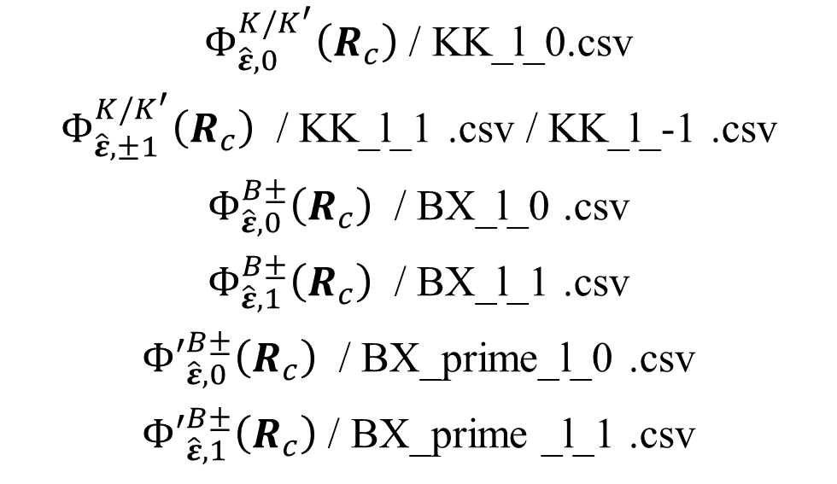
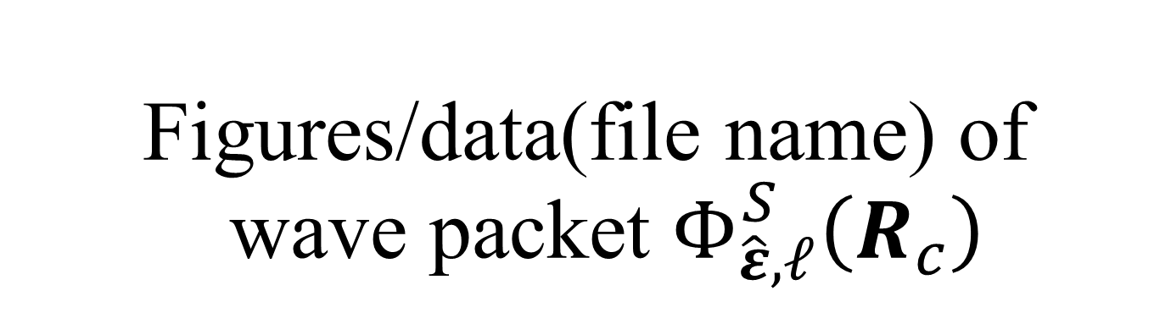
Figures/data(file name) of wave packet $Φ_{\hat{ε},ℓ}^{S}\left(R_{c}\right)$
Figures/data(file name)
page
Figures number in thesis
$Φ_{\hat{ε},0}^{K/K^{′}}\left(R_{c}\right)$ / KK_l_0.csv
$Φ_{\hat{ε},±1}^{K/K^{′}}\left(R_{c}\right)$ / KK_l_1 .csv / KK_l_-1 .csv
$Φ_{\hat{ε},0}^{B±}\left(R_{c}\right)$ / BX_l_0 .csv
$Φ_{\hat{ε},1}^{B±}\left(R_{c}\right)$ / BX_l_1 .csv
${Φ′}_{\hat{ε},0}^{B±}\left(R_{c}\right)$ / BX_prime_l_0 .csv
${Φ′}_{\hat{ε},1}^{B±}\left(R_{c}\right)$ / BX_prime _l_1 .csv
P3
P4
P5
P6
P7
P8
P9
Figure 4.2
Figure 4.4
Figure 4.5
Figure 4.6
Figure 4.7
Figure 4.8

Slide 2
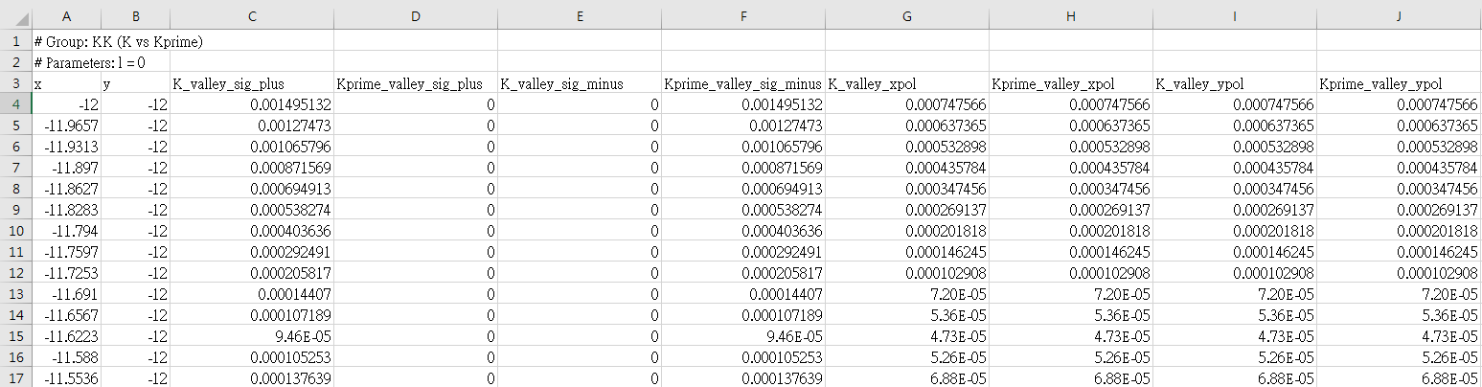
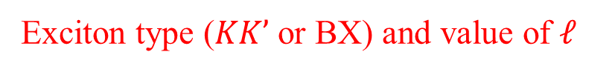
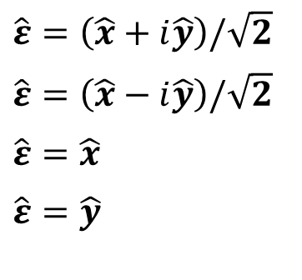
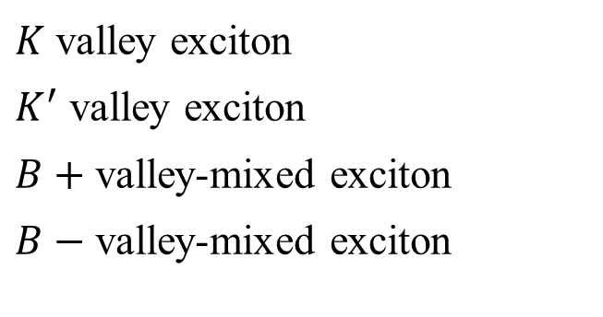
Data arrangement
For example, open KK_l_0.csv in excel
Exciton type ($KK’$ or BX) and value of $ℓ$
Coordinate
Unit(um)
Title of wave packet data:
Polarization of light :
_sig_plus :
_sig_minus :
_xpol :
_ypol :
$\hat{ε}=\left(\hat{x}+i\hat{y}\right)/\sqrt{2}$
$\hat{ε}=\left(\hat{x}−i\hat{y}\right)/\sqrt{2}$
$\hat{ε}=\hat{x}$
$\hat{ε}=\hat{y}$
Exciton type :
K_valley :
Kprime_valley :
upperBX:
lowerBX:
$K$ valley exciton
$K^{′}$ valley exciton
$B+$ valley-mixed exciton
$B−$ valley-mixed exciton

Slide 3
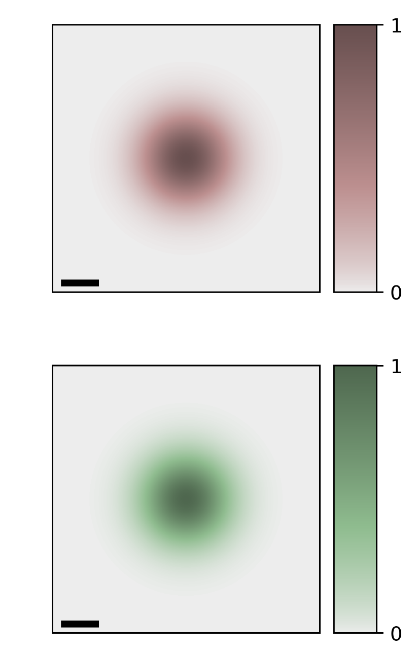
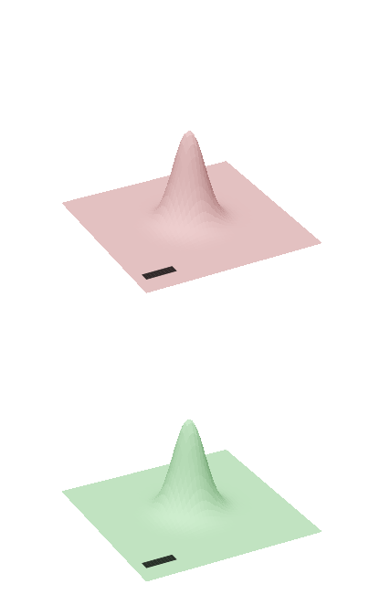
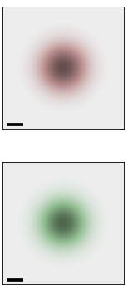
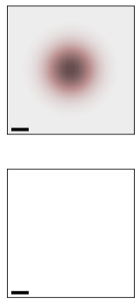
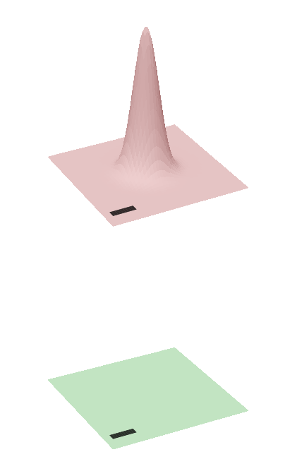
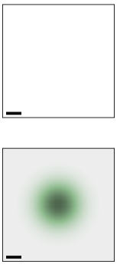
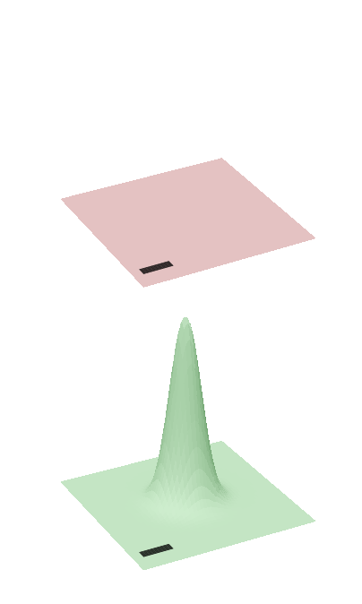


























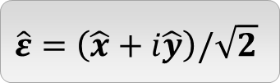


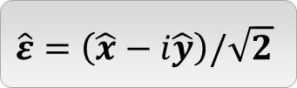


$Φ_{\hat{ε},0}^{K/K^{′}}\left(R_{c}\right)$ / KK_l_0.csv
$$\hat{ε}=\hat{x}$$
$$\hat{ε}=\hat{y}$$
$$S$$
$${\left|{\tilde{M}}_{\hat{ε},0}^{S,Q}\right|}^{2}$$
$${\left|Φ_{\hat{ε},0}^{S}\left(R_{c}\right)\right|}^{2}$$
$$S$$
$${\left|{\tilde{M}}_{\hat{ε},0}^{S,Q}\right|}^{2}$$
$${\left|Φ_{\hat{ε},0}^{S}\left(R_{c}\right)\right|}^{2}$$
$$Q_{y}$$
$$K$$
$$Q_{x}$$
$$K$$
$${0.1Q}_{c}$$
$$y$$
$$W_{0}$$
$$x$$
$$K′$$
$$K′$$
$$\hat{ε}=\left(\hat{x}+i\hat{y}\right)/\sqrt{2}$$
$$\hat{ε}=\left(\hat{x}−i\hat{y}\right)/\sqrt{2}$$
$$S$$
$${\left|{\tilde{M}}_{\hat{ε},0}^{S,Q}\right|}^{2}$$
$${\left|Φ_{\hat{ε},0}^{S}\left(R_{c}\right)\right|}^{2}$$
$$S$$
$${\left|{\tilde{M}}_{\hat{ε},0}^{S,Q}\right|}^{2}$$
$${\left|Φ_{\hat{ε},0}^{S}\left(R_{c}\right)\right|}^{2}$$
$$K$$
$$K$$
No
Excitation
$$K′$$
No
Excitation
$$K′$$
$$W_{0}=1.5um$$

Slide 4
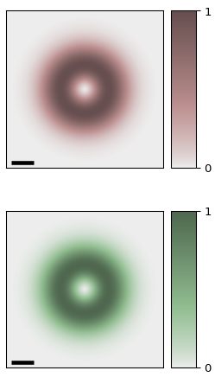
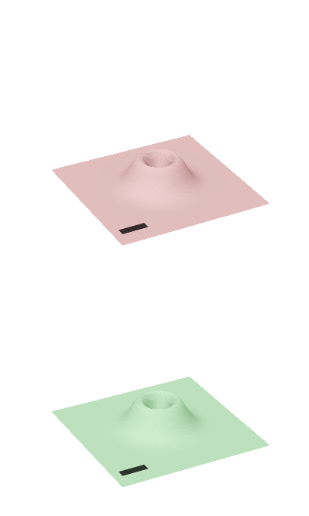
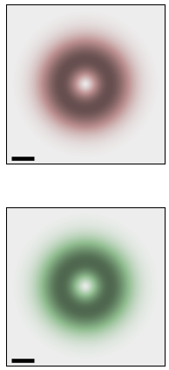
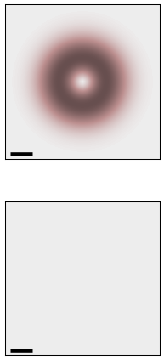
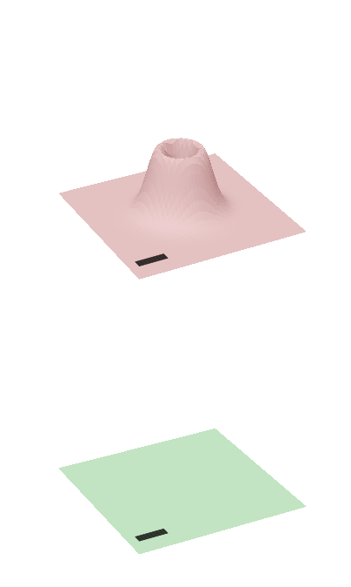
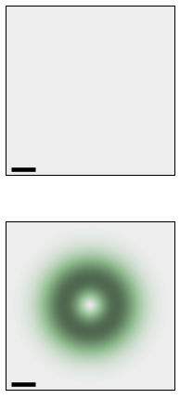
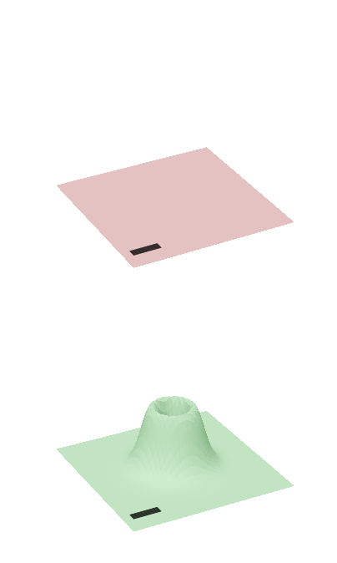






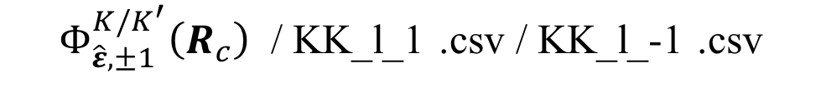









$Φ_{\hat{ε},±1}^{K/K^{′}}\left(R_{c}\right)$ / KK_l_1 .csv / KK_l_-1 .csv
$$\hat{ε}=\hat{x}$$
$$\hat{ε}=\hat{y}$$
$$S$$
$${\left|{\tilde{M}}_{\hat{ε},±1}^{S,Q}\right|}^{2}$$
$${\left|Φ_{\hat{ε},±1}^{S}\left(R_{c}\right)\right|}^{2}$$
$$S$$
$${\left|{\tilde{M}}_{\hat{ε},±1}^{S,Q}\right|}^{2}$$
$${\left|Φ_{\hat{ε},±1}^{S}\left(R_{c}\right)\right|}^{2}$$
$$Q_{y}$$
$$K$$
$$Q_{x}$$
$$K$$
$${0.1Q}_{c}$$
$$y$$
$$W_{0}$$
$$x$$
$$K′$$
$$K′$$
$$\hat{ε}=\left(\hat{x}+i\hat{y}\right)/\sqrt{2}$$
$$\hat{ε}=\left(\hat{x}−i\hat{y}\right)/\sqrt{2}$$
$$S$$
$${\left|{\tilde{M}}_{\hat{ε},±1}^{S,Q}\right|}^{2}$$
$${\left|Φ_{\hat{ε},±1}^{S}\left(R_{c}\right)\right|}^{2}$$
$$S$$
$${\left|{\tilde{M}}_{\hat{ε},±1}^{S,Q}\right|}^{2}$$
$${\left|Φ_{\hat{ε},±1}^{S}\left(R_{c}\right)\right|}^{2}$$
$$K$$
$$K$$
No
Excitation
$$K′$$
No
Excitation
$$K′$$
$$W_{0}=1.5um$$

Slide 5
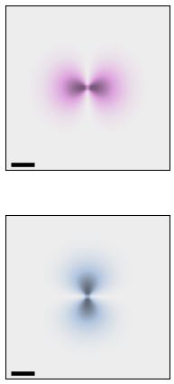
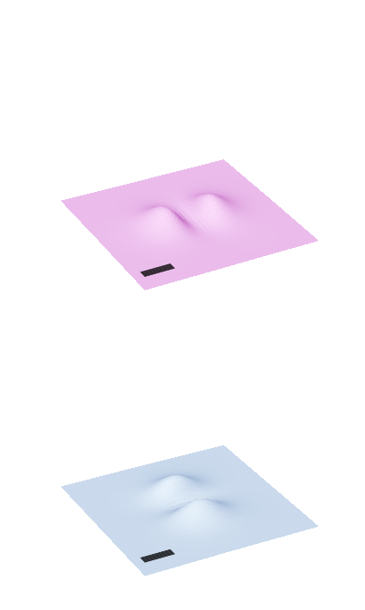
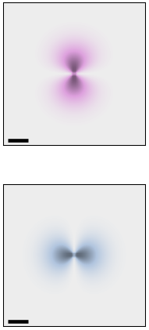
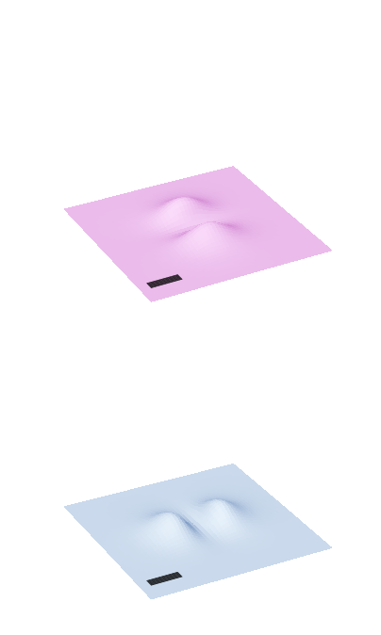
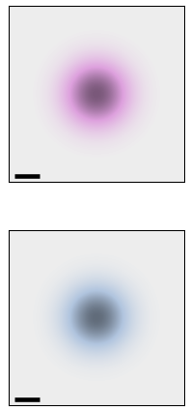
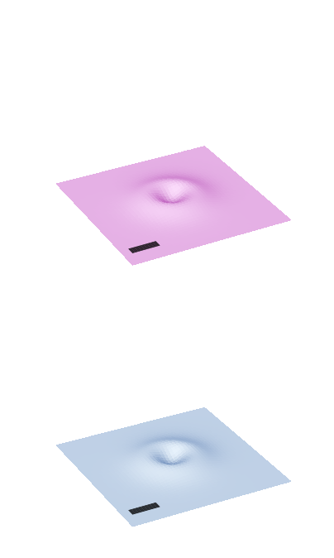
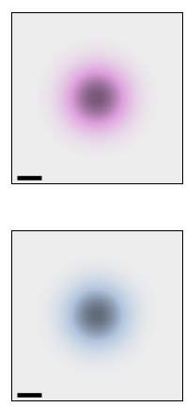




















$Φ_{\hat{ε},0}^{B±}\left(R_{c}\right)$ / BX_l_0 .csv
$$\hat{ε}=\hat{x}$$
$$\hat{ε}=\hat{y}$$
$$S$$
$${\left|{\tilde{M}}_{\hat{ε},0}^{S,Q}\right|}^{2}$$
$${\left|Φ_{\hat{ε},0}^{S}\left(R_{c}\right)\right|}^{2}$$
$$S$$
$${\left|{\tilde{M}}_{\hat{ε},0}^{S,Q}\right|}^{2}$$
$${\left|Φ_{\hat{ε},0}^{S}\left(R_{c}\right)\right|}^{2}$$
$$Q_{y}$$
$$B+$$
$$Q_{x}$$
$$B+$$
$${0.1Q}_{c}$$
$$y$$
$$W_{0}$$
$$x$$
$$B−$$
$$B−$$
$$\hat{ε}=\left(\hat{x}+i\hat{y}\right)/\sqrt{2}$$
$$\hat{ε}=\left(\hat{x}−i\hat{y}\right)/\sqrt{2}$$
$$S$$
$${\left|{\tilde{M}}_{\hat{ε},0}^{S,Q}\right|}^{2}$$
$${\left|Φ_{\hat{ε},0}^{S}\left(R_{c}\right)\right|}^{2}$$
$$S$$
$${\left|{\tilde{M}}_{\hat{ε},0}^{S,Q}\right|}^{2}$$
$${\left|Φ_{\hat{ε},0}^{S}\left(R_{c}\right)\right|}^{2}$$
$$B+$$
$$B+$$
$$B−$$
$$B−$$
$$W_{0}=1.5um$$

Slide 6
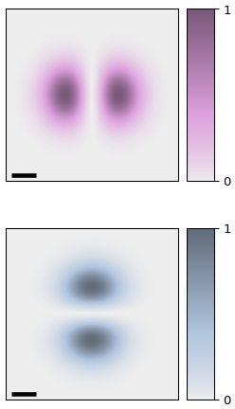
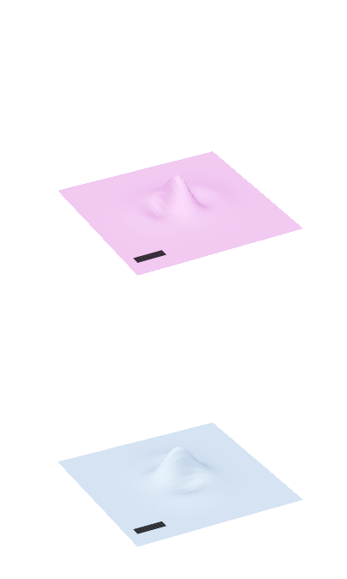
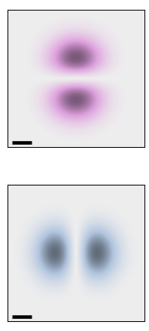
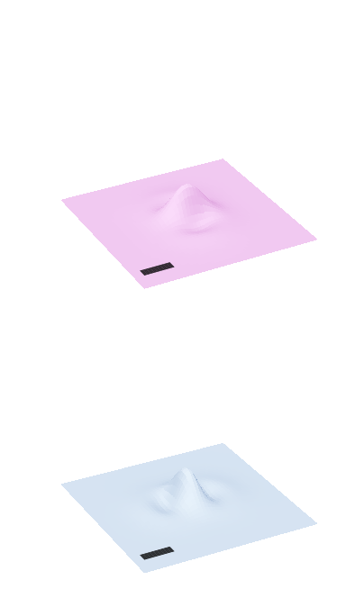
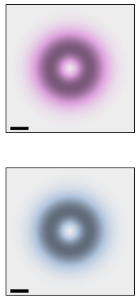

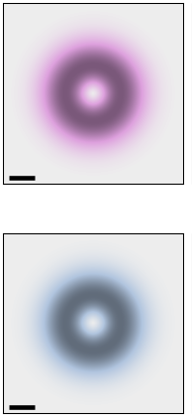
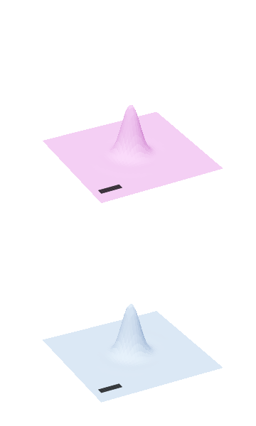









$Φ_{\hat{ε},0}^{B±}\left(R_{c}\right)$ / BX_l_1 .csv
$$\hat{ε}=\hat{x}$$
$$\hat{ε}=\hat{y}$$
$$S$$
$${\left|{\tilde{M}}_{\hat{ε},1}^{S,Q}\right|}^{2}$$
$${\left|Φ_{\hat{ε},1}^{S}\left(R_{c}\right)\right|}^{2}$$
$$S$$
$${\left|{\tilde{M}}_{\hat{ε},1}^{S,Q}\right|}^{2}$$
$${\left|Φ_{\hat{ε},1}^{S}\left(R_{c}\right)\right|}^{2}$$
$$Q_{y}$$
$$B+$$
$$Q_{x}$$
$$B+$$
$${0.1Q}_{c}$$
$$y$$
$$W_{0}$$
$$x$$
$$B−$$
$$B−$$
$$\hat{ε}=\left(\hat{x}+i\hat{y}\right)/\sqrt{2}$$
$$\hat{ε}=\left(\hat{x}−i\hat{y}\right)/\sqrt{2}$$
$$S$$
$${\left|{\tilde{M}}_{\hat{ε},1}^{S,Q}\right|}^{2}$$
$${\left|Φ_{\hat{ε},1}^{S}\left(R_{c}\right)\right|}^{2}$$
$$S$$
$${\left|{\tilde{M}}_{\hat{ε},1}^{S,Q}\right|}^{2}$$
$${\left|Φ_{\hat{ε},1}^{S}\left(R_{c}\right)\right|}^{2}$$
$$B+$$
$$B+$$
$$B−$$
$$B−$$
$$W_{0}=1.5um$$

Slide 7

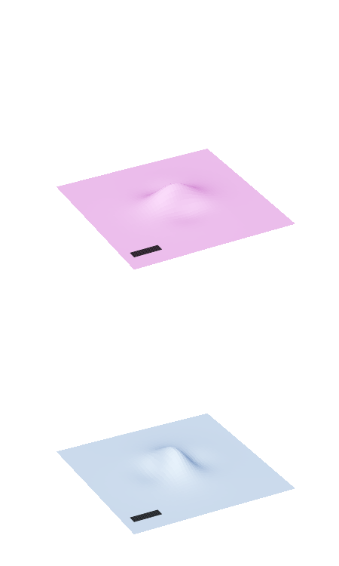







${Φ′}_{\hat{ε},0}^{B±}\left(R_{c}\right)$ / BX_prime_l_0 .csv
$$\hat{ε}=\hat{x}$$
$$\hat{ε}=\hat{y}$$
$$S$$
$${\left|{\tilde{M}}_{\hat{ε},0}^{S,Q}\right|}^{2}$$
$${\left|{Φ′}_{\hat{ε},0}^{S}\left(R_{c}\right)\right|}^{2}$$
$$S$$
$${\left|{\tilde{M}}_{\hat{ε},0}^{S,Q}\right|}^{2}$$
$${\left|{Φ′}_{\hat{ε},0}^{S}\left(R_{c}\right)\right|}^{2}$$
$$Q_{y}$$
$$B+$$
$$Q_{x}$$
$$B+$$
$${0.1Q}_{c}$$
$$y$$
$$W_{0}$$
$$x$$
$$B−$$
$$B−$$
$$\hat{ε}=\left(\hat{x}+i\hat{y}\right)/\sqrt{2}$$
$$\hat{ε}=\left(\hat{x}−i\hat{y}\right)/\sqrt{2}$$
$$S$$
$${\left|{\tilde{M}}_{\hat{ε},0}^{S,Q}\right|}^{2}$$
$${\left|{Φ′}_{\hat{ε},0}^{S}\left(R_{c}\right)\right|}^{2}$$
$$S$$
$${\left|{\tilde{M}}_{\hat{ε},0}^{S,Q}\right|}^{2}$$
$${\left|{Φ′}_{\hat{ε},0}^{S}\left(R_{c}\right)\right|}^{2}$$
$$B+$$
$$B+$$
$$B−$$
$$B−$$
$$W_{0}=1.5um$$

Slide 8









${Φ′}_{\hat{ε},0}^{B±}\left(R_{c}\right)$ / BX_prime _l_1 .csv
$$\hat{ε}=\hat{x}$$
$$\hat{ε}=\hat{y}$$
$$S$$
$${\left|{\tilde{M}}_{\hat{ε},1}^{S,Q}\right|}^{2}$$
$${\left|{Φ′}_{\hat{ε},1}^{S}\left(R_{c}\right)\right|}^{2}$$
$$S$$
$${\left|{\tilde{M}}_{\hat{ε},1}^{S,Q}\right|}^{2}$$
$${\left|{Φ′}_{\hat{ε},1}^{S}\left(R_{c}\right)\right|}^{2}$$
$$Q_{y}$$
$$B+$$
$$Q_{x}$$
$$B+$$
$${0.1Q}_{c}$$
$$y$$
$$W_{0}$$
$$x$$
$$B−$$
$$B−$$
$$\hat{ε}=\left(\hat{x}+i\hat{y}\right)/\sqrt{2}$$
$$\hat{ε}=\left(\hat{x}−i\hat{y}\right)/\sqrt{2}$$
$$S$$
$${\left|{\tilde{M}}_{\hat{ε},1}^{S,Q}\right|}^{2}$$
$${\left|{Φ′}_{\hat{ε},1}^{S}\left(R_{c}\right)\right|}^{2}$$
$$S$$
$${\left|{\tilde{M}}_{\hat{ε},1}^{S,Q}\right|}^{2}$$
$${\left|{Φ′}_{\hat{ε},1}^{S}\left(R_{c}\right)\right|}^{2}$$
$$B+$$
$$B+$$
$$B−$$
$$B−$$
$$W_{0}=1.5um$$

