Slide 1
Theoretical studies of excitonic transitions in two dimensional materials under photoexcitation of scalar and vector vortex beams

Slide 2
Outline
1. Introduction
2. Spin-orbital angular momentum interaction in light
3. Light-matter interaction
4. Exciton wave packet
Summary and outlook

Slide 3
Outline
1. Introduction
2. Spin-orbital angular momentum interaction in light
3. Light-matter interaction
4. Exciton wave packet
Summary and outlook

Slide 4
1. Introduction

Slide 5
Outline
1. Introduction
2. Spin-orbital angular momentum interaction (SOI) in light
Laguerre-Gaussian beams : SOI in phase
Vector vortex beams : SOI in magnitude
3. Light-matter interaction
4. Exciton wave packet
Summary and outlook

Slide 6
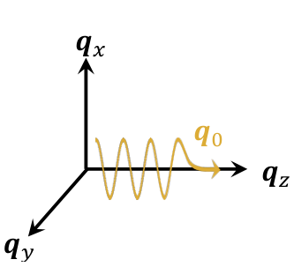
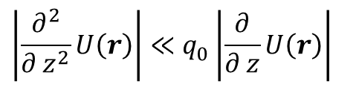
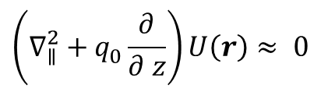

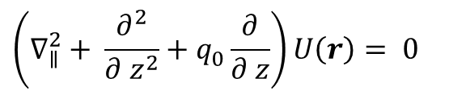
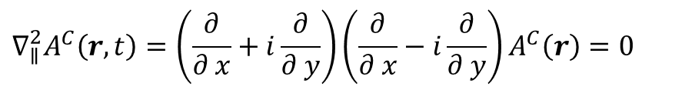
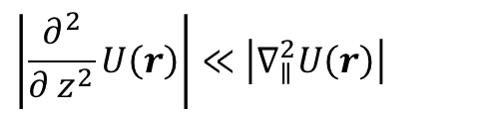
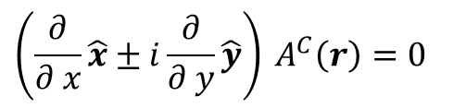


2. Spin-orbital angular momentum interaction in light
Laguerre-Gaussian beam is solved from paraxial Helmholtz equation within Lorentz gauge. Why?
From Maxwell equations:
scalar Helmholtz equation
Transversely polarized light in Coulomb gauge gives the condition
$$\left(∇_{ }^{2}+q_{0}^{2}\right)A^{L}\left(r\right)= 0$$
$$∇⋅A^{C}\left(r, t\right)=\hat{ε}⋅∇_{∥}A^{C}\left(r, t\right)=0$$
paraxial wave ansztz $\left(A^{L}\left(r\right)=U\left(r\right)e^{iq_{0}z}\right)$
$$\left(∇_{∥}^{2}+ \frac{∂^{2}}{∂ z^{2}}+q_{0}^{ }\frac{∂}{∂ z}\right)U\left(r\right)= 0$$
The condition fail the paraxial approximation for $\hat{ε}=\hat{x}±i\hat{y}$
paraxial approximation
The condition
$$\left|\frac{∂^{2}}{∂ z^{2}}U\left(r\right)\right|≪\left|∇_{∥}^{2}U\left(r\right)\right|$$
$$\left(\frac{∂}{∂ x}\hat{x}±i\frac{∂}{∂ y}\hat{y}\right) A^{C}\left(r\right)=0$$
$$\left|\frac{∂^{2}}{∂ z^{2}}U\left(r\right)\right|≪q_{0}^{ }\left|\frac{∂}{∂ z}U\left(r\right)\right|$$
Fail of the paraxial approximation
paraxial Helmholtz equation
$$∇_{∥}^{2}A^{C}\left(r, t\right)=\left(\frac{∂}{∂ x}+i\frac{∂}{∂ y}\right)\left(\frac{∂}{∂ x}−i\frac{∂}{∂ y}\right)A^{C}\left(r\right)=0$$
$$\left(∇_{∥}^{2}+q_{0}^{ }\frac{∂}{∂ z}\right)U\left(r\right)≈ 0$$

Slide 7
Outline
1. Introduction
2. Spin-orbital angular momentum interaction in light
3. Light-matter interaction
Encoding SOI information
Selective excitation
4. Exciton wave packet
Summary and outlook

Slide 8
3. Light-matter interaction

Slide 9
Outline
1. Introduction
2. Spin-orbital angular momentum interaction in light
3. Light-matter interaction
4. Exciton wave packet
Summary and outlook

Slide 10
4. Exciton wave packet

Slide 11
Summary and outlook
123

