Slide 1
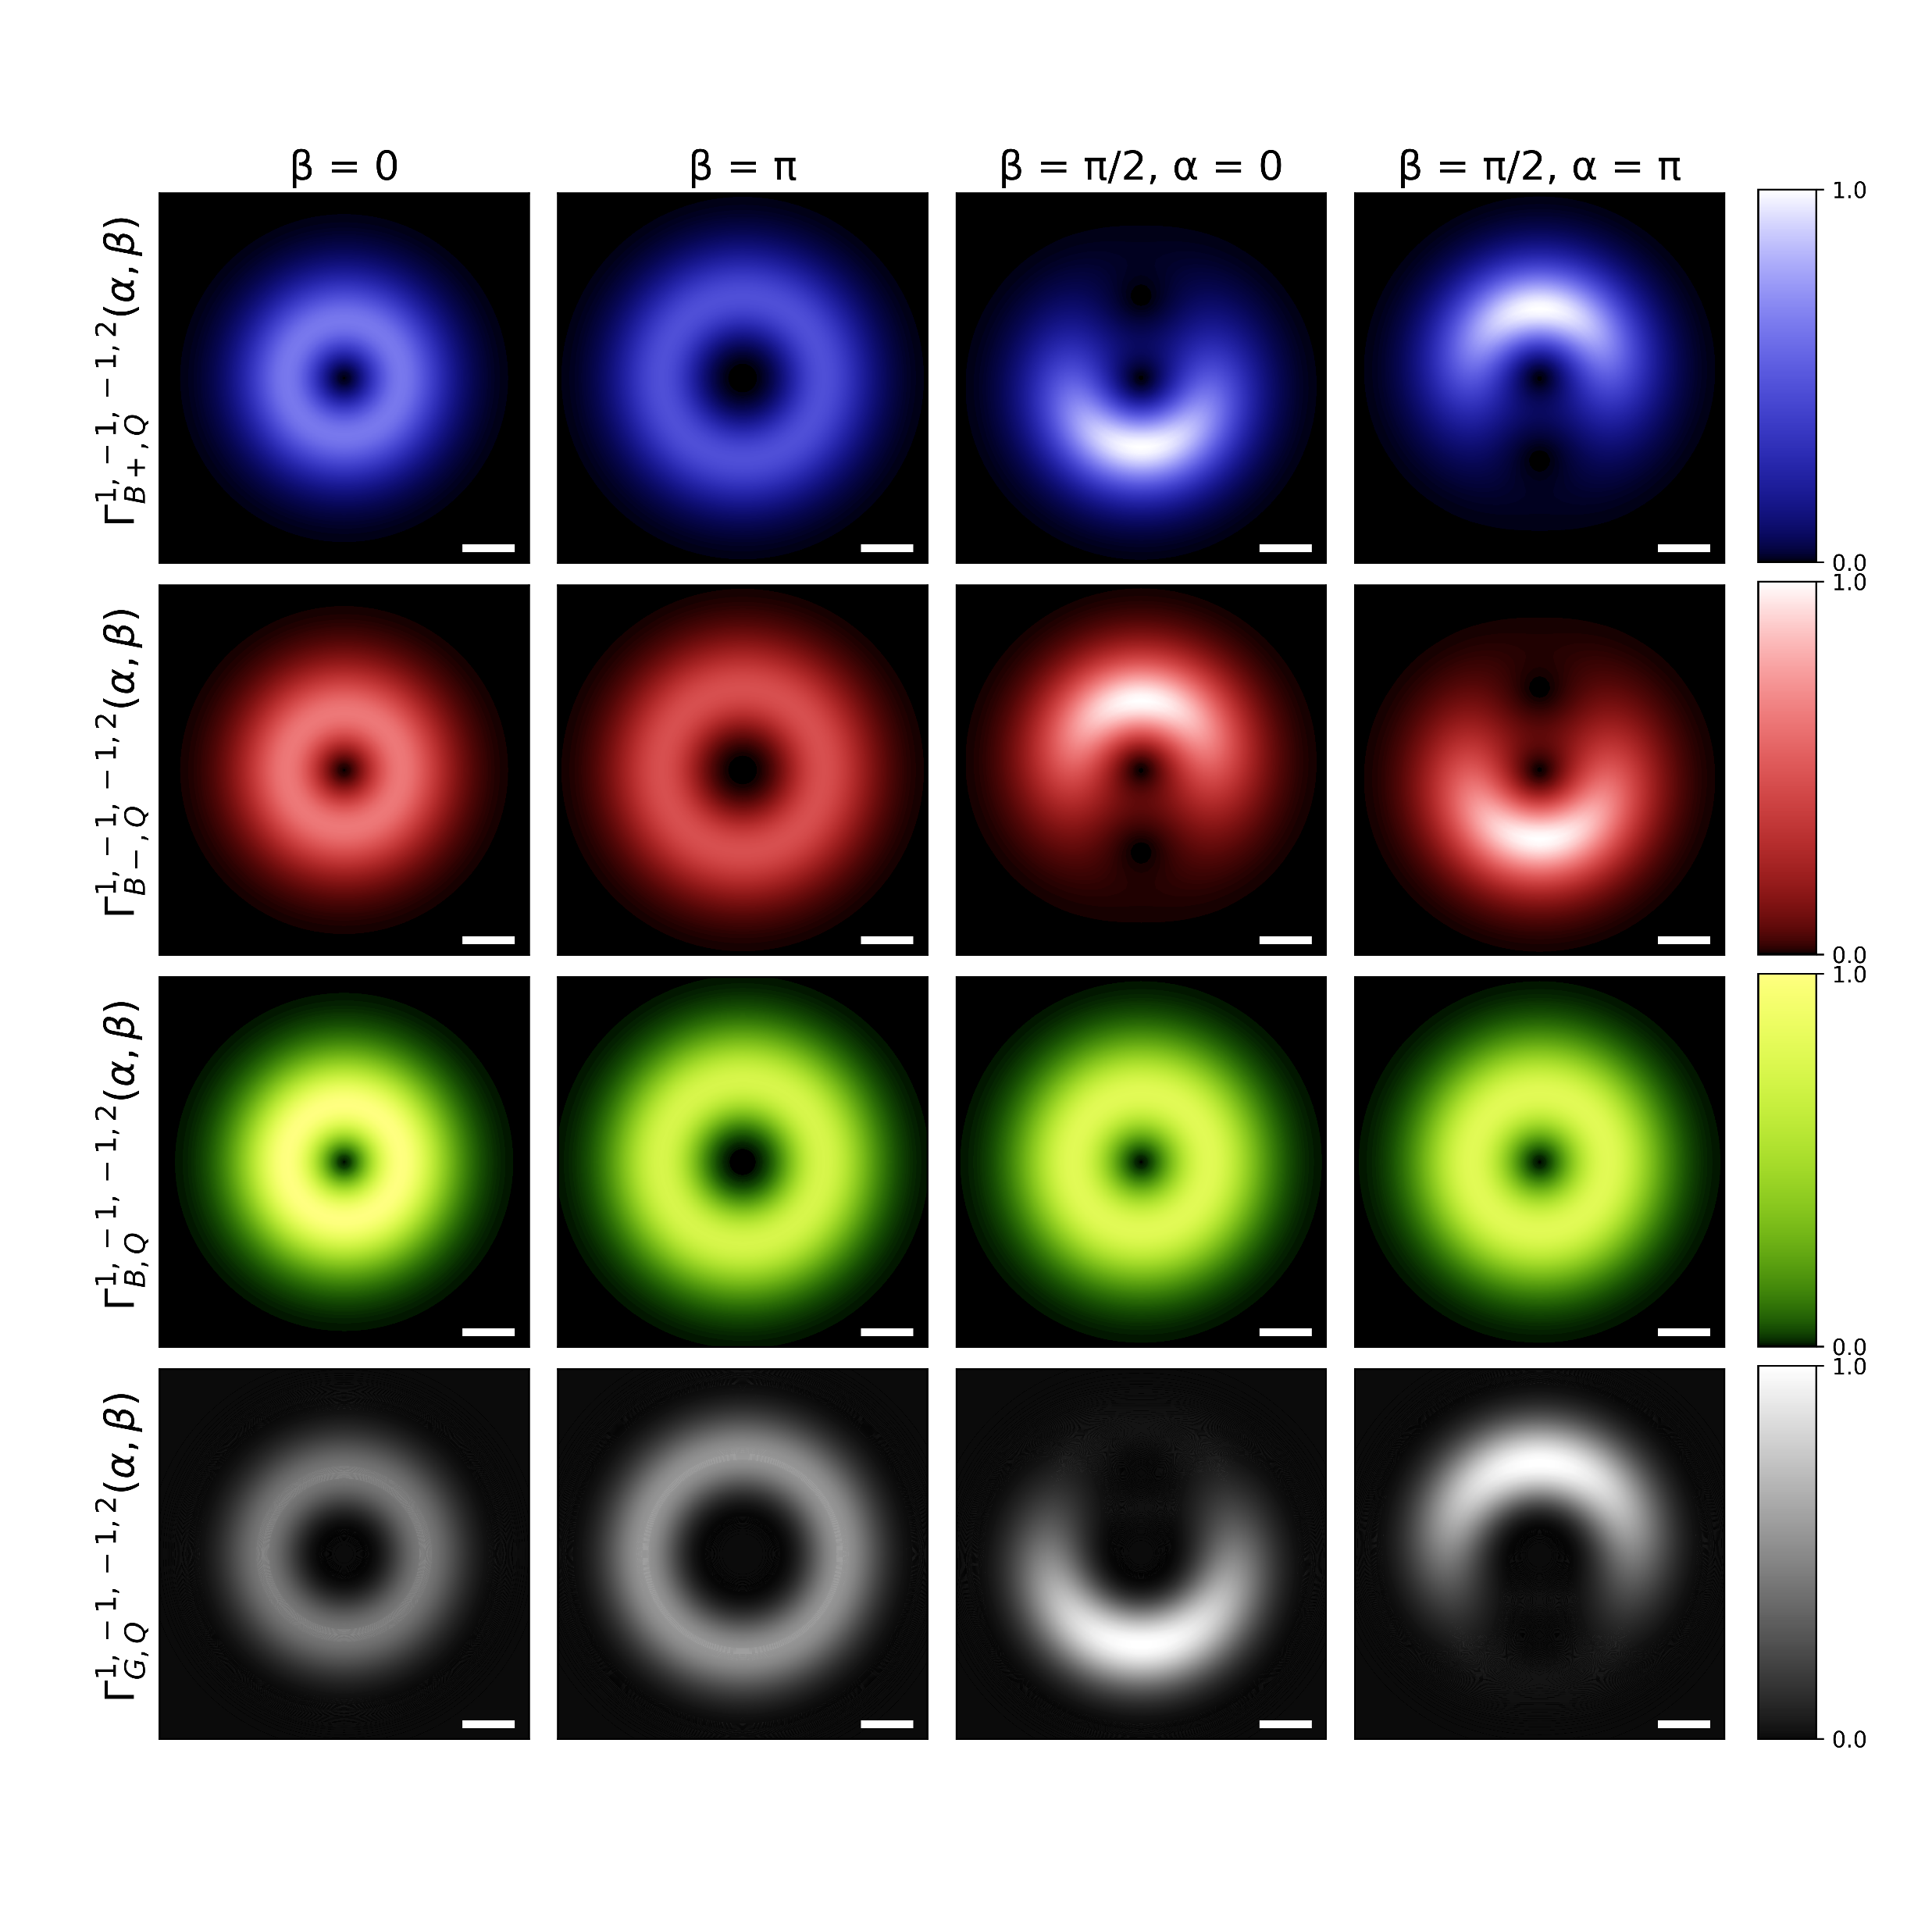
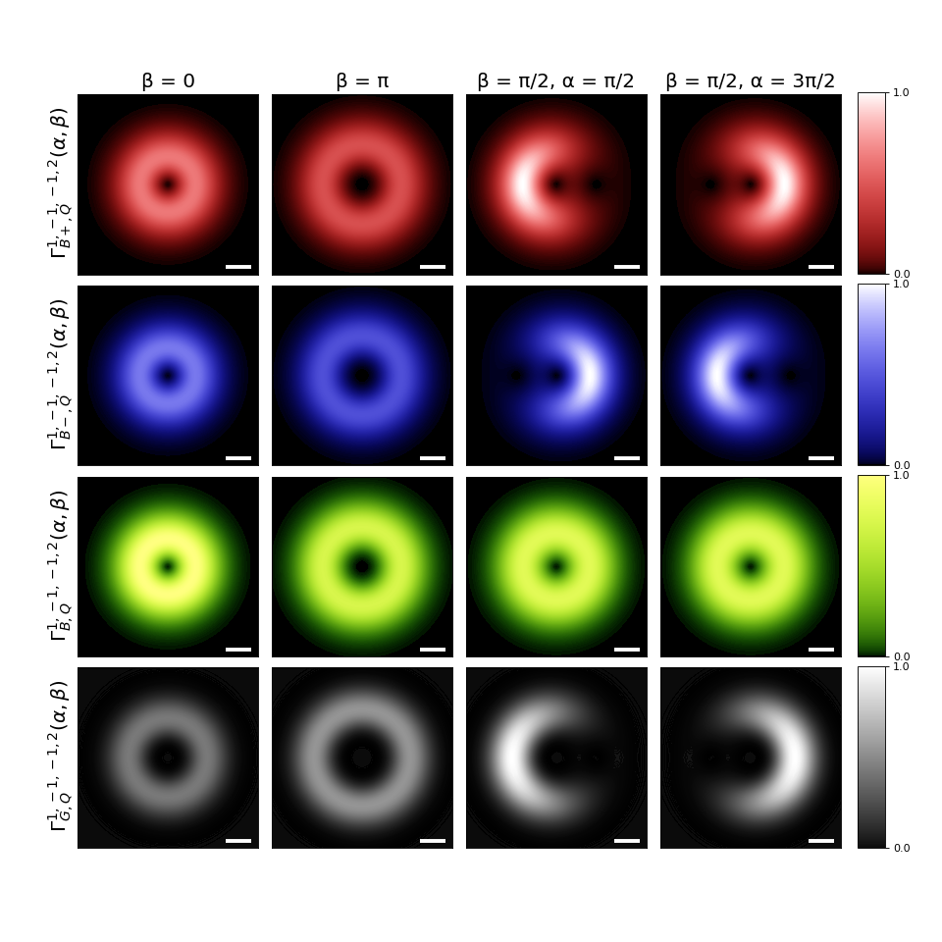
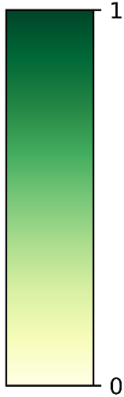
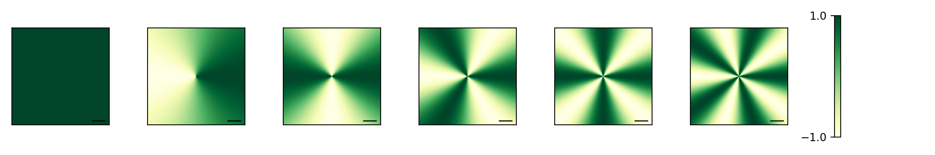

Slide 2
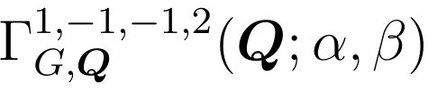

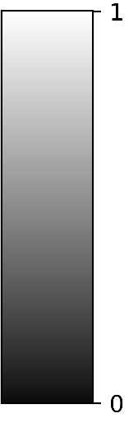

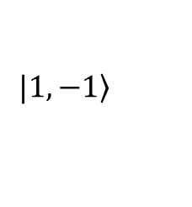



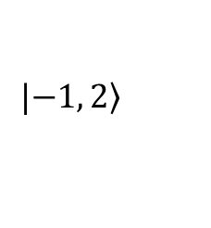







Gray exciton transition rate
$$|\left.1, −1\right\rangle$$
$$\left(α, β\right)=\left(0, \text{0}\right)$$
$$z$$
$$\left(0, π\right)$$
$$β$$
$$Q_{y}$$
$$x$$
$$Q_{x}$$
$$α$$
$$y$$
$${0.1Q}_{c}$$
$$a.u.$$
$$|\left.−1, 2\right\rangle$$

