Slide 1
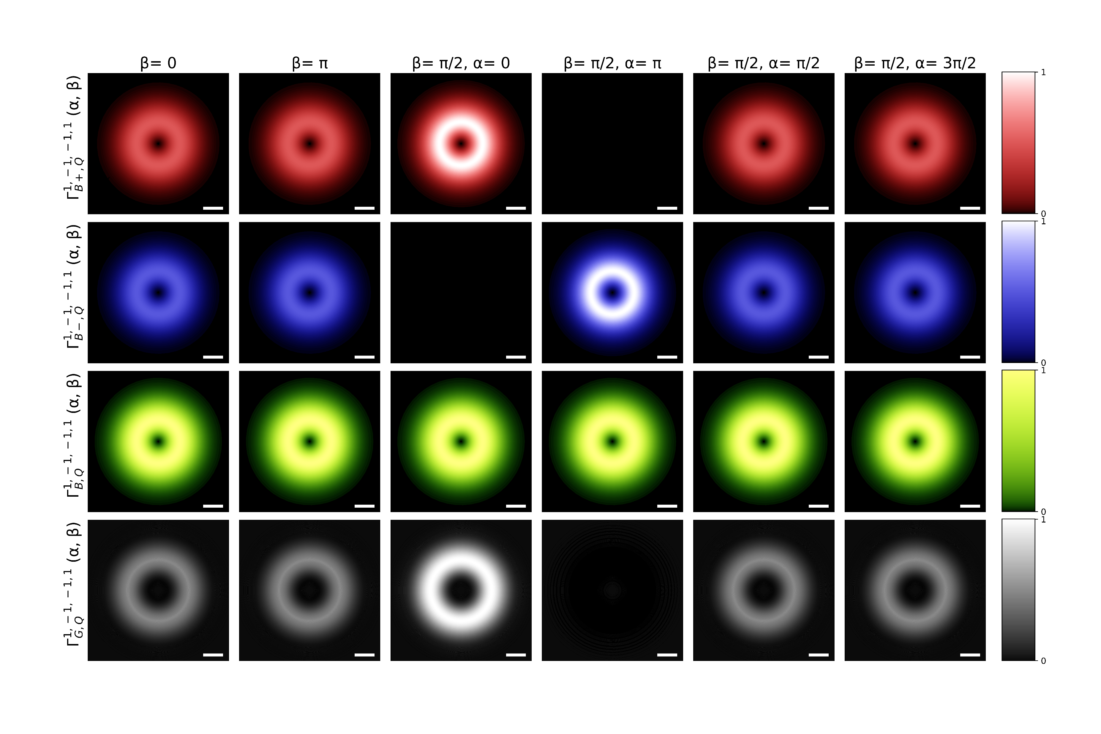

Slide 2

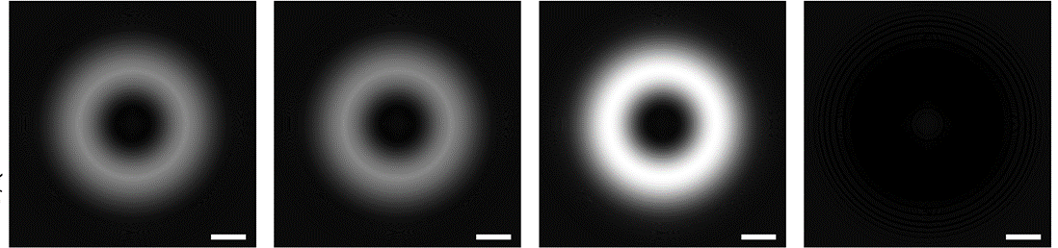


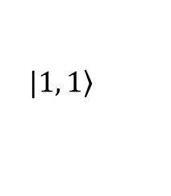










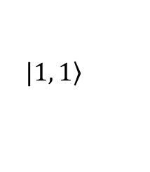


Gray exciton transition rate
$$\left(α, β\right)=\left(0, \text{0}\right)$$
$$Q_{y}$$
$$Q_{x}$$
$${0.1Q}_{c}$$
$$a.u.$$
$$|\left.1, 1\right\rangle$$
$$\left(0, π/2\right)$$
$$z$$
$$\left(π,π/2\right)$$
$$β$$
$$x$$
$$y$$
$$α$$
$$|\left.1, 1\right\rangle$$
$$\left(0, π\right)$$

