Slide 1
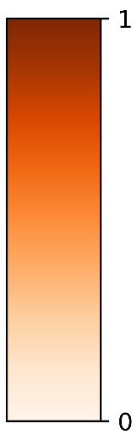
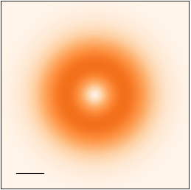
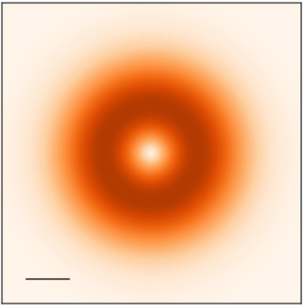
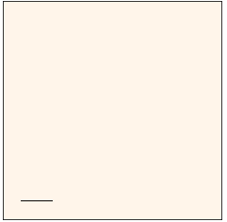









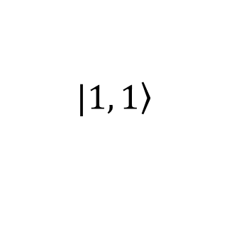


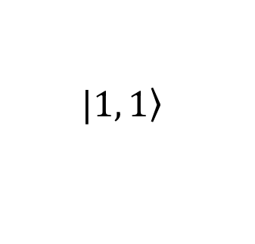



Transverse component
$$\left(α, β\right)=\left(0, \text{0}\right)$$
$$q_{y}$$
$$q_{y}$$
$$q_{x}$$
$$q_{x}$$
$$Q_{c}$$
$$|\left.1, 1\right\rangle$$
$$z$$
$$\left(0, π/2\right)$$
$$\left(π,π/2\right)$$
$$b$$
$$x$$
No
Light
$$a$$
$$y$$
$$|\left.1, 1\right\rangle$$
$$\left(0, π\right)$$

Slide 2
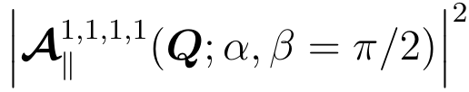



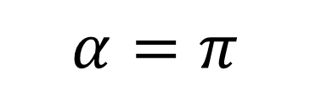

$$α=0$$
$$α=π$$
No
Light
$$Q_{y}$$
$$Q_{x}$$
$$Q_{c}$$

