Slide 1
Theoretical studies of excitonic transitions in two dimensional materials under photoexcitation of scalar and vector vortex beams
Student : 劉人瑩
Supervisor : 鄭舜仁 教授

Slide 2
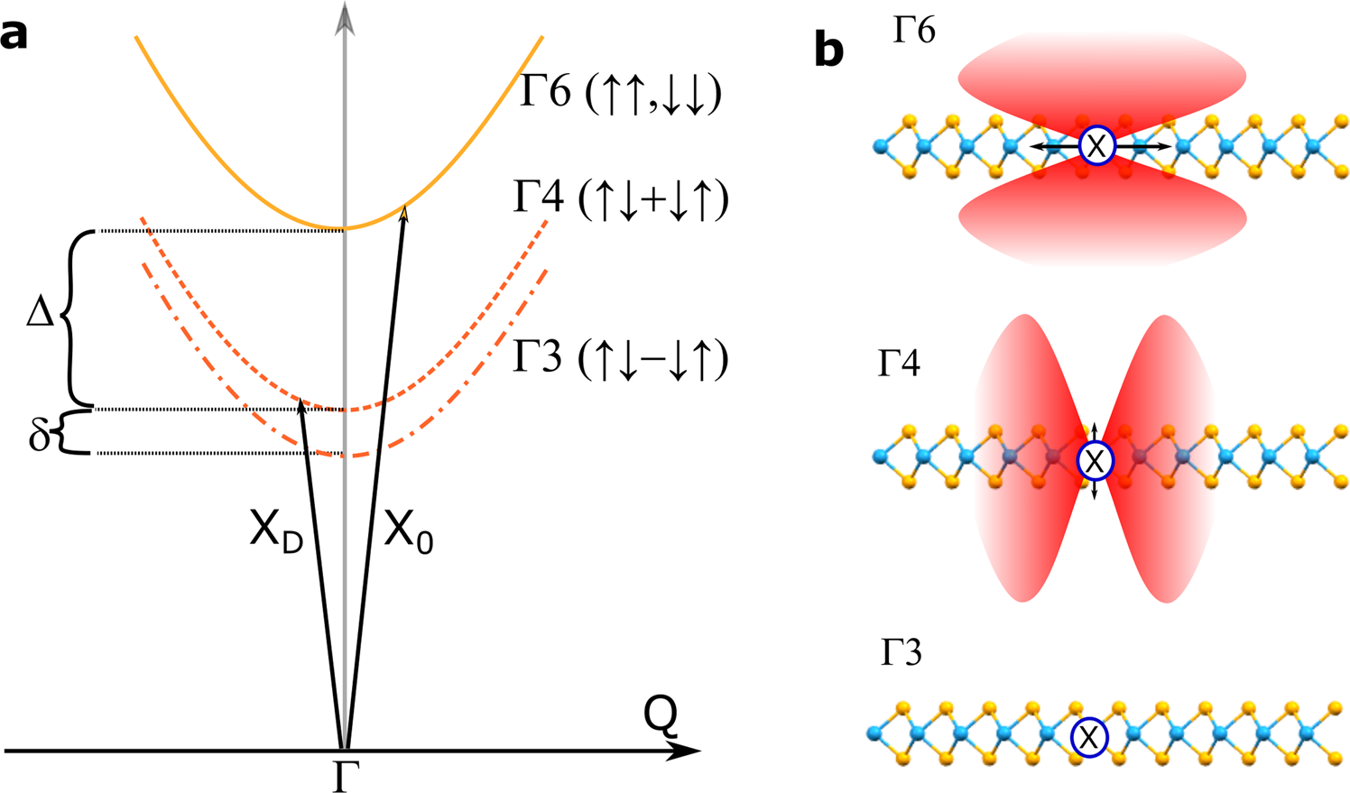
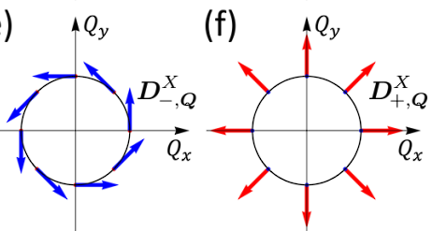
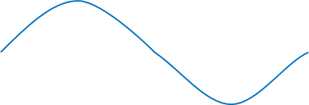
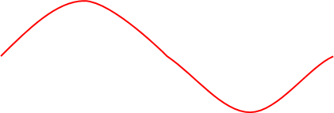
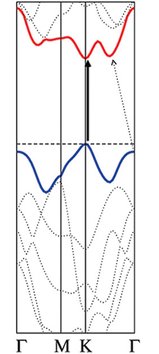
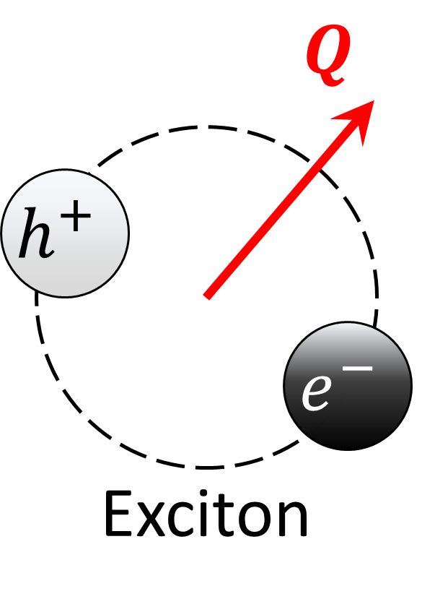
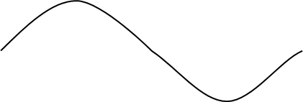
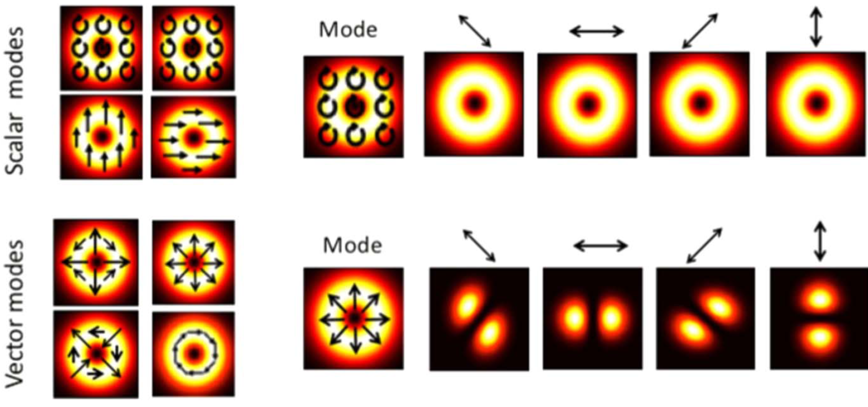
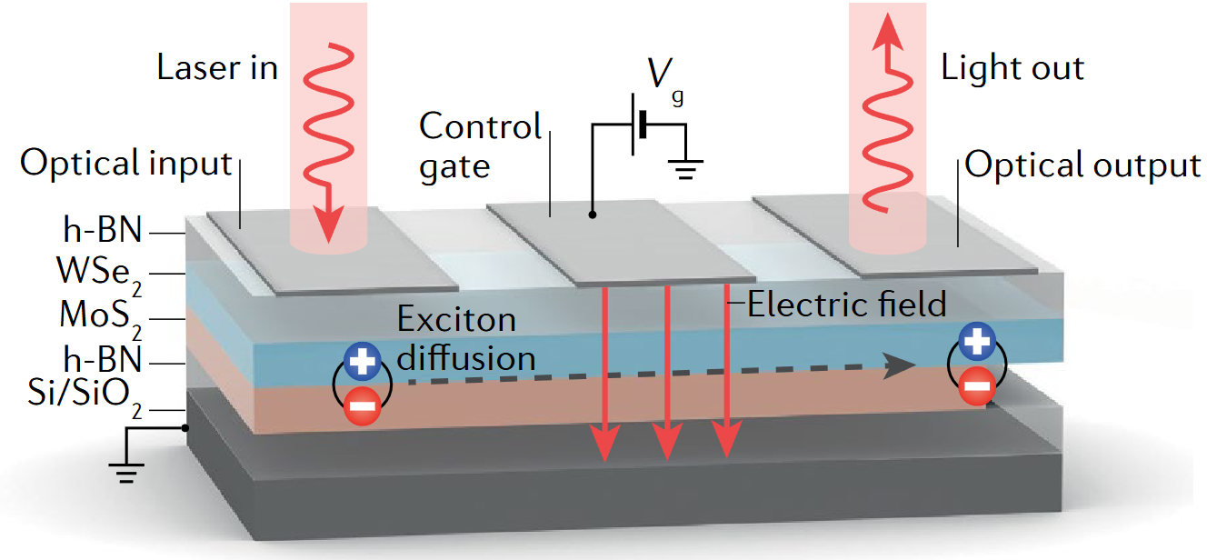

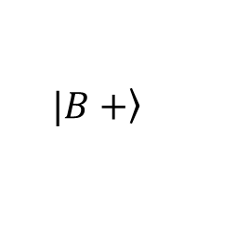


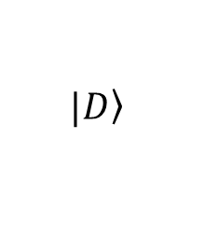


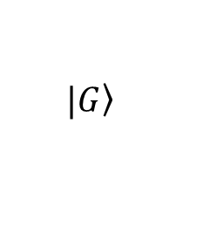



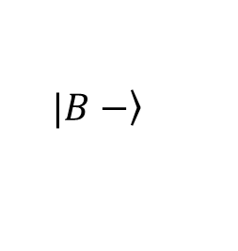


1. Introduction
2D Transition metal dichalcogenide (TMD)
Spin-orbit interaction in 2D TMD
Valley-mixing in 2D TMD
w/o e-h exchange
w/ e-h exchange
BX
$$K$$
$$K′$$
$$\left.|B+\right\rangle$$
+
+
$$D^{B+, Q}$$
+
+
1-2$eV$ $≈$
GX
$$×$$
$$\left.|B−\right\rangle$$
$$\left.|G\right\rangle$$
$$D^{B−, Q}$$
$$Q$$
$$Q$$
DX
$$\left.|D\right\rangle$$
+
+
$$Q$$
$$D^{G, Q}=D^{0}\hat{z}$$
L. M. Schneider et al., Sci. Rep. 10, 8091 (2020)
D. Y. Qiu et al., Phys. Rev. Lett. 115, 176801 (2015) / G.-H. Peng et al., Phys. Rev. B 106, 155304 (2022).
Manipulation in light – vortex beam
Device based on exciton diffusion
Manipulation of
Direct band gap
&
Polarization
&
Intensity
Suitable energy gap
A. Splendiani et al., Nano Lett. 10, 1271 (2010)
A. Ciarrocchi, F. Tagarelli et al., Nat. Rev. Mater. 7, 449 (2022)
C. Rosales-Guzmán, B. Ndagano et al., J. Opt. 20, 123001 (2018)

Slide 3
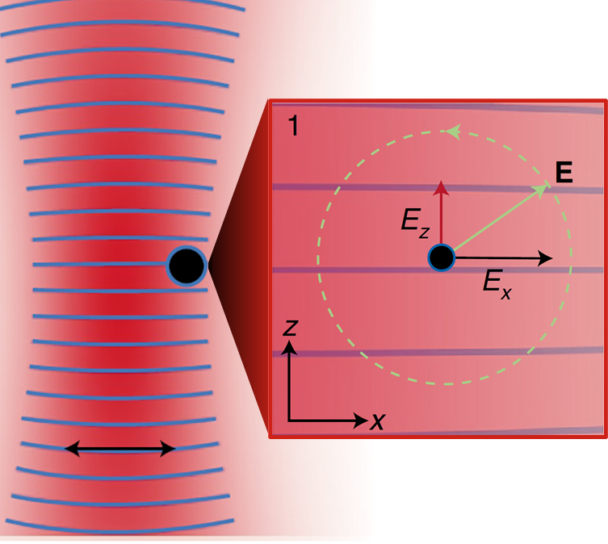
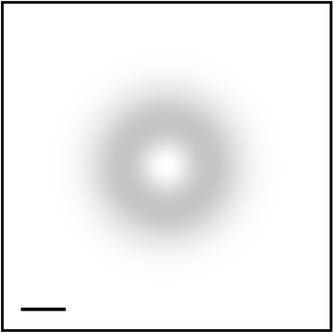

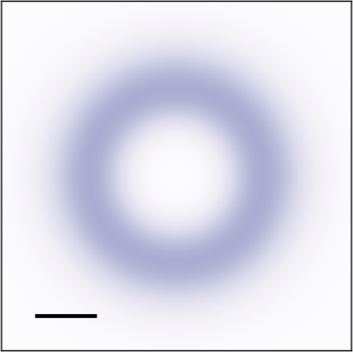

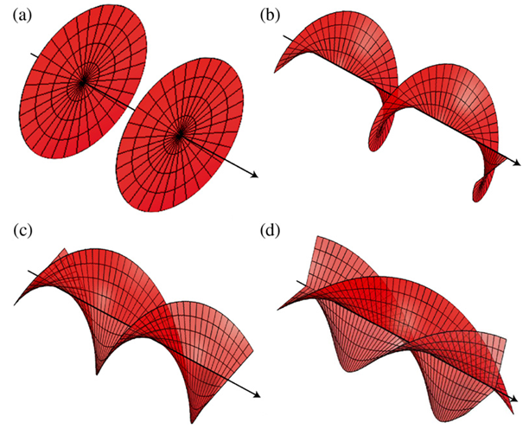
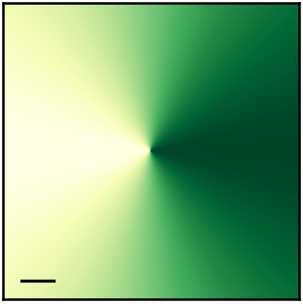
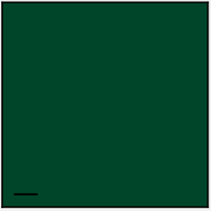

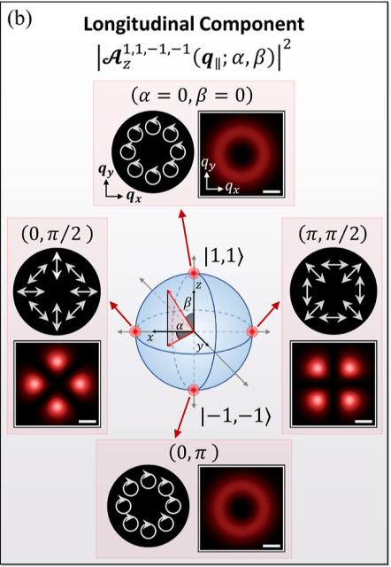
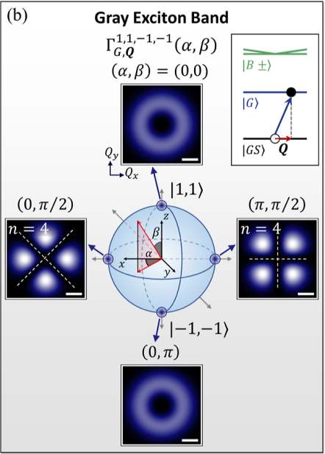
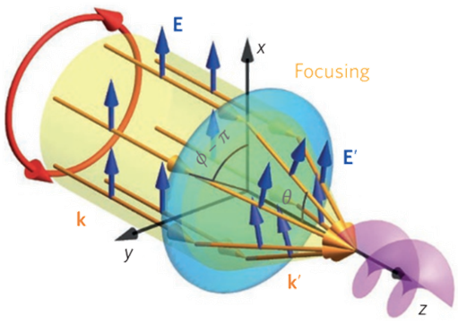
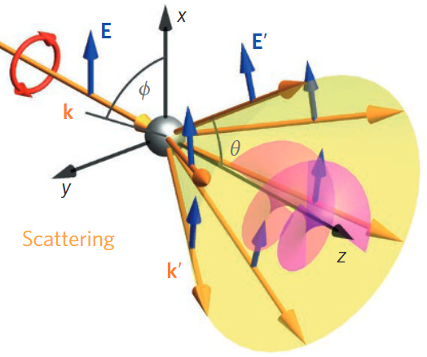
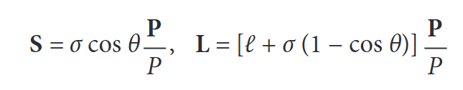



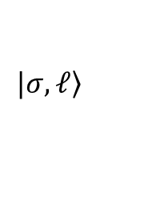




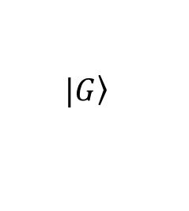

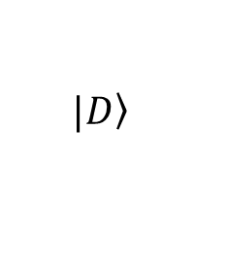


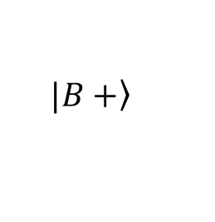






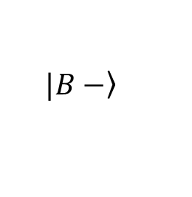

1. Introduction
Spin-orbit interaction (SOI) in paraxial light
$$\left.|σ, ℓ\right\rangle$$
Transverse
Longitudinal
1
1
Intensity :
$$y$$
$$y$$
Longitudinal
$$x$$
$$x$$
$$1μm$$
a.u.
$$0$$
$$1μm$$
a.u.
$$0$$
Transverse
$$2π$$
a.u.
$$e^{iℓφ_{q_{∥}}}$$
$$y$$
Phase :
$$x$$
$$e^{iJφ_{q_{∥}}}$$
F. Cardano & L. Marrucci, Nat. Photonics 15, 72 (2021).
$$J≡σ+ℓ$$
$$1μm$$
$$0$$
SOI in nonparaxial fields
Selective excitation with SOI in light
O. J. G. Sanchez, G.-H. Peng et al., ACS Nano 18, 11425 (2024).
$$\left.|B+\right\rangle$$
$$\left.|B−\right\rangle$$
$$\left.|G\right\rangle$$
$$\left.|D\right\rangle$$
K. Y. Bliokh, F. J. Rodríguez-Fortuño et al., Nat. Photonics 9, 796–808 (2015)
$$Q_{y}$$
$$Q=0$$

Slide 4
Outline
1. Introduction
2. Vector vortex beam (VVB) : SOI beyond single beams
  Scalar vortex beams in angular spectrum & conditions
  VVB : even number of AM difference - symmetry
  VVB : odd number of AM difference - asymmetry
3. Optical transitions
  Directional momentum-selective excitation
  Selective excitation
Summary and outlook

Slide 5
Outline
1. Introduction
2. Vector vortex beam (VVB) : SOI beyond single beams
  Scalar vortex beams in angular spectrum & conditions
  VVB : even number of AM difference - symmetry
  VVB : odd number of AM difference - asymmetry
3. Optical transitions
Summary and outlook

Slide 6


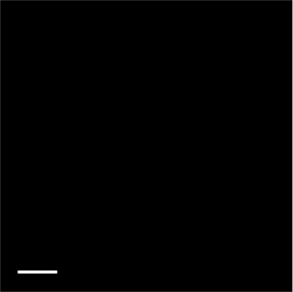
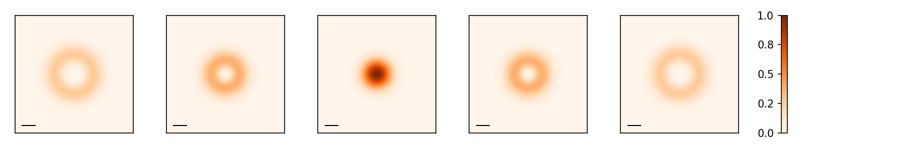
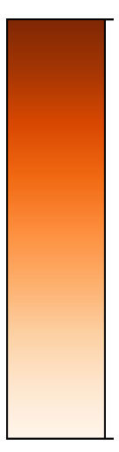
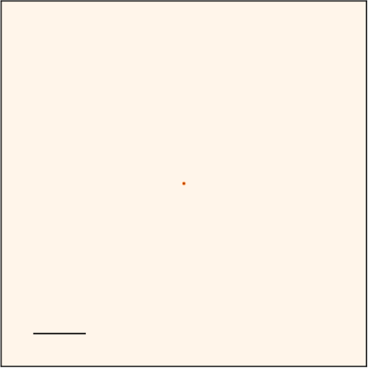
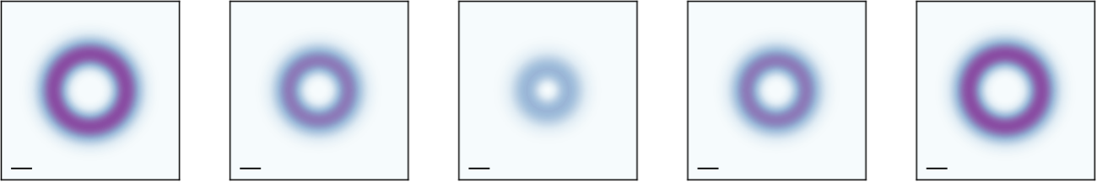




















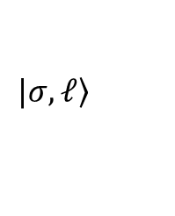








2. Scalar vortex beams in angular spectrum
Plane wave
$$\left.|σ,ℓ\right\rangle$$
Vector potential form in Coulomb gauge :
$$_{σ,ℓ }\left(q_{∥}\right)={ }_{ℓ }^{∥}\left(q_{∥}\right){\hat{ε}}_{σ}+{ }_{σ,ℓ }^{z}\left(q_{∥}\right)\hat{z}$$
$${\hat{ε}}_{σ}≡\left(\hat{x}+iσ\hat{y}\right)/\sqrt{2},σ=±1$$
Transverse :
$_{ℓ}^{∥}\left(q_{∥}\right)≈{\tilde{F}}_{\left|ℓ\right|}\left(q_{∥}\right)e^{iℓφ_{q_{∥}}}$
$$\hat{z}$$
$$\hat{z}$$
$_{σ,ℓ}^{z}\left(q_{∥}\right)≈\frac{−\sin{θ_{q}}}{\sqrt{2}}{\tilde{F}}_{\left|ℓ\right|}\left(q_{∥}\right) e^{iJφ_{q_{∥}}}$
Longitudinal :
1
$$ℓ=−2$$
$$ℓ=−1$$
$$ℓ=0$$
$$ℓ=1$$
$$ℓ=2$$
1
$$y$$
$${\left|{ }_{ℓ}^{∥}\left(q_{∥}\right)\right|}^{2}$$
$$q_{y}$$
$$1μm$$
a.u.
$$q_{x}$$
0
$$x$$
$${0.1Q}_{c}$$
a.u.
0
1
1
$${\left|{ }_{σ,ℓ}^{z}\left(q_{∥}\right) \right|}^{2}$$
$$q_{y}$$
$$q_{x}$$
$$q_{y}$$
$${0.1Q}_{c}$$
a.u.
$${0.1Q}_{c}$$
a.u.
0
0
$$φ_{q_{∥}}$$
$$q_{x}$$
O. J. G. Sanchez, G.-H. Peng et al., ACS Nano 18, 11425 (2024)
Radial structure : $F_{\left|ℓ\right|}\left(q_{∥}\right)=\frac{A_{0}^{LG} W_{0}^{2} {\left(−i\right)}^{\left|ℓ\right|} π}{Ω\sqrt{\left(\left|ℓ\right|\right)!π/2}}{\left(\frac{q_{∥}W_{0}}{\sqrt{2}}\right)}^{\left|ℓ\right|}e^{−\frac{q_{∥}^{2}W_{0}^{2}}{4} }$

Slide 7
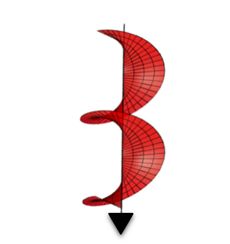


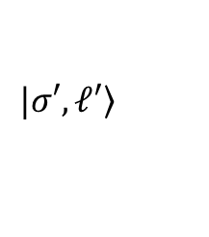







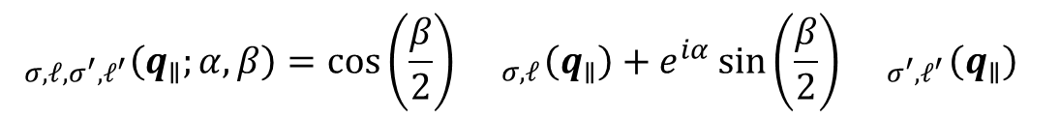
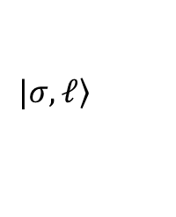


2. Vector vortex beams (VVB)
Vector vortex beams :
$$_{σ,ℓ,σ^{′},ℓ^{′}}\left(q_{∥};α,β\right)=\cos\left(\frac{β}{2}\right){ }_{σ,ℓ}\left(q_{∥}\right)+e^{iα}\sin\left(\frac{β}{2}\right){ }_{σ^{′},ℓ^{′}}\left(q_{∥}\right)$$
$$\left.|σ,ℓ\right\rangle$$
$$\left.|σ′,ℓ′\right\rangle$$
Represent in Poincaré sphere
$${ }_{σ,ℓ}\left(q_{∥}\right)$$
$$\frac{1}{\sqrt{2}}{ }_{σ,ℓ}\left(q_{∥}\right)−\frac{i}{\sqrt{2}}{ }_{σ^{′},ℓ^{′}}\left(q_{∥}\right)$$
$$z$$
$$\frac{1}{\sqrt{2}}{ }_{σ,ℓ}\left(q_{∥}\right)+\frac{1}{\sqrt{2}}{ }_{σ^{′},ℓ^{′}}\left(q_{∥}\right)$$
$$β$$
$$\frac{1}{\sqrt{2}}{ }_{σ,ℓ}\left(q_{∥}\right)−\frac{1}{\sqrt{2}}{ }_{σ^{′},ℓ^{′}}\left(q_{∥}\right)$$
$$x$$
$$α$$
$$y$$
$$\frac{1}{\sqrt{2}}{ }_{σ,ℓ}\left(q_{∥}\right)+\frac{i}{\sqrt{2}}{ }_{σ^{′},ℓ^{′}}\left(q_{∥}\right)$$
$${ }_{σ^{′},ℓ^{′}}\left(q_{∥}\right)$$

Slide 8
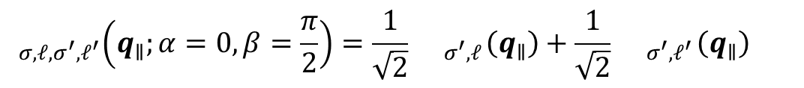

2. VVB : focus on $β=π/2$ and $α=0$
Vector vortex beams :
$$_{σ,ℓ,σ^{′},ℓ^{′}}\left(q_{∥};α=0,β=\frac{π}{2}\right)=\frac{1}{\sqrt{2}}{ }_{σ^{′},ℓ}\left(q_{∥}\right)+\frac{1}{\sqrt{2}}{ }_{σ^{′},ℓ^{′}}\left(q_{∥}\right)$$
$$={ }_{σ,ℓ,σ^{′},ℓ^{′}}^{∥}\left(q_{∥}\right)+{ }_{σ,ℓ,σ^{′},ℓ^{′}}^{z}\left(q_{∥}\right)$$
$$\left.|σ,ℓ\right\rangle$$
$$\left.|σ′,ℓ′\right\rangle$$
Represent in Poincaré sphere
$${ }_{σ,ℓ}\left(q_{∥}\right)$$
$$z$$
$$\frac{1}{\sqrt{2}}{ }_{σ,ℓ}\left(q_{∥}\right)+\frac{1}{\sqrt{2}}{ }_{σ^{′},ℓ^{′}}\left(q_{∥}\right)$$
$$β$$
$$x$$
$$α$$
$$y$$
$${ }_{σ^{′},ℓ^{′}}\left(q_{∥}\right)$$

Slide 9


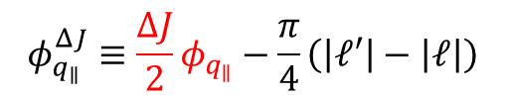





2. VVB : SOI beyond single beams
Longitudinal component
$$=\frac{−\sin{θ_{q}}}{2}\left[{\tilde{F}}_{\left|ℓ\right|}\left(q_{∥}\right)e^{iJφ_{q_{∥}}}+{\tilde{F}}_{\left|ℓ^{′}\right|}\left(q_{∥}\right)e^{iJ^{′}φ_{q_{∥}}}\right]\hat{z}$$
$${ }_{σ,ℓ,σ^{′},ℓ^{′}}^{z}\left(q_{∥}\right)$$
SOI in phase
SOI in phase
$$e^{iJφ_{q_{∥}}}$$
$$e^{iJ^{′}φ_{q_{∥}}}$$
$$=\frac{−\sin{θ_{q}}}{2}e^{i\frac{J^{′}+J}{2}φ_{q_{∥}}}\left[{\tilde{F}}_{\left|ℓ\right|}\left(q_{∥}\right)e^{−i\frac{J^{′}−J}{2}φ_{q_{∥}}}+{\tilde{F}}_{\left|ℓ^{′}\right|}\left(q_{∥}\right)e^{i\frac{J^{′}−J}{2}φ_{q_{∥}}}\right]\hat{z}$$
$$=\frac{−\sin{θ_{q}}}{2}e^{−i\frac{π}{4}\left(\left|ℓ^{′}\right|+\left|ℓ\right|\right)}e^{i\left(\frac{J^{′}+J}{2}\right)φ_{q_{∥}}}\left\{G_{\left|ℓ\right|,\left|ℓ^{′}\right|}^{+}\left(q_{∥}\right)cos\left(φ_{q_{∥}}^{ΔJ}\right)+G_{\left|ℓ\right|,\left|ℓ^{′}\right|}^{−}\left(q_{∥}\right) i sin\left(φ_{q_{∥}}^{ΔJ}\right)\right\}\hat{z}$$
Definitions
$$ΔJ≡J^{′}−J$$
SOI in phase & amplitude
$$φ_{q_{∥}}^{ΔJ}≡\frac{ΔJ}{2}φ_{q_{∥}}−\frac{π}{4}\left(\left|ℓ′\right|−\left|ℓ\right|\right)$$
$$G_{\left|ℓ\right|,\left|ℓ^{′}\right|}^{±}\left(q_{∥}\right)≡F_{\left|ℓ\right|}\left(q_{∥}\right)±F_{\left|ℓ^{′}\right|}\left(q_{∥}\right)$$
$${\tilde{F}}_{\left|ℓ\right|}\left(q_{∥}\right)={\left(−i\right)}^{\left|ℓ\right|}F_{\left|ℓ\right|}\left(q_{∥}\right)$$

Slide 10

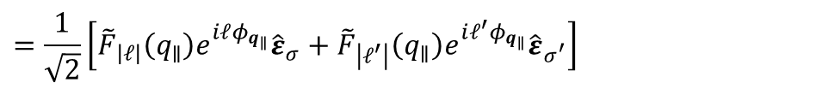


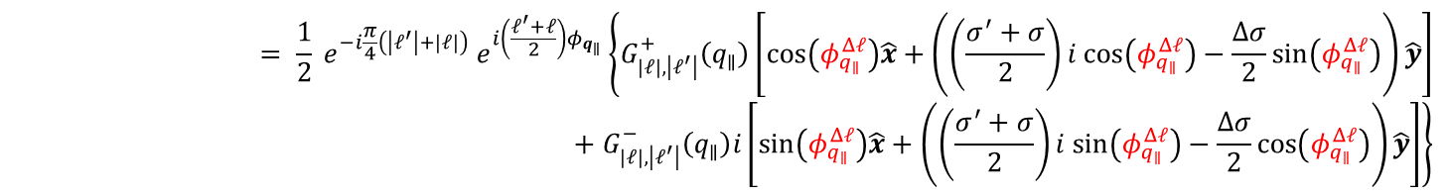
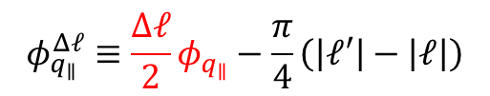
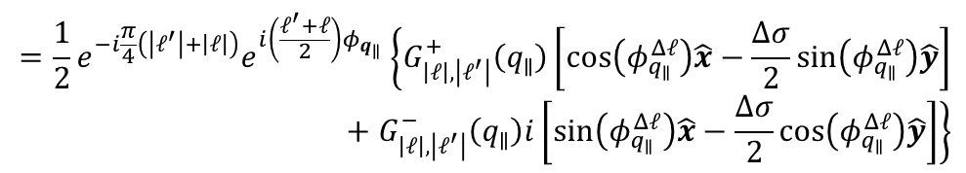



2. VVB : SOI beyond single beams
Transverse component
$${ }_{σ,ℓ,σ^{′},ℓ^{′}}^{∥}\left(q_{∥}\right)$$
$$=\frac{1}{\sqrt{2}}\left[{\tilde{F}}_{\left|ℓ\right|}\left(q_{∥}\right)e^{iℓφ_{q_{∥}}}{\hat{ε}}_{σ}+{\tilde{F}}_{\left|ℓ^{′}\right|}\left(q_{∥}\right)e^{iℓ^{′}φ_{q_{∥}}}{\hat{ε}}_{σ^{′}}\right]$$
$$= \frac{1}{2} e^{−i\frac{π}{4}\left(\left|ℓ^{′}\right|+\left|ℓ\right|\right)} e^{i\left(\frac{ℓ^{′}+ℓ}{2}\right)φ_{q_{∥}}}\left\{G_{\left|ℓ\right|,\left|ℓ^{′}\right|}^{+}\left(q_{∥}\right)\left[cos\left(φ_{q_{∥}}^{Δℓ}\right)\hat{x}+\left(\left(\frac{σ^{′}+σ}{2}\right)i cos\left(φ_{q_{∥}}^{Δℓ}\right)−\frac{Δσ}{2}sin\left(φ_{q_{∥}}^{Δℓ}\right)\right)\hat{y}\right]+G_{\left|ℓ\right|,\left|ℓ^{′}\right|}^{−}\left(q_{∥}\right)i\left[sin\left(φ_{q_{∥}}^{Δℓ}\right)\hat{x}+\left(\left(\frac{σ^{′}+σ}{2}\right)i sin\left(φ_{q_{∥}}^{Δℓ}\right)−\frac{Δσ}{2}cos\left(φ_{q_{∥}}^{Δℓ}\right)\right)\hat{y}\right]\right\}$$
$$e^{iℓφ_{q_{∥}}}$$
$$e^{iℓ^{′}φ_{q_{∥}}}$$
To manipulate the polarization, we need $σ≠σ^{′}$ and $ℓ≠ℓ′$
$${ }_{σ,ℓ,−σ,ℓ^{′}}^{∥}\left(q_{∥}\right)$$
$$=\frac{1}{2}e^{−i\frac{π}{4}\left(\left|ℓ^{′}\right|+\left|ℓ\right|\right)}e^{i\left(\frac{ℓ^{′}+ℓ}{2}\right)φ_{q_{∥}}}\left\{G_{\left|ℓ\right|,\left|ℓ^{′}\right|}^{+}\left(q_{∥}\right)\left[cos\left(φ_{q_{∥}}^{Δℓ}\right)\hat{x}−\frac{Δσ}{2}sin\left(φ_{q_{∥}}^{Δℓ}\right)\hat{y}\right]+G_{\left|ℓ\right|,\left|ℓ^{′}\right|}^{−}\left(q_{∥}\right)i\left[sin\left(φ_{q_{∥}}^{Δℓ}\right)\hat{x}−\frac{Δσ}{2}cos\left(φ_{q_{∥}}^{Δℓ}\right)\hat{y}\right]\right\}$$
SOI in polarization
Definitions
$$Δσ≡σ^{′}−σ$$
$$Δℓ≡ℓ^{′}−ℓ$$
$$φ_{q_{∥}}^{Δℓ}≡\frac{Δℓ}{2}φ_{q_{∥}}−\frac{π}{4}\left(\left|ℓ′\right|−\left|ℓ\right|\right)$$

Slide 11
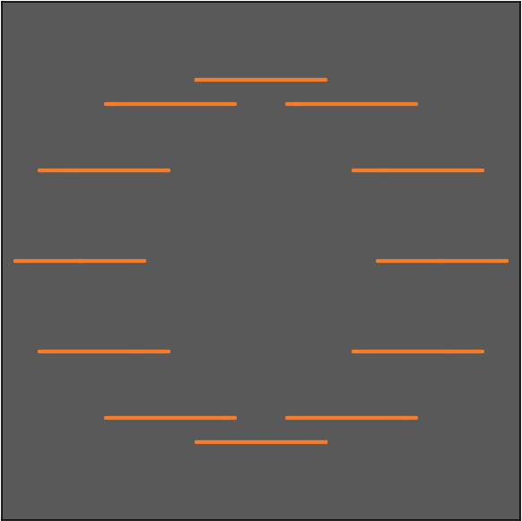

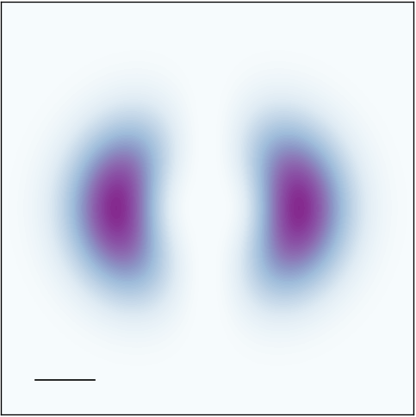
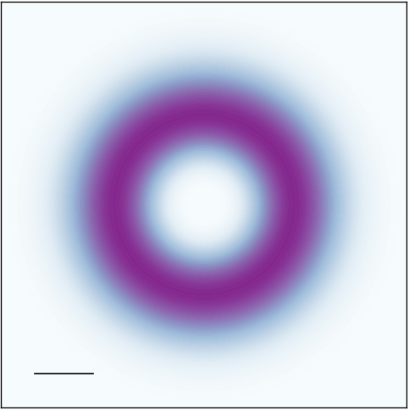
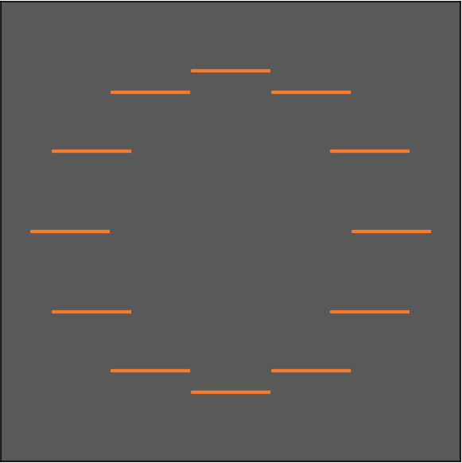
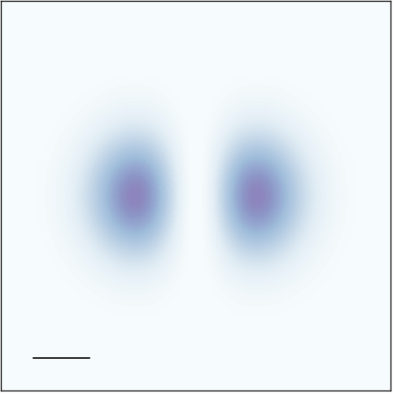











































2. VVB : even number of AM difference - symmetry
$${ }_{1,ℓ,−1,ℓ^{′}}^{∥}\left(q_{∥}\right)$$
$$∝F_{\left|ℓ\right|}\left(q_{∥}\right)\left\{cos\left(φ_{q_{∥}}^{Δℓ}\right)\hat{x}+sin\left(φ_{q_{∥}}^{Δℓ}\right)\hat{y}\right\}$$
$$φ_{q_{∥}}^{ΔJ}≡\frac{ΔJ}{2}φ_{q_{∥}}−\frac{π}{2}\left(\left|ℓ′\right|−\left|ℓ\right|\right)$$
$$Δσ=−2$$
$${ }_{1,ℓ,−1,ℓ^{′}}^{z}\left(q_{∥}\right)$$
$$∝F_{\left|ℓ\right|}\left(q_{∥}\right)cos\left(φ_{q_{∥}}^{ΔJ}\right)\hat{z}$$
$$φ_{q_{∥}}^{Δℓ}≡\frac{Δℓ}{2}φ_{q_{∥}}−\frac{π}{2}\left(\left|ℓ′\right|−\left|ℓ\right|\right)$$
Polarization trajectory
Longitudinal intensity
$$ℓ^{′}=−1$$
$$ℓ^{′}=0$$
$$ℓ^{′}=1$$
$$1$$
$$J^{′}=−2$$
$$J^{′}=−1$$
$$J^{′}=0$$
$$q_{y}$$
$$q_{y}$$
$$ℓ=−1$$
$$q_{x}$$
$$J=0$$
$$q_{x}$$
$$a.u.$$
$$Δℓ=0$$
$$2$$
$$0$$
$$ΔJ=−2$$
$$0$$
$${0.1Q}_{c}$$
$$ℓ=0$$
$$J=1$$
$$0$$
$$−2$$
$$ℓ=1$$
$$J=2$$
$$−2$$
$$0$$
$$−4$$
$$−2$$
Symmetry when $Δℓ$ is an even number
Symmetry when $ΔJ$ is an even number
O. J. G. Sanchez, G.-H. Peng et al., ACS Nano 18, 11425 (2024)

Slide 12






























2. VVB : even number of AM difference - symmetry ($\left|ℓ\right|≠\left|ℓ^{′}\right|$)
$${ }_{1,ℓ,−1,ℓ^{′}}^{∥}\left(q_{∥}\right)$$
$$∝\frac{1}{2}\left\{G_{\left|ℓ\right|,\left|ℓ^{′}\right|}^{+}\left(q_{∥}\right)\left[cos\left(φ_{q_{∥}}^{Δℓ}\right)\hat{x}+sin\left(φ_{q_{∥}}^{Δℓ}\right)\hat{y}\right]+G_{\left|ℓ\right|,\left|ℓ^{′}\right|}^{−}\left(q_{∥}\right)i\left[sin\left(φ_{q_{∥}}^{Δℓ}\right)\hat{x}+cos\left(φ_{q_{∥}}^{Δℓ}\right)\hat{y}\right]\right\}$$
$$Δσ=−2$$
$${ }_{1,ℓ,−1,ℓ^{′}}^{z}\left(q_{∥}\right)$$
$$∝\frac{1}{2}\left\{G_{\left|ℓ\right|,\left|ℓ^{′}\right|}^{+}\left(q_{∥}\right)cos\left(φ_{q_{∥}}^{ΔJ}\right)+G_{\left|ℓ\right|,\left|ℓ^{′}\right|}^{−}\left(q_{∥}\right) i sin\left(φ_{q_{∥}}^{ΔJ}\right)\right\}\hat{z}$$
$$G_{\left|ℓ\right|,\left|ℓ^{′}\right|}^{±}\left(q_{∥}\right)≡F_{\left|ℓ\right|}\left(q_{∥}\right)±F_{\left|ℓ^{′}\right|}\left(q_{∥}\right)$$
Polarization trajectory
Longitudinal intensity
$$ℓ^{′}=−1$$
$$ℓ^{′}=0$$
$$ℓ^{′}=1$$
$$J^{′}=−2$$
$$J^{′}=−1$$
$$J^{′}=0$$
$$ℓ=−1$$
$$ℓ′=2$$
$$J=0$$
$$J^{′}=1$$
$$1$$
$$q_{y}$$
$$q_{y}$$
$$ℓ=0$$
$$q_{x}$$
$$J=1$$
$$q_{x}$$
$$a.u.$$
$${0.1Q}_{c}$$
$$0$$
$$Δℓ=2$$
$$ΔJ=0$$
$$ℓ=1$$
Symmetry since $Δℓ$ is an even number
Elliptical since $G_{\left|ℓ\right|,\left|ℓ^{′}\right|}^{+}\left(q_{∥}\right)≫ G_{\left|ℓ\right|,\left|ℓ^{′}\right|}^{−}≠0$
Symmetry since $ΔJ$ is an even number
Additional pattern since $G_{\left|ℓ\right|,\left|ℓ^{′}\right|}^{+}\left(q_{∥}\right)≫ G_{\left|ℓ\right|,\left|ℓ^{′}\right|}^{−}≠0$
$$J=2$$

Slide 13













































2. VVB : odd number of AM difference - asymmetry
$${ }_{1,ℓ,−1,ℓ^{′}}^{∥}\left(q_{∥}\right)$$
$$∝\frac{1}{2}\left\{G_{\left|ℓ\right|,\left|ℓ^{′}\right|}^{+}\left(q_{∥}\right)\left[cos\left(φ_{q_{∥}}^{Δℓ}\right)\hat{x}+sin\left(φ_{q_{∥}}^{Δℓ}\right)\hat{y}\right]+G_{\left|ℓ\right|,\left|ℓ^{′}\right|}^{−}\left(q_{∥}\right)i\left[sin\left(φ_{q_{∥}}^{Δℓ}\right)\hat{x}+cos\left(φ_{q_{∥}}^{Δℓ}\right)\hat{y}\right]\right\}$$
$$Δσ=−2$$
$${ }_{1,ℓ,−1,ℓ^{′}}^{z}\left(q_{∥}\right)$$
$$∝\frac{1}{2}\left\{G_{\left|ℓ\right|,\left|ℓ^{′}\right|}^{+}\left(q_{∥}\right)cos\left(φ_{q_{∥}}^{ΔJ}\right)+G_{\left|ℓ\right|,\left|ℓ^{′}\right|}^{−}\left(q_{∥}\right) i sin\left(φ_{q_{∥}}^{ΔJ}\right)\right\}\hat{z}$$
Polarization trajectory
Longitudinal intensity
$$ℓ^{′}=−1$$
$$ℓ^{′}=0$$
$$ℓ^{′}=1$$
$$ℓ′=2$$
$$1$$
$$J^{′}=−2$$
$$J^{′}=−1$$
$$J^{′}=0$$
$$J^{′}=1$$
$$q_{y}$$
$$q_{y}$$
$$ℓ=−1$$
$$q_{x}$$
$$J=0$$
$$q_{x}$$
$$a.u.$$
$$0$$
$$Δℓ=−1$$
$$2$$
$$3$$
$$0$$
$$−2$$
$$ΔJ=−1$$
$$0$$
$$1$$
$${0.1Q}_{c}$$
$$ℓ=0$$
$$J=1$$
$$−1$$
$$0$$
$$1$$
$$2$$
$$−3$$
$$−2$$
$$1$$
$$0$$
$$ℓ=1$$
$$J=2$$
$$−2$$
$$−1$$
$$0$$
$$1$$
$$−4$$
$$−4$$
$$−2$$
$$−1$$
Asymmetry when $Δℓ$ is an odd number
Asymmetry when $ΔJ$ is an odd number

Slide 14
Outline
1. Introduction
2. Vector vortex beam (VVB) : SOI beyond single beams
3. Optical transitions
  Directional momentum-selective excitation
  Selective excitation
Summary and outlook

Slide 15








3. Directional momentum-selective excitation
The transition rate is obtained as
$$Γ_{σ,ℓ,σ^{′},ℓ^{′}}^{S, Q}\left(Q\right)=\frac{2π}{ℏ}{\left|{\tilde{M}}_{σ,ℓ,σ^{′},ℓ^{′}}^{S, Q}\left(Q\right)\right|}^{2}ρ\left(ℏω=E_{S, Q}^{X}\right),$$
$$S=B+, B−, G$$
$$\left.|σ,ℓ\right\rangle$$
$$\left.|σ′,ℓ′\right\rangle$$
The optical matrix element is
+
$${\tilde{M}}_{σ,ℓ,σ^{′},ℓ^{′}}^{S, Q}\left(Q\right)=\frac{E_{g}}{2iℏ}\left({ }_{σ,ℓ,σ^{′},ℓ^{′}}\left(Q\right)⋅D_{ }^{S, Q∗}\right)$$
$D_{ }^{S, Q}$ : transition dipole moment
O. J. G. Sanchez, G.-H. Peng et al., ACS Nano 18, 11425 (2024)

Slide 16










































3. Directional momentum-selective excitation (BXs)
Polarization
of ${ }_{1, −1, −1, 2}\left(Q\right)$
$$\left.|B+\right\rangle$$
$$D_{ }^{S, Q}$$
$$Γ_{σ,ℓ,σ^{′},ℓ^{′}}^{S, Q}\left(Q\right)$$
w/ e-h exchange
$$1$$
$$Q_{y}$$
$$a.u.$$
$$\left.|B−\right\rangle$$
At $Q_{y}>0$ have $\hat{y}$ polarized
$$Q_{x}$$
$${0.1Q}_{c}$$
$$0$$
$$D^{B+, Q}$$
$${0.1Q}_{c}$$
$$Γ_{1, −1, −1, 2}^{B+, Q}\left(Q\right)$$
$$Q_{y}$$
$$\left.|G\right\rangle$$
$$Q_{x}$$
$$\left.|D\right\rangle$$
$$Q_{y}$$
$$1$$
At $Q_{y}<0$ have $\hat{x}$ polarized
$$a.u.$$
$${\left|{ }_{1,−1,−1,2 }^{∥}\left(Q\right) \right|}^{2}$$
$$Q_{y}$$
$$Q_{x}$$
$$Q=0$$
$$0$$
$$D^{B−, Q}$$
$$Γ_{1, −1, −1, 2}^{B−, Q}\left(Q\right)$$
$$a.u.$$
$≈\hat{x}$ polarized
$≈\hat{y}$ polarized
$${0.1Q}_{c}$$
$$Q_{y}/Q_{c}$$
$$−0.5$$
$$−0.1$$
$$0.1$$
$$0.5$$

Slide 17



















3. Directional momentum-selective excitation (GXs)
$$\left.|B+\right\rangle$$
$${\left|{ }_{1,−1,−1,2}^{z}\left(Q\right) \right|}^{2}$$
$$D_{ }^{S, Q}$$
$$Γ_{σ,ℓ,σ^{′},ℓ^{′}}^{S, Q}\left(Q\right)$$
w/ e-h exchange
$$\left.|B−\right\rangle$$
$$1$$
$$1$$
$$Q_{y}$$
$$Q_{y}$$
$$a.u.$$
$$\left.|G\right\rangle$$
$$D^{G, Q}=D^{0}\hat{z}$$
$$Q_{x}$$
$$a.u.$$
$$Q_{y}$$
$$Q_{x}$$
$$\left.|D\right\rangle$$
$$0$$
$$Q_{x}$$
$${0.1Q}_{c}$$
$$0$$
$${0.1Q}_{c}$$
$$Γ_{1, −1, −1, 2}^{G, Q}\left(Q\right)$$
$$Q_{y}$$
$$Q_{x}$$
$${\left|{ }_{1,−1,−1,2}^{z}\left(Q\right) \right|}^{2}$$
$$Q_{y}$$
$$Q=0$$
$$a.u.$$
$${0.1Q}_{c}$$
$$Q_{y}/Q_{c}$$
$$−0.5$$
$$−0.1$$
$$0.1$$
$$0.5$$

Slide 18










































4. Effect of relative phase $α$
18
VVB :
$_{σ,ℓ,σ^{′},ℓ^{′}}\left(q_{∥};α,β=\frac{π}{2}\right)=\frac{1}{\sqrt{2}}{ }_{σ,ℓ}\left(q_{∥}\right)+e^{iα}\frac{1}{\sqrt{2}}{ }_{σ^{′},ℓ^{′}}\left(q_{∥}\right)={ }_{σ,ℓ,σ^{′},ℓ^{′}}^{∥}\left(q_{∥};α\right)+{ }_{σ,ℓ,σ^{′},ℓ^{′}}^{z}\left(q_{∥};α\right)$
$${ }_{1,ℓ,−1,ℓ^{′}}^{∥}\left(q_{∥};α\right)$$
$$∝\frac{1}{2}\left\{G_{\left|ℓ\right|,\left|ℓ^{′}\right|}^{+}\left(q_{∥}\right)\left[cos\left(φ_{q_{∥}}^{Δℓ}\right)\hat{x}+sin\left(φ_{q_{∥}}^{Δℓ}\right)\hat{y}\right]+G_{\left|ℓ\right|,\left|ℓ^{′}\right|}^{−}\left(q_{∥}\right)i\left[sin\left(φ_{q_{∥}}^{Δℓ}\right)\hat{x}+cos\left(φ_{q_{∥}}^{Δℓ}\right)\hat{y}\right]\right\}$$
$$φ_{q_{∥}}^{ΔJ}≡\frac{ΔJ}{2}φ_{q_{∥}}+\frac{α}{2}−\frac{π}{2}\left(\left|ℓ′\right|−\left|ℓ\right|\right)$$
$$Δσ=−2$$
$${ }_{1,ℓ,−1,ℓ^{′}}^{z}\left(q_{∥};α\right)$$
$$∝\frac{1}{2}\left\{G_{\left|ℓ\right|,\left|ℓ^{′}\right|}^{+}\left(q_{∥}\right)cos\left(φ_{q_{∥}}^{ΔJ}\right)+G_{\left|ℓ\right|,\left|ℓ^{′}\right|}^{−}\left(q_{∥}\right) i sin\left(φ_{q_{∥}}^{ΔJ}\right)\right\}\hat{z}$$
$$φ_{q_{∥}}^{Δℓ}≡\frac{Δℓ}{2}φ_{q_{∥}}+\frac{α}{2}−\frac{π}{2}\left(\left|ℓ′\right|−\left|ℓ\right|\right)$$
Polarization trajectory
Longitudinal intensity
$$α=0$$
$$α=π$$
$$α=0$$
$$α=π$$
$${\left|{ }_{1,−1,−1,1}^{z}\left(q_{∥};α\right) \right|}^{2}$$
$$1$$
$${ }_{1,−1,−1,1 }^{∥}\left(q_{∥};α\right)$$
$$q_{y}$$
$$q_{y}$$
$$q_{x}$$
$$a.u.$$
$$q_{x}$$
$$α=0$$
$$Δℓ=2$$
$$2$$
$${0.1Q}_{c}$$
$$ΔJ=0$$
$$0$$
$$α=π$$
$$φ_{q_{∥}}$$
$$0$$
$${\left|{ }_{1,1,−1,−1}^{z}\left(q_{∥};α\right) \right|}^{2}$$
$${ }_{1,1,−1,−1 }^{∥}\left(q_{∥};α\right)$$
$$−2$$
$$−2$$
$$−4$$
$$−4$$
$$φ_{q_{∥}}$$
$α$ rotate the orientation
Only when $ΔJ=0$ can $α$ change the overall value
$${ }_{1,ℓ,−1,ℓ^{′}}^{∥}\left(q_{∥};α\right)$$
$$∝\frac{1}{2}\left\{G_{\left|ℓ\right|,\left|ℓ^{′}\right|}^{+}\left(q_{∥}\right)\left[cos\left(φ_{q_{∥}}^{Δℓ}\right)\hat{x}−\frac{Δσ}{2}sin\left(φ_{q_{∥}}^{Δℓ}\right)\hat{y}\right]+G_{\left|ℓ\right|,\left|ℓ^{′}\right|}^{−}\left(q_{∥}\right)i\left[sin\left(φ_{q_{∥}}^{Δℓ}\right)\hat{x}−\frac{Δσ}{2}cos\left(φ_{q_{∥}}^{Δℓ}\right)\hat{y}\right]\right\}$$
$${ }_{1,ℓ,−1,ℓ^{′}}^{z}\left(q_{∥};α\right)$$
$$∝\frac{1}{2}\left\{G_{\left|ℓ\right|,\left|ℓ^{′}\right|}^{+}\left(q_{∥}\right)cos\left(φ_{q_{∥}}^{ΔJ}\right)+G_{\left|ℓ\right|,\left|ℓ^{′}\right|}^{−}\left(q_{∥}\right) i sin\left(φ_{q_{∥}}^{ΔJ}\right)\right\}\hat{z}$$

Slide 19



































4. Selective excitation with $α$
19
Polarization trajectory
$$D_{ }^{S, Q}$$
Transition rate
$$α=0$$
$$α=π$$
$$1$$
$$Γ_{1, −1, −1, 1}^{B+, Q}\left(Q;α\right)$$
$$a.u.$$
$$Q_{y}$$
$$Q_{x}$$
$$α=0$$
$$0$$
$${0.1Q}_{c}$$
$$α=π$$
$$φ_{q_{∥}}$$
$$α=0$$
$$α=π$$
$${ }_{1,−1,−1,1 }^{∥}\left(q_{∥};α\right)$$
$$q_{y}$$
$$D^{B+, Q}$$
$$q_{x}$$
$$Γ_{1, 1, −1, −1}^{B+, Q}\left(Q;α\right)$$
$$−2$$
$$Δℓ=2$$
$$2$$
$$φ_{q_{∥}}$$
$$1$$
$$q_{y}$$
$$a.u.$$
$$q_{x}$$
$${ }_{1,1,−1,−1 }^{∥}\left(q_{∥};α\right)$$
$$Γ_{1, −1, −1, 1}^{B−, Q}\left(Q;α\right)$$
$$−2$$
$$−2$$
$$0$$
$$φ_{q_{∥}}$$
$$D^{B−, Q}$$
$$Γ_{1, 1, −1, −1}^{B−, Q}\left(Q;α\right)$$
$$φ_{q_{∥}}$$
Only $Δℓ=2$ can $α$ change the excitation

Slide 20






























4. Selective excitation with $α$
20
Longitudinal intensity
$$D_{ }^{S, Q}$$
Transition rate
$$α=0$$
$$α=π$$
$$α=0$$
$$α=π$$
$$1$$
$$1$$
$$q_{y}$$
$$a.u.$$
$$Q_{y}$$
$${\left|{ }_{1,−1,−1,1}^{z}\left(q_{∥};α\right) \right|}^{2}$$
$$q_{x}$$
$$Γ_{1, −1, −1, 1}^{G, Q}\left(Q;α\right)$$
$$α=0$$
$$a.u.$$
$$Q_{x}$$
$${0.1Q}_{c}$$
$$ΔJ=0$$
$$α=π$$
$$φ_{q_{∥}}$$
$$0$$
$$0$$
$$D^{G, Q}$$
$$=$$
$$D^{0}\hat{z}$$
$$0$$
$${0.1Q}_{c}$$
$${\left|{ }_{1,1,−1,−1}^{z}\left(q_{∥};α\right) \right|}^{2}$$
$$Γ_{1, 1, −1, −1}^{G, Q}\left(Q;α\right)$$
$$−4$$
$$−4$$
$$φ_{q_{∥}}$$
Only $ΔJ=0$ can $α$ change the excitation

Slide 21


































4. Selective excitation with $α$
21
Total transition rate :
$Γ_{σ,ℓ,σ^{′},ℓ^{′}}^{S}\left(α\right)=\sum_{Q}{Γ_{σ,ℓ,σ^{′},ℓ^{′}}^{S, Q}\left(Q;α\right)}$
Total transition rate for total BXs :
$Γ_{σ,ℓ,σ^{′},ℓ^{′}}^{B}\left(α\right)=\sum_{B±}{Γ_{σ,ℓ,σ^{′},ℓ^{′}}^{B±}\left(α\right)}$
$$ℓ^{′}=−ℓ$$
$$5$$
$$3$$
$$1$$
$$−1$$
$$−3$$
$$−5$$
$$5$$
$$3$$
$$1$$
$$−1$$
$$−3$$
$$−5$$
$$5$$
$$3$$
$$1$$
$$−1$$
$$−3$$
$$−5$$
$$5$$
$$3$$
$$1$$
$$−1$$
$$−3$$
$$−5$$
$$Γ_{1,ℓ,−1,ℓ^{′}}^{B+}\left(α\right)$$
$$Γ_{1,ℓ,−1,ℓ^{′}}^{B−}\left(α\right)$$
$$Γ_{1,ℓ,−1,ℓ^{′}}^{B}\left(α\right)$$
$$Γ_{1,ℓ,−1,ℓ^{′}}^{G}\left(α\right)$$
$α=0$
$$a.u.$$
$α=π/2$
$$a.u.$$
$α=π$
$$a.u.$$
$$ℓ$$
$$Δℓ=2$$
$$Δℓ=−2$$
$$Δℓ=2$$
$$Δℓ=−2$$
$$ΔJ=0$$
$$ΔJ=−4$$

Slide 22

Summary and outlook
Summary :
The TAM difference and OAM difference independently determine the angular geometry of the longitudinal and transverse components, manifested as intensity and polarization distributions, respectively. This governing rule remains valid beyond the equal-OAM condition ($\left|ℓ\right|=\left|ℓ′\right|$) provided that the constituent beams maintain sufficient spatial overlap.
Matching between the optical angular geometry and the orientation of exciton transition dipole moments enables directional momentum-selective excitation of excitons in center-of-mass momentum space.
The relative phase $α$ generally rotates the optical angular geometry and the corresponding transition-rate distribution. Under the special SOI condition, $Δℓ=2$ and $ΔJ=0$, however, relative phase $α$ acts as an on/off switch for exciton excitation.
Outlook
Selective excitation of excitons : Observe the evolution of exciton populations generated by tailored vector vortex beams through time-resolved photoluminescence imaging.
Exciton wave packets : Vector vortex beams actually carry average angular momentum in their phase, which can be further utilized to engineer exciton wave packets.

Slide 23
Acknowledgment
&
Thank you for listening

