Slide 1
Theoretical studies of excitonic transitions in two dimensional materials under photoexcitation of scalar and vector vortex beams

Slide 2
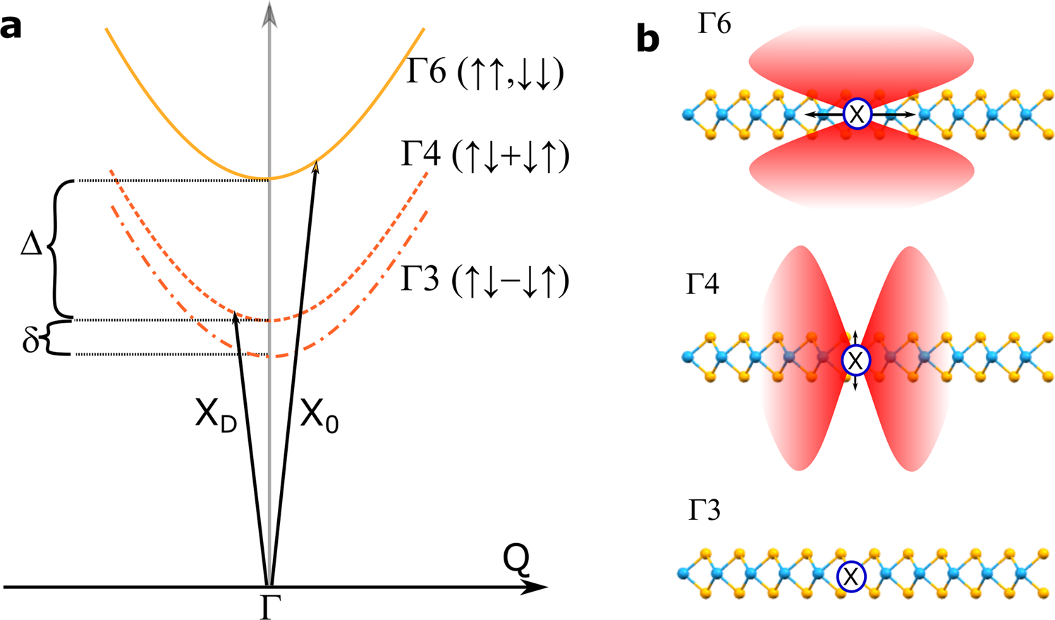
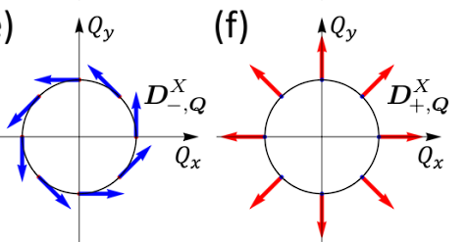
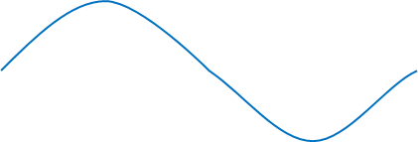
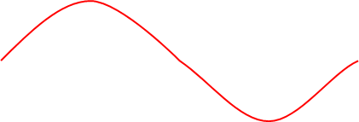
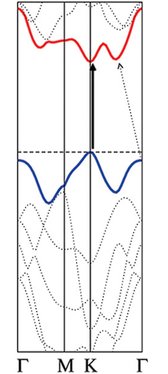
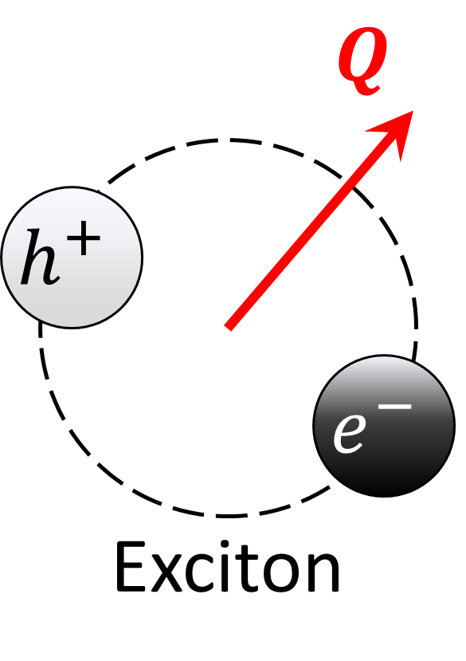
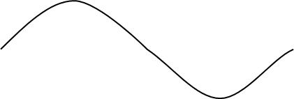
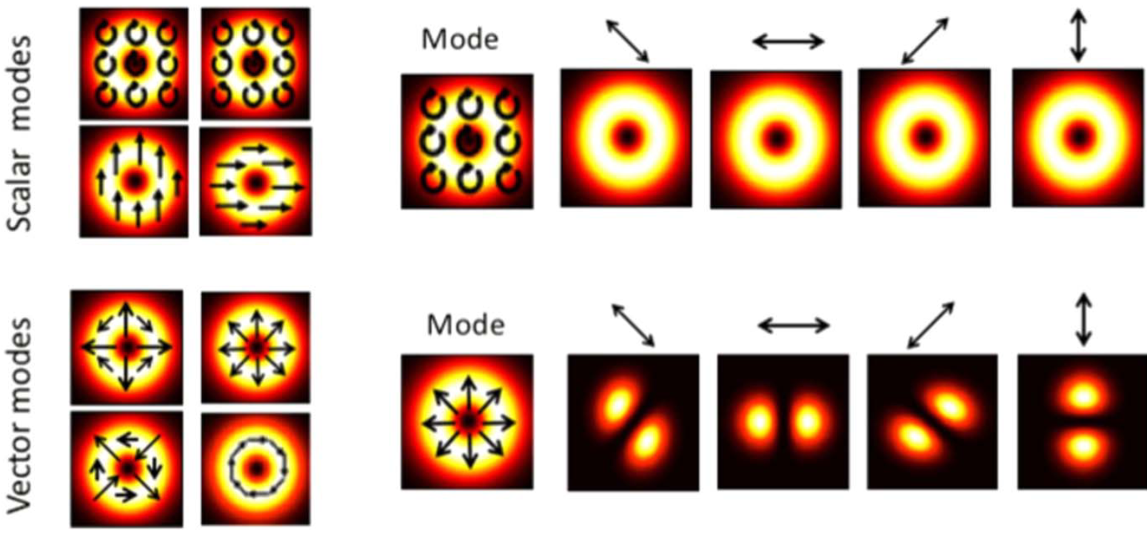
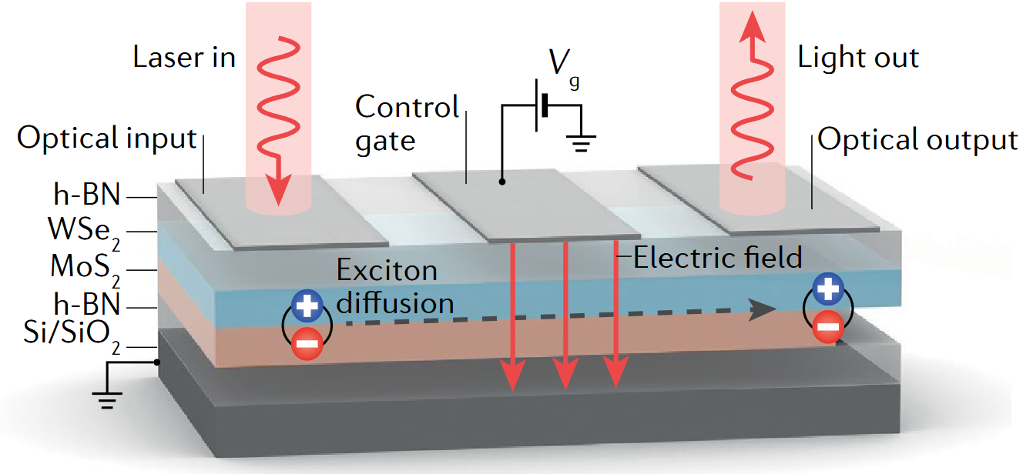

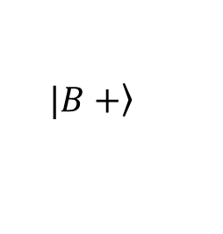


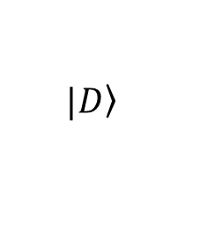


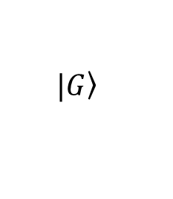



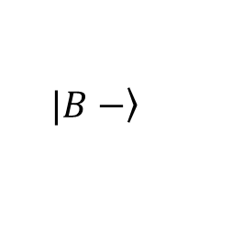


1. Introduction
2D Transition metal dichalcogenide (TMD)
Spin-orbit interaction in 2D TMD
Valley-mixing in 2D TMD
w/o e-h exchange
w/ e-h exchange
BX
$$K$$
$$K′$$
$$\left.|B+\right\rangle$$
+
+
$$D^{B+, Q}$$
+
+
1-2$eV$ $≈$
GX
$$×$$
$$\left.|B−\right\rangle$$
$$\left.|G\right\rangle$$
$$D^{B−, Q}$$
$$Q$$
$$Q$$
DX
$$\left.|D\right\rangle$$
+
+
$$Q$$
$$D^{G, Q}=D^{0}\hat{z}$$
L. M. Schneider et al., Sci. Rep. 10, 8091 (2020)
D. Y. Qiu et al., Phys. Rev. Lett. 115, 176801 (2015) / G.-H. Peng et al., Phys. Rev. B 106, 155304 (2022).
Manipulation in light – vortex beam
Device based on exciton diffusion
Manipulation of
Direct band gap
&
Polarization
&
Intensity
Suitable energy gap
A. Splendiani et al., Nano Lett. 10, 1271 (2010)
A. Ciarrocchi, F. Tagarelli et al., Nat. Rev. Mater. 7, 449 (2022)
C. Rosales-Guzmán, B. Ndagano et al., J. Opt. 20, 123001 (2018)

Slide 3
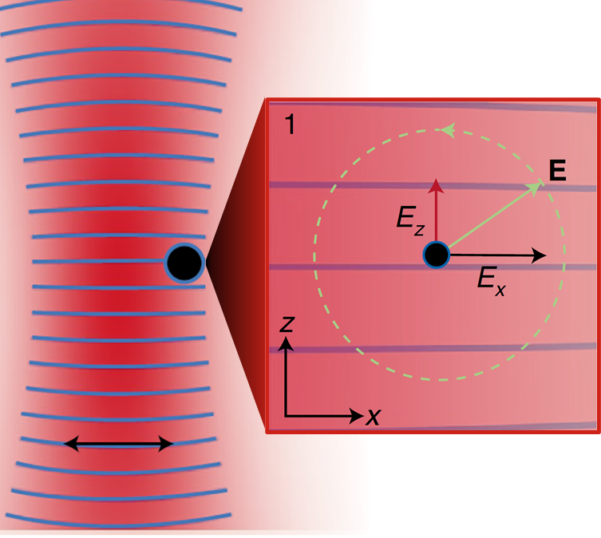
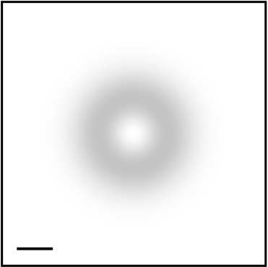

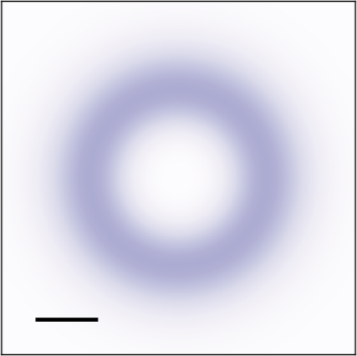

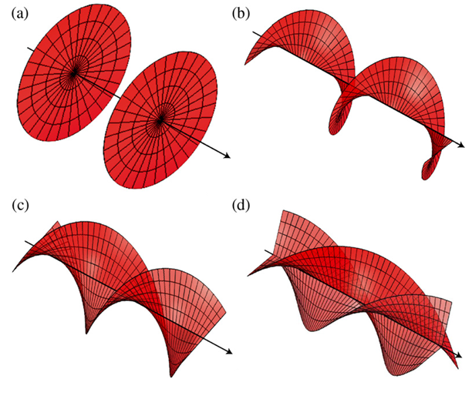
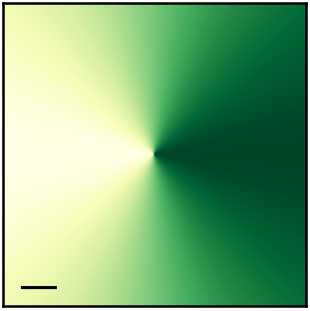
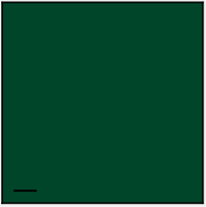

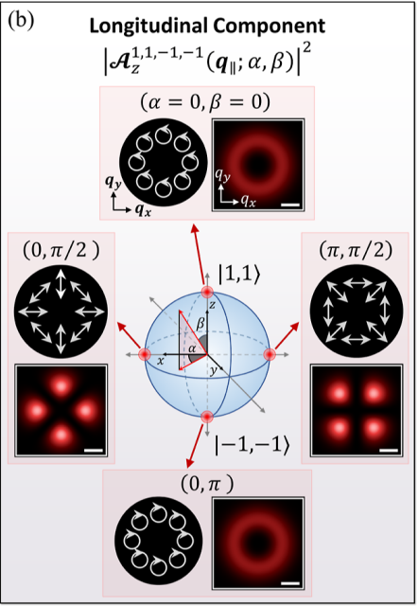
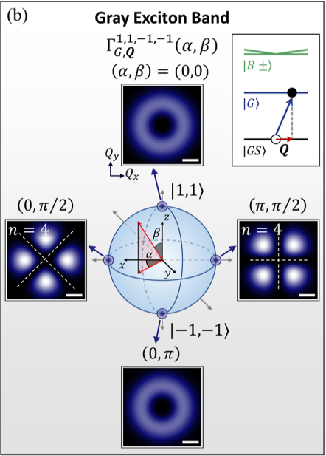
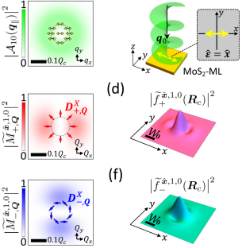
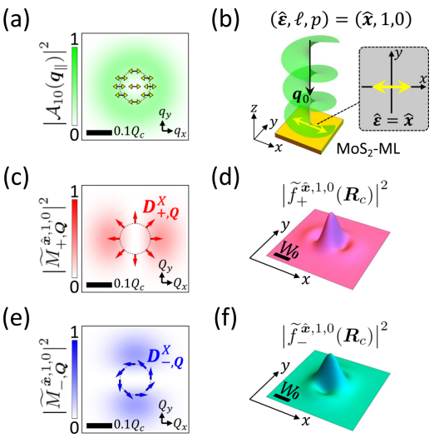


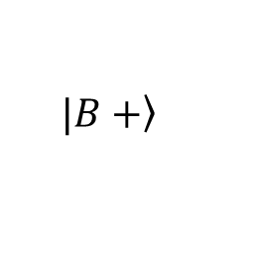





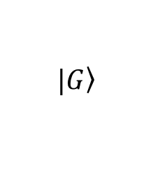


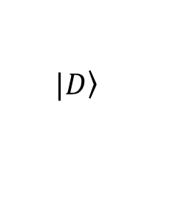

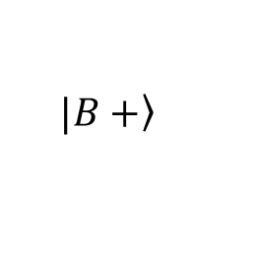



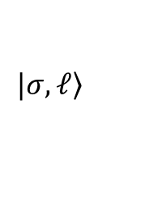

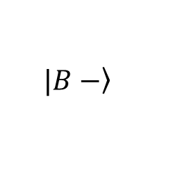

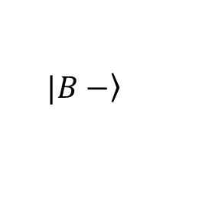


1. Introduction
Spin-orbit interaction (SOI) in light
$$\left.|σ, ℓ\right\rangle$$
Transverse
Longitudinal
1
1
Intensity :
$$y$$
$$y$$
Longitudinal
$$x$$
$$x$$
$$1μm$$
a.u.
$$0$$
$$1μm$$
a.u.
$$0$$
Transverse
$$2π$$
a.u.
$$e^{iℓφ_{q_{∥}}}$$
$$y$$
Phase :
$$x$$
$$e^{iJφ_{q_{∥}}}$$
F. Cardano & L. Marrucci, Nat. Photonics 15, 72 (2021).
$$J≡σ+ℓ$$
$$1μm$$
$$0$$
Selective excitation with SOI in light
O. J. G. Sanchez, G.-H. Peng et al., ACS Nano 18, 11425 (2024).
Exciton in real space – wave packet
$$\left.|B+\right\rangle$$
$$\left.|B+\right\rangle$$
$$\left.|B−\right\rangle$$
$$\left.|G\right\rangle$$
$$\left.|B−\right\rangle$$
$$\left.|D\right\rangle$$
$$Q_{y}$$
$$Q=0$$
G.-H. Peng et al., Phys. Rev. B 106, 155304 (2022).

Slide 4
Outline
1. Introduction
2. Angular momentums (AM) induced pattern in vector vortex beam (VVB)
Scalar vortex beams in angular spectrum & conditions
VVB : even number of AM difference - symmetry
VVB : odd number of AM difference - asymmetry
3. Optical transitions
Directional momentum-selective excitation
4. Excitation manipulation
Relative phase
Summary and outlook

Slide 5
Outline
1. Introduction
2. Angular momentums (AM) induced pattern in vector vortex beam (VVB)
Scalar vortex beams in angular spectrum
VVB : even number of AM difference - symmetry
VVB : odd number of AM difference - asymmetry
3. Optical transitions
4. Excitation manipulation
Summary and outlook

Slide 6


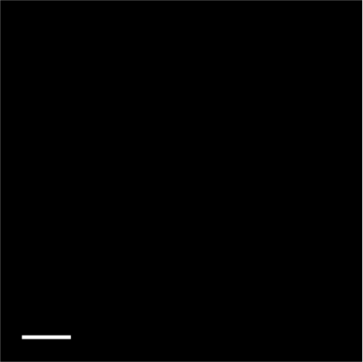
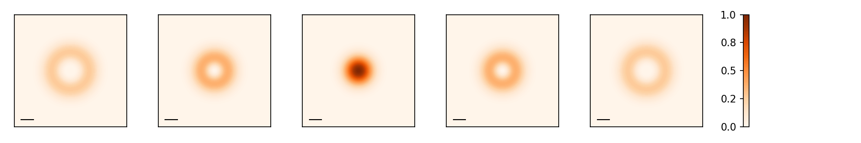
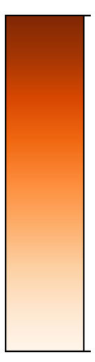

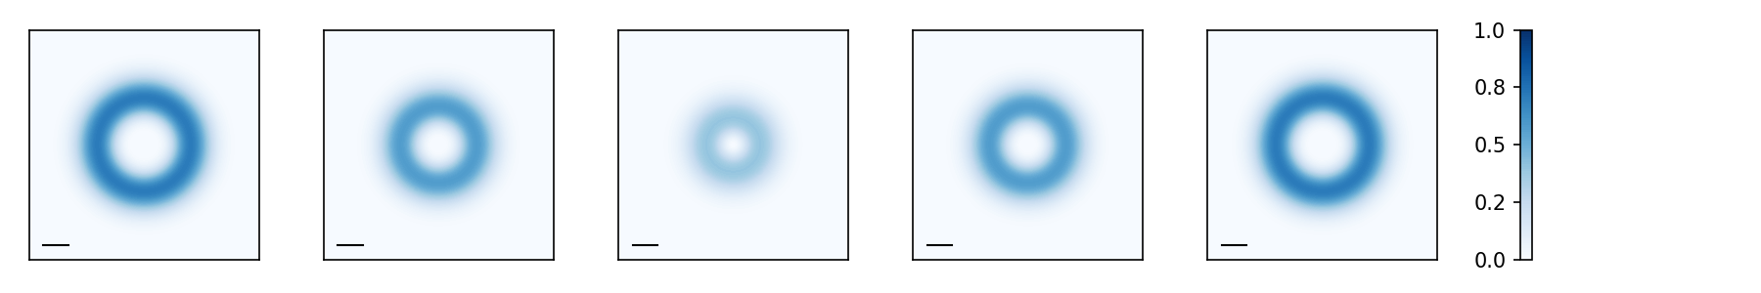
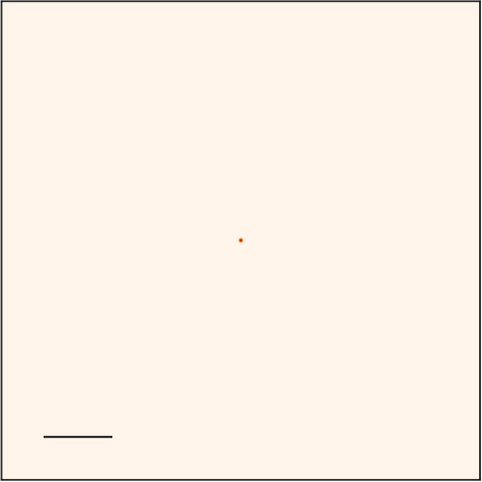

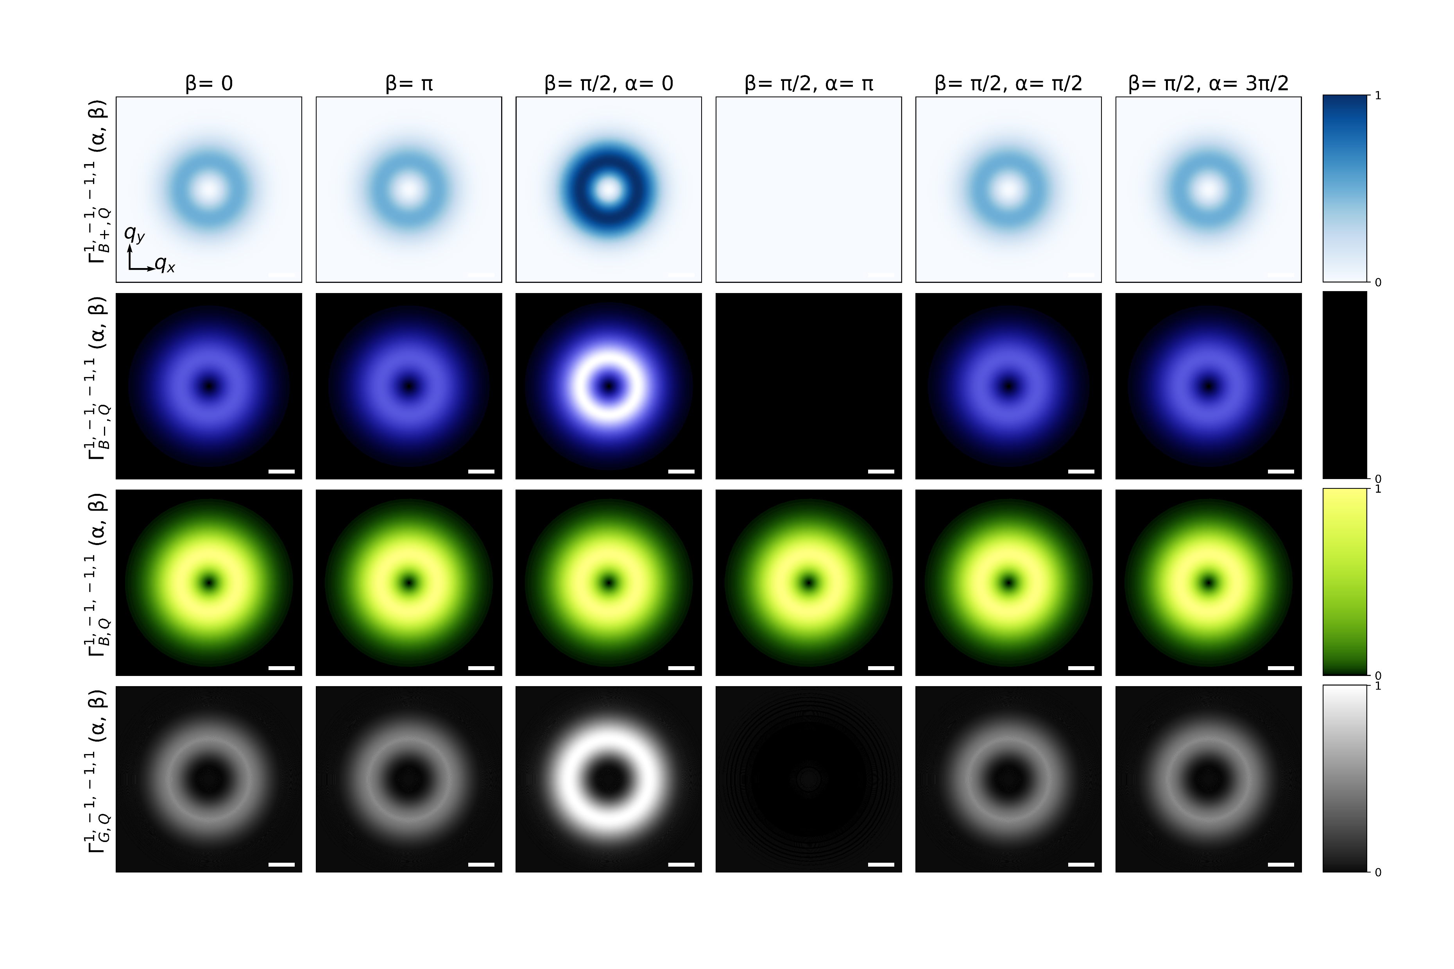




















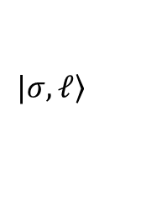





2. Scalar vortex beams in angular spectrum
Plane wave
$$\left.|σ,ℓ\right\rangle$$
Vector potential form in Coulomb gauge :
$$_{σ,ℓ }\left(q_{∥}\right)={ }_{ℓ }^{∥}\left(q_{∥}\right){\hat{ε}}_{σ}+{ }_{σ,ℓ }^{z}\left(q_{∥}\right)\hat{z}$$
$${\hat{ε}}_{σ}≡\hat{x}+iσ\hat{y},σ=±1$$
Transverse :
$_{ℓ}^{∥}\left(q_{∥}\right)≈{\left(−i\right)}^{\left|ℓ\right|}F_{\left|ℓ\right|}\left(q_{∥}\right)e^{iℓφ_{q_{∥}}}$
$$\hat{z}$$
$$\hat{z}$$
$_{σ,ℓ}^{z}\left(q_{∥}\right)≈\frac{−\sin{θ_{q}}}{\sqrt{2}}{\left(−i\right)}^{\left|ℓ\right|}F_{\left|ℓ\right|}\left(q_{∥}\right) e^{iJφ_{q_{∥}}}$
Longitudinal :
1
$$ℓ=−2$$
$$ℓ=−1$$
$$ℓ=0$$
$$ℓ=1$$
$$ℓ=2$$
1
$$x$$
$${\left|{ }_{ℓ}^{∥}\left(q_{∥}\right)\right|}^{2}$$
$$q_{y}$$
$$1μm$$
$$q_{x}$$
0
a.u.
$$y$$
$${0.1Q}_{c}$$
a.u.
0
1
1
$${\left|{ }_{σ,ℓ}^{z}\left(q_{∥}\right) \right|}^{2}$$
$$q_{y}$$
$$q_{x}$$
$$q_{y}$$
$${0.1Q}_{c}$$
$${0.1Q}_{c}$$
a.u.
0
0
$$φ_{q_{∥}}$$
a.u.
$$q_{x}$$
O. J. G. Sanchez, G.-H. Peng et al., ACS Nano 18, 11425 (2024)
Radial structure : $F_{\left|ℓ\right|}\left(q_{∥}\right)=\frac{A_{0}^{LG} W_{0}^{2} {\left(−i\right)}^{\left|ℓ\right|} π}{Ω\sqrt{\left(\left|ℓ\right|\right)!π/2}}{\left(\frac{q_{∥}W_{0}}{\sqrt{2}}\right)}^{\left|ℓ\right|}e^{−\frac{q_{∥}^{2}W_{0}^{2}}{4} }$

Slide 7
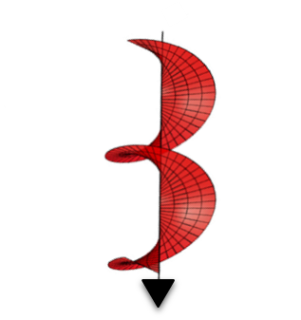





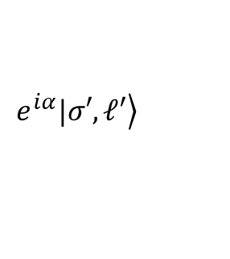




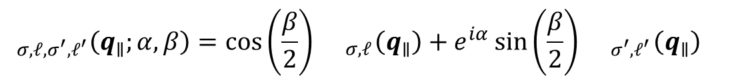
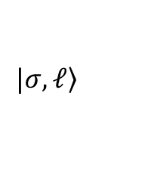


2. Vector vortex beams (VVB)
Vector vortex beams :
$$_{σ,ℓ,σ^{′},ℓ^{′}}\left(q_{∥};α,β\right)=\cos\left(\frac{β}{2}\right){ }_{σ,ℓ}\left(q_{∥}\right)+e^{iα}\sin\left(\frac{β}{2}\right){ }_{σ^{′},ℓ^{′}}\left(q_{∥}\right)$$
$$\left.|σ,ℓ\right\rangle$$
$$\left.e^{iα}|σ′,ℓ′\right\rangle$$
+
Represent in Poincaré sphere
$${ }_{σ,ℓ}\left(q_{∥}\right)$$
$$\frac{1}{\sqrt{2}}{ }_{σ,ℓ}\left(q_{∥}\right)−\frac{i}{\sqrt{2}}{ }_{σ^{′},ℓ^{′}}\left(q_{∥}\right)$$
$$z$$
$$\frac{1}{\sqrt{2}}{ }_{σ,ℓ}\left(q_{∥}\right)+\frac{1}{\sqrt{2}}{ }_{σ^{′},ℓ^{′}}\left(q_{∥}\right)$$
$$β$$
$$\frac{1}{\sqrt{2}}{ }_{σ,ℓ}\left(q_{∥}\right)−\frac{1}{\sqrt{2}}{ }_{σ^{′},ℓ^{′}}\left(q_{∥}\right)$$
$$x$$
$$α$$
$$y$$
$$\frac{1}{\sqrt{2}}{ }_{σ,ℓ}\left(q_{∥}\right)+\frac{i}{\sqrt{2}}{ }_{σ^{′},ℓ^{′}}\left(q_{∥}\right)$$
$${ }_{σ^{′},ℓ^{′}}\left(q_{∥}\right)$$

Slide 8
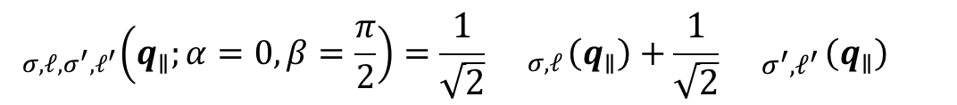
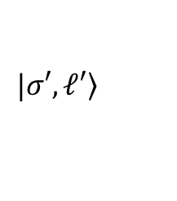

2. VVB : focus on $β=π/2$ and $α=0$
Vector vortex beams :
$$_{σ,ℓ,σ^{′},ℓ^{′}}\left(q_{∥};α=0,β=\frac{π}{2}\right)=\frac{1}{\sqrt{2}}{ }_{σ,ℓ}\left(q_{∥}\right)+\frac{1}{\sqrt{2}}{ }_{σ^{′},ℓ^{′}}\left(q_{∥}\right)$$
$$={ }_{σ,ℓ,σ^{′},ℓ^{′}}^{∥}\left(q_{∥}\right)+{ }_{σ,ℓ,σ^{′},ℓ^{′}}^{z}\left(q_{∥}\right)$$
$$\left.|σ,ℓ\right\rangle$$
$$\left.|σ′,ℓ′\right\rangle$$
+
Represent in Poincaré sphere
$${ }_{σ,ℓ}\left(q_{∥}\right)$$
$$z$$
$$\frac{1}{\sqrt{2}}{ }_{σ,ℓ}\left(q_{∥}\right)+\frac{1}{\sqrt{2}}{ }_{σ^{′},ℓ^{′}}\left(q_{∥}\right)$$
$$β$$
$$x$$
$$α$$
$$y$$
$${ }_{σ^{′},ℓ^{′}}\left(q_{∥}\right)$$

Slide 9
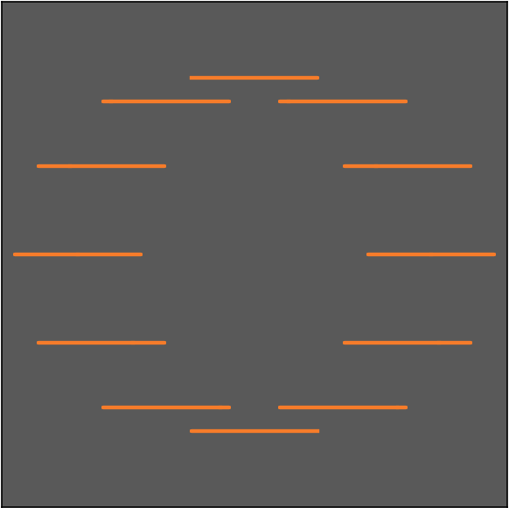

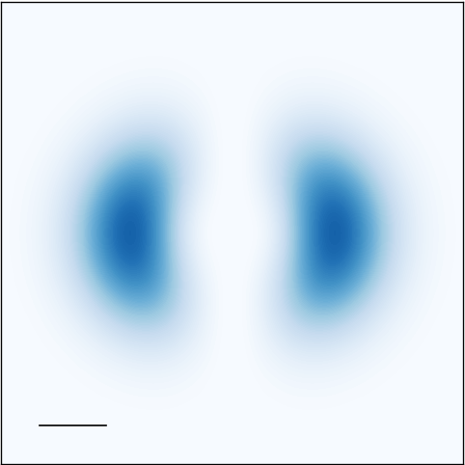
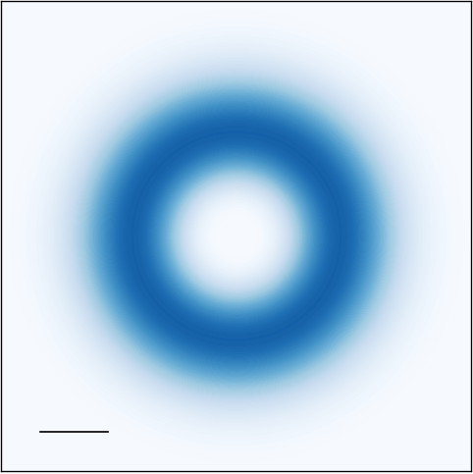
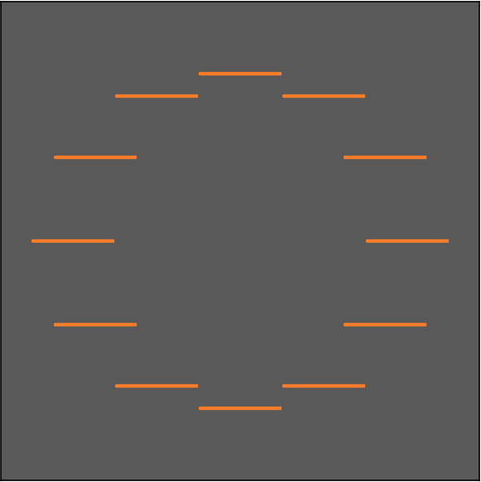
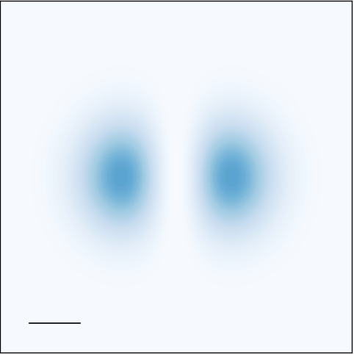
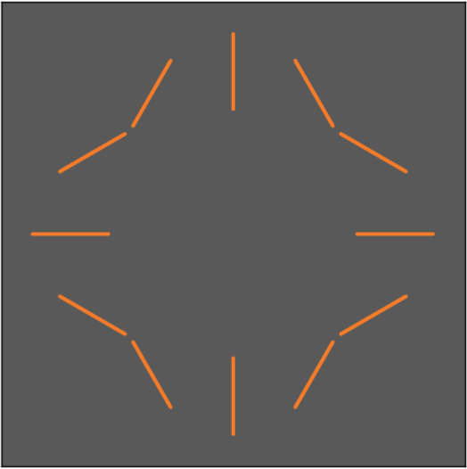
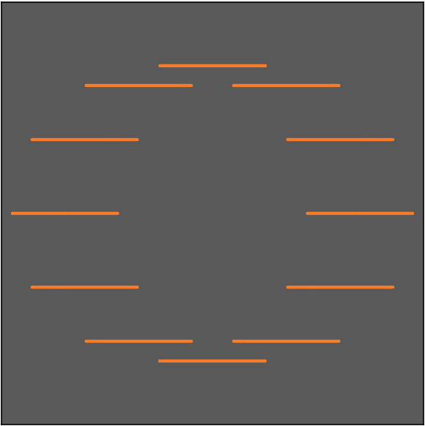





























2. VVB : even number of AM difference - symmetry
$${ }_{1,ℓ,−1,ℓ^{′}}^{∥}\left(q_{∥}\right)$$
$$∝F_{\left|ℓ\right|}\left(q_{∥}\right)\left\{cos\left(\frac{Δℓ}{2}φ_{q_{∥}}\right)\hat{x}+sin\left(\frac{Δℓ}{2}φ_{q_{∥}}\right)\hat{y}\right\}$$
$$Δℓ≡ℓ^{′}−ℓ$$
$${ }_{1,ℓ,−1,ℓ^{′}}^{z}\left(q_{∥}\right)$$
$$∝F_{\left|ℓ\right|}\left(q_{∥}\right)cos\left(\frac{ΔJ}{2}φ_{q_{∥}}\right)\hat{z}$$
$$ΔJ≡J^{′}−J$$
Polarization trajectory
Longitudinal intensity
$$ℓ^{′}=−1$$
$$ℓ^{′}=0$$
$$ℓ^{′}=1$$
$$1$$
$$J^{′}=−2$$
$$J^{′}=−1$$
$$J^{′}=0$$
$$q_{y}$$
$$q_{y}$$
$$ℓ=−1$$
$$q_{x}$$
$$J=0$$
$$q_{x}$$
$$a.u.$$
$${0.1Q}_{c}$$
$$0$$
$$ℓ=0$$
$$J=1$$
$$ℓ=1$$
$$J=2$$
symmetry since $Δℓ$ is an even number
symmetry since $ΔJ$ is an even number
O. J. G. Sanchez, G.-H. Peng et al., ACS Nano 18, 11425 (2024)

Slide 10



























2. VVB : even number of AM difference - symmetry ($\left|ℓ\right|≠\left|ℓ^{′}\right|$)
$${ }_{1,ℓ,−1,ℓ^{′}}^{∥}\left(q_{∥}\right)$$
$$∝\frac{1}{2}\left\{G_{\left|ℓ\right|,\left|ℓ^{′}\right|}^{+}\left(q_{∥}\right)\left[cos\left(\frac{Δℓ}{2}φ_{q_{∥}}+const.\right)\hat{x}+sin\left(\frac{Δℓ}{2}φ_{q_{∥}}+const.\right)\hat{y}\right]+G_{\left|ℓ\right|,\left|ℓ^{′}\right|}^{−}\left(q_{∥}\right)i\left[sin\left(\frac{Δℓ}{2}φ_{q_{∥}}+const.\right)\hat{x}+cos\left(\frac{Δℓ}{2}φ_{q_{∥}}+const.\right)\hat{y}\right]\right\}$$
$${ }_{1,ℓ,−1,ℓ^{′}}^{z}\left(q_{∥}\right)$$
$$∝\frac{1}{2}\left\{G_{\left|ℓ\right|,\left|ℓ^{′}\right|}^{+}\left(q_{∥}\right)cos\left(\frac{ΔJ}{2}φ_{q_{∥}}+const.\right)+G_{\left|ℓ\right|,\left|ℓ^{′}\right|}^{−}\left(q_{∥}\right)isin\left(\frac{ΔJ}{2}φ_{q_{∥}}+const.\right)\right\}\hat{z}$$
$$G_{\left|ℓ\right|,\left|ℓ^{′}\right|}^{±}\left(q_{∥}\right)≡F_{\left|ℓ\right|}\left(q_{∥}\right)±F_{\left|ℓ^{′}\right|}\left(q_{∥}\right)$$
Polarization trajectory
Longitudinal intensity
$$ℓ^{′}=−1$$
$$ℓ^{′}=0$$
$$ℓ^{′}=1$$
$$J^{′}=−2$$
$$J^{′}=−1$$
$$J^{′}=0$$
$$ℓ=−1$$
$$ℓ′=2$$
$$J=0$$
$$J^{′}=1$$
$$1$$
$$q_{y}$$
$$q_{y}$$
$$ℓ=0$$
$$q_{x}$$
$$J=1$$
$$q_{x}$$
$$a.u.$$
$${0.1Q}_{c}$$
$$0$$
$$ℓ=1$$
Symmetry since $Δℓ=2$ is an even number
Elliptical since since $G_{\left|ℓ\right|,\left|ℓ^{′}\right|}^{+}\left(q_{∥}\right)≫ G_{\left|ℓ\right|,\left|ℓ^{′}\right|}^{−}≠0$
Symmetry since $ΔJ=0$ is an even number
Additional pattern since $G_{\left|ℓ\right|,\left|ℓ^{′}\right|}^{+}\left(q_{∥}\right)≫ G_{\left|ℓ\right|,\left|ℓ^{′}\right|}^{−}≠0$
$$J=2$$

Slide 11




















2. VVB : odd number of AM difference - asymmetry
$${ }_{1,ℓ,−1,ℓ^{′}}^{∥}\left(q_{∥}\right)$$
$$∝\frac{1}{2}\left\{G_{\left|ℓ\right|,\left|ℓ^{′}\right|}^{+}\left(q_{∥}\right)\left[cos\left(\frac{Δℓ}{2}φ_{q_{∥}}+const.\right)\hat{x}+sin\left(\frac{Δℓ}{2}φ_{q_{∥}}+const.\right)\hat{y}\right]+G_{\left|ℓ\right|,\left|ℓ^{′}\right|}^{−}\left(q_{∥}\right)i\left[sin\left(\frac{Δℓ}{2}φ_{q_{∥}}+const.\right)\hat{x}+cos\left(\frac{Δℓ}{2}φ_{q_{∥}}+const.\right)\hat{y}\right]\right\}$$
$${ }_{1,ℓ,−1,ℓ^{′}}^{z}\left(q_{∥}\right)$$
$$∝\frac{1}{2}\left\{G_{\left|ℓ\right|,\left|ℓ^{′}\right|}^{+}\left(q_{∥}\right)cos\left(\frac{ΔJ}{2}φ_{q_{∥}}+const.\right)+G_{\left|ℓ\right|,\left|ℓ^{′}\right|}^{−}\left(q_{∥}\right)isin\left(\frac{ΔJ}{2}φ_{q_{∥}}+const.\right)\right\}\hat{z}$$
Polarization trajectory
Longitudinal intensity
$$ℓ^{′}=−1$$
$$ℓ^{′}=0$$
$$ℓ^{′}=1$$
$$ℓ′=2$$
$$1$$
$$J^{′}=−2$$
$$J^{′}=−1$$
$$J^{′}=0$$
$$J^{′}=1$$
$$q_{y}$$
$$q_{y}$$
$$ℓ=−1$$
$$q_{x}$$
$$J=0$$
$$q_{x}$$
$$a.u.$$
$$0$$
$${0.1Q}_{c}$$
$$ℓ=0$$
$$J=1$$
$$ℓ=1$$
$$J=2$$
Asymmetry since $Δℓ=$ odd number
Asymmetry since $ΔJ=$ odd number
$$q_{y}$$
$$q_{y}$$
$$q_{x}$$
$${0.1Q}_{c}$$
$$q_{x}$$

Slide 12
Outline
1. Introduction
2. Angular momentums (AM) induced asymmetry in vector vortex beam (VVB)
3. Matching with transition dipole moments
Directional momentum-selective excitation
4. Excitation manipulation
Summary and outlook

Slide 13






3. Directional momentum-selective excitation
Schematic
The transition rate is obtained as
$$Γ_{σ,ℓ,σ^{′},ℓ^{′}}^{S, Q}\left(Q\right)=\frac{2π}{ℏ}{\left|{\tilde{M}}_{σ,ℓ,σ^{′},ℓ^{′}}^{S, Q}\left(Q\right)\right|}^{2}ρ\left(ℏω=E_{S, Q}^{X}\right),$$
Where the optical matrix element is
$$\left.|σ,ℓ\right\rangle$$
$$\left.|σ′,ℓ′\right\rangle$$
+
$${\tilde{M}}_{σ,ℓ,σ^{′},ℓ^{′}}^{S, Q}\left(Q\right)∝{ }_{σ,ℓ,σ^{′},ℓ^{′}}\left(Q\right)⋅D_{ }^{S, Q}$$
Polarization
&
Intensity
Alinement of with Transition dipole moments
O. J. G. Sanchez, G.-H. Peng et al., ACS Nano 18, 11425 (2024)

Slide 14









































3. Directional momentum-selective excitation (BXs)
Polarization
of ${ }_{1, −1, −1, 2}\left(Q\right)$
$$\left.|B+\right\rangle$$
$$D_{ }^{S, Q}$$
$$Γ_{σ,ℓ,σ^{′},ℓ^{′}}^{S, Q}\left(Q\right)$$
w/ e-h exchange
$$1$$
$$Q_{y}$$
$$a.u.$$
$$\left.|B−\right\rangle$$
At $Q_{y}>0$ nearly $\hat{y}$ polarized
$$Q_{x}$$
$${0.1Q}_{c}$$
$$0$$
$$D^{B+, Q}$$
$${0.1Q}_{c}$$
$$Γ_{1, −1, −1, 2}^{B+, Q}\left(Q\right)$$
$$Q_{y}$$
$$\left.|G\right\rangle$$
$$Q_{x}$$
$$\left.|D\right\rangle$$
$$Q_{y}$$
$$1$$
At $Q_{y}<0$ nearly $\hat{x}$ polarized
$$a.u.$$
$${\left|{ }_{1,−1,−1,2 }^{∥}\left(q_{∥}\right) \right|}^{2}$$
$$Q$$
$$Q_{x}$$
$$Q=0$$
$$0$$
$$D^{B−, Q}$$
$$Γ_{1, −1, −1, 2}^{B−, Q}\left(Q\right)$$
$≈\hat{x}$ polarized
$≈\hat{y}$ polarized
$${0.1Q}_{c}$$
$$Q_{y}/Q_{c}$$
$$−0.5$$
$$−0.1$$
$$0.1$$
$$0.5$$

Slide 15

















3. Directional momentum-selective excitation (GXs)
$$\left.|B+\right\rangle$$
$${\left|{ }_{1,−1,−1,2}^{z}\left(Q_{∥}\right) \right|}^{2}$$
$$D_{ }^{S, Q}$$
$$Γ_{σ,ℓ,σ^{′},ℓ^{′}}^{S, Q}\left(Q\right)$$
w/ e-h exchange
$$\left.|B−\right\rangle$$
$$1$$
$$1$$
$$Q_{y}$$
$$Q_{y}$$
$$a.u.$$
$$\left.|G\right\rangle$$
$$D^{G, Q}=D^{0}\hat{z}$$
$$Q_{x}$$
$$a.u.$$
$$Q_{y}$$
$$Q_{x}$$
$$\left.|D\right\rangle$$
$$0$$
$$Q_{x}$$
$${0.1Q}_{c}$$
$$0$$
$${0.1Q}_{c}$$
$$Γ_{1, −1, −1, 2}^{G, Q}\left(Q\right)$$
$$Q_{y}$$
$$Q_{x}$$
$$Q$$
$$Q=0$$
$${\left|{ }_{1,−1,−1,2}^{z}\left(Q_{∥}\right) \right|}^{2}$$
$$Q_{y}/Q_{c}$$
$$−0.5$$
$$−0.1$$
$$0.1$$
$$0.5$$

Slide 16
Outline
1. Introduction
2. Angular geometry in vector vortex beam
3. Angular momentum difference governed optical transition
4. Excitation manipulation
Relative phase
Summary and outlook

Slide 17





















4. Excitation manipulation with $α$
$${ }_{1,ℓ,−1,ℓ^{′}}^{∥}\left(q_{∥};α\right)$$
$$∝\frac{1}{2}\left\{G_{\left|ℓ\right|,\left|ℓ^{′}\right|}^{+}\left(q_{∥}\right)\left[cos\left(\frac{Δℓ}{2}φ_{q_{∥}}+\frac{α}{2}+const.\right)\hat{x}+sin\left(\frac{Δℓ}{2}φ_{q_{∥}}+\frac{α}{2}+const.\right)\hat{y}\right]+G_{\left|ℓ\right|,\left|ℓ^{′}\right|}^{−}\left(q_{∥}\right)i\left[sin\left(\frac{Δℓ}{2}φ_{q_{∥}}+\frac{α}{2}+const.\right)\hat{x}+cos\left(\frac{Δℓ}{2}φ_{q_{∥}}+\frac{α}{2}+const.\right)\hat{y}\right]\right\}$$
$${ }_{1,ℓ,−1,ℓ^{′}}^{z}\left(q_{∥};α\right)$$
$$∝\frac{1}{2}\left\{G_{\left|ℓ\right|,\left|ℓ^{′}\right|}^{+}\left(q_{∥}\right)cos\left(\frac{ΔJ}{2}φ_{q_{∥}}+\frac{α}{2}+const.\right)+G_{\left|ℓ\right|,\left|ℓ^{′}\right|}^{−}\left(q_{∥}\right)isin\left(\frac{ΔJ}{2}φ_{q_{∥}}+\frac{α}{2}+const.\right)\right\}\hat{z}$$
Polarization trajectory
Longitudinal intensity
$$α=0$$
$$α=π$$
$$α=0$$
$$α=π$$
$$1$$
$$q_{y}$$
$$q_{y}$$
$$Δℓ=2$$
$$q_{x}$$
$$ΔJ=0$$
$$q_{x}$$
$$a.u.$$
$${0.1Q}_{c}$$
$$0$$
$$Δℓ=−2$$
$$ΔJ=−4$$
$ΔJ=0$ : $α$ change the intensity
$ΔJ≠0$ : $α$ rotate the pattern
$α$ change the orientation

Slide 18


























4. Excitation manipulation with $α$
Polarization trajectory
$$D_{ }^{S, Q}$$
Transition rate
$$D_{ }^{S, Q}$$
Transition rate
$$Γ_{1, −1, −1, 1}^{B+, Q}\left(Q;α\right)$$
$$Γ_{1, −1, −1, 1}^{B−, Q}\left(Q;α\right)$$
$$α=0$$
$$α=π$$
$$α=0$$
$$α=π$$
$$α=0$$
$$α=π$$
$$1$$
$$q_{y}$$
$$1$$
$$q_{y}$$
$$Q_{y}$$
$$a.u.$$
$$q_{x}$$
$$a.u.$$
$$Δℓ=2$$
$$q_{x}$$
$$Q_{x}$$
$${0.1Q}_{c}$$
$$0$$
$$0$$
$$D^{B+, Q}$$
$$D^{B−, Q}$$
$$Δℓ=−2$$
$$Γ_{1, 1, −1, −1}^{B+, Q}\left(Q;α\right)$$
$$Γ_{1, 1, −1, −1}^{B−, Q}\left(Q;α\right)$$
$Δℓ=2$ : $α$ change the excitation
$Δℓ≠2$ : $α$ rotate the pattern

Slide 19













4. Excitation manipulation with $α$
Longitudinal intensity
$$D_{ }^{S, Q}$$
Transition rate
Total transition rate
$$Γ_{1, −1, −1, 1}^{G, Q}\left(Q;α\right)$$
$$α=0$$
$$α=π$$
$$α=0$$
$$α=π$$
$$1$$
$$1$$
$$q_{y}$$
$$Q_{y}$$
$$a.u.$$
$$ΔJ=0$$
$$q_{x}$$
$$a.u.$$
$$Q_{x}$$
Excitation can be evaluate through
$${0.1Q}_{c}$$
$${0.1Q}_{c}$$
$${0.1Q}_{c}$$
$$0$$
$$0$$
$$D^{G, Q}=D^{0}\hat{z}$$
$$Γ_{σ,ℓ,σ^{′},ℓ^{′}}^{S}\left(α\right)=\sum_{Q}{Γ_{σ,ℓ,σ^{′},ℓ^{′}}^{S, Q}\left(Q;α\right)}$$
$$ΔJ=−4$$
$$Γ_{1, 1, −1, −1}^{G, Q}\left(Q;α\right)$$
$ΔJ=0$ : $α$ change the excitation
$ΔJ≠0$ : $α$ rotate the pattern

Slide 20















4. Excitation manipulation with $α$
Total transition rate : $Γ_{σ,ℓ,σ^{′},ℓ^{′}}^{S}\left(α,\right)=\sum_{Q}{Γ_{σ,ℓ,σ^{′},ℓ^{′}}^{S, Q}\left(Q;α\right)}$
$$Γ_{1,ℓ,−1,−ℓ}^{B+}$$
$$Γ_{1,ℓ,−1,−ℓ}^{B−}$$
$$Γ_{1,ℓ,−1,−ℓ}^{B}$$
$$Γ_{1,ℓ,−1,−ℓ}^{G}$$
$α=0$
$α=π/2$
$α=π$
$$a.u.$$
$$ℓ$$
$$ℓ$$
$$ℓ$$
$$ℓ$$
For a VVB with $σ,ℓ,σ^{′},ℓ^{′}=1, ℓ,−1,−ℓ$
Only $ℓ=−1$ can have $Δℓ=2$ and $ΔJ=0$ and enable excitation manipulation with $α$
$$q_{y}$$
$${0.1Q}_{c}$$
$$q_{x}$$

Slide 21

Summary and outlook
Summary :
The TAM difference and OAM difference independently determine the angular geometry of the longitudinal and transverse components, manifested as intensity and polarization distributions, respectively. This governing rule remains valid beyond the equal-OAM condition ($\left|ℓ\right|=\left|ℓ′\right|$) provided that the constituent beams maintain sufficient spatial overlap.
Matching between the optical angular geometry and the orientation of exciton transition dipole moments enables directional momentum-selective excitation of excitons in center-of-mass momentum space.
The relative phase $α$ generally rotates the optical angular geometry and the corresponding transition-rate distribution. Under the special condition $Δℓ=2$ and $ΔJ=0$, however, it acts as an on/off switch for exciton excitation.
Outlook
Selective excitation of excitons : Observe the evolution of exciton populations generated by tailored vector vortex beams through time-resolved photoluminescence imaging.
Exciton wave packets : Vector vortex beams actually carry average angular momentum in their phase, which can be further utilized to engineer exciton wave packets.

