Slide 1


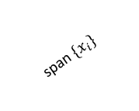
$$β^{⋆}$$
span ${\{x}_{i}\}$
subspace of global minima

Slide 2

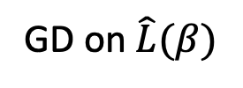
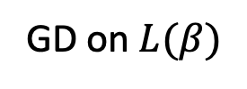
Family of global minima of training loss
GD on$\hat{L}(β)$
generalizable global minima of training loss
$$S_{r}$$
0
GD on$L(β)$
Notes:
\mathbb{E} f(U) \approx f(U), \forall U \in S_r

