Slide 1
VALSE2019 GAN与迁移网络进展
Hongzhi Liu
April 21st, 2019

Slide 2
CONTENT
1. Review of Previous Work
2. Additional Experiments
3. Research about Text-to-image
4. Further Research

Slide 3
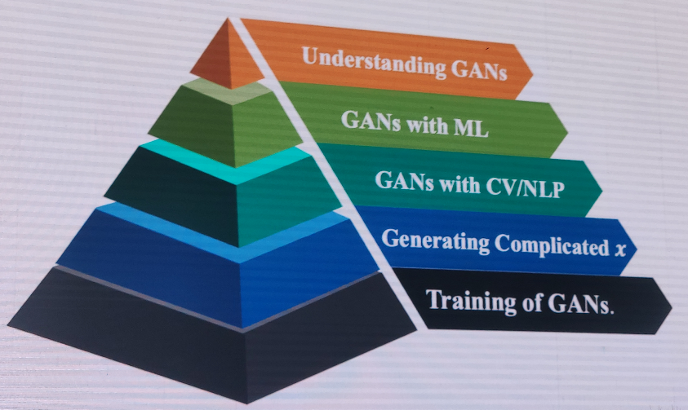
Generative Adversarial Networks
1. The overall framework
报告人：徐畅（悉尼大学）
主要关注机器学习算法及其在计算机视觉中的应用，如多视角学习、对抗学习、人体行为分析及图像生成等。在人工智能领域重要国际会议和期刊发表论文50余篇，包括ICML、NIPS、IJCAI、AAAI、IEEE T-PAMI和IEEE T-IP等。
Dr Chang Xu joined as Lecturer in Machine Learning and Computer Vision at the School of Computer Science, University of Sydney in 2017. He obtained a Bachelor of Engineering from Tianjin University, China, and a Ph.D. degree from Peking University, China.
Figure 1. The overall structure of the report which includes five important parts.
1/11

Slide 4
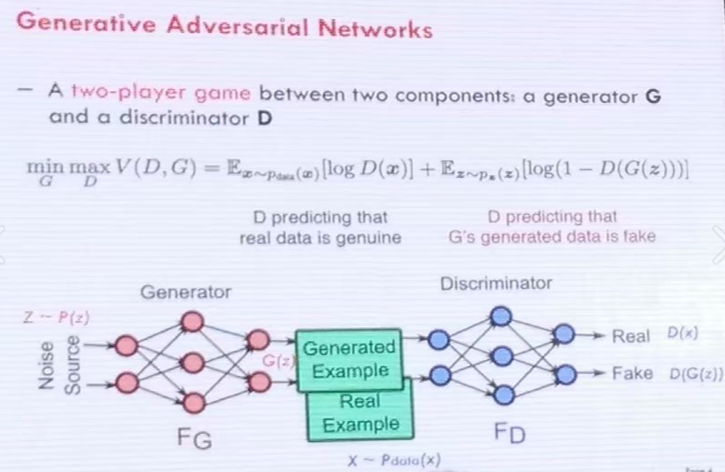

Generative Adversarial Networks
1. Understanding GANs
GAN同时训练一个生成网络(Generator)和一个判别网络(Discriminator)
前者输入一个noise变量 z ，输出一个假图 G(z;θg)，后者输入一个图片(real image)以及假图(fake image)数据 x
输出一个表示该输入是真实图片或者假图的二分类置信度 D(x;θd)，理想情况下，判别器D 需要尽可能准确的判断输入数据到底是一个真图还是假图，而生成器G又需要让D把自己产生的假图判断成真图。
论文中所给优化目标(价值函数)如下：
Figure 2. The key diagram and value function.
Goodfellow I J, Pouget-Abadie J, Mirza M, et al. Generative adversarial nets. In NIPS, 2014.
1/11

Slide 5
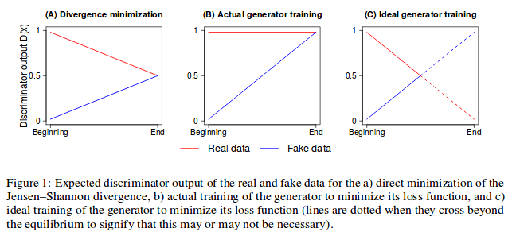
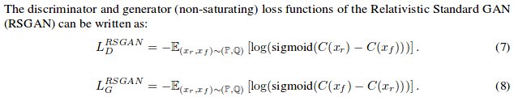
Generative Adversarial Networks
1. Relativistic GAN
GAN训练的时候一味地希望生成的图片足够逼真，即一直在让 D(fake_data) 向1趋近，而不管 D(real_data)，这样做是达不到最小值的，优化 optimization 过程是存在问题的，WGAN 论文中似乎也有提到这一点。
如果 G 生成的样本能够影响 D(xr)，让它变得不那么真实，也即相对的真假。这个时候，D(xr) 才可能变成 0。总结起来一句话就是，在 D(xf) 提升的时候 D(xr) 相应地减少（这是一种相对的变化），这样 GAN 的训练才能更加稳定。
如何把这种相对为真和为假的概率考虑进去？很简单，只要把 logits 做一个简单相减，即左图Loss函数所示。这里用 sigmoid 函数将 logits 转化成概率，然后再取对数；我们可以很容易地把这个式子进行泛化，即用更一般的函数（不一定是似然函数）来替换它。
Jolicoeur-Martineau A. The relativistic discriminator: A key element missing from standard GAN. In ICLR, 2019. https://github.com/AlexiaJM/RelativisticGAN
1/11

Slide 6
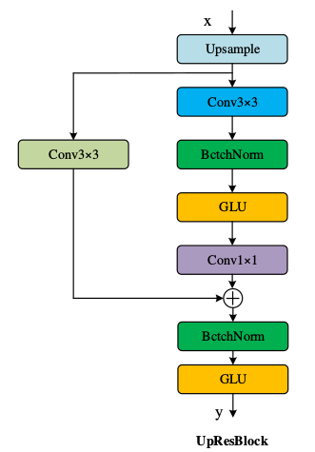
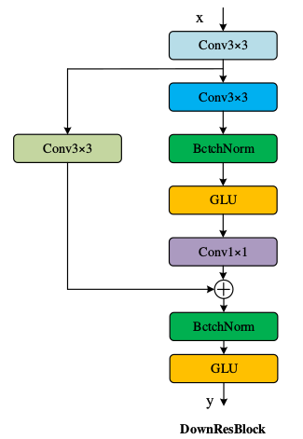
Review of Previous Work
2. The architecture of method
(a)
(b)
Figure 1. The architecture of upResBlock and downResBlock. (a) our upResBlock could make all information pass through and also make backward propagation of gradients more efficiently with the help of shortcut. (b) The downResblock could preserve the full features especially the usefull ones.
2/11

Slide 7
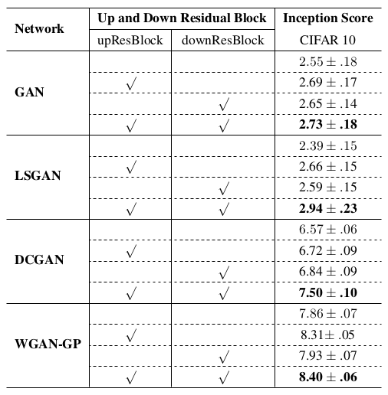
Review of Previous Work
3. Experimental results
Table 1. Inception score results of the GAN models without (blank) or with (√) upResBlock/downResBlock for image generation on CIFAR10 dataset. The values in bold font indicate the best results.
I. Goodfellow, et al. Generative Adversarial Nets. In NIPS, 2014.
A. Radford,et al. Unsupervised Representation Learning with Deep Convolutional Generative Adversarial Networks. In ICLR, 2016.
3/11
X. Mao, et al. Least Squares Generative Adversarial Networks. In ICCV, 2017.
I. Gulrajani, et al. Improved training of wasserstein GANs. In NIPS. 2017.

Slide 8
Additional Experiments
1. Image translation —— Pix2Pix
Network | Up and Down Residual Blocks |  | FCN scores (Mean pixel accuracy)
 | upResBlocks | downResBlocks
pix2pix |  |  | 0.71
 | √ |  | 0.74
 |  | √ | 0.63
 | √ | √ | 0.65
Table 2. Inception score results of the GAN models without (blank) or with (√) upResBlock/downResBlock for image generation on CIFAR10 dataset. The values in bold font indicate the best results.
P Isola, et al. Image-to-Image Translation with Conditional Adversarial Networks. In CVPR, 2017.
4/11

Slide 9
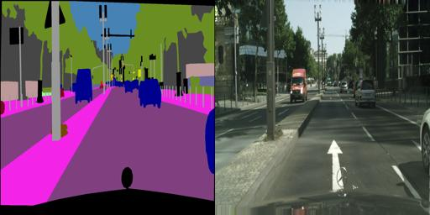
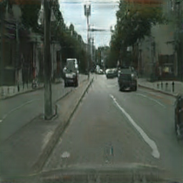
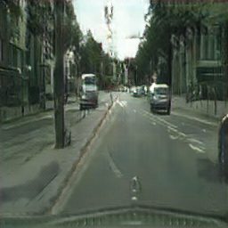
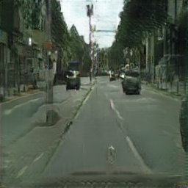
Additional Experiments
1. Image translation —— Pix2Pix
(a)
(b)
(c)
Figure 2. Example results of pix2pix on Cityscapse datasets at 256x256 resolution. (a) images generated by pix2pix with upResBlocks. (b) images generated by pix2pix with downResBlocks. (c) images generated by pix2pix with up and down ResBlocks.
5/11

Slide 10
Additional Experiments
2. Image translation —— CycleGAN
Network | Up and Down Residual Blocks |  | FCN scores (Mean pixel accuracy)
 | upResBlocks | downResBlocks
CycleGAN |  |  | 0.52
 | √ |  | 0.54
 |  | √ | 0.60
 | √ | √ | 0.65
Table 3. Inception score results of the GAN models without (blank) or with (√) upResBlock/downResBlock for image generation on CIFAR10 dataset. The values in bold font indicate the best results.
J Zhu, et al. Unpaired Image-to-Image Translation Using Cycle-Consistent Adversarial Networks. In ICCV, 2017.
6/11

Slide 11
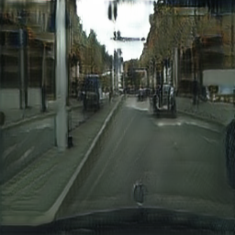
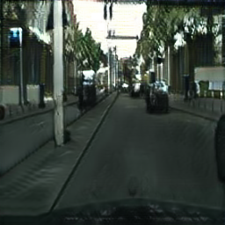
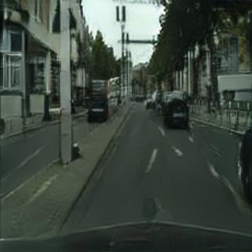
Additional Experiments
2. Image translation —— CycleGAN
(a)
(b)
(c)
Figure 3. Example results of CycleGAN on Cityscapse datasets at 256x256 resolution. (a) images generated by CycleGAN with upResBlocks. (b) images generated by CycleGAN with downResBlocks. (c) images generated by CycleGAN with up and down ResBlocks.
7/11

Slide 12
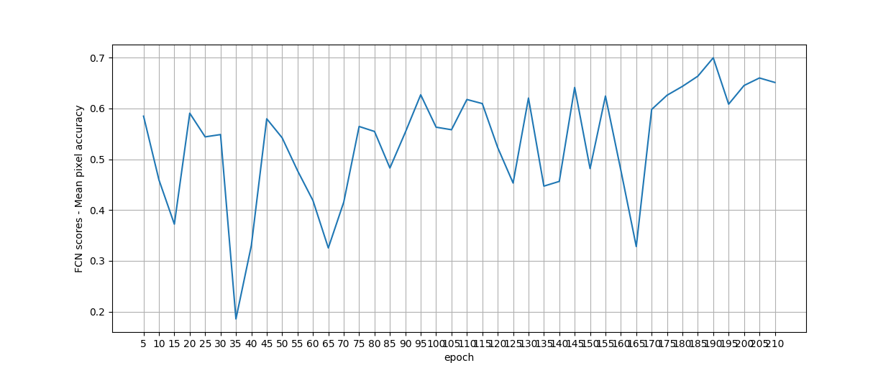
Additional Experiments
2. Image translation —— CycleGAN
Figure 4. Example results of CycleGAN on Cityscapse datasets at 512x512 resolution.
8/11

Slide 13
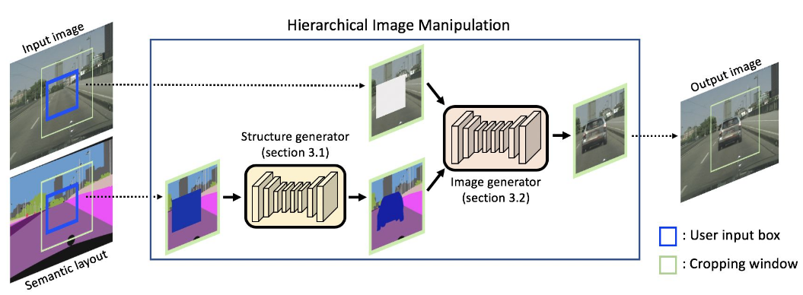
Research about Text-to-image
1. Semantic Image Manipulation
Figure 5. Overall pipeline of the proposed semantic manipulation framework.
S. Hong, et al. Learning Hierarchical Semantic Image Manipulation through Structured Representations. In NIPS, 2018.
9/11

Slide 14
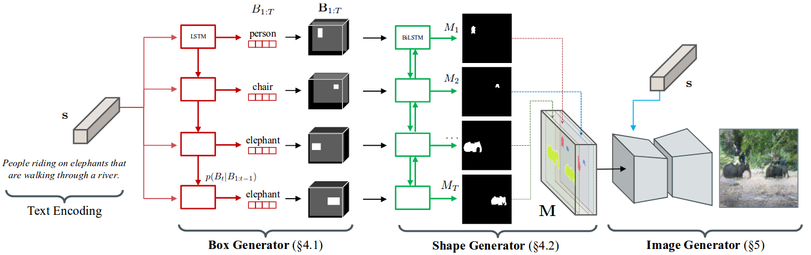
Research about Text-to-image
2. Hierarchical Text-to-Image Synthesis
Figure 6. Given a text embedding, our algorithm first generates a coarse layout of the image by placing a set of object bounding boxes using the box generator, and further refines the object shape inside each box using the shape generator. Combining outputs from the box and the shape generator leads to a semantic label map defining semantic structure of the scene. Conditioned on the inferred semantic layout and the text, a pixel-wise image is finally generated by the image generator.
S. Hong, et al. Inferring Semantic Layout for Hierarchical Text-to-Image Synthesis. In CVPR, 2018.
10/11

Slide 15
Further Research
1. Additional Experiments for up and down ResBlocks
2. AttnGAN with semantic segmentation image datasets
3. Looking for better advice and methods
11/11

Slide 16


