Slide 1
Text to Image Algorithm Understanding
and Results Recurrence
Hongzhi Liu
September 28, 2018

Slide 2
CONTENTS
1. Research Purposes
2. Code Implementation
3. Experimental Results
4. Further Research

Slide 3
Research Purposes
1. Text-to-Image Problem
Generating images according to natural language descriptions with text format is a fundamental problem in many applications, such as art generation, computer-aided design and data sets expansion.
Most recently proposed text-to-image synthesis methods are based on Generative Adversarial Networks (GANs). AttnGAN, as the state-of-the-art algorithm, shows the best inception score on CUB and COCO test sets which are 4.36 and 25.89 respectively.
Tao Xu, et al. AttnGAN: Fine-grained text to image generation with attentional generative adversarial networks. In CVPR, 2018.
1/8

Slide 4
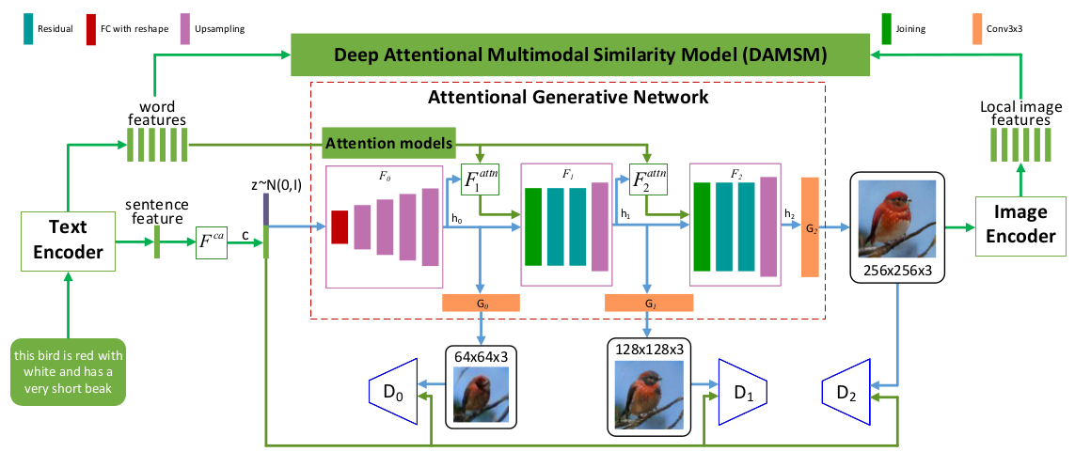
Research Purposes
2. My Research Goal
I should learn about AttnGAN algorithm and its architecture as shown in Fig. 1.
Figure1: The architecture of the proposed AttnGAN. Each attention model automatically retrieves the conditions (i.e., the most relevant word vectors) for generating different sub-regions of the image; the DAMSM provides the fine-grained image-text matching loss for the generative network.
2/8

Slide 5
Research Purposes
3. Results Recurrence
I should make inception scores by GAN models reappear as shown in the table below in two weeks.
Dataset | GAWWN | StackGAN | StackGAN-v2 | AttnGAN
CUB | 3.62 ± .07 | 3.70 ± .04 | 3.84 ± .06 | 4.36 ± .03
COCO | / | 8.45 ± .03 | / | 25.89 ± .47
S. Reed, et al. Generative adversarial text-to-image synthesis. In ICML, 2016.
Han Zhang, et al. StackGAN: Text to photo-realistic image synthesis with stacked generative adversarial networks. In ICCV, 2017.
3/8
Han Zhang, et al. StackGAN++: Realistic image synthesis with stacked generative adversarial networks. IEEE TPAMI, 2018

Slide 6
Code Implementation
1. Methods
Firstly, I build runtime environment of algorithms in the server.
Next, after solving the problem of operation, I need to run the python or lua codes in order to make the algorithm generate the pictures we need including CUB and COCO pictures.
At last, I should modify the codes of computing inception score which auther provides, because the program can not directly calculate the value of scores.
4/8

Slide 7

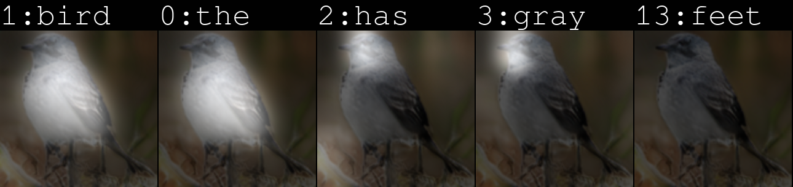
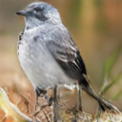
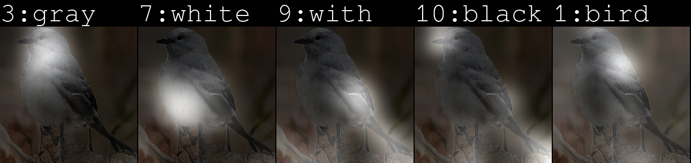
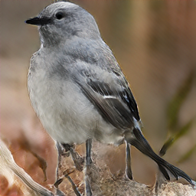
Code Implementation
2. Generate CUB Pictures
The bird has gray crown, belly and white abdomen, with black tarsus and feet.
Figure2: Example CUB pictures with one sentence of the proposed AttnGAN.
5/8

Slide 8

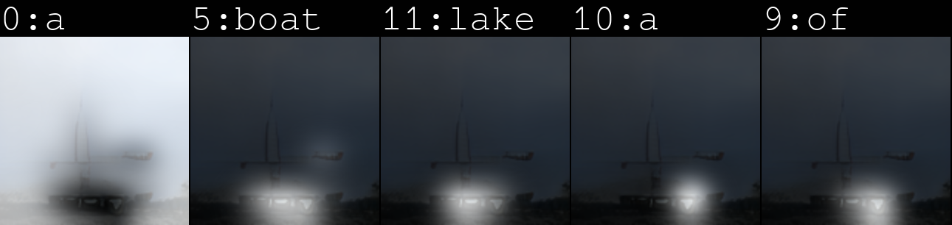
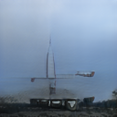
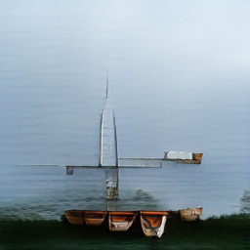
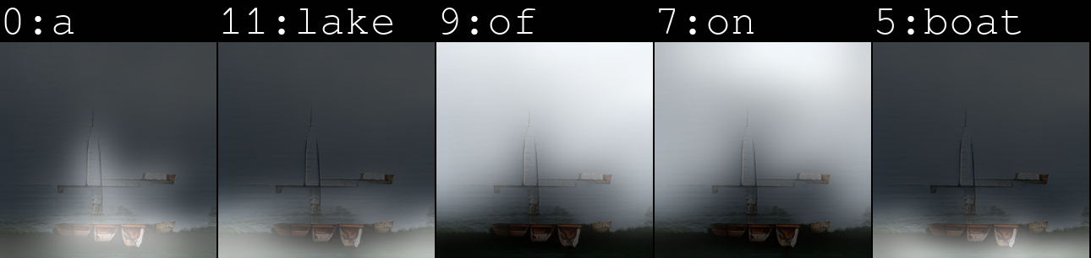
Code Implementation
3. Generate COCO Pictures
A large red and white boat floating on top of a lake.
Figure3: Example COCO pictures with one sentence of the proposed AttnGAN.
6/8

Slide 9
Experimental Results
1. Inception Scores
Dataset | GAWWN | StackGAN | StackGAN-v2 | AttnGAN
CUB | 3.62 ± .07 | 3.70 ± .04 | 3.84 ± .06 | 4.36 ± .03
Ours | 2.05 ± .23 | 3.91± .03 | 4.10± .04 | 4.24 ± .18
COCO | / | 8.45 ± .03 | / | 25.89 ± .47
Ours | / | 9.74±.50 | / | 23.96± .35
Table1: Inception scores by state-of-the art GAN models and my results recurrence.
7/8

Slide 10
Further Research
1. SSD evaluation
2. ResNeXt algorithm and OpenGL GLU
3. Multiple target generation
8/8

Slide 11


