Slide 1
Up and Down Residual Blocks and Text to Image Algorithm
Hongzhi Liu
December 23rd, 2018

Slide 2
CONTENT
1. Review of Previous Work
2. Additional Experiments
3. Research about Text-to-image
4. Further Research

Slide 3
Review of Previous Work
1. Up and Down Residual Blocks
For the last 3 months, our team proposed up and down residual blocks in the paper submitted, dubbed upResBlock and downResBlock respectively.
In summary, the contribution of our method is three-fold as follows:
1) The upResBlocks and downResBlocks for convolutional GANs;
2) Comprehensive experiments were carried out to evaluate its universality;
3) Extensive experiments about text-to-image synthesis.
1/11

Slide 4
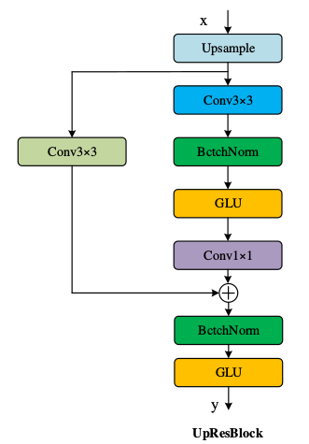
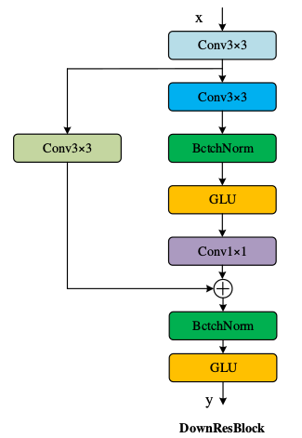
Review of Previous Work
2. The architecture of method
(a)
(b)
Figure 1. The architecture of upResBlock and downResBlock. (a) our upResBlock could make all information pass through and also make backward propagation of gradients more efficiently with the help of shortcut. (b) The downResblock could preserve the full features especially the usefull ones.
2/11

Slide 5
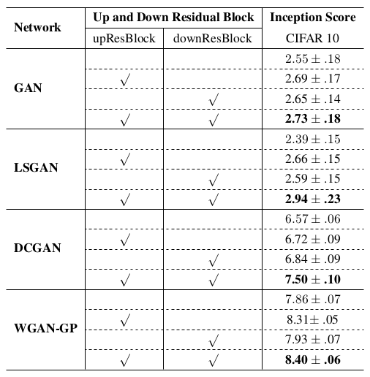
Review of Previous Work
3. Experimental results
Table 1. Inception score results of the GAN models without (blank) or with (√) upResBlock/downResBlock for image generation on CIFAR10 dataset. The values in bold font indicate the best results.
I. Goodfellow, et al. Generative Adversarial Nets. In NIPS, 2014.
A. Radford,et al. Unsupervised Representation Learning with Deep Convolutional Generative Adversarial Networks. In ICLR, 2016.
3/11
X. Mao, et al. Least Squares Generative Adversarial Networks. In ICCV, 2017.
I. Gulrajani, et al. Improved training of wasserstein GANs. In NIPS. 2017.

Slide 6
Additional Experiments
1. Image-to-image translation—Pix2Pix
Network | Up and Down Residual Blocks |  | FCN scores (Mean pixel accuracy)
 | upResBlocks | downResBlocks
pix2pix |  |  | 0.71
 | √ |  | 0.74
 |  | √ | 0.63
 | √ | √ | 0.65
Table 2. FCN score results of pix2pix model without (blank) or with (√) upResBlock/downResBlock for image generation on cityscapes datasets. The values in bold font indicate the best results.
P Isola, et al. Image-to-Image Translation with Conditional Adversarial Networks. In CVPR, 2017.
4/11

Slide 7
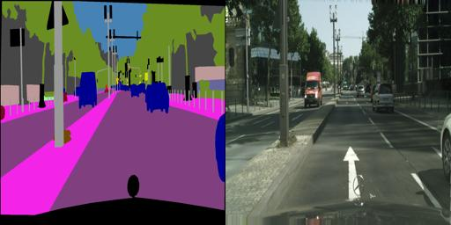
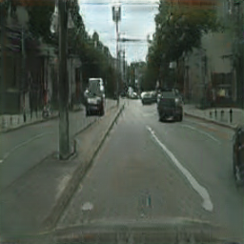
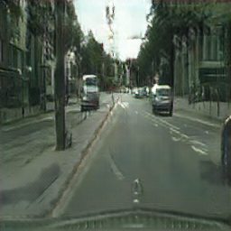
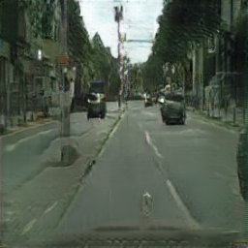
Additional Experiments
1. Image-to-image translation—Pix2Pix
(a)
(b)
(c)
Figure 2. Example results of pix2pix on cityscapses datasets at 256x256 resolution. (a) the image generated by pix2pix with upResBlocks. (b) the image generated by pix2pix with downResBlocks. (c) the image generated by pix2pix with up and down ResBlocks.
5/11

Slide 8
Additional Experiments
2. Image-to-image translation—CycleGAN
Network | Up and Down Residual Blocks |  | FCN scores (Mean pixel accuracy)
 | upResBlocks | downResBlocks
CycleGAN |  |  | 0.52
 | √ |  | 0.54
 |  | √ | 0.60
 | √ | √ | 0.65
Table 3. FCN score results of the CycleGAN model without (blank) or with (√) upResBlock/downResBlock for image generation on cityscapes datasets. The values in bold font indicate the best results.
J Zhu, et al. Unpaired Image-to-Image Translation Using Cycle-Consistent Adversarial Networks. In ICCV, 2017.
6/11

Slide 9
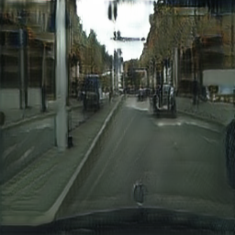
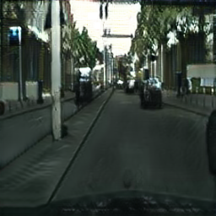
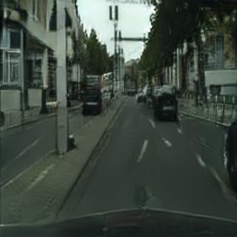
Additional Experiments
2. Image-to-image translation—CycleGAN
(a)
(b)
(c)
Figure 3. Example results of CycleGAN on Cityscapse datasets at 256x256 resolution. (a) the image generated by CycleGAN with upResBlocks. (b) the image generated by CycleGAN with downResBlocks. (c) the image generated by CycleGAN with up and down ResBlocks.
7/11

Slide 10
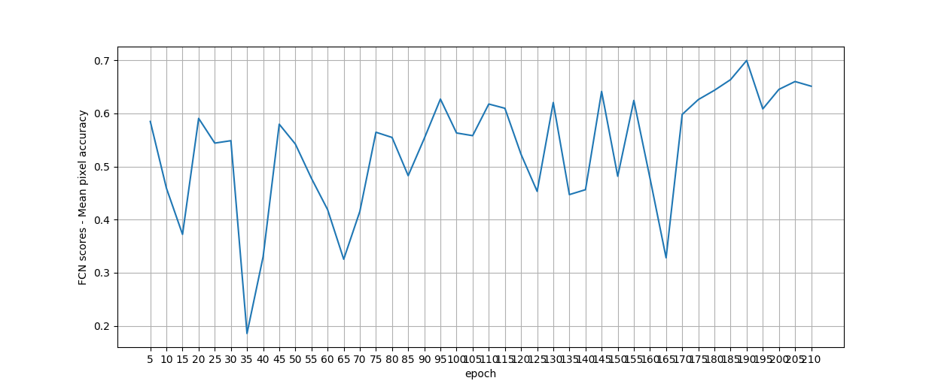
Additional Experiments
2. Image-to-image translation—CycleGAN
Figure 4. The curve shows mean pixel accuracy changes from 5 epoch to 210 epoch in CycleGAN experiment with up and down Resblocks. There is one peak at 190 epoch and the lowest value appears at 35 epoch.
8/11

Slide 11
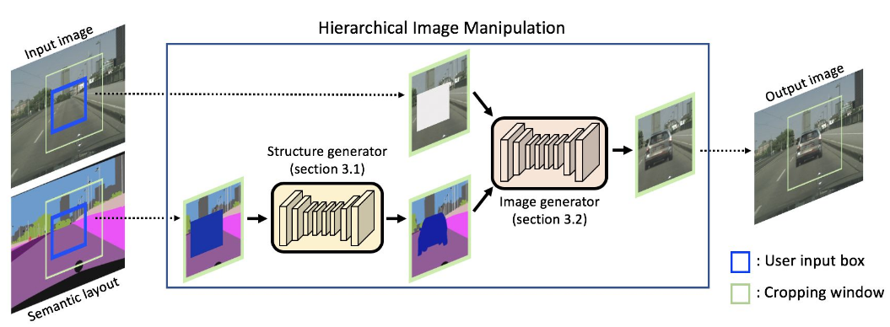
Research about Text-to-image
1. Semantic Image Manipulation
Figure 5. Overall pipeline of the proposed semantic manipulation framework.
S. Hong, et al. Learning Hierarchical Semantic Image Manipulation through Structured Representations. In NIPS, 2018.
9/11

Slide 12
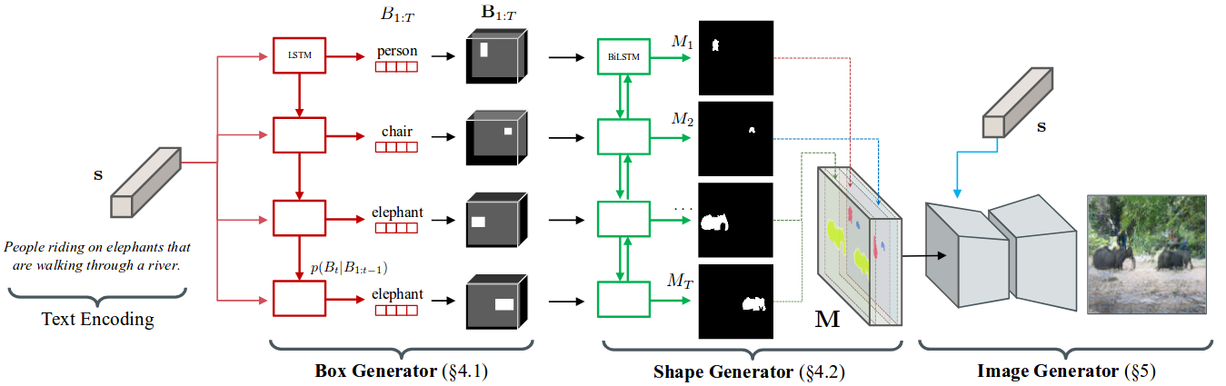
Research about Text-to-image
2. Hierarchical Text-to-Image Synthesis
Figure 6. Given a text embedding, the algorithm first generates a coarse layout of the image by placing a set of object bounding boxes using the box generator, and further refines the object shape inside each box using the shape generator. Combining outputs from the box and the shape generator leads to a semantic label map defining semantic structure of the scene. Conditioned on the inferred semantic layout and the text, a pixel-wise image is finally generated by the image generator.
S. Hong, et al. Inferring Semantic Layout for Hierarchical Text-to-Image Synthesis. In CVPR, 2018.
10/11

Slide 13
Further Research
1. Additional Experiments for up and down ResBlocks
2. AttnGAN with semantic segmentation image datasets
3. Looking for better advice and methods
11/11

Slide 14


