Slide 1
Up and Down Residual Blocks and Text to Image Algorithm
Hongzhi Liu
December 23rd, 2018

Slide 2
CONTENTS
1. Review of Previous Work
2. Additional Experiments
3. Research about Text-to-image
4. Further Research

Slide 3
Review of Previous Work
1. Up and Down Residual Blocks
For the last 2 months, our team proposed up and down residual blocks, dubbed upResBlock and downResBlock respectively in the submission paper.
In summary, the contribution of our method is three-fold as follows:
1) The upResBlocks and downResBlocks for convolutional GANs;
2) Comprehensive experiments were carried out to evaluate its universality;
3) Extensive experiments about for text-to-image synthesis.
1/8

Slide 4
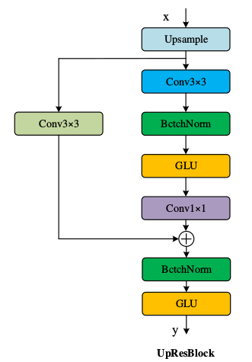
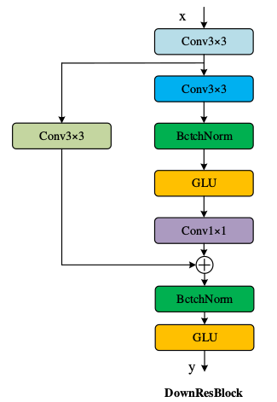
Review of Previous Work
2. The architecture of method
(a)
(b)
Figure 1: The architecture of upResBlock and downResBlock. (a) our upResBlock could make all information pass through and make backward propagation of gradients more efficiently with the help of shortcut. (b) The downResblock could preserve the full features especially the usefull ones.
2/8

Slide 5
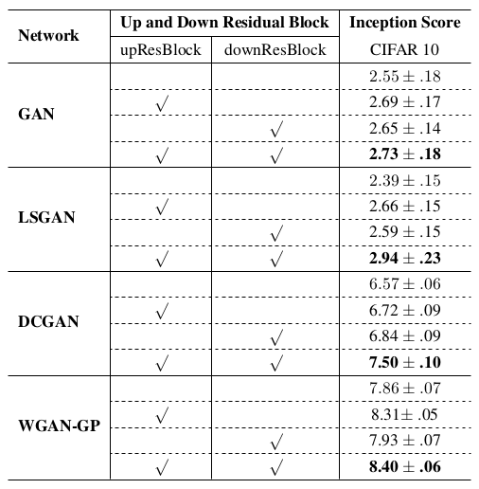
Review of Previous Work
3. Experimental results
Table 1. Inception score results of the GAN models without (blank) or with (√) upResBlock/downResBlock for image generation on CIFAR10 dataset. The values in bold font indicate the best results.
I. Goodfellow, et al. Generative Adversarial Networks. In NIPS, 2014.
X. Mao, et al. Least Squares Generative Adversarial Networks. In ICCV, 2017.
3/8
I. Gulrajani, et al. Improved training of wasserstein GANs. In NIPS. 2017.

Slide 6
Additional Experiments
1. Image translation —— Pix2Pix
Network | Up and Down Residual Blocks |  | FCN scores
 | upResBlocks | downResBlocks
 |  |  | Mean pixel accuracy 0.71
pix2pix
 | √ |  | Mean pixel accuracy 0.74
 |  | √ | Mean pixel accuracy 0.63
 | √ | √ | Mean pixel accuracy 0.65
Table 2. Inception score results of the GAN models without (blank) or with (√) upResBlock/downResBlock for image generation on CIFAR10 dataset. The values in bold font indicate the best results.
P Isola, et al. Image-to-Image Translation with Conditional Adversarial Networks. In CVPR, 2017.
4/8

Slide 7
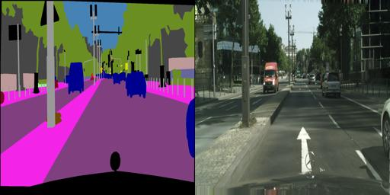
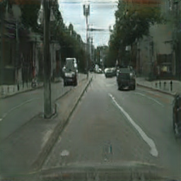
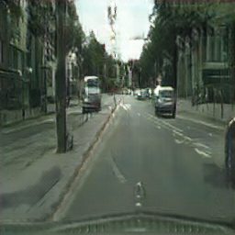
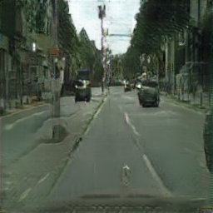
Additional Experiments
1. Image translation —— Pix2Pix
Figure 2: The architecture of upResBlock and downResBlock. (a) our upResBlock could make all information pass through and make backward propagation of gradients more efficiently with the help of shortcut. (b) The downResblock could preserve the full features especially the usefull ones.
4/8

Slide 8
Additional Experiments
2. Image translation —— CycleGAN
Network | Up and Down Residual Blocks |  | FCN scores
 | upResBlocks | downResBlocks
 |  |  | Mean pixel accuracy 0.52
CycleGAN
 | √ |  | Mean pixel accuracy 0.54
 |  | √ | Mean pixel accuracy 0.60
 | √ | √ | Mean pixel accuracy 0.65
Table 3. Inception score results of the GAN models without (blank) or with (√) upResBlock/downResBlock for image generation on CIFAR10 dataset. The values in bold font indicate the best results.
J Zhu, et al. Unpaired Image-to-Image Translation Using Cycle-Consistent Adversarial Networks. In ICCV, 2017.
4/8

Slide 9
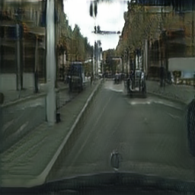
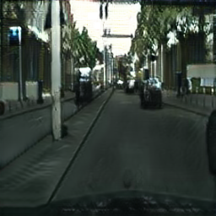
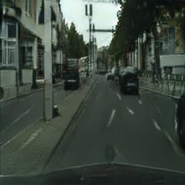
Additional Experiments
2. Image translation —— CycleGAN
Figure3: The architecture of upResBlock and downResBlock. (a) our upResBlock could make all information pass through and make backward propagation of gradients more efficiently with the help of shortcut. (b) The downResblock could preserve the full features especially the usefull ones.
4/8

Slide 10
Additional Experiments
2. Image translation —— CycleGAN
4/8

Slide 11
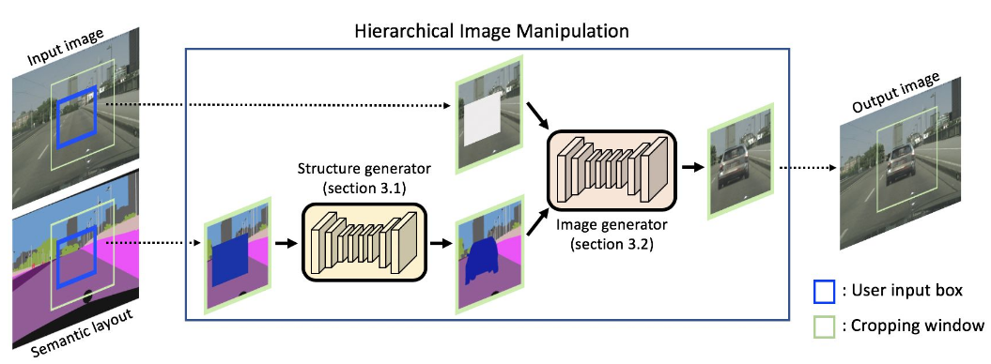
Research about Text-to-image
1. Semantic Image Manipulation
Figure 4: Overall pipeline of the proposed semantic manipulation framework.
S. Hong, et al. Learning Hierarchical Semantic Image Manipulation through Structured Representations. In NIPS, 2018.
4/8

Slide 12
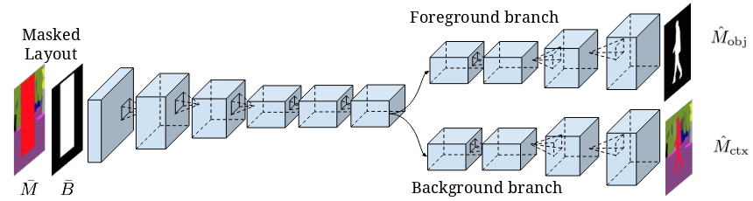
Research about Text-to-image
1. Semantic Image Manipulation
Figure 5: Architecture of the structure generator. Given a masked layout and a binary mask encoding the class and location of the object, respectively, the model produces the manipulated layout by the outputs from the two-stream decoder corresponding to the binary mask of object and semantic label map of entire region inside the box.
S. Hong, et al. Learning Hierarchical Semantic Image Manipulation through Structured Representations. In NIPS, 2018.
4/8

Slide 13
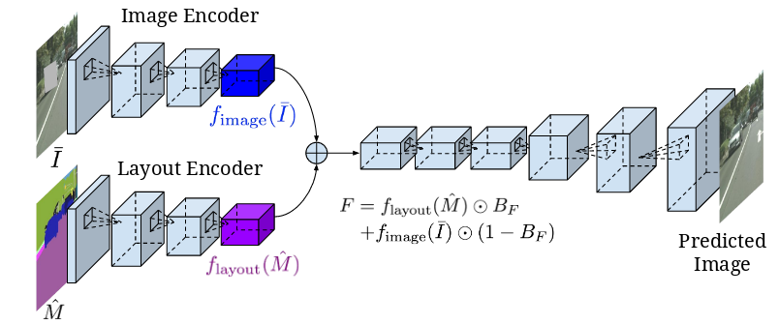
Research about Text-to-image
1. Semantic Image Manipulation
Figure 6: Overall pipeline of the proposed semantic manipulation framework. Given a masked image and the semantic layout, the model encodes visual style and semantic structure of the object using separate encoding pathways and produces the manipulated image.
S. Hong, et al. Learning Hierarchical Semantic Image Manipulation through Structured Representations. In NIPS, 2018.
4/8

Slide 14
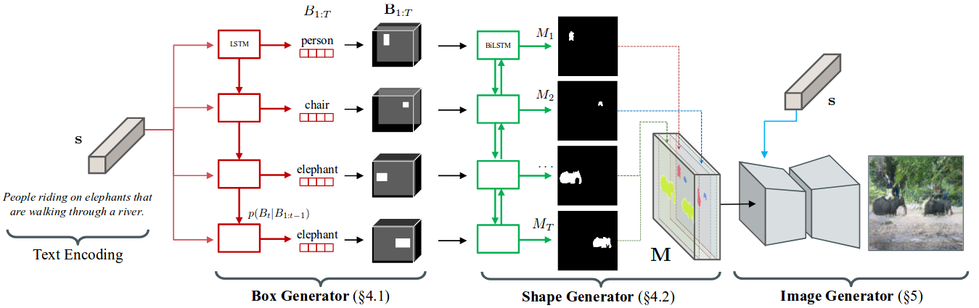
Research about Text-to-image
2. Hierarchical Text-to-Image Synthesis
Figure 7. Given a text embedding, our algorithm first generates a coarse layout of the image by placing a set of object bounding boxes using the box generator, and further refines the object shape inside each box using the shape generator. Combining outputs from the box and the shape generator leads to a semantic label map defining semantic structure of the scene. Conditioned on the inferred semantic layout and the text, a pixel-wise image is finally generated by the image generator.
S. Hong, et al. Inferring Semantic Layout for Hierarchical Text-to-Image Synthesis. In CVPR, 2018.
4/8

Slide 15
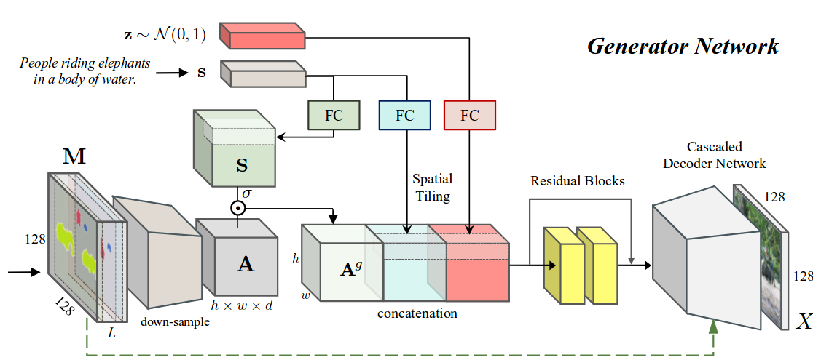
Research about Text-to-image
2. Hierarchical Text-to-Image Synthesis
Figure 8. Architecture of the image generator. Conditioned on the text description and the semantic layout generated by the layout generator, it generates an image that matches both inputs.
S. Hong, et al. Inferring Semantic Layout for Hierarchical Text-to-Image Synthesis. In CVPR, 2018.
4/8

Slide 16
Further Research
1. Additional Experiments for up and down ResBlocks
2. AttnGAN with semantic segmentation images
3. Looking for better advice and methods
8/8

Slide 17


