Slide 1
Mid Exam
考試日期 :
10/08(四)
考試方式 : 以個人為單位
考試時間 : 50 min
考試注意事項：可帶一張A4紙大小的參考資料(只限一張)，如晶片編號等有助於考試資訊皆可印在參考資料中，內容是手寫或影印都可以，正反面皆可有資料。

Slide 2
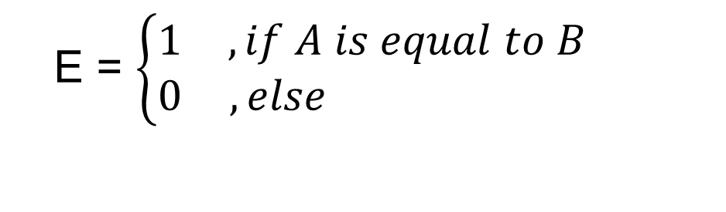
Comparator (1/2)
There are two inputs denoted as A and B. Both A and B are 1-bit value. A comparator is designed to determine whether A is equal to B or not. The output results are represented with E .
The function and truth table of the comparator is described as follows.
A | B | E
0 | 0 | 1
0 | 1 | 0
1 | 0 | 0
1 | 1 | 1
E = $\left\{\begin{matrix}1 & , if A is equal to B \\ 0 & ,else \end{matrix}\right.$

Slide 3
Comparator (2/2)
Please
(a) implement the circuit on the breadboard.
Suggested Boolean algebra of the comparator.
E = AB + A’B’

Slide 4

XOR (1/2)
1. Boolean Algebra
2. Truth Table
F = A + B
A | B | F
0 | 0 | 0
0 | 1 | 1
1 | 0 | 1
1 | 1 | 0
=> F = A’B + AB’
3. Circuit Diagram
A
F
B

Slide 5
XOR (2/2)
Please
(a) implement the circuit on the breadboard.

Slide 6
Constant Multiplier (1/2)
MSB
There is a 2-bit input X (represented as X1 and X0). A constant multiplier is designed to multiply the input by 3. Finally, show the result with decimal format (0, 1, 2, …..,9) on Digital Display in the breadboard.
Hint-1:
The output digital number is 0, 3, 6 or 9, respectively, for four different inputs (0, 1, 2, 3).

Slide 7
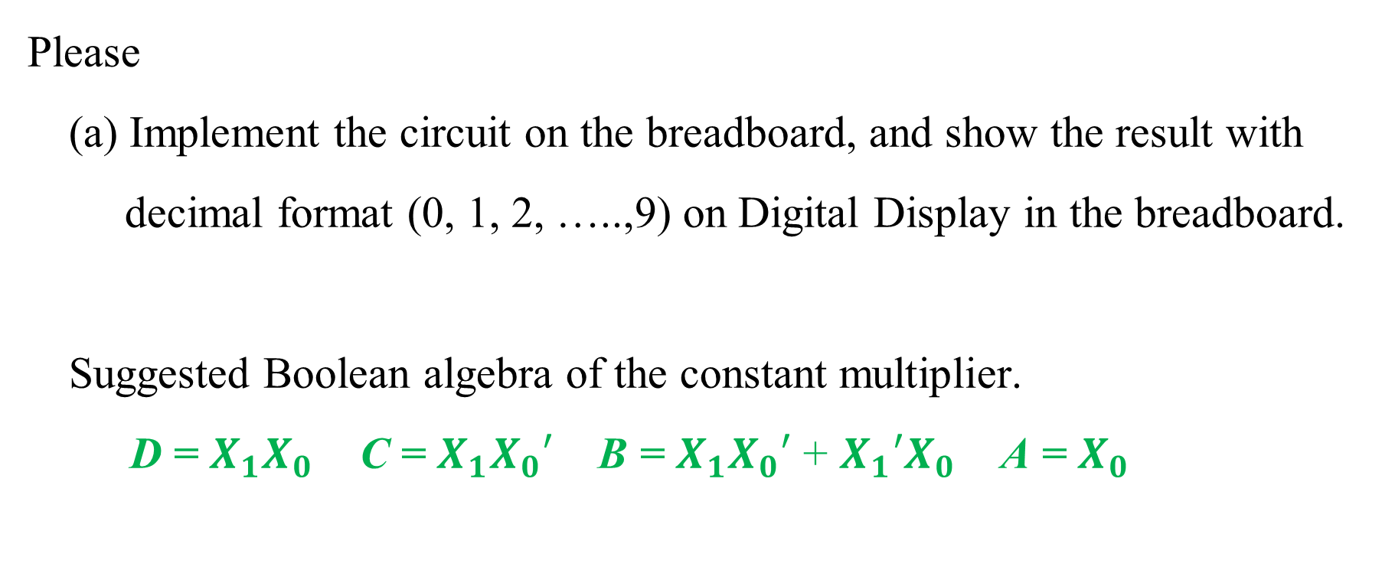
Constant Multiplier(1/2)
Please
(a) Implement the circuit on the breadboard, and show the result with
decimal format (0, 1, 2, …..,9) on Digital Display in the breadboard.
Suggested Boolean algebra of the constant multiplier.
D = $X_{1}X_{0}$ C = $X_{1}X_{0}′$ B = $X_{1}X_{0}′$ + $X_{1}′X_{0}$ A = $X_{0}$

