Slide 1
LAB - 03
陳培殷
國立成功大學 資訊工程系

Slide 2
Outline
Video preview for 布林代數+全及項
Mid Exam
Lab I -- Comparator
Lab II -- Constant Multiplier
Lab III(practice) -- Constant Comparator

Slide 3
Mid Exam
考試日期 :
10/08(四) 09:00-12:00
考試方式 : 以個人為單位
考試時間 : 50 min

Slide 4
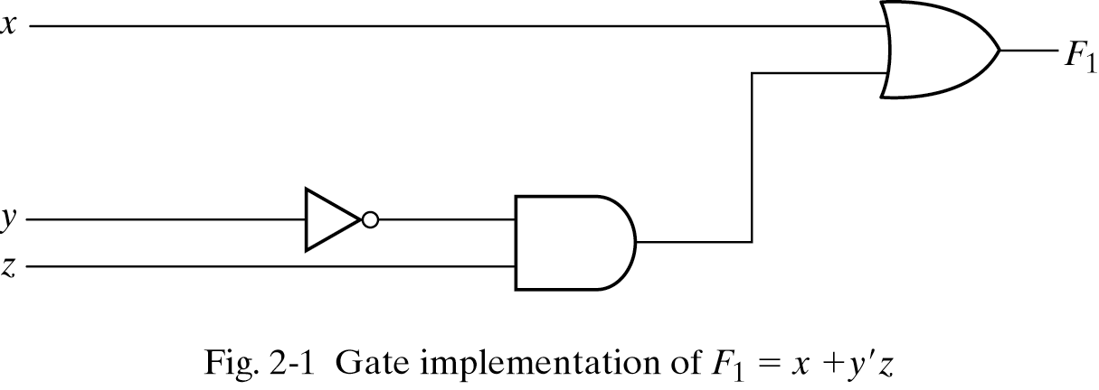
Three representations for a circuit
1. Boolean Algebra
2. Truth Table
真值表
n input variables ➔ 2^{n} combinations
F₁=x+y’z
Inputs
3. Circuit Diagram

Slide 5
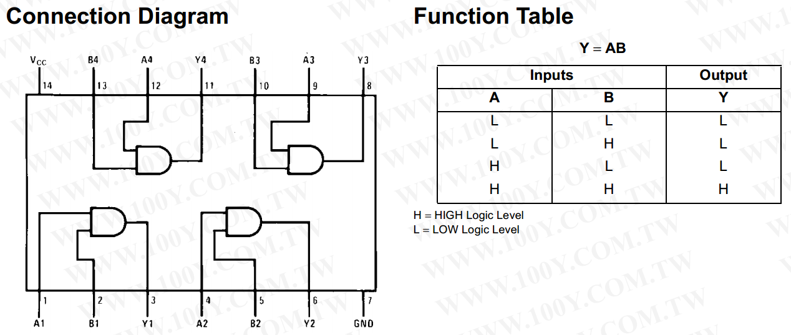
74LS08
AND gate
Boolean Algebra
F=xy

Slide 6
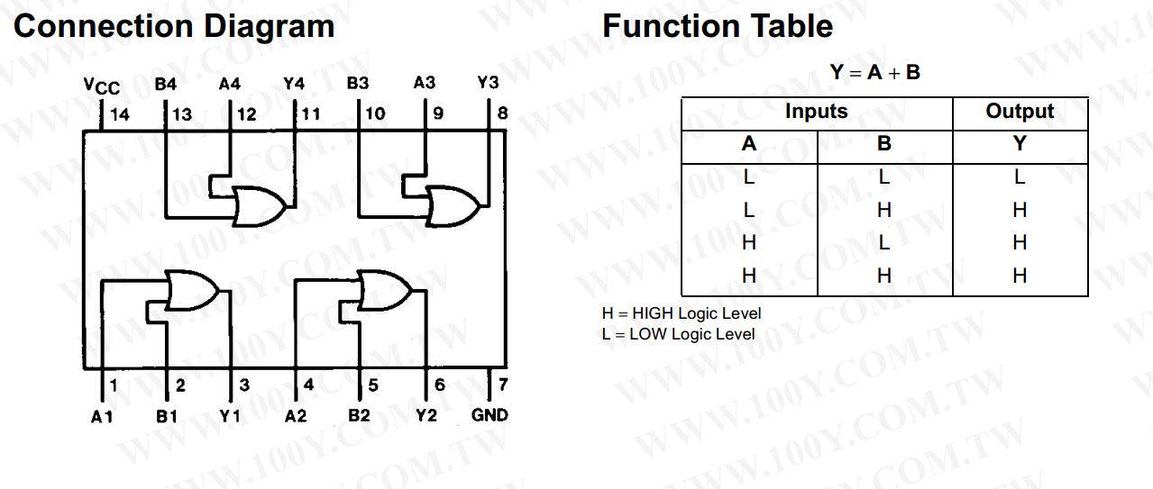
74LS32
OR gate
Boolean Algebra
F=x+y

Slide 7
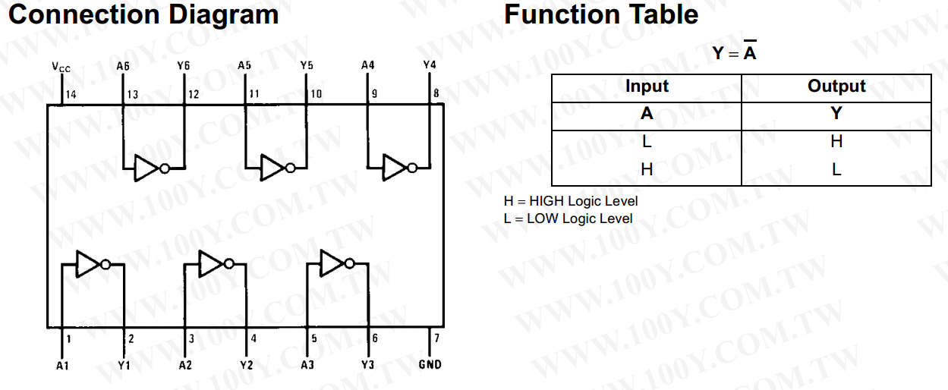
74LS04
NOT gate
Boolean Algebra
F=x’

Slide 8
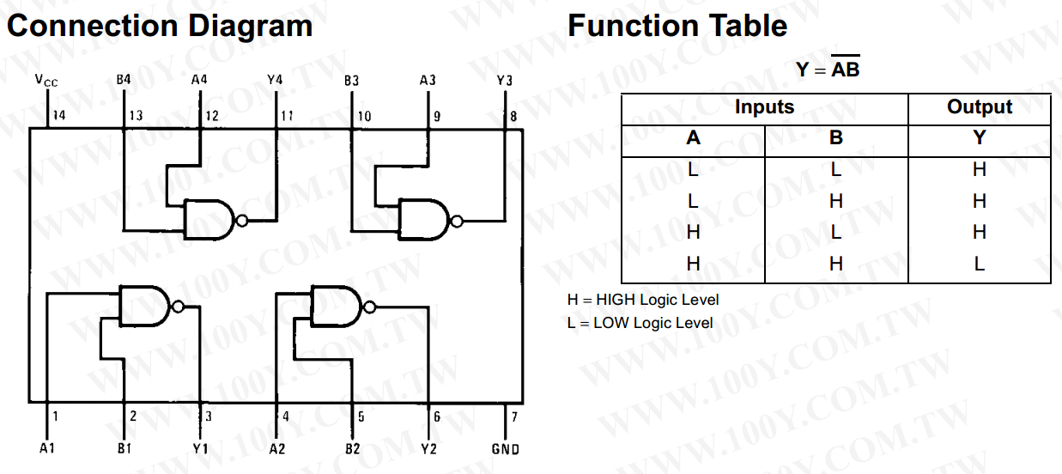
74LS00
NAND gate
Not - AND
Boolean Algebra
F=(xy)’

Slide 9
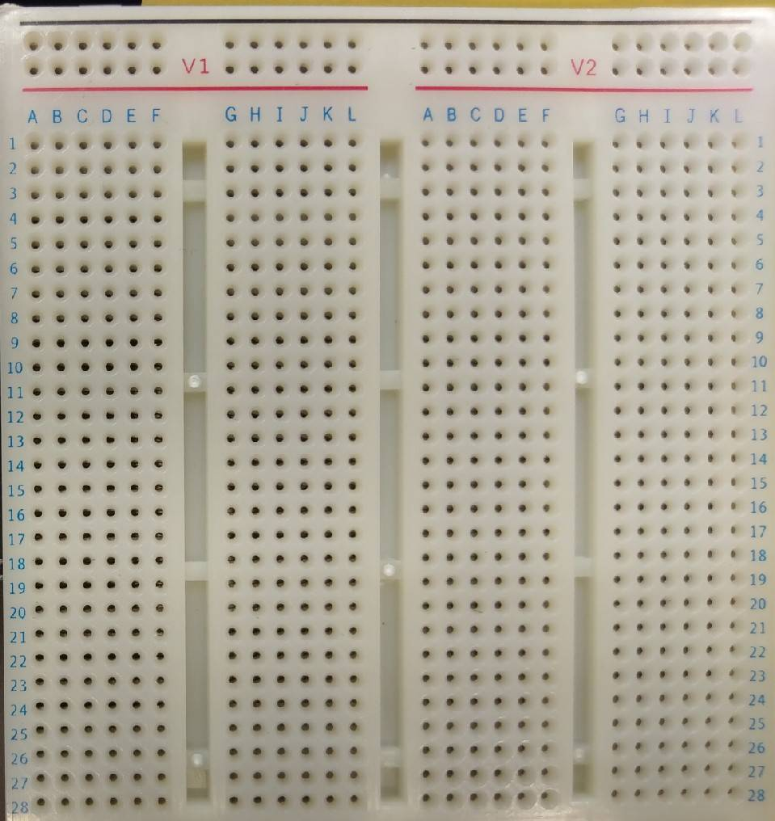
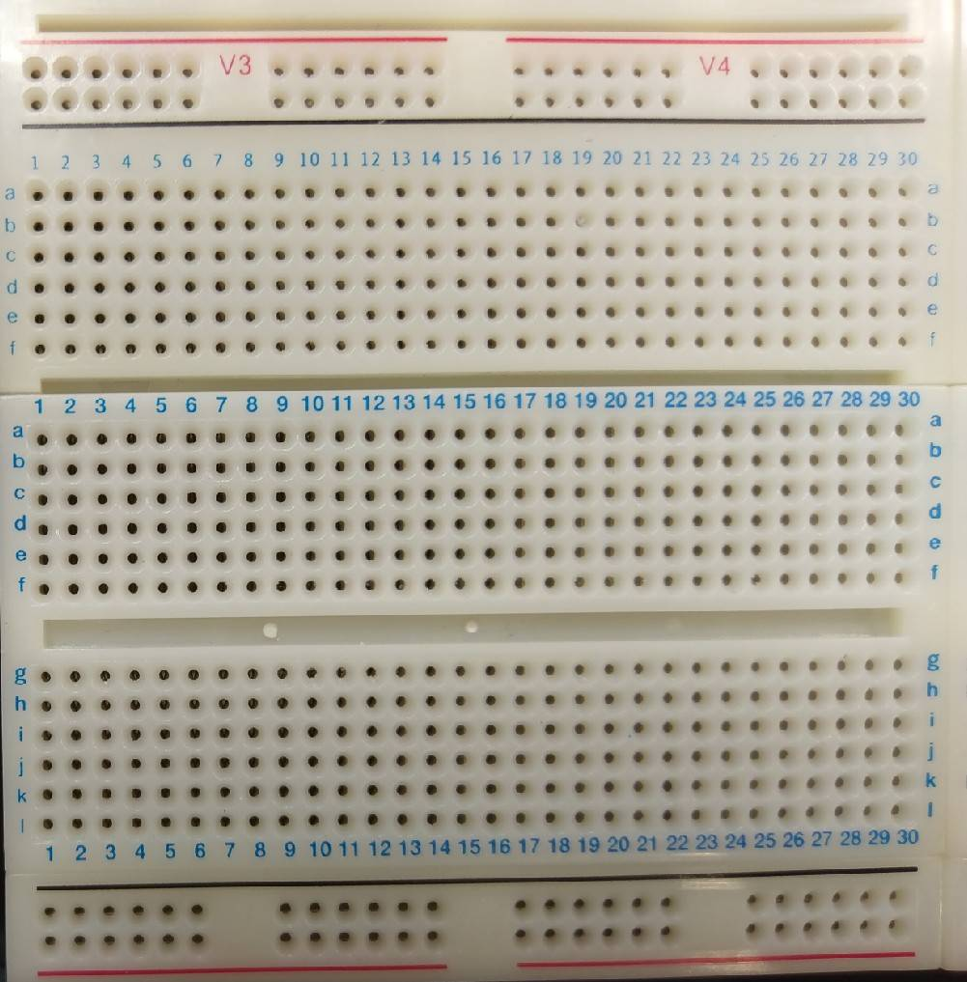
Top View of the Solderless Breadboard
: connected : disconected
Let a VCC be shared to multiple logic gate
Let a input be shared to multiple logic gate

Slide 10
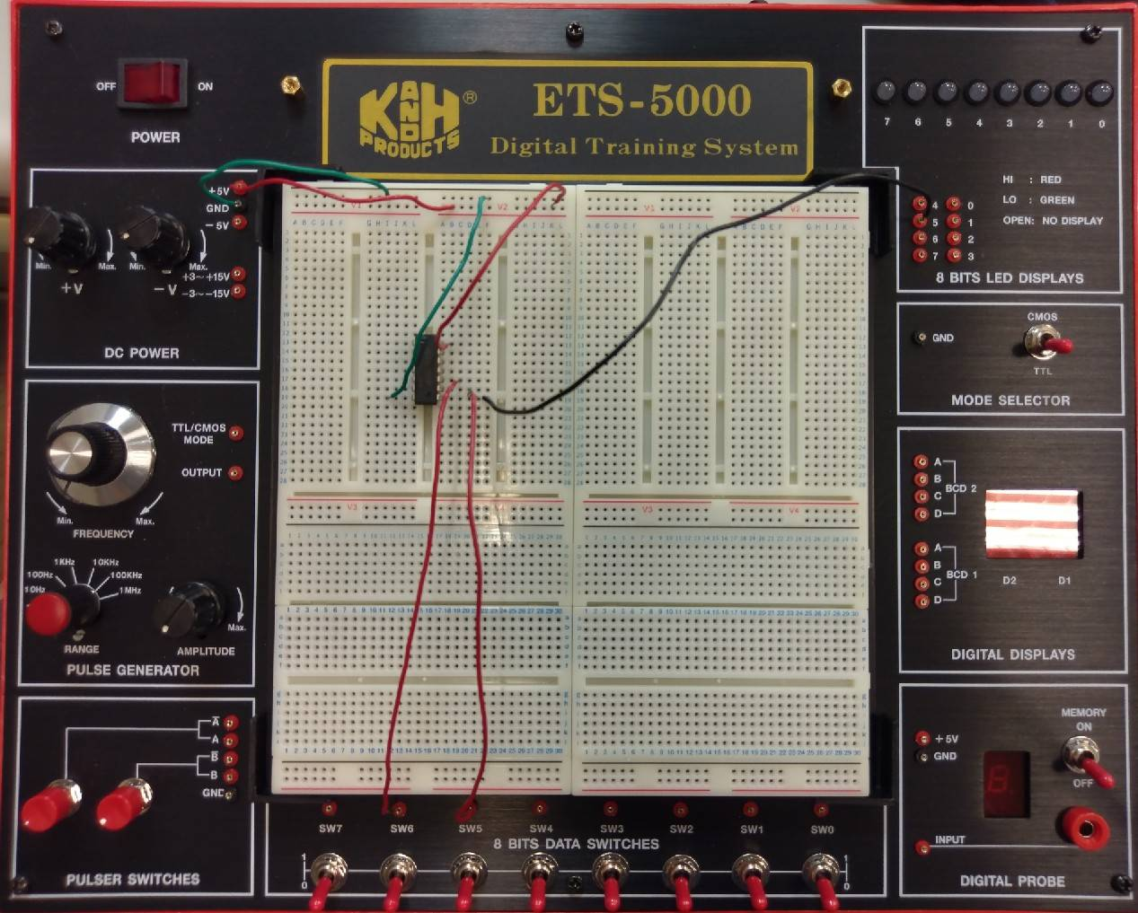
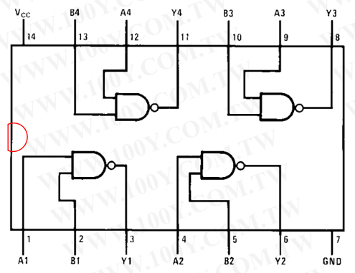
Example: Connection with 74LS00 Chip
Board
output
power supply
Chip(NAND)
TTL mode
Wire connection & IC placement
input

Slide 11
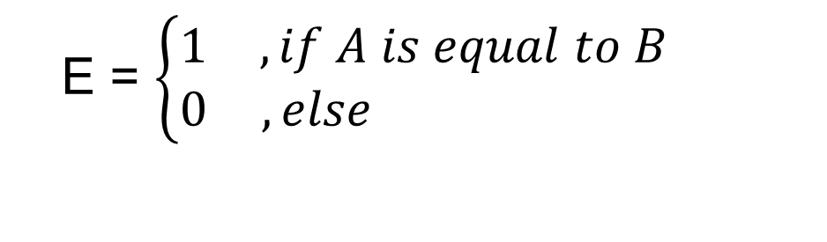
Lab I – Comparator (1/2)
There are two inputs denoted as A and B. Both A and B are 1-bit value. A comparator is designed to determine whether A is equal to B or not. The output results are represented with E .
The function and truth table of the comparator is described as follows.
A | B | E
0 | 0 | 1
0 | 1 | 0
1 | 0 | 0
1 | 1 | 1
E = $\left\{\begin{matrix}1 & , if A is equal to B \\ 0 & ,else \end{matrix}\right.$
用全及項的概念去推導布林表示式

Slide 12
Lab I – Comparator (2/2)
Please
(a) write Boolean algebra of the comparator.
(b) implement the circuit on the breadboard.

Slide 13
Components needed for LAB I
Names | Amount
Solerless Breadboard | ×1
74LS04 | ×1
74LS08 | ×1
74LS32 | ×1

Slide 14
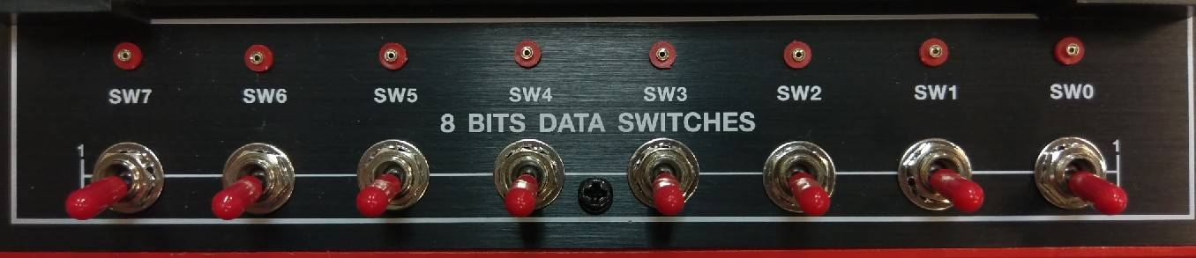
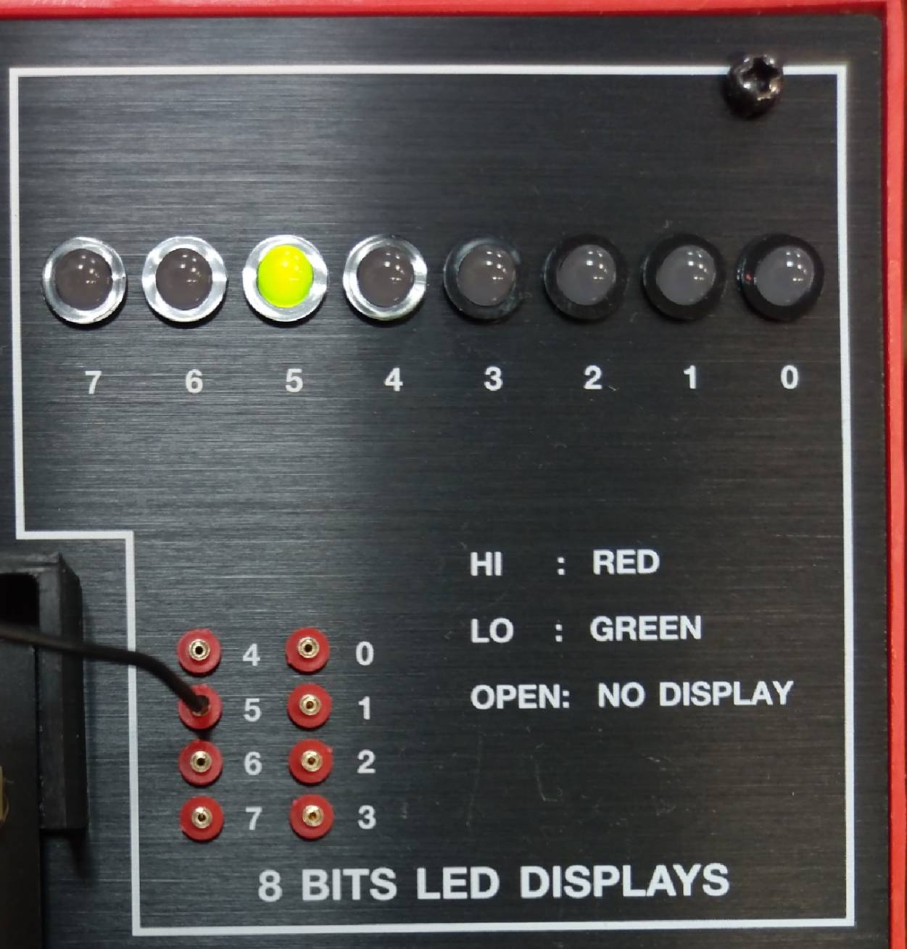
Notice for LAB I
Input
Output
A
B
E

Slide 15
Lab II -- Constant Multiplier (1/4)
MSB
There is a 2-bit input X (represented as X1 and X0). A constant multiplier is designed to multiply the input by 3. Finally, show the result with decimal format (0, 1, 2, …..,9) on Digital Display in the breadboard.
Hint-1:
The output digital number is 0, 3, 6 or 9, respectively, for four different inputs (0, 1, 2, 3).

Slide 16
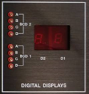
Lab II -- Constant Multiplier (2/4)
Hint-2:
Function of the Digital Display in the breadboard is as follows.
D | C | B | A | DIGITAL DISPLAY
0 | 0 | 0 | 0 | 0
0 | 0 | 0 | 1 | 1
0 | 0 | 1 | 0 | 2
0 | 0 | 1 | 1 | 3
0 | 1 | 0 | 0 | 4
0 | 1 | 0 | 1 | 5
0 | 1 | 1 | 0 | 6
0 | 1 | 1 | 1 | 7
1 | 0 | 0 | 0 | 8
1 | 0 | 0 | 1 | 9

Slide 17
Lab II -- Constant Multiplier (3/4)
Hint-3:
Write Boolean Algebra. (D = ? C = ? B = ? A = ?)
用全及項的概念去推導布林表示式
X1 | X0 | Decimal |  | D | C | B | A | Decimal
0 | 0 | 0 |  | 0 | 0 | 0 | 0 | 0
0 | 1 | 1 |  | 0 | 0 | 1 | 1 | 3
1 | 0 | 2 |  | 0 | 1 | 1 | 0 | 6
1 | 1 | 3 |  | 1 | 0 | 0 | 1 | 9
Notes:
A+b+c+d=0
A’+B’+C+D=3

Slide 18
Lab II -- Constant Multiplier(4/4)
Please
(a) draw the circuit diagram of the constant multiplier.
(b) implement the circuit on the breadboard, and show the result with decimal format (0, 1, 2, …..,9) on Digital Display in the breadboard.

Slide 19
Components needed for LAB II
Names | Amount
Solerless Breadboard | ×1
74LS04 | ×1
74LS08 | ×1
74LS32 | ×1

Slide 20

Lab III – Constant Comparator(practice) (1/2)
MSB
LSB
There are a 3-bit input X (represented as X2, X1 and X0) and two 1-bit outputs A and B. The comparator is designed to let output A be 1 if X>3 and output B be 1 if X>4.
The function of the comparator is described as follows.
A = $\left\{\begin{matrix}1 & , if X is greater than 3 \\ 0 & ,else \end{matrix}\right.$
B = $\left\{\begin{matrix}1 & , if X is greater than 4 \\ 0 & ,else \end{matrix}\right.$

Slide 21
Lab III– Constant Comparator (practice) (2/2)
Please
(a) draw the truth table of the comparator where three input bits are X2, X1 and X0, and two output bits are A and B, respectively.
(b) implement the circuit on the breadboard.

Slide 22
Components needed for LAB II
Names | Amount
Solerless Breadboard | ×1
74LS04 | ×1
74LS08 | ×1
74LS32 | ×1

Slide 23
Notice for LAB III
Input
Output
X2
X1
X0
A
B

