Slide 1

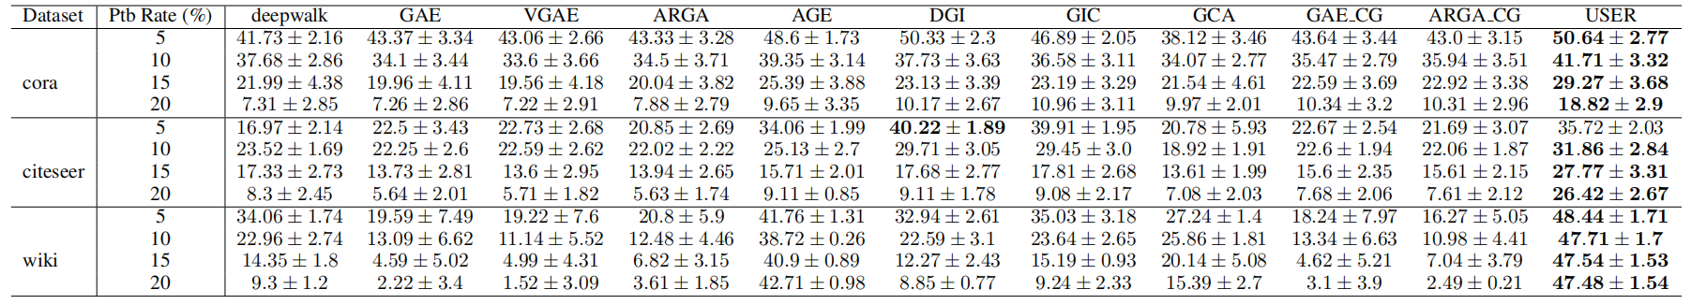
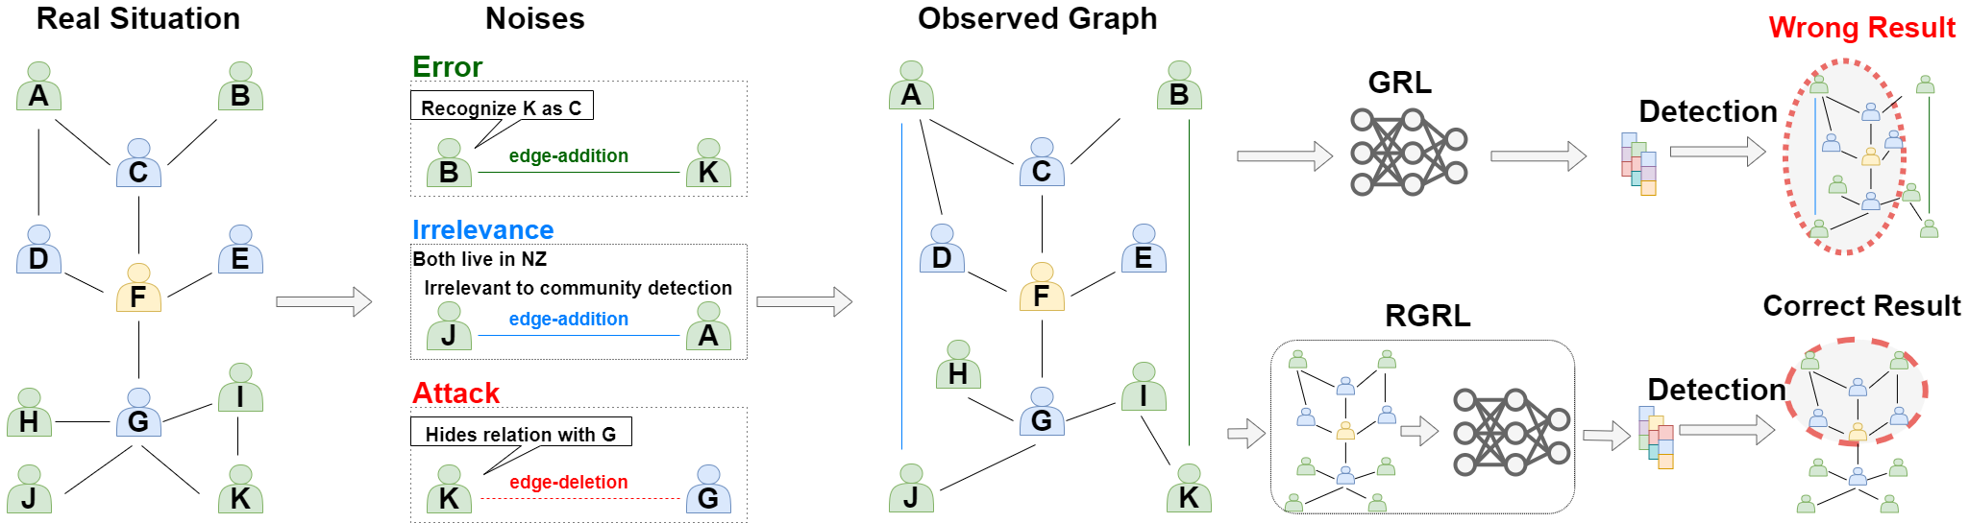
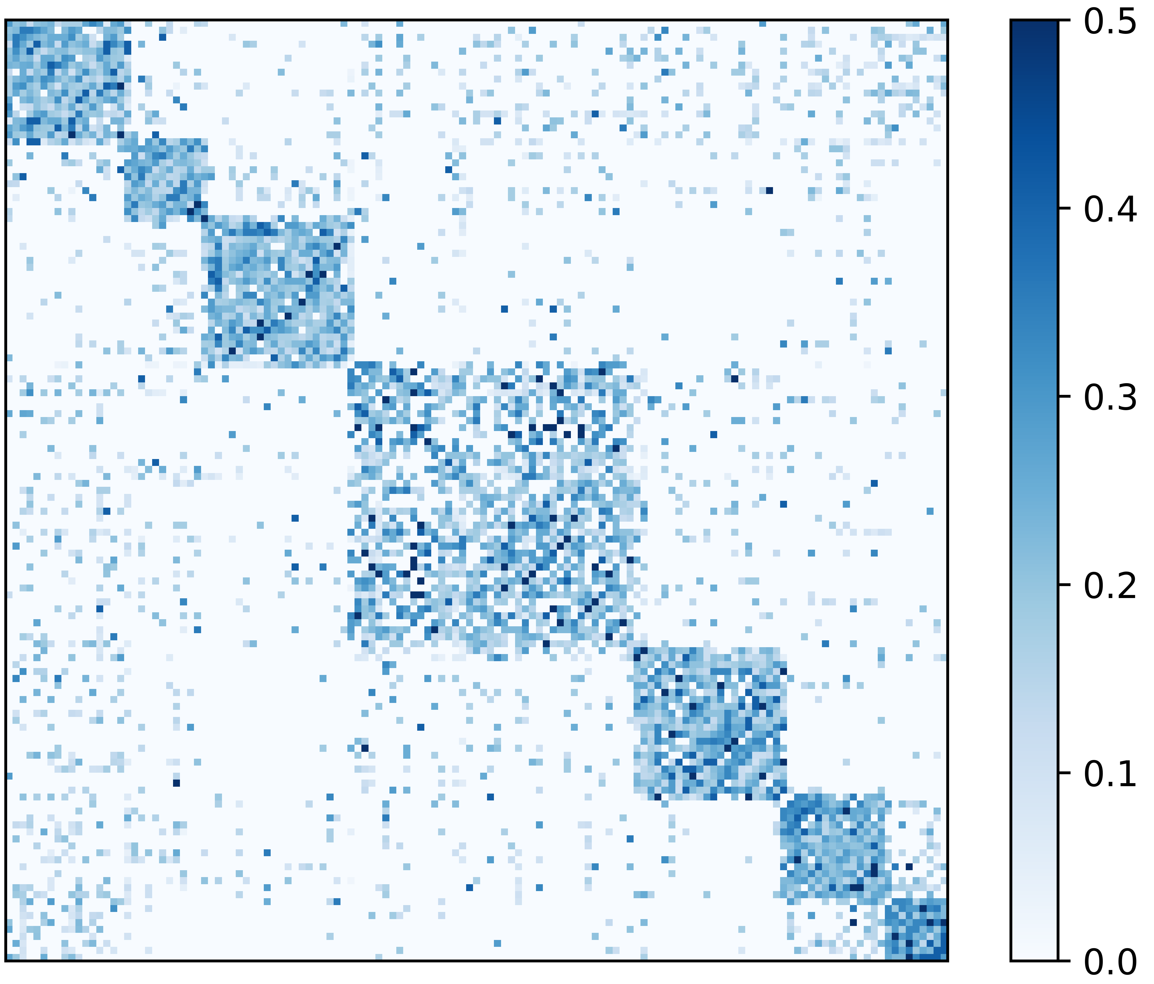
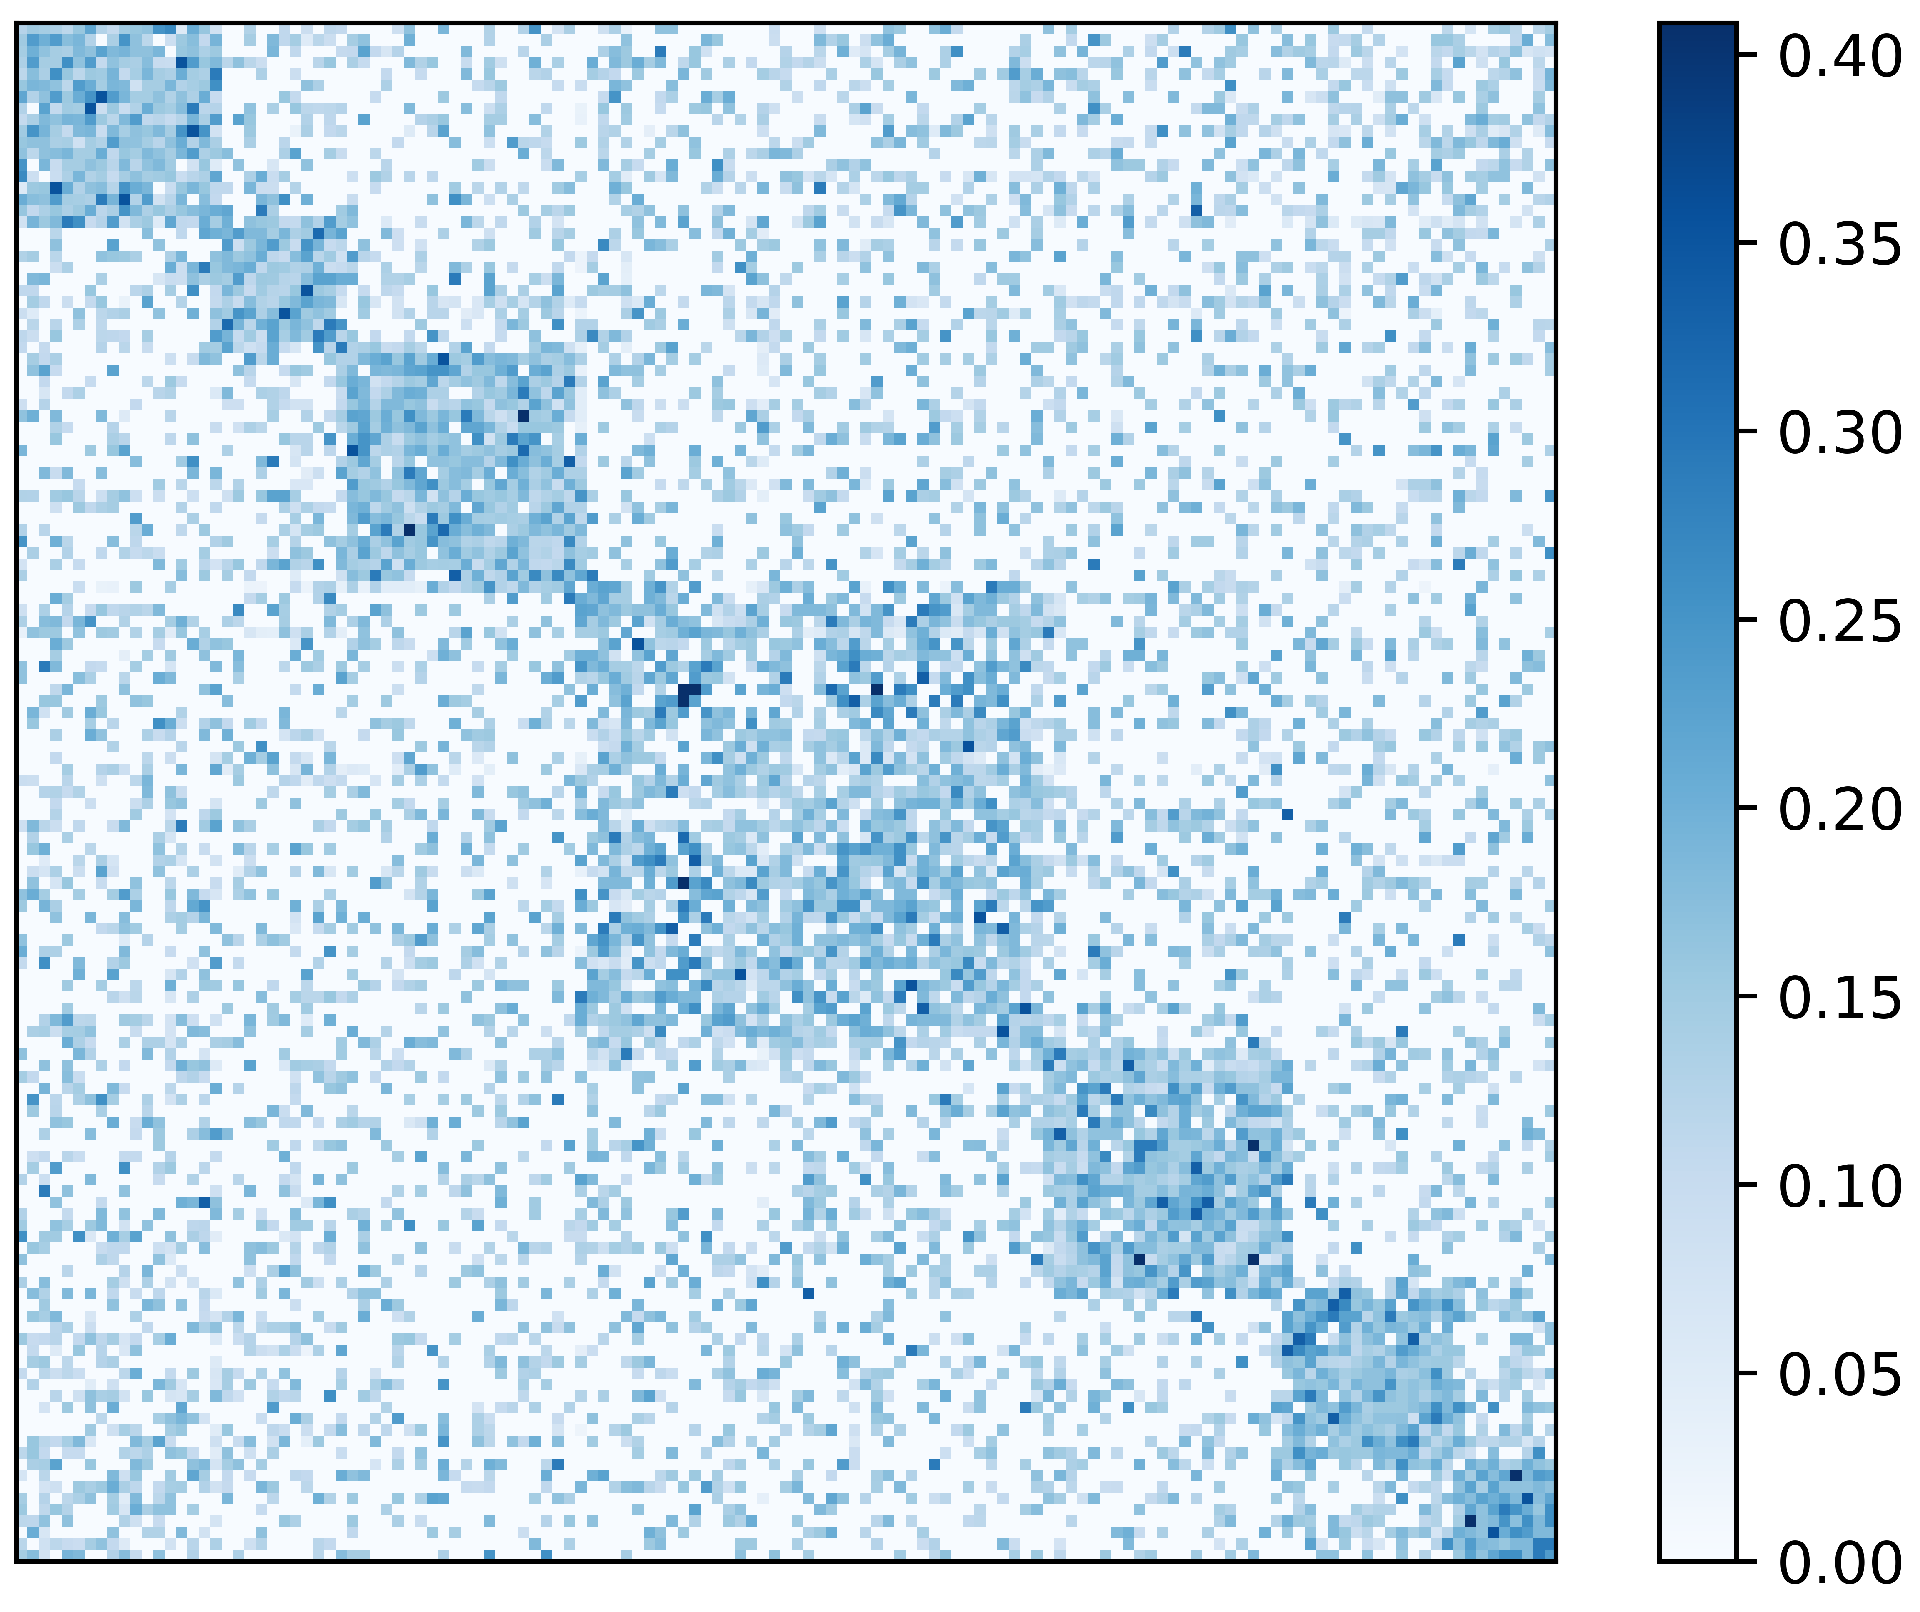
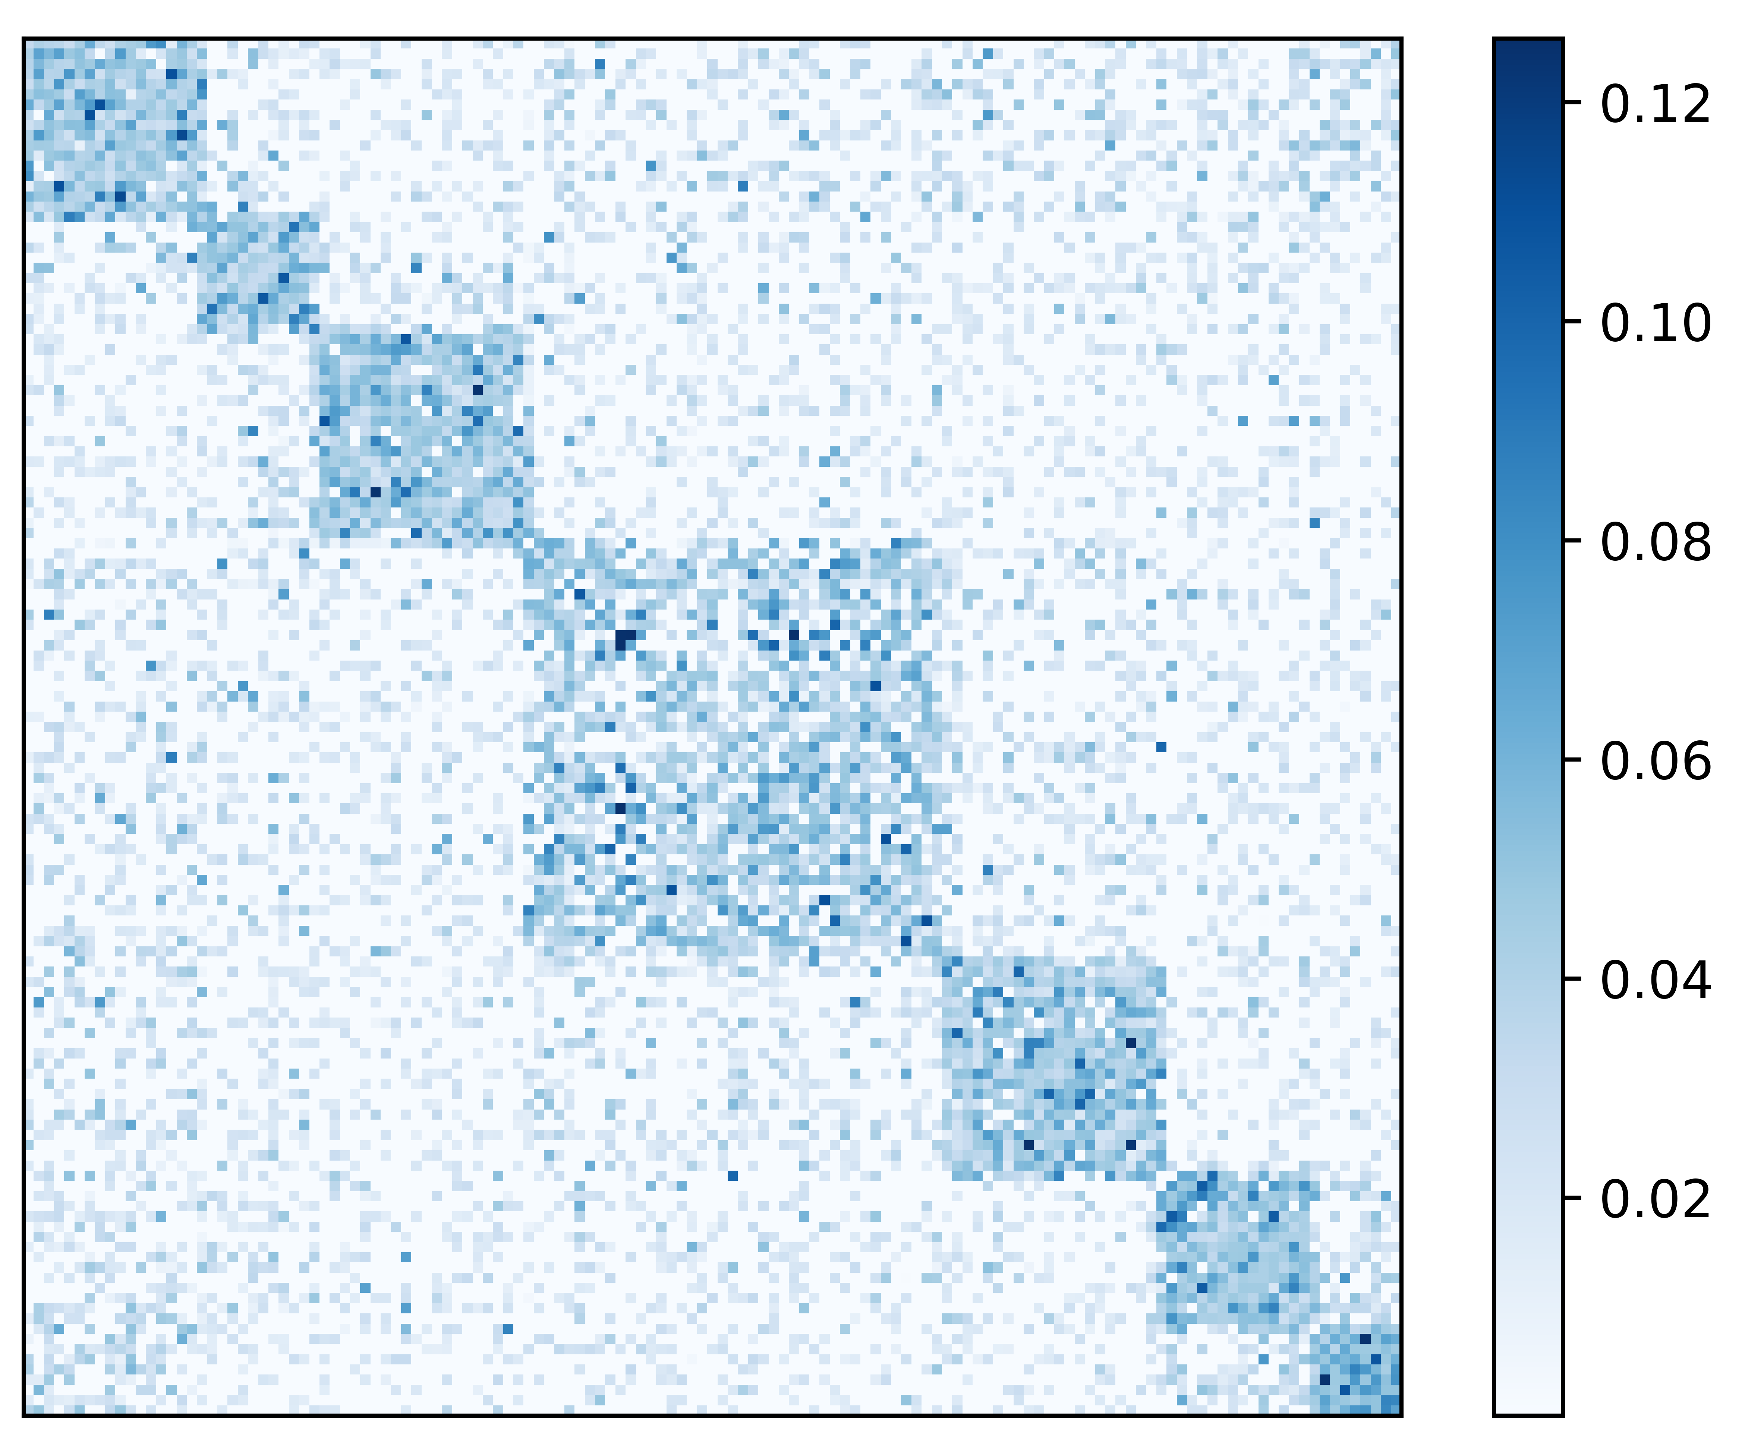
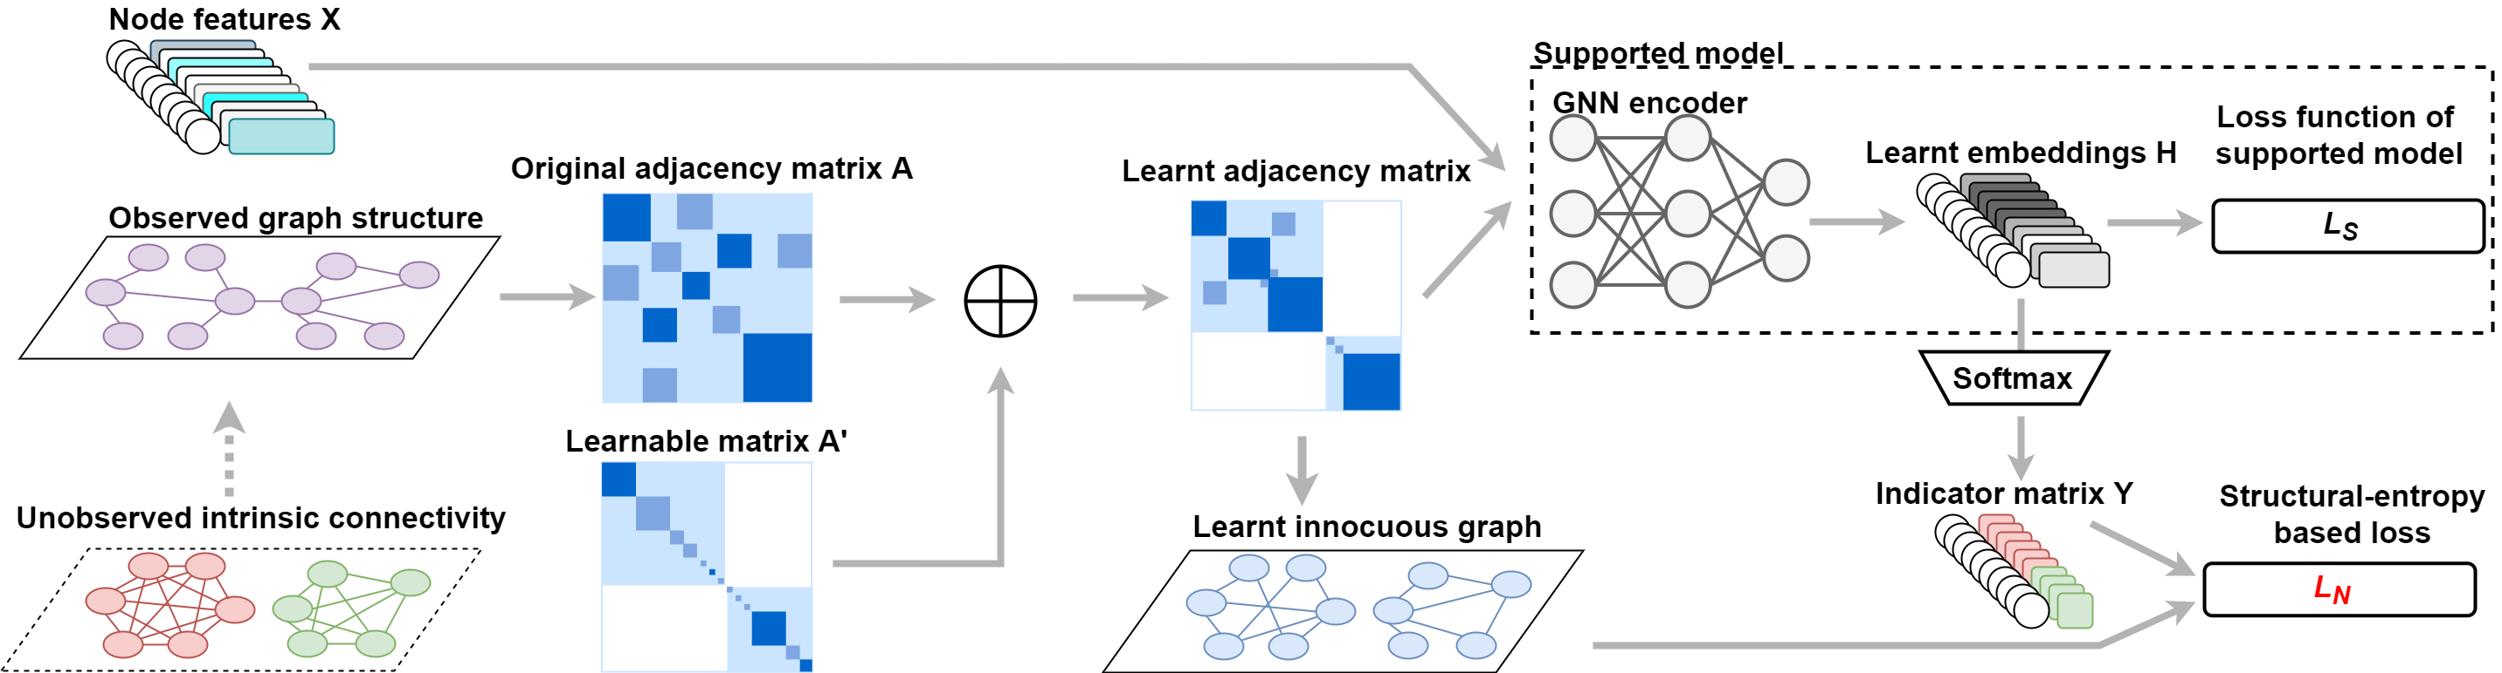
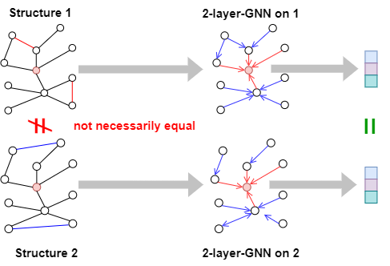
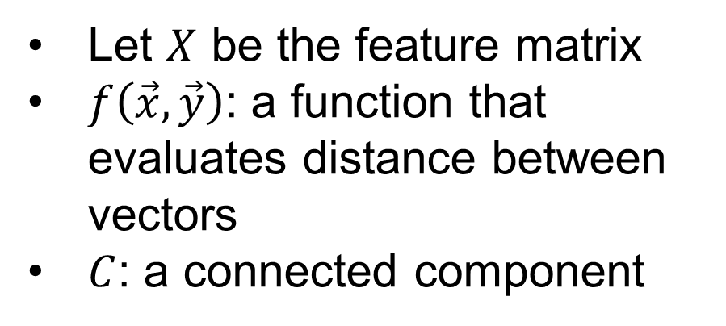
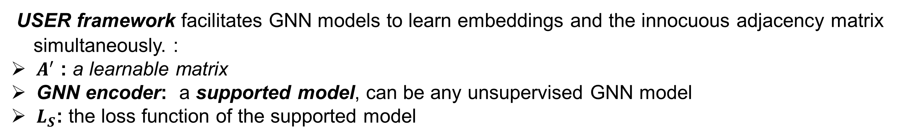

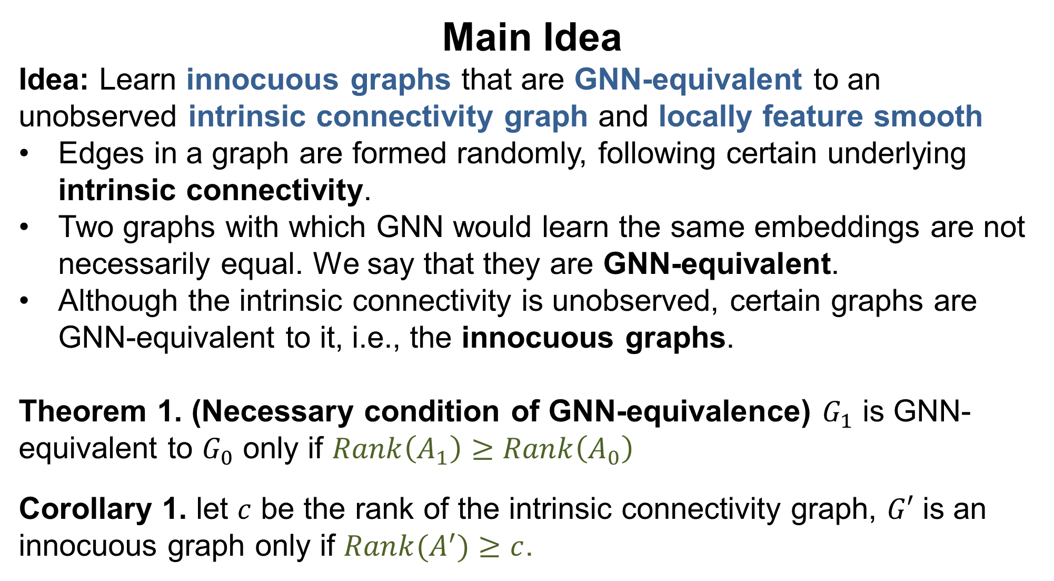
USER: Unsupervised Structural Entropy-based Robust Graph Neural Network Yifei Wang, Yupan Wang, Zeyu Zhang, Song Yang, Kaiqi Zhao, Jiamou Liu The University of Auckland, Auckland, New Zealand wany107@aucklanduni.ac.nz, jiamou.liu@auckland.ac.nz
Background
Unsupervised graph representation learning models are vulnerable to inherent randomness in the input graph.
Unsupervised robust graph representation learning aims to alleviate the interference of randomness in the input graph while learning graph representation without label information.
Structural Entropy-based Objective Function
To search for innocuous graphs, we invoke network partition structural information (NPSI) [1,2]:
${NPSI}_{GP\left(G\right)}≔\sum_{k<r}{\frac{{vol}_{k} − g_{k}}{2|ε|}\log_{2}\frac{{vol}_{k} }{2|ε|}}$,
where ${vol}_{k}$ is volumn of $C_{k}$ and $g_{k}$ denotes the number of edges with exactly one end in $C_{k}$.
To utilize it in GNN models, we introduce a matrix form of NPSI:
$NPSI(A,Y)≔trace\left(\frac{Y^{T}AY}{2sum\left(A\right)}⊗\log_{2}\left(\frac{{\left\{1\right\}}^{r×n}AY}{2sum\left(A\right)}\right)\right)$,
where $A$ is the adjancecy matrix of graph $G$ while $Y∈{\left\{0,1\right\}}^{n×r}$ is an indicator matrix that satisfies $Y_{ik}=1$ if $i∈C_{k}$, otherwise $Y_{ik}=0$.
Theorem 2. (minimize $NPSI(A,Y)$ with learnable $A$):
Suppose $A=\underset{A}{argmin}{NPSI(A,Y)}$, s.t., $A_{ij}≥0$ and $A=A^{T}$. Then $Rank(A) ≥ r$.
By Theorem 1 and Theorem 2, one may search for a graph that satisfies the necessary condition of being innocuous graph (Corollary 1) by minimizing $NPSI(A,Y)$ with $r=c$.
With $\left\{C_{1},C_{2}⋯C_{r}\right\}$ indicated by $Y$, a graph satisfies local feature smoothness can be learned by minimizing Davies-Bouldin index $DBI\left(X,Y\right)$, where $Y=\underset{A, Y}{argmin}{NPSI(A,Y)}$ [3].
The process of finding an innocuous graph into an optimization requires minimizing the loss $L_{N}$ :
$$L_{N}≔NPSI(A,Y)+βDBI\left(X,Y\right)$$
Unsupervised Structural Entropy-based Robust GNN
Experiments
Dataset: 3 real-world networks. Noises: {Random noise, meta-attack}.
Tasks: {Node clustering, Link prediction}.
Node clustering performance (NMI±Std) under meta-attack
Challenges
How to find a graph that mitigates the interference of randomness in the input data without labels?
What’s objective function that guides a model to reveal such graphs?
Case study of learnt innocuous graph
Main Idea
Idea: Learn innocuous graphs that are GNN-equivalent to an unobserved intrinsic connectivity graph and locally feature smooth
Edges in a graph are formed randomly, following certain underlying intrinsic connectivity.
Two graphs with which GNN would learn the same embeddings are not necessarily equal. We say that they are GNN-equivalent.
Although the intrinsic connectivity is unobserved, certain graphs are GNN-equivalent to it, i.e., the innocuous graphs.
Theorem 1. (Necessary condition of GNN-equivalence) $G_{1}$ is GNN-equivalent to $G_{0}$ only if $Rank\left(A_{1}\right)≥Rank\left(A_{0}\right)$
Corollary 1. let $c$ be the rank of the intrinsic connectivity graph, $G′$ is an innocuous graph only if $Rank(A^{′})≥c$.
(a) Original (b) Poisoned (c) USER
Parameter analysis
(a) α on Citeseer (b) β on Citeseer (c) α on Wiki (b) β on Wiki
Conclusions
There are multiple innocuous graphs with which GNN can learn the appropriate embeddings.
NPSI-based objective function is an ideal tool to capture innocuous graph.
Unsupervised RGRL framework may effectively alleviate the interference of graph randomness.
Code available: https://github.com/wangyifeibeijing/USER
[1] Li, A., & Pan, Y. (2016) Structural information and dynamical complexity of networks.
[2] Liu, Y., Liu, J., Zhang, Z., Zhu, L., & Li, A. (2019). REM: From structural entropy to community structure deception
[3] Davies, D. L., & Bouldin, D. W. (1979). A cluster separation measure.
Let $X$ be the feature matrix
$f\left(\vec{x},\vec{y}\right)$: a function that evaluates distance between vectors
$C$: a connected component
USER framework facilitates GNN models to learn embeddings and the innocuous adjacency matrix simultaneously. :
$A^{′}$ : a learnable matrix
GNN encoder: a supported model, can be any unsupervised GNN model
$L_{S}$: the loss function of the supported model
Local feature smoothness: For nodes $v_{a}∈C$, $v_{b}∈C$ and $v_{c}∉C$, $f\left(X_{a},X_{b}\right)≤f\left(X_{a},X_{c}\right).$

