Slide 1
Week5-6 results
Data based on test day 3 & test day 4

Slide 2
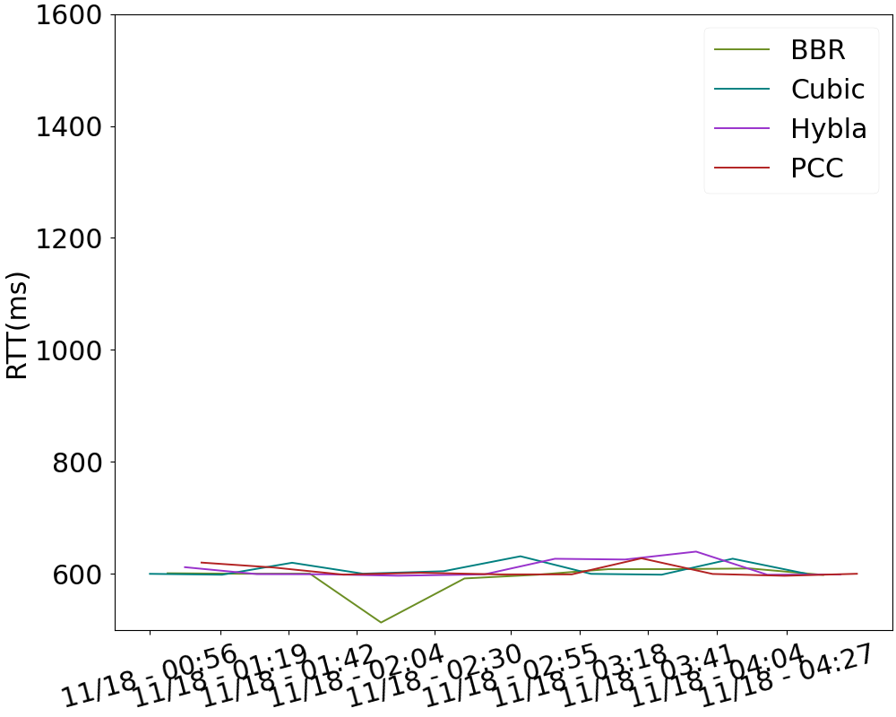
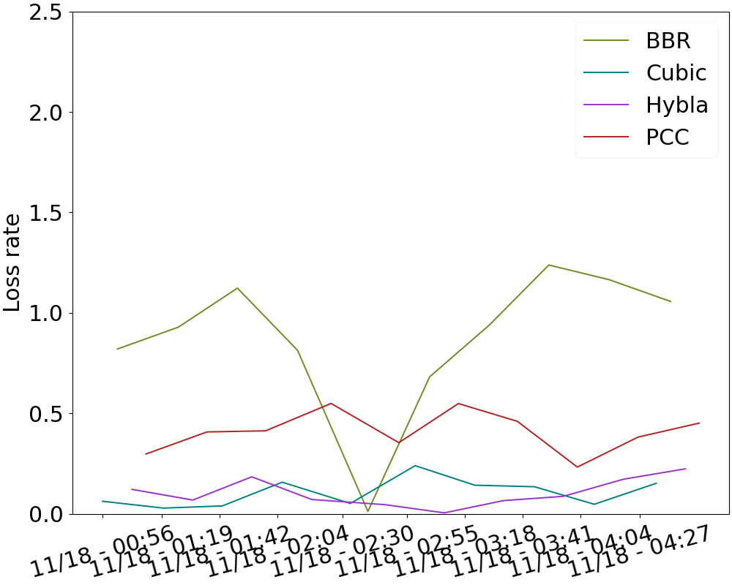
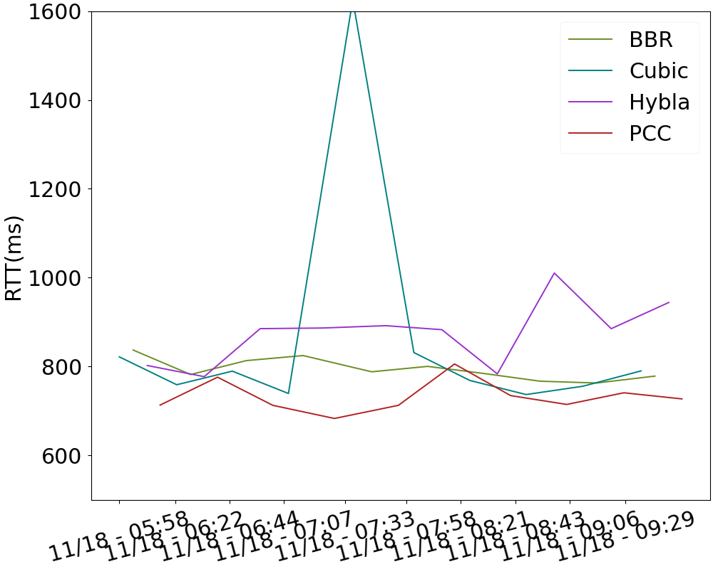
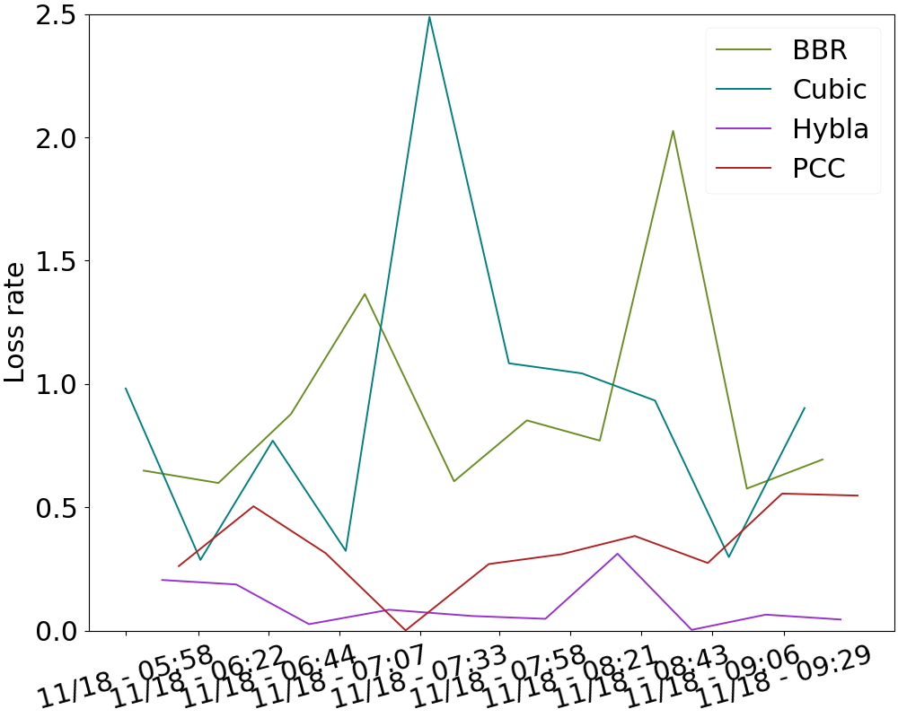
RTT/Loss over time
Proxy on
Proxy off

Slide 3
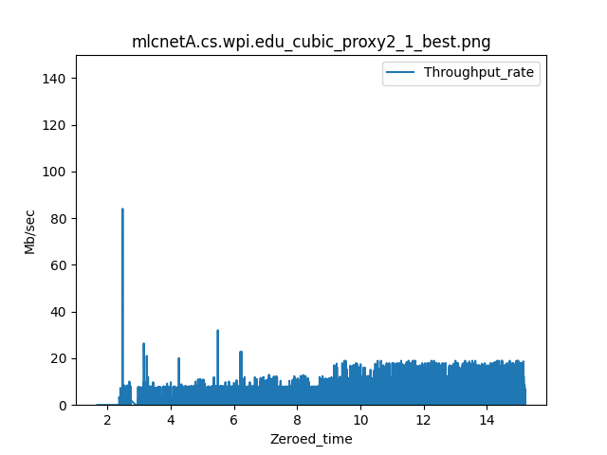
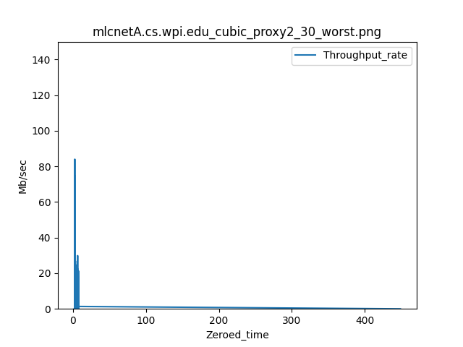
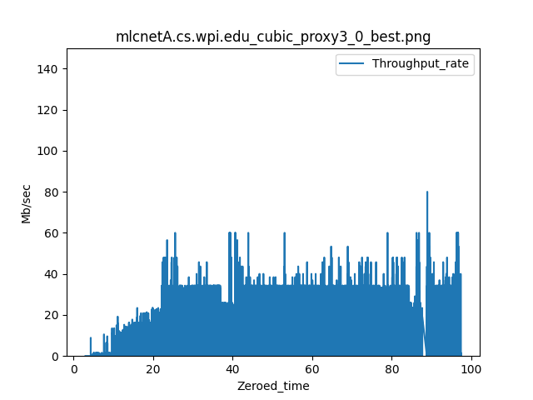
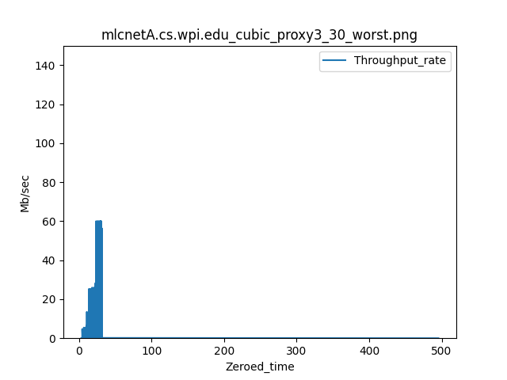
Cubic
Best Worst
Proxy on
Proxy off

Slide 4
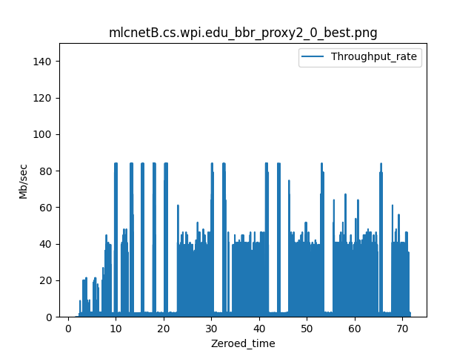
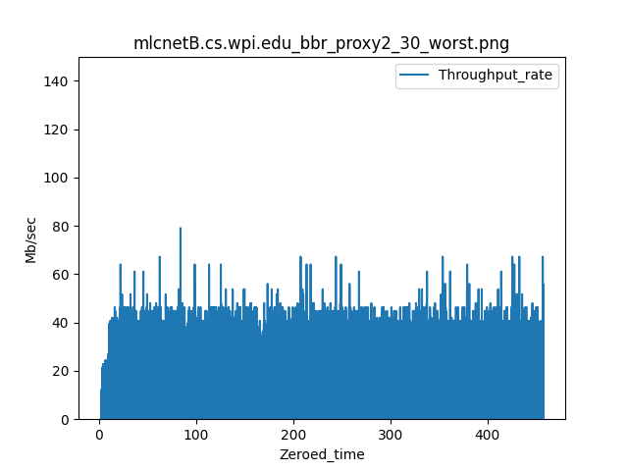
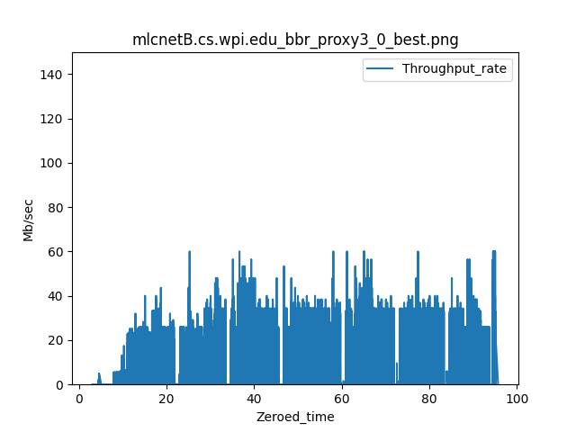
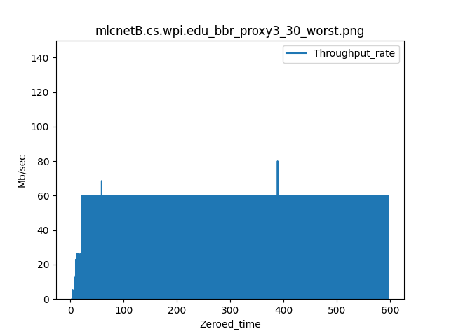
BBR
Best Worst
Proxy on
Proxy off

Slide 5
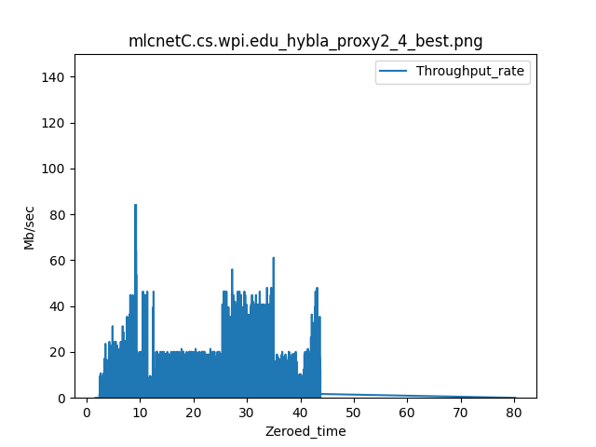
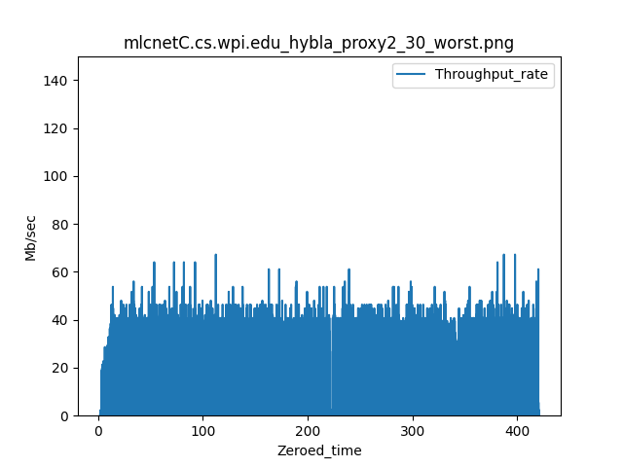
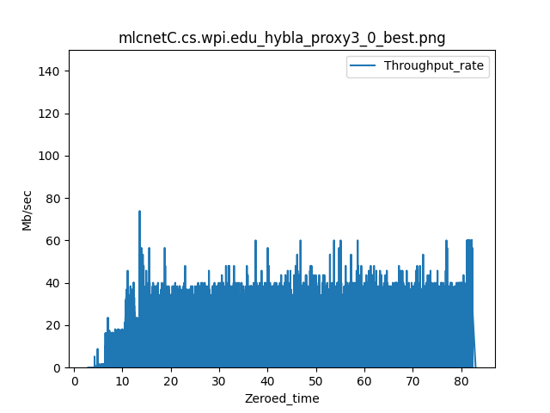
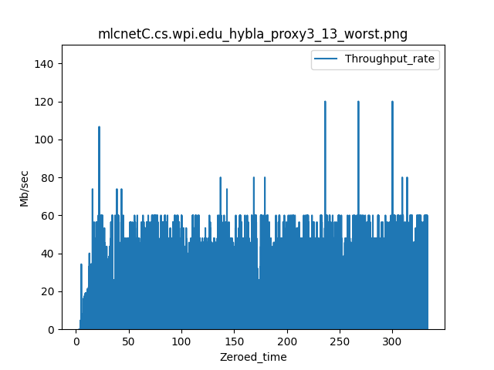
Hybla
Best Worst
Proxy on
Proxy off

Slide 6
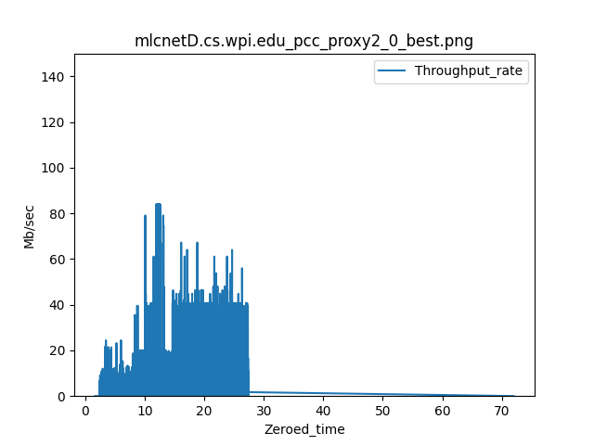
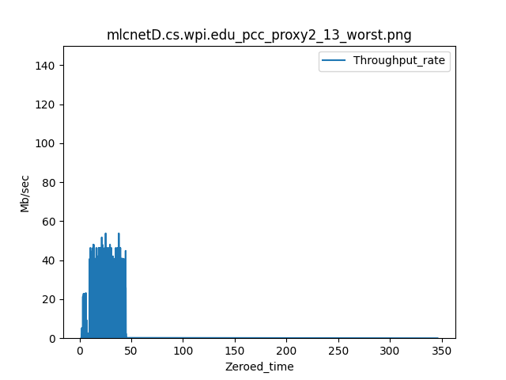
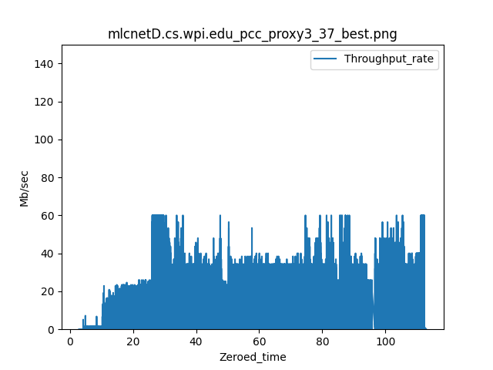
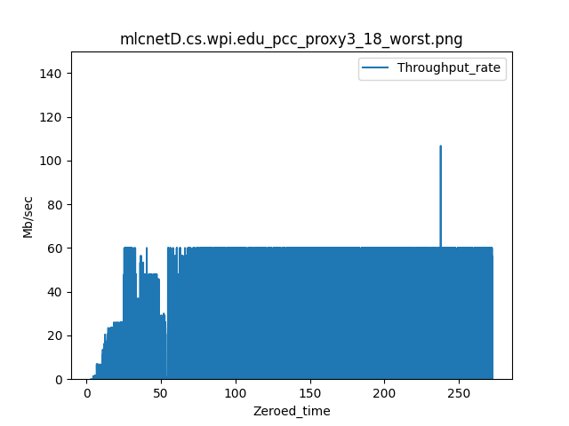
PCC
Best Worst
Proxy on
Proxy off

Slide 7
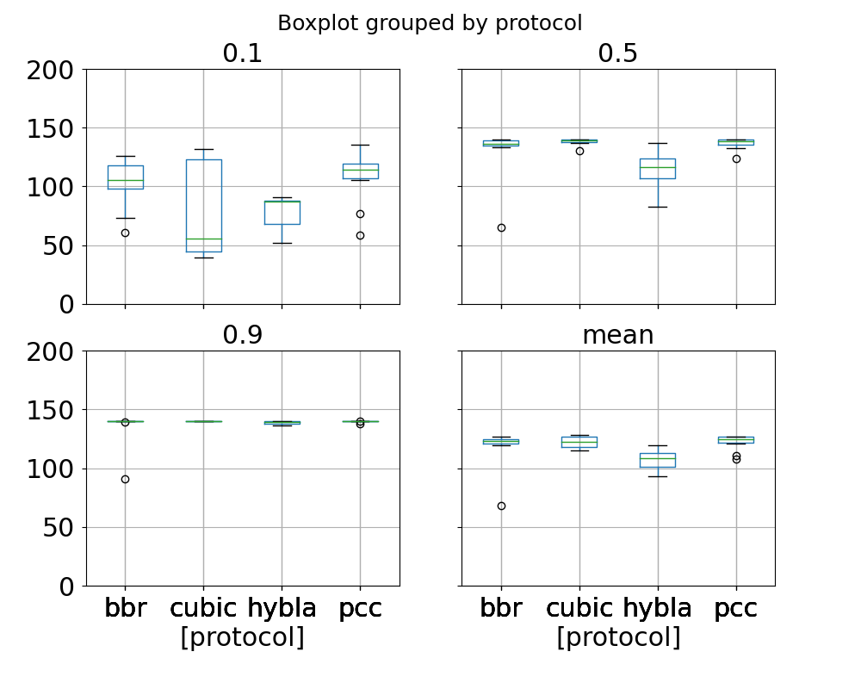
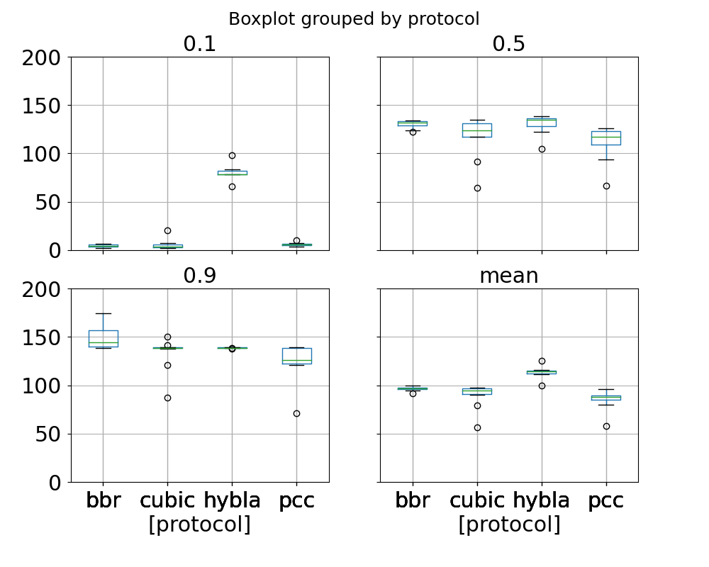
Boxplot
Proxy on
Proxy off

Slide 8
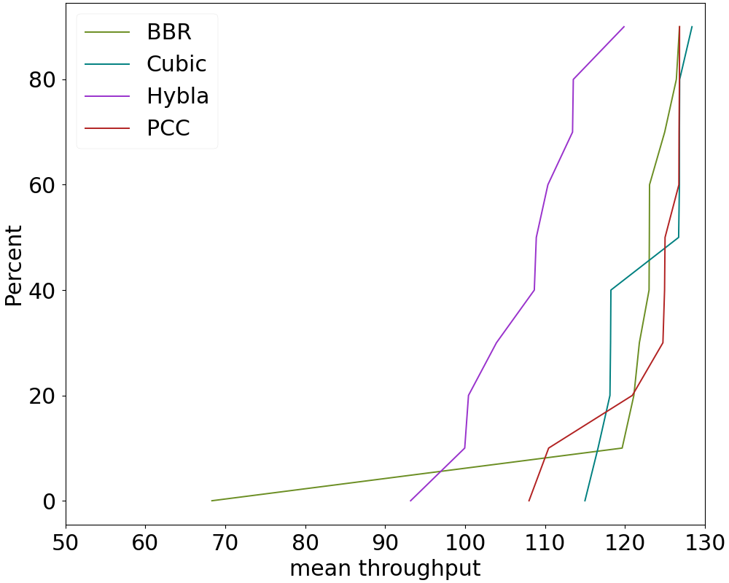
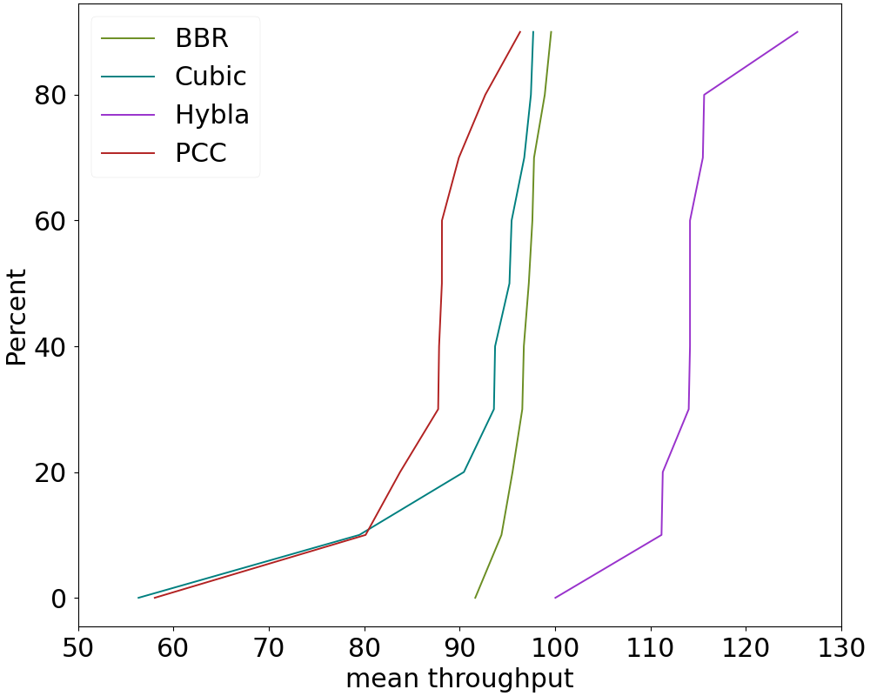
CDF on mean throughput
Proxy on
Proxy off

Slide 9
Average Diff & Standard Dev
Theoretical
(Test day 3)
 | Cubic | BBR | Hybla | PCC
mean diff (Mbytes/s) | 6.16015638 | 6.91216463 | 2.21173721 | 18.6132509
standard dev | 6.41556502 | 3.89916391 | 4.03565417 | 7.01929383

Slide 10
Next Step
Steady state & start
Applying to larger data sets ->analyze busy/Non-busy hours
Small objects transfer
Three way handshake

