Slide 1
CCRG ISP B Term -- Week 7 / Final Week Report
Yongcheng Liu, Mingxi Liu,
Mona Ma, Zachary Porter

Slide 2
Agenda
Data Collection - Yongcheng
Trial Setup
New Trial System
Data Analysis - Mona, Mingxi
Single trial
Best & worst round for each congestion control algorithms
Throughput
Average over time, Boxplot, RTT/Lose over time, CDF of mean
Throughput during steady state
Average over time, Boxplot, RTT/Lose over time, CDF of mean
Average difference & standard deviation

Slide 3
Data Collection – Test Setup
Trials:
1 on weekday (Dec 7)
24 hours
Main Experiment Loop:
47 rounds
4 TCP Flows (Cubic, BBR, Hybla, PCC)
2 Proxy Status (on, off)
= 376 Data Sets
Raw Data Dir: /home/yliu31/clayTrials/WEEKEND_TEST_2 (Though in fact it is experimented at weekday)

Slide 4
Data Collection – New Trial System
Old Trials:
Discarded lots of tests, due to
1. Glomma Resetting Issues. After glomma resets, glomma’s ip may change. Thus, due to the firewall rule, Glomma may fail to scp/ssh to MLCs. Also, we need to send our key files to satellite server after reset.
2. Route Resetting Issues (Collisions?). While we are running our experiments, for some reasons our routes reset many times. Even in some trials, it happened in the middle of the trial.
Other Issues:
SSH Overheads: We tried with 50M tests, which will cost around 1 minute per trial on 1 machine. Majorly caused by using ssh to issue commands at MLCs.
No Auto Error Detection and Correction:
In many times, we had to discard the whole test if any error occurred. Also, we can only know errors might happened after data is analyzed in old settings.
Like SSH issues in the middle of the test. Test will not auto-terminate or auto-correct

Slide 5
Data Collection – New Trial System
New Trial System:
We proposed a new trial system to solve found issues
Features:
Auto checking, before the experiment and during the experiment
Auto correcting for some checks
Lower SSH overheads
Extensible

Slide 6
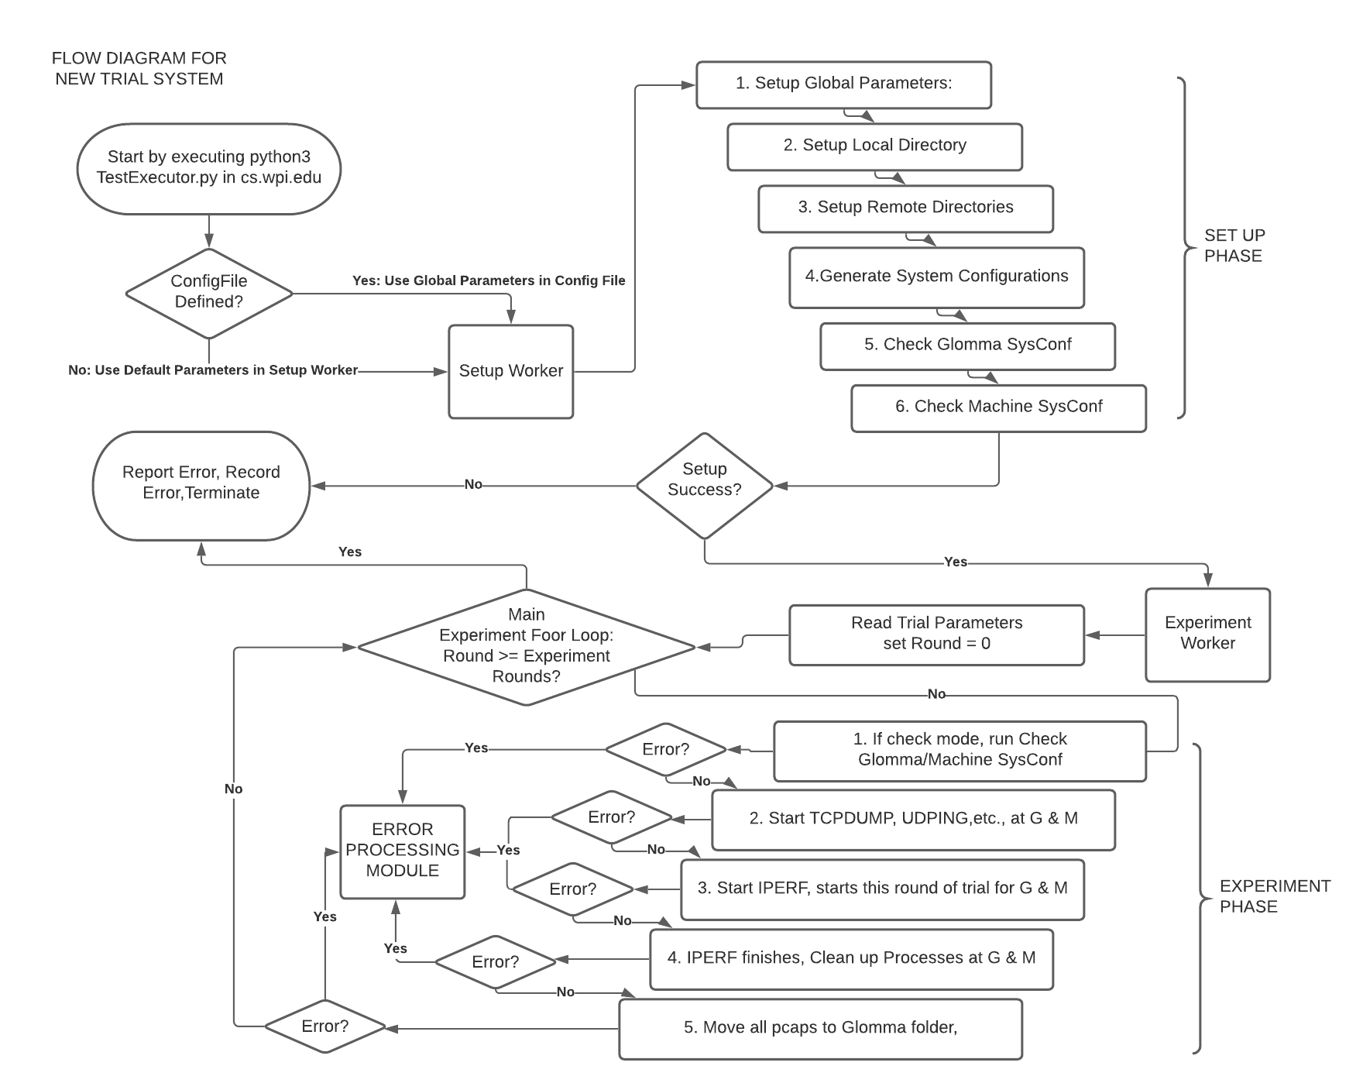
New Trial System Flow Diagram

Slide 7
New Trial System Structure – Error Detection And Handling
Configuration Based Checking
Checks if system field equals those in configuration files
Glomma:
[IP] section: MLC IPs
MLCs:
[TCP] section: tcp_mem, wmem, rmem, protocol
[IP] section: Glomma IP (get at cs server)
SSH Based Checking
Connection Testing:
Basically call “ssh host ‘echo ‘TEST’ or ‘$HOME’ ’”. Verify by comparing output from ssh calls
In Experiment, if “ssh: / scp: … err” received at Glomma, report.
In Experiment, cs server use screens to TCPDUMP, etc.
If screens closed before it should (cannot find screen instance at cleanup()), report.
In Experiment, if “scp pcap < 1KB”, report

Slide 8
New Trial System Structure – Error Detection And Handling
ConfigChecker:
@TEST Decorator, and will run all test methods with @TEST in defined CheckerClass
Return False if any error, else True. If –message flag, return error method names also.
Glomma Checks:
SSH – Connection to satellite and permission? -> If no, in output report this and terminates
ip route show – [IP] section exists (specific to eno2 via 192.168.1.1)? -> If not add missing one
SSH Connection Reset By Peer -> Ask CS to check Machine Conf
Machine Checks:
[IP] section Glomma ip in hosts.allow?
Check and set [TCP] section
Working:
Move all error handling to a module in cs server / executor server (not implemented yet). On error, report an error code if knows type, else error message.

Slide 9
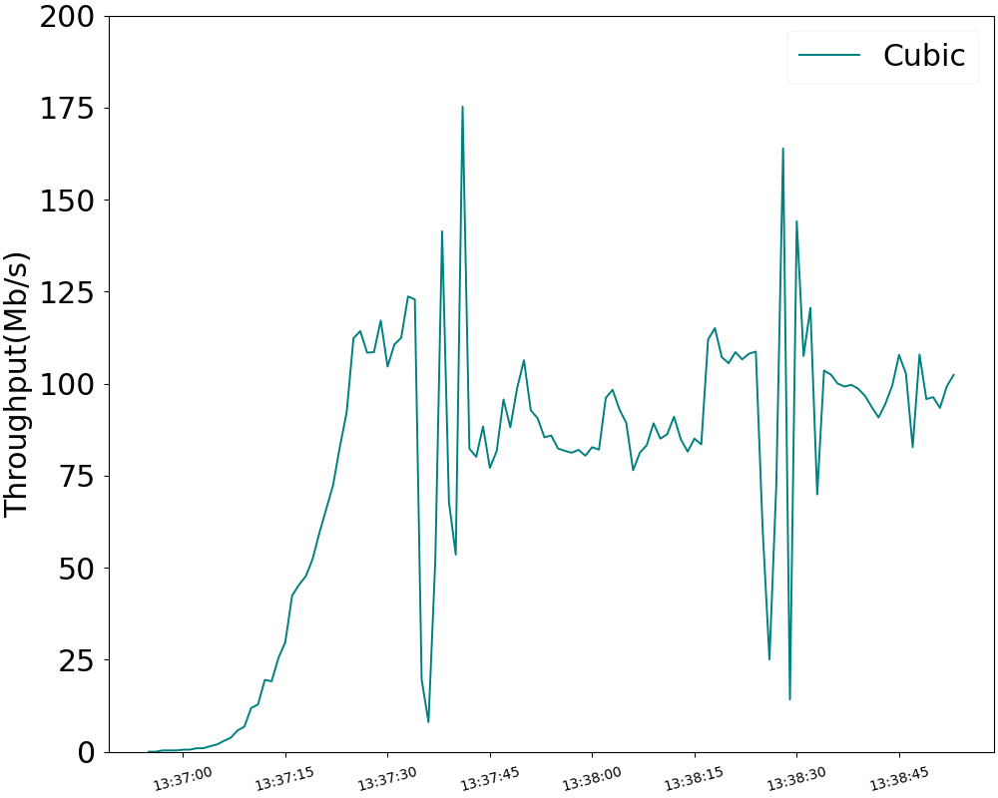
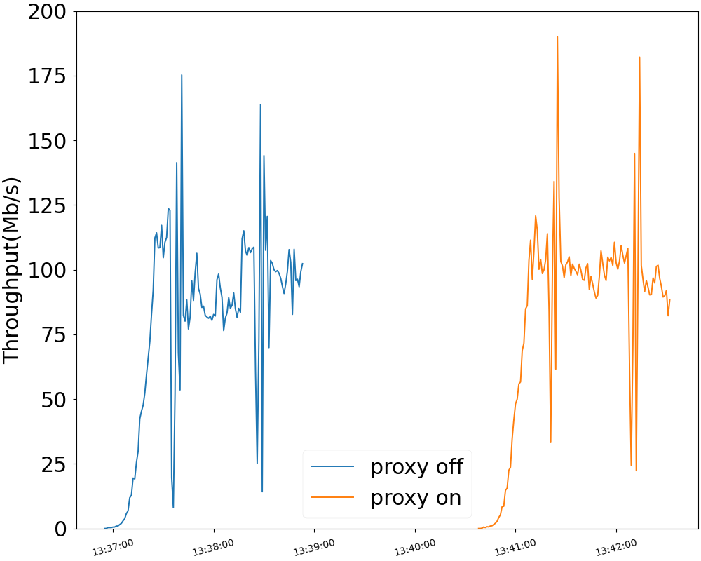
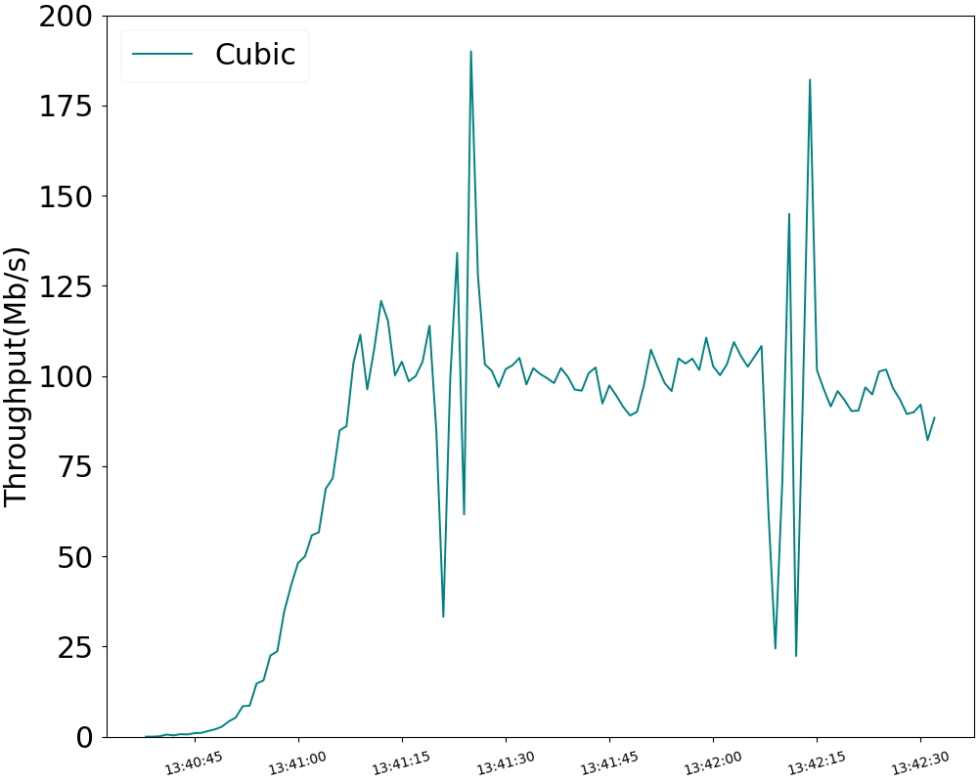
Single trial setup
Proxy off
Proxy on
Time(s)

Slide 10
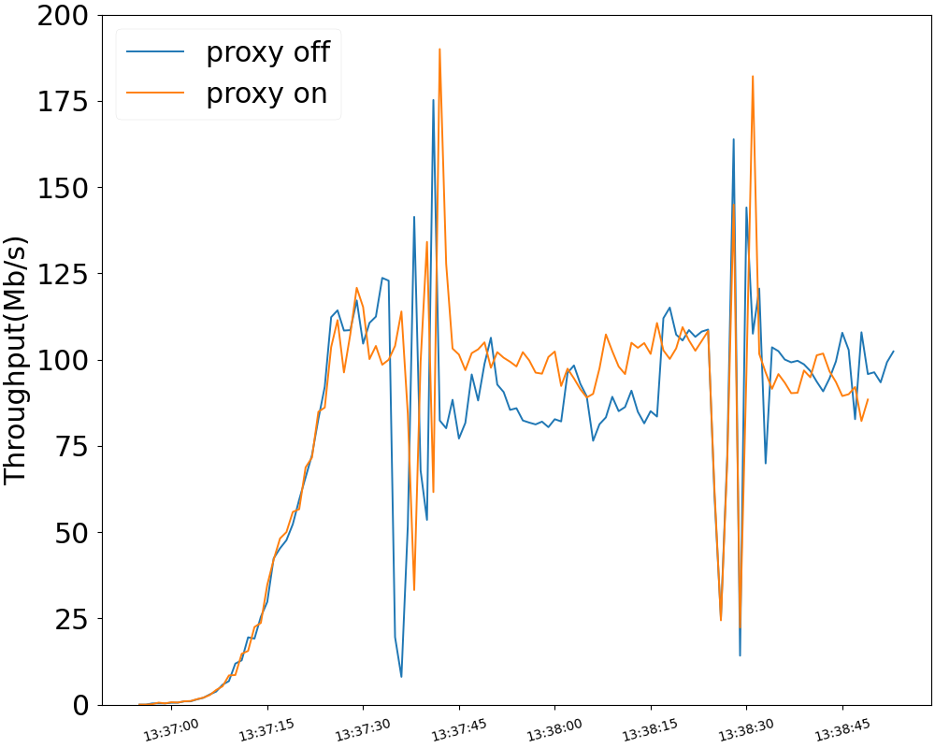
Direct comparison
cubic | proxy off | proxy on
average | 75.6806083 | 79.4155727
standard dev | 40.1686941 | 40.9763953
max | 175.26592 | 190.023936
median | 85.432 | 96.274624
Time(s)

Slide 11
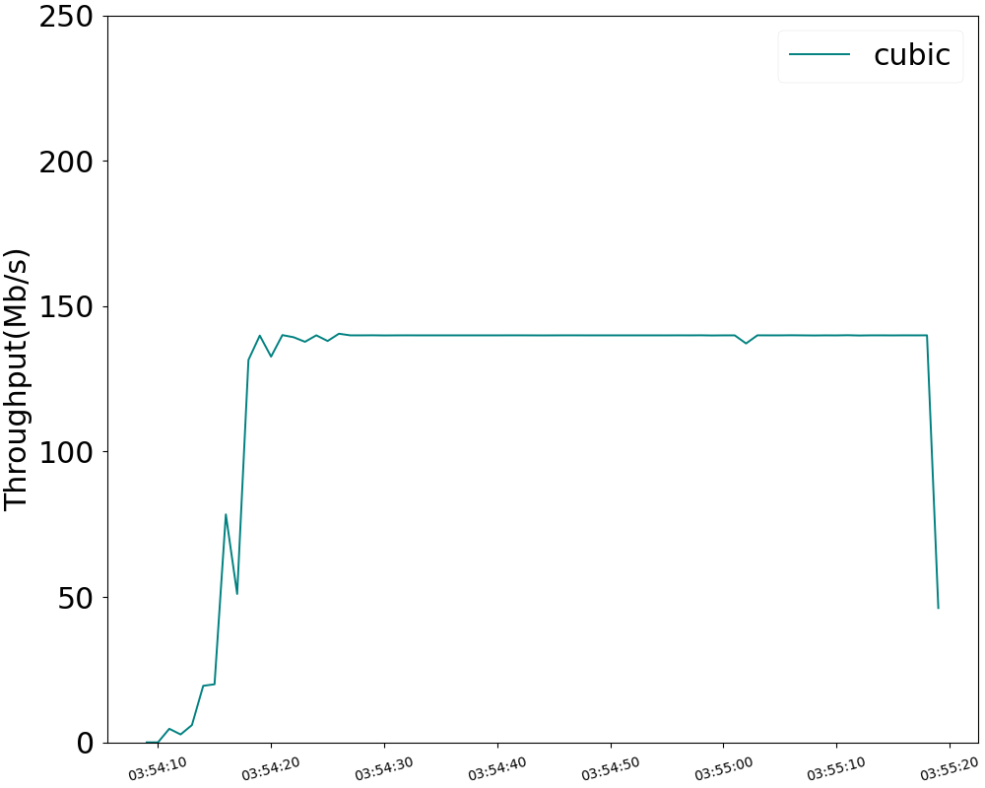
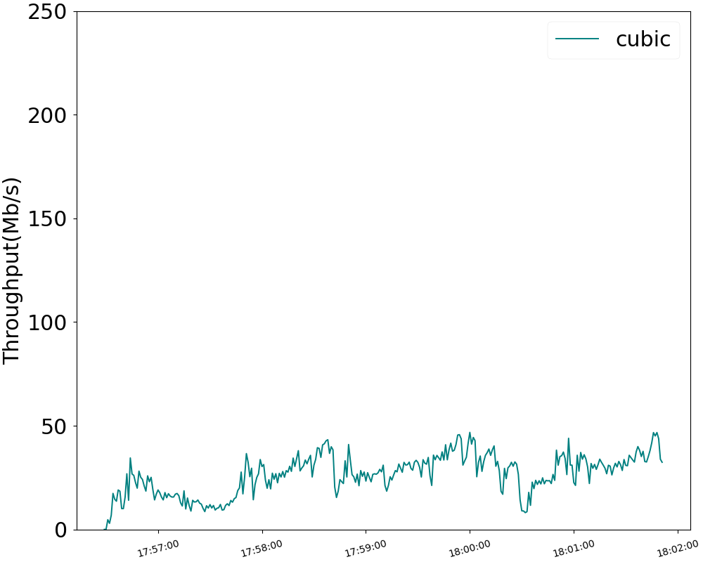
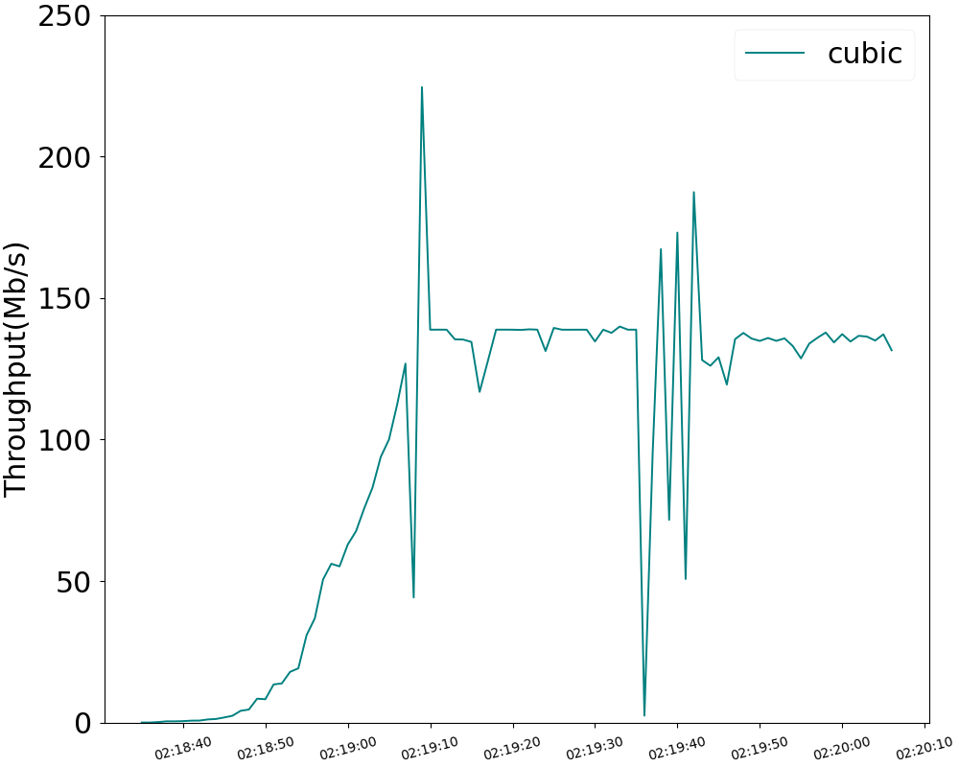
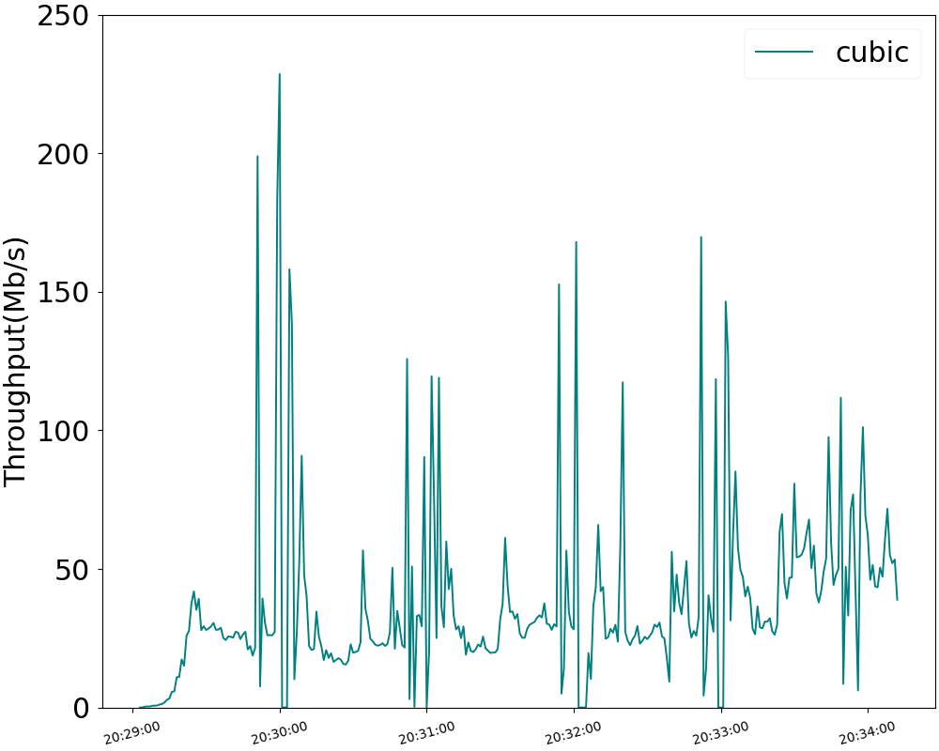
Cubic
Best
Worst
Proxy on
Proxy off

Slide 12
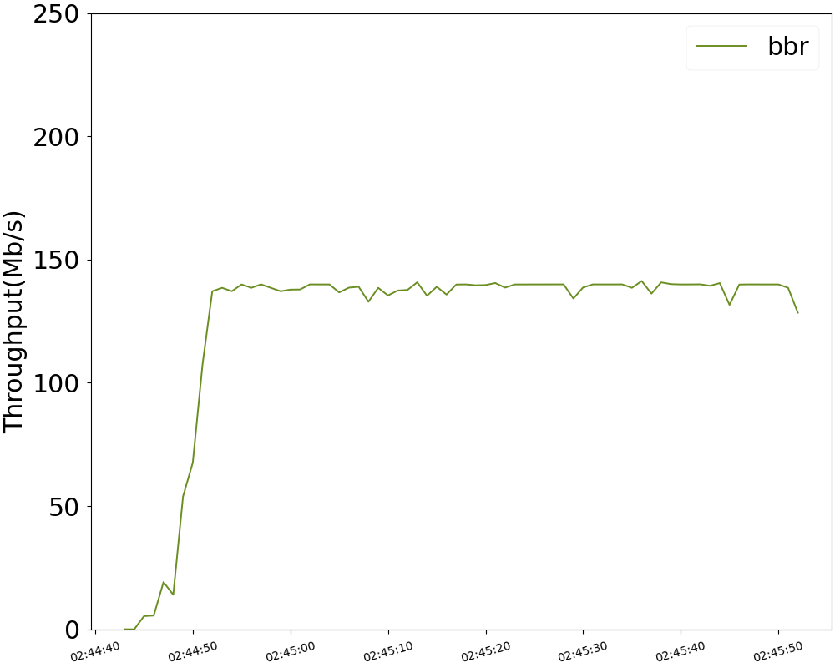
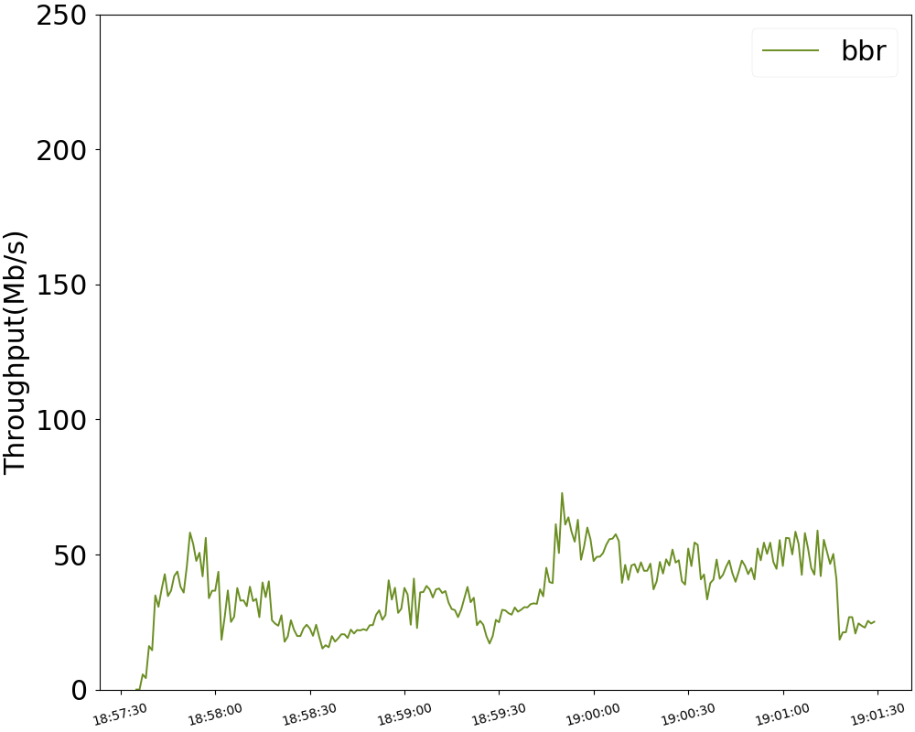
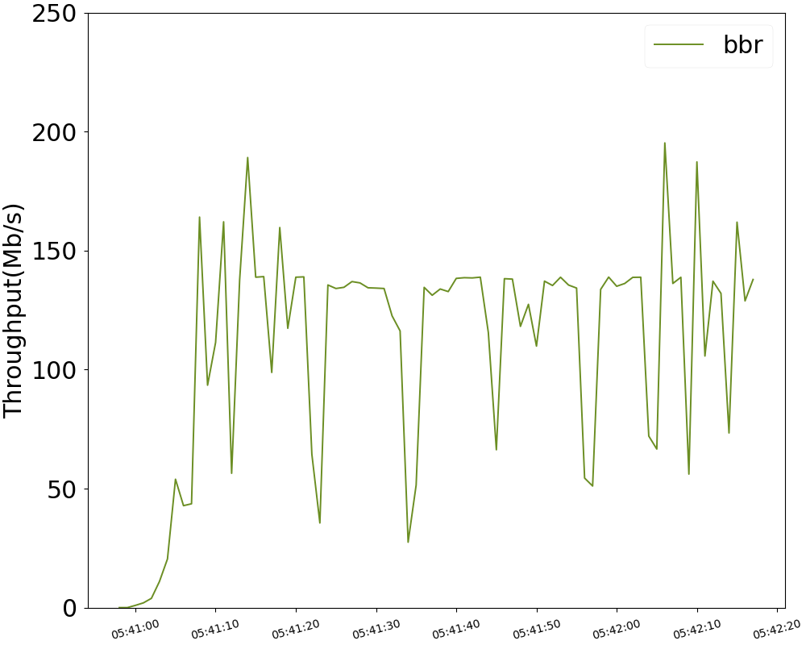
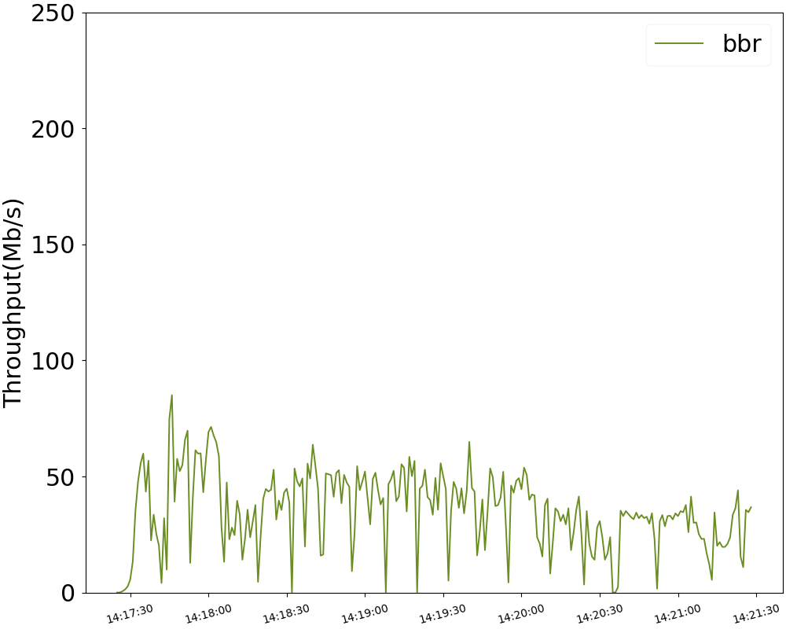
BBR
Best
Worst
Proxy on
Proxy off

Slide 13
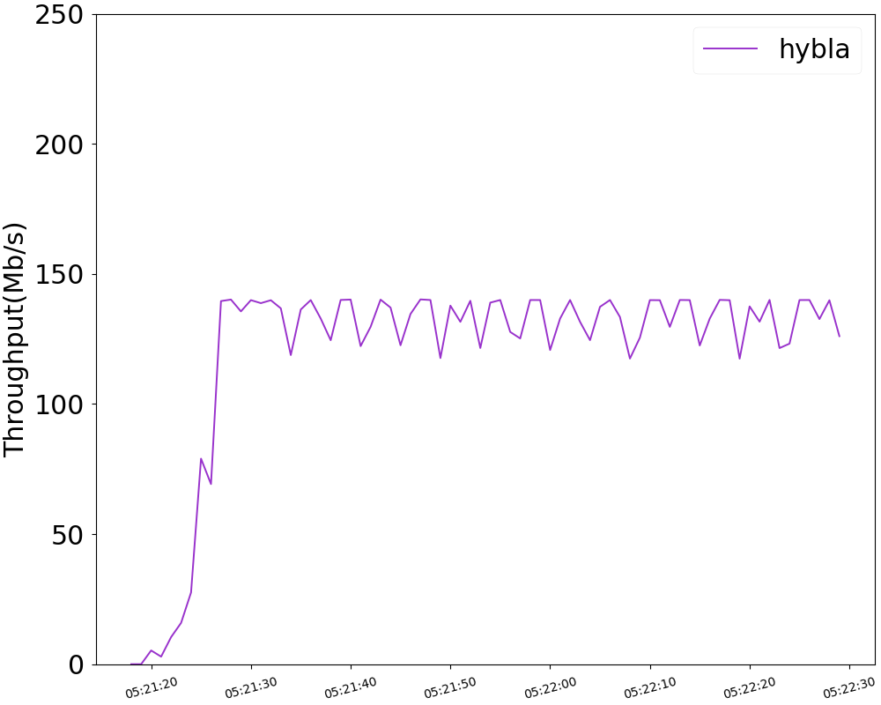
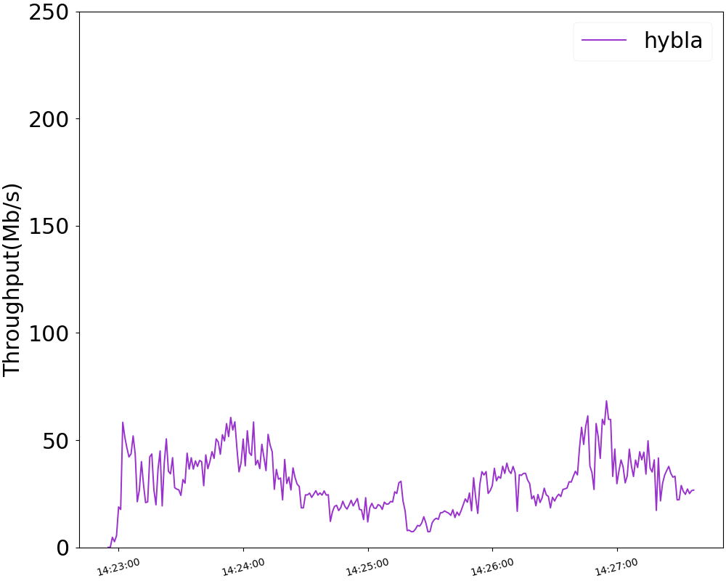
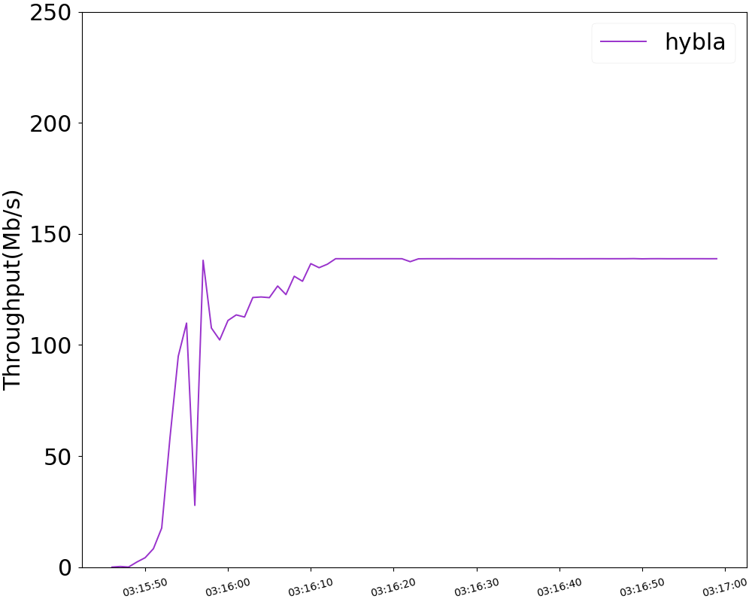
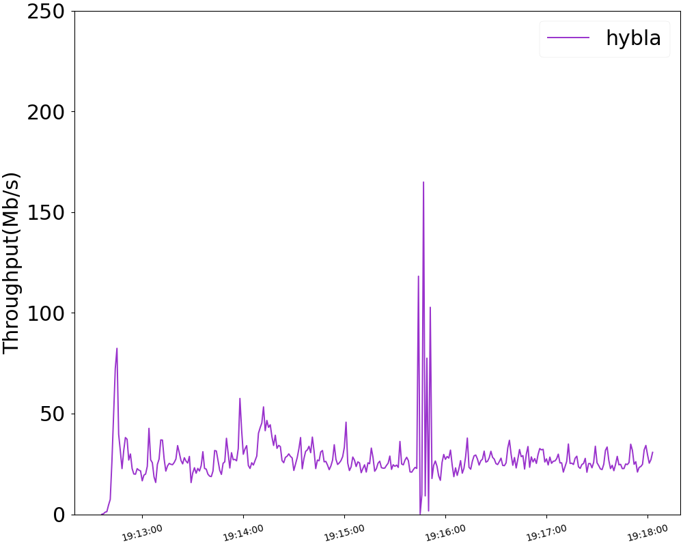
Hybla
Best
Worst
Proxy on
Proxy off

Slide 14
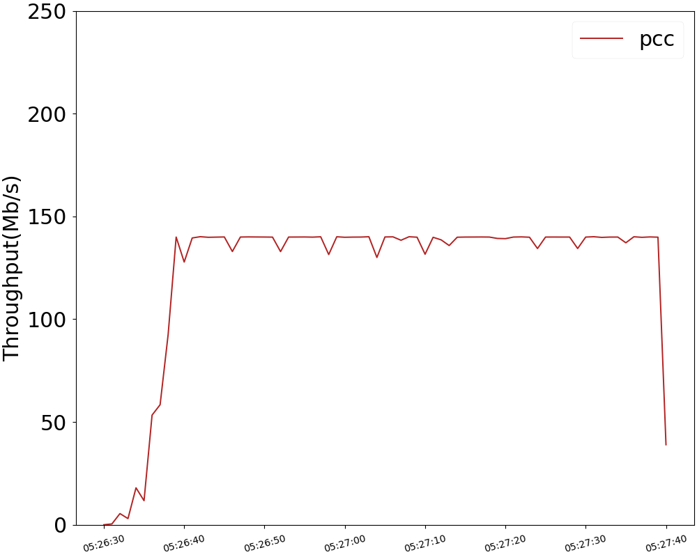
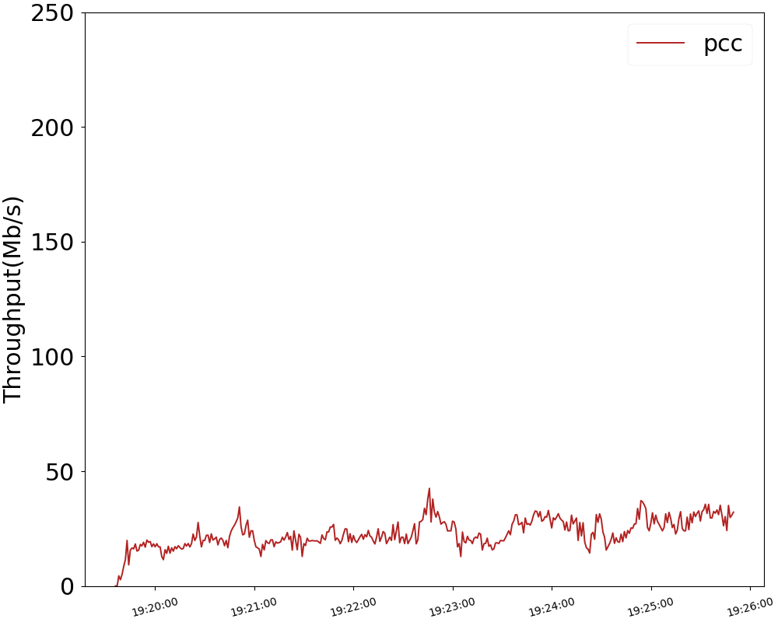
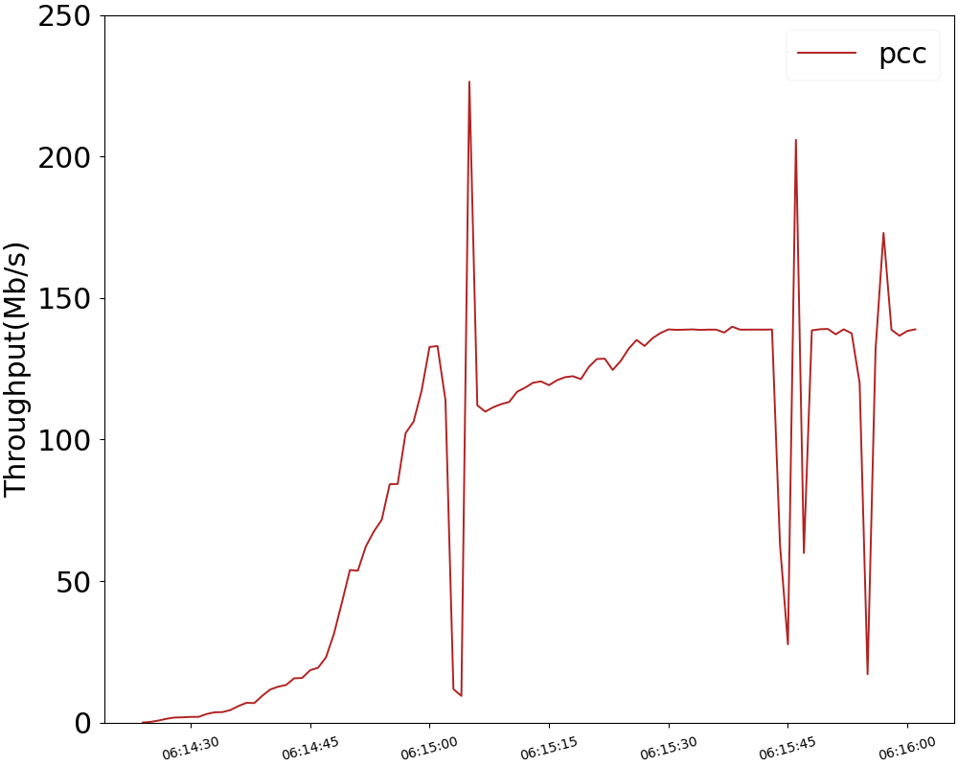
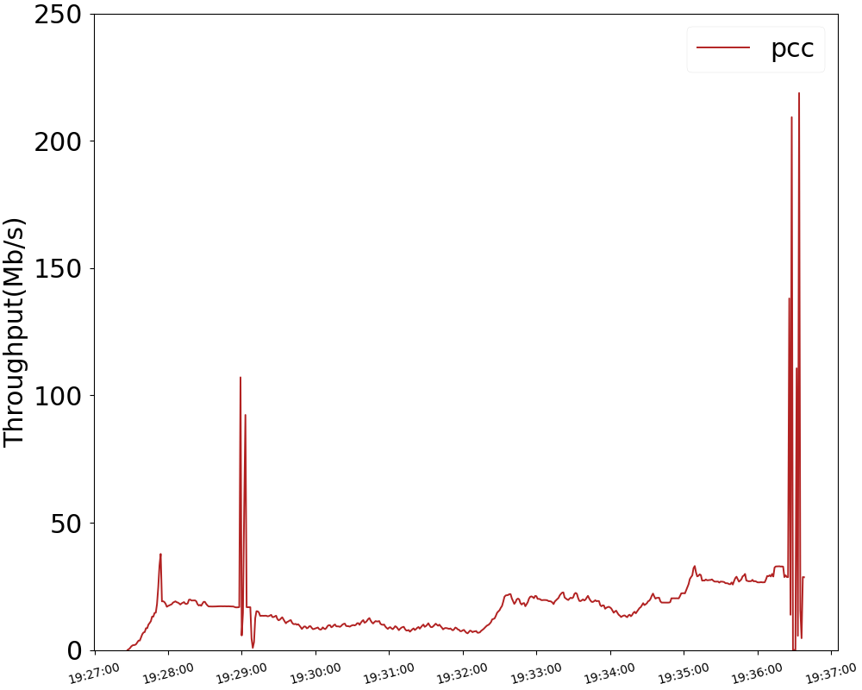
PCC
Best
Worst
Proxy on
Proxy off

Slide 15
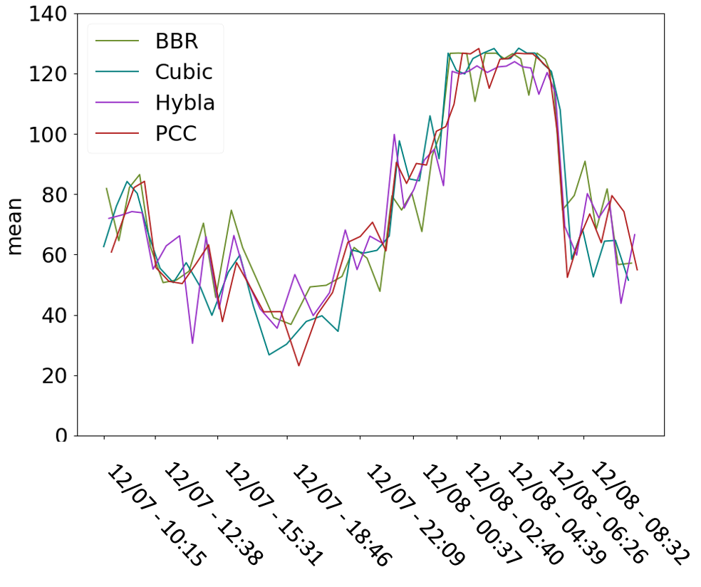
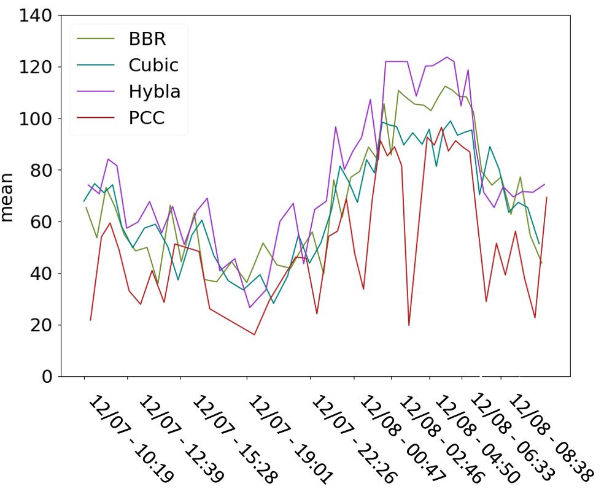
Weekday trial (24 hours)
Proxy on
Proxy off

Slide 16
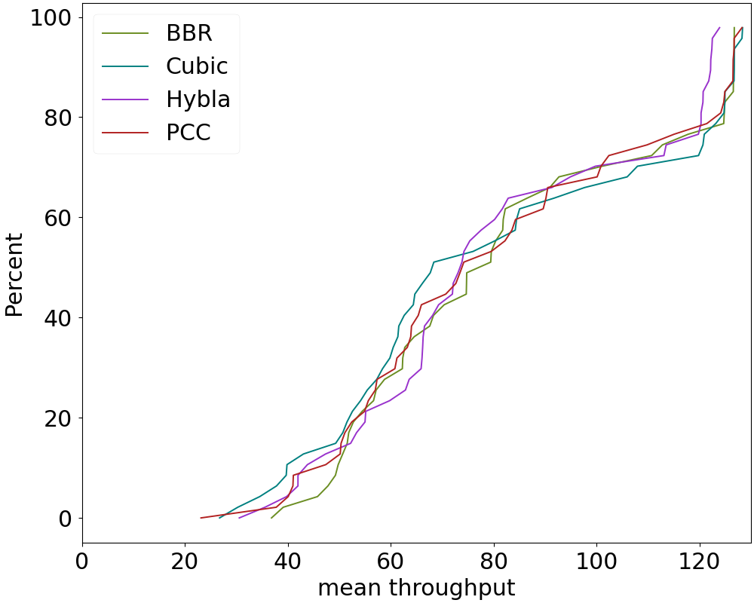
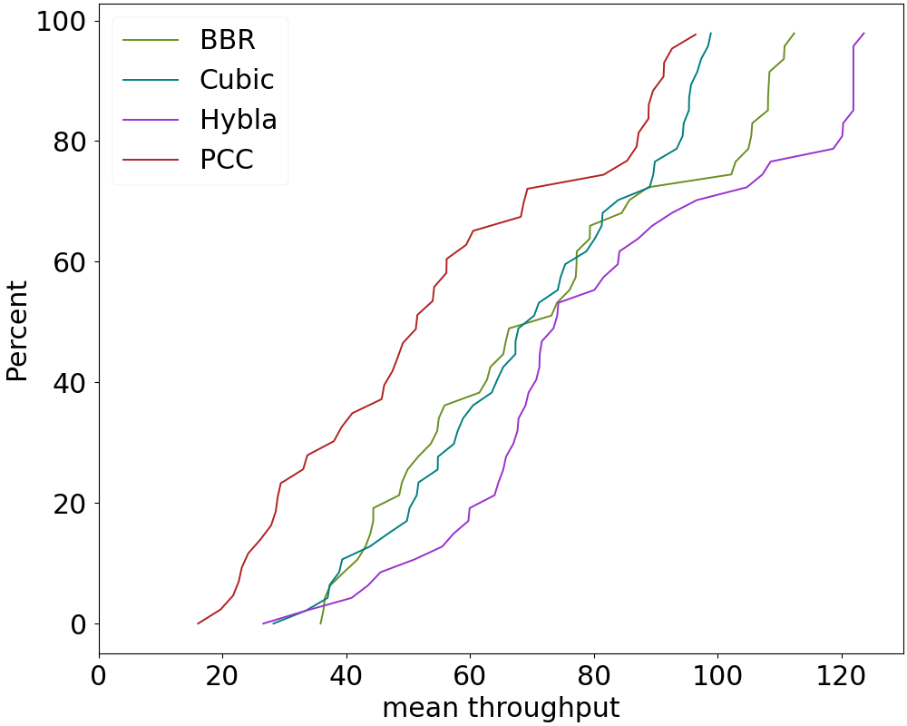
CDF (mean)
Proxy on
Proxy off

Slide 17
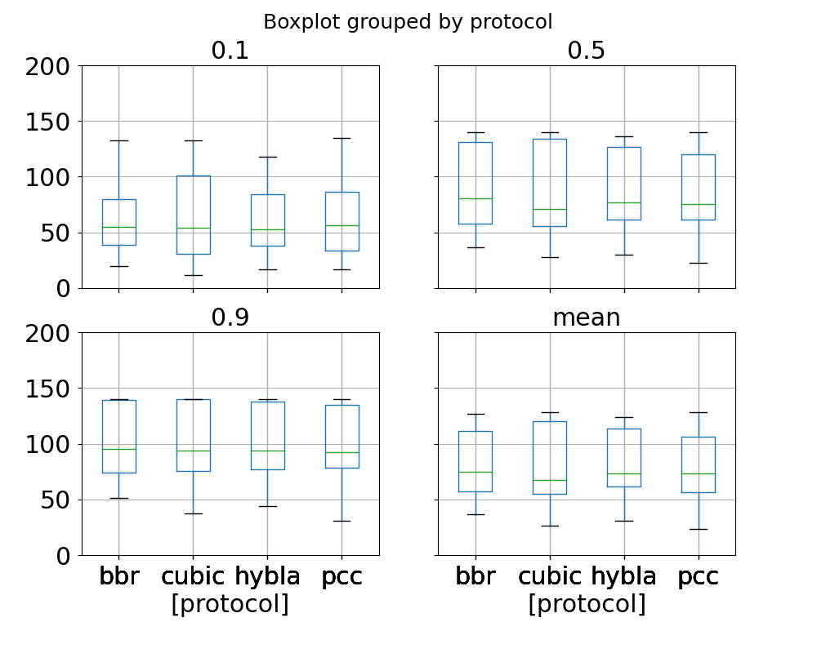
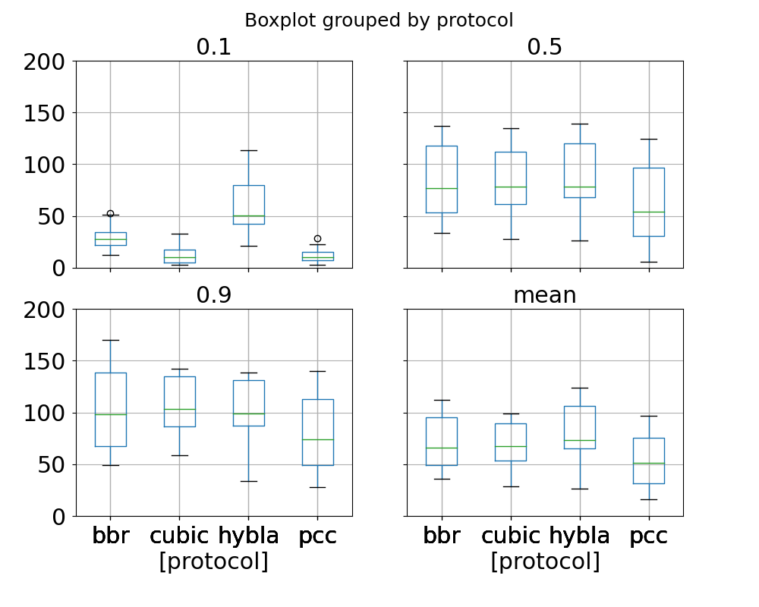
Boxplot
Proxy on
Proxy off

Slide 18
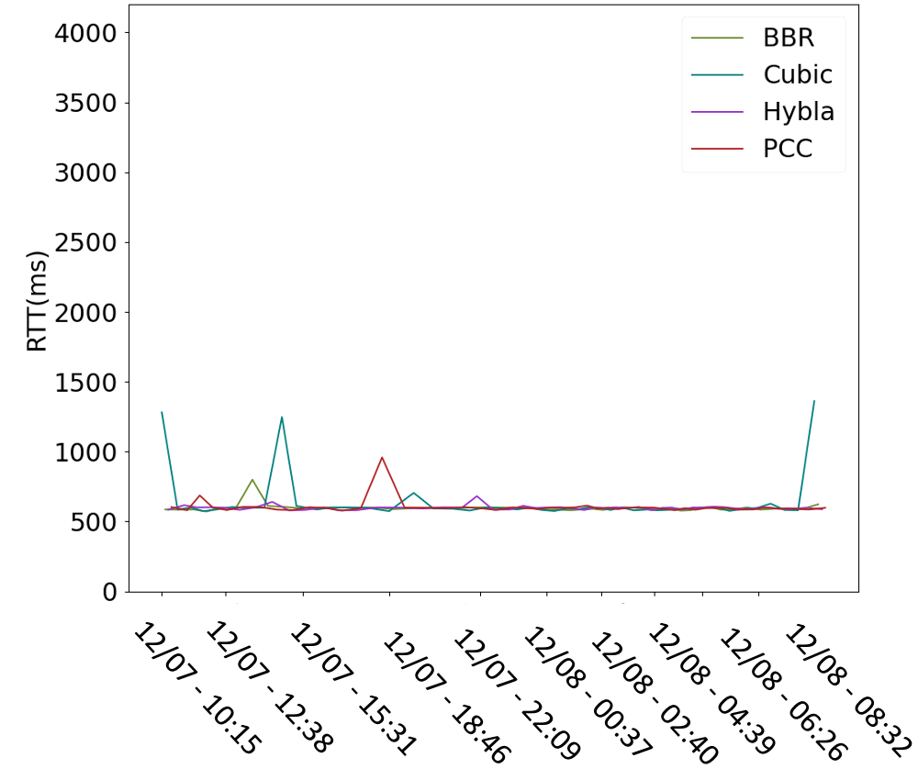
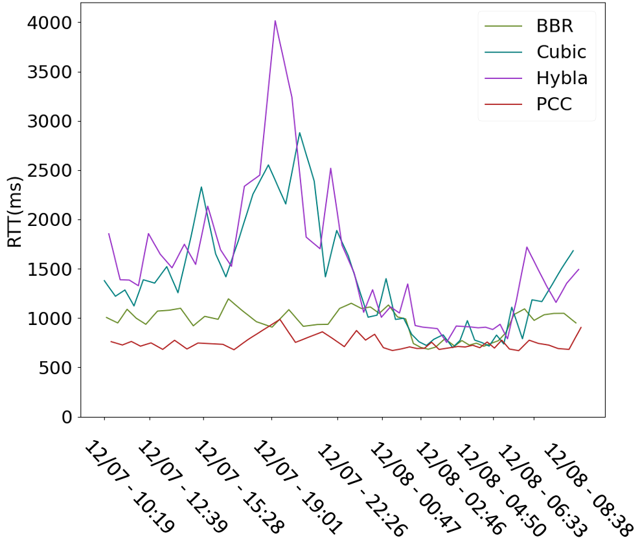
RTT over time
Proxy on
Proxy off

Slide 19
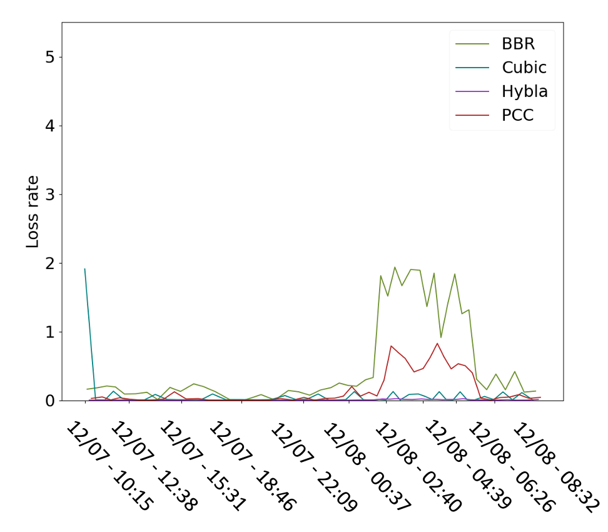
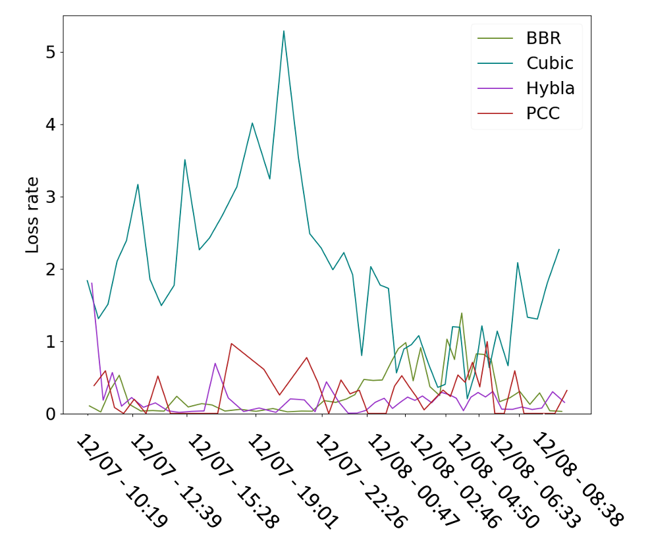
Loss over time
Proxy on
Proxy off

Slide 20
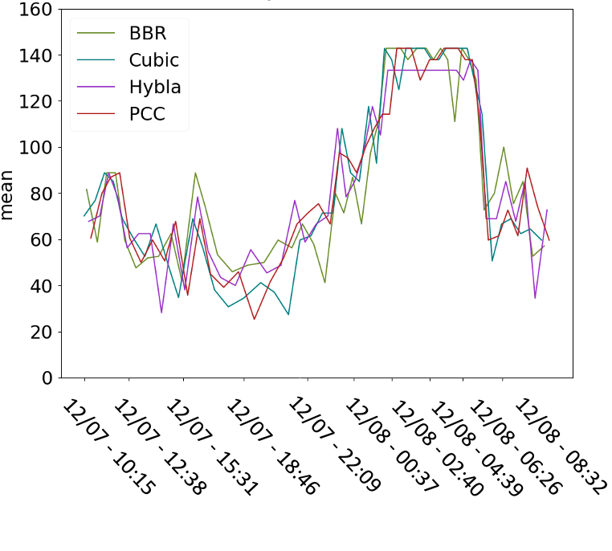
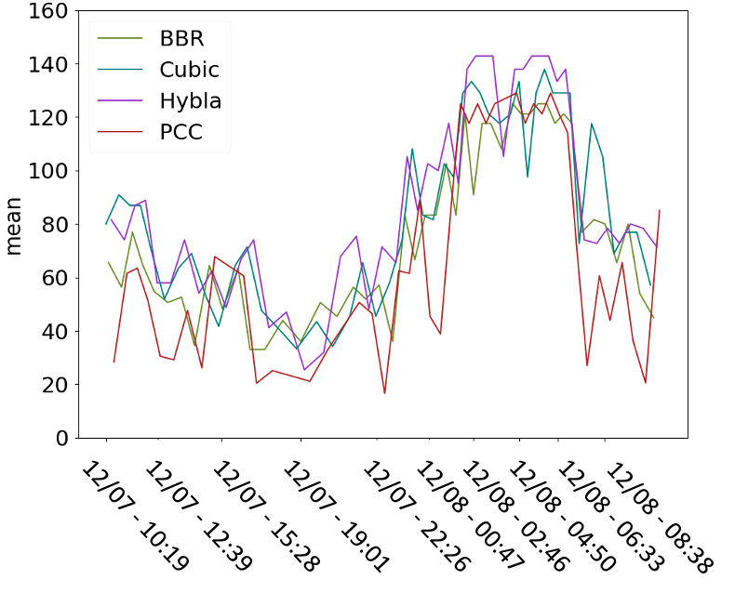
Weekday trial (steady state)
Proxy on
Proxy off

Slide 21
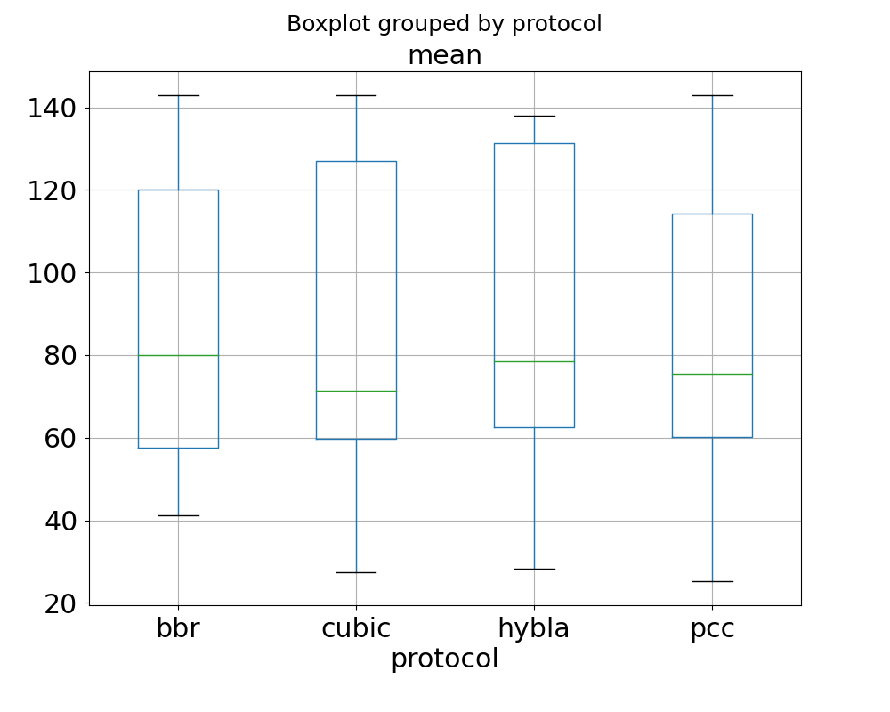
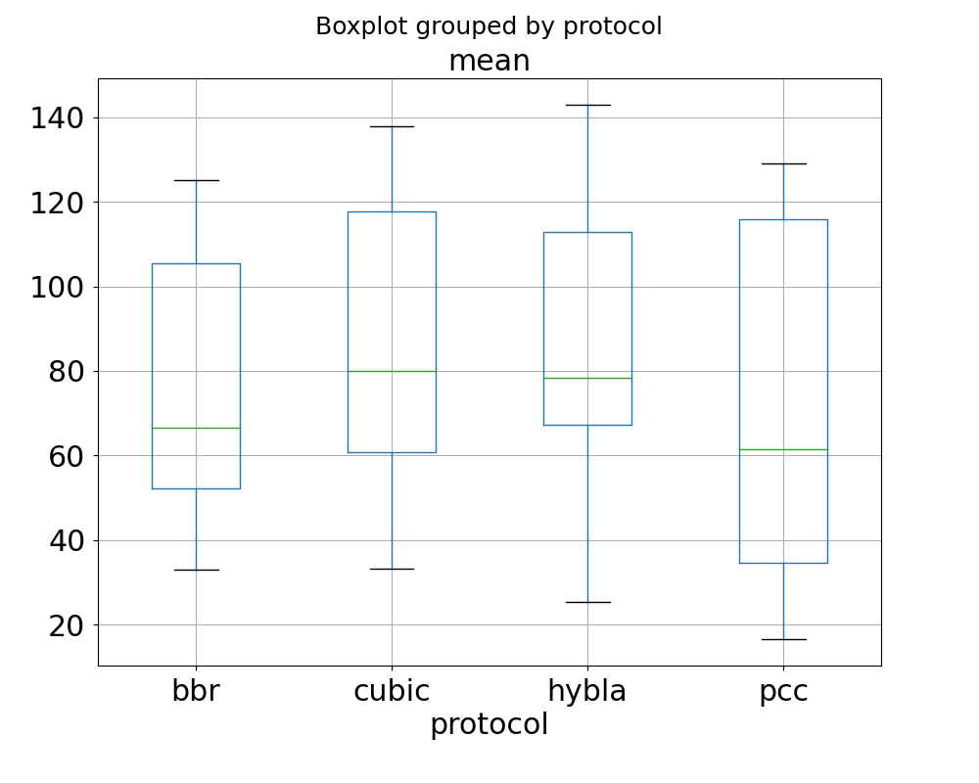
Boxplot (steady state)
Proxy on
Proxy off

Slide 22
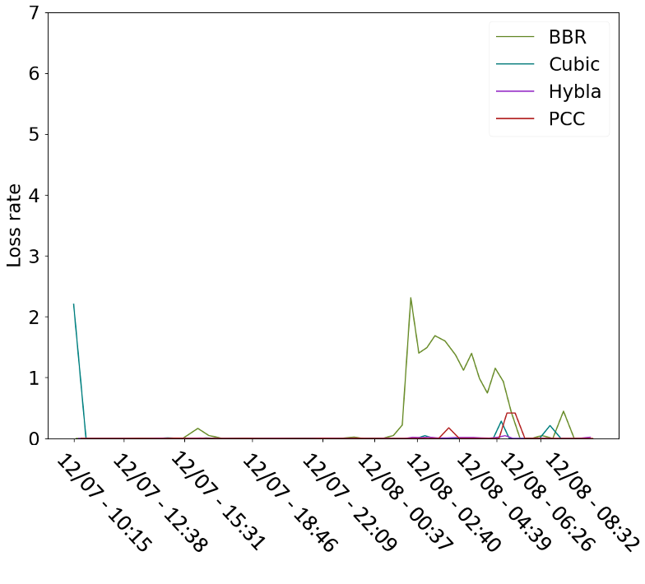
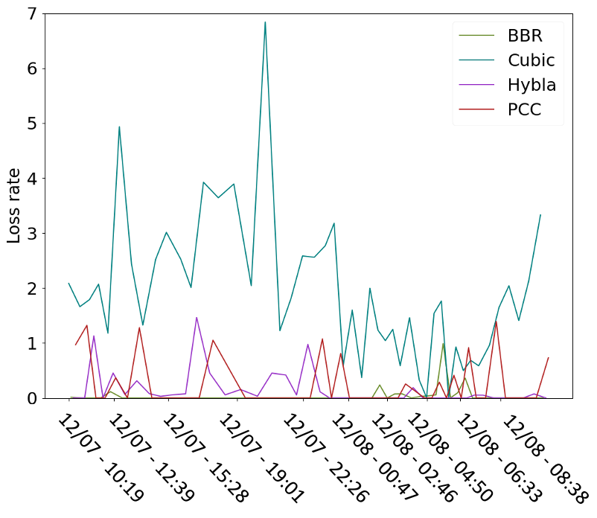
Loss over time (steady state)
Proxy on
Proxy off

Slide 23
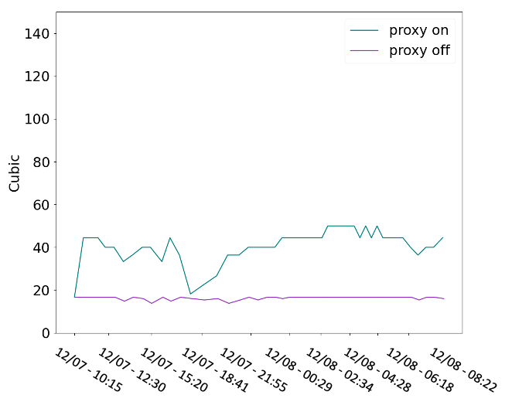
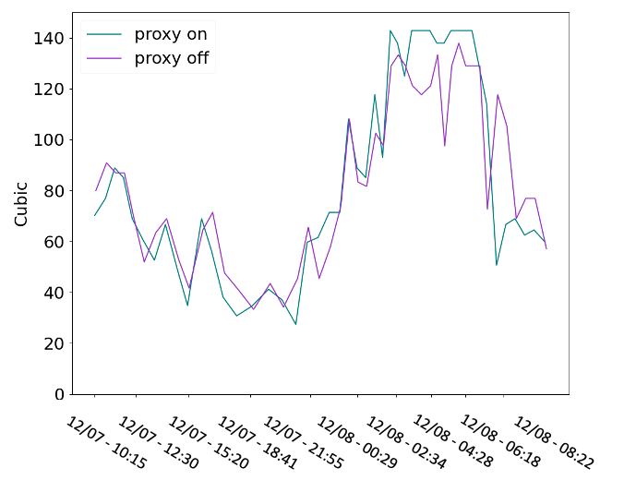
Average Diff & Standard Dev
Startup state
Steady state
Cubic | Mbytes/sec
Average difference | 24.6108975
Standard deviation | 7.4474517
Cubic(steady state) | Mbytes/sec
Average difference | 0.8478034
Standard deviation | 17.5729021

Slide 24
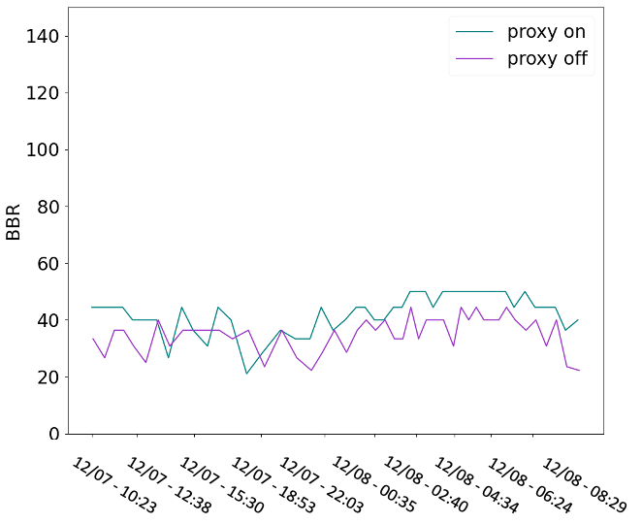
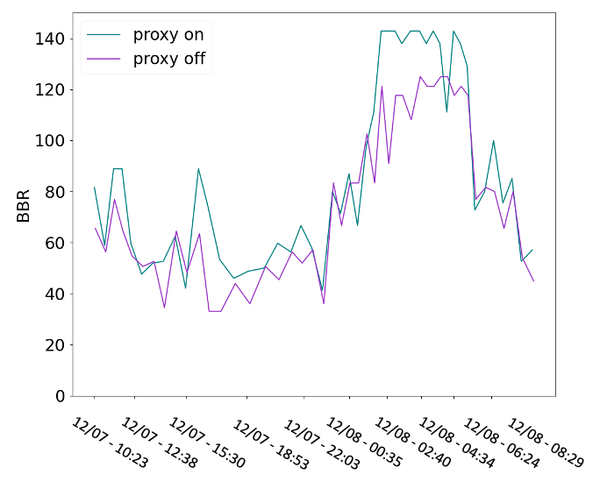
Average Diff & Standard Dev
Startup state
Steady state
BBR | Mbytes/sec
Average difference | 7.433451
Standard deviation | 6.535414
BBR(steady state) | Mbytes/sec
Average difference | 10.9672840
Standard deviation | 13.8420893

Slide 25
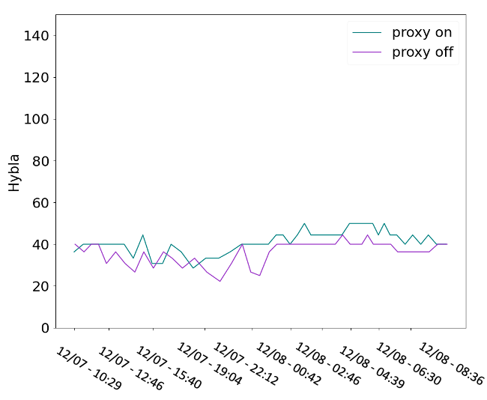
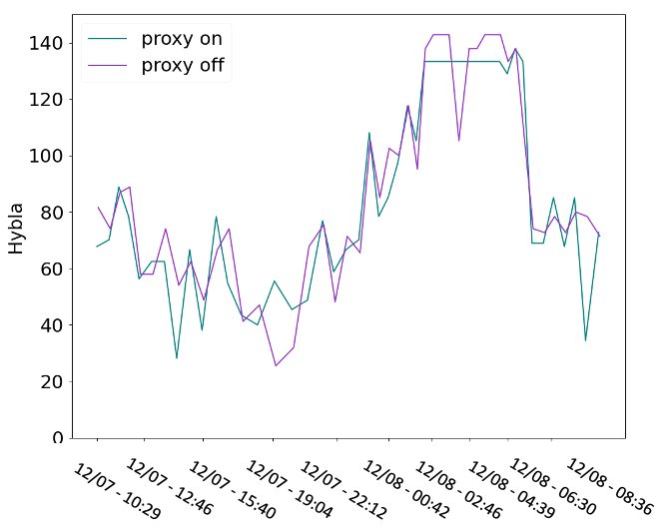
Average Diff & Standard Dev
Startup state
Steady state
Hybla | Mbytes/sec
Average difference | 5.106114
Standard deviation | 4.482034
Hybla(steady state) | Mbytes/sec
Average difference | -2.6286000
Standard deviation | 12.9442221

Slide 26
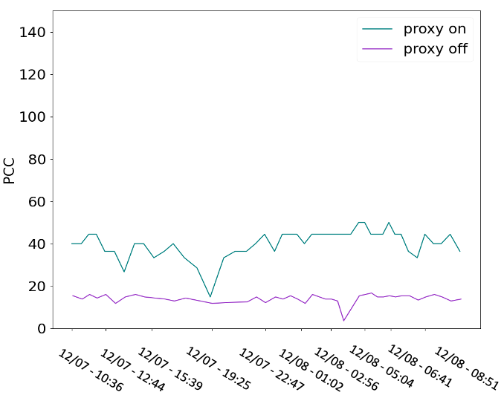
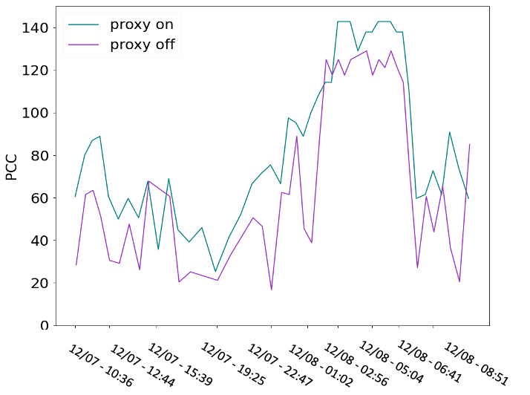
Average Diff & Standard Dev
Startup state
Steady state
PCC | Mbytes/sec
Average difference | 26.195413
Standard deviation | 6.631563
PCC(steady state) | Mbytes/sec
Average difference | 19.9629806
Standard deviation | 31.0013881

Slide 27
Summary
Complete(Mbytes/sec) | Cubic | BBR | Hybla | PCC
Average difference | 10.7816896 | 10.1398785 | -1.013994 | 27.6126552
Standard deviation | 16.4409405 | 9.5258862 | 9.62518649 | 25.5394993
Startup state(Mbytes/sec) | Cubic | BBR | Hybla | PCC
Average difference | 24.6108975 | 7.433451 | 5.106114 | 26.195413
Standard deviation | 7.4474517 | 6.535414 | 4.482034 | 6.631563
Steady state(Mbytes/sec) | Cubic | BBR | Hybla | PCC
Average difference | 0.8478034 | 10.9672840 | -2.6286000 | 19.9629806
Standard deviation | 17.5729021 | 13.8420893 | 12.9442221 | 31.0013881

Slide 28
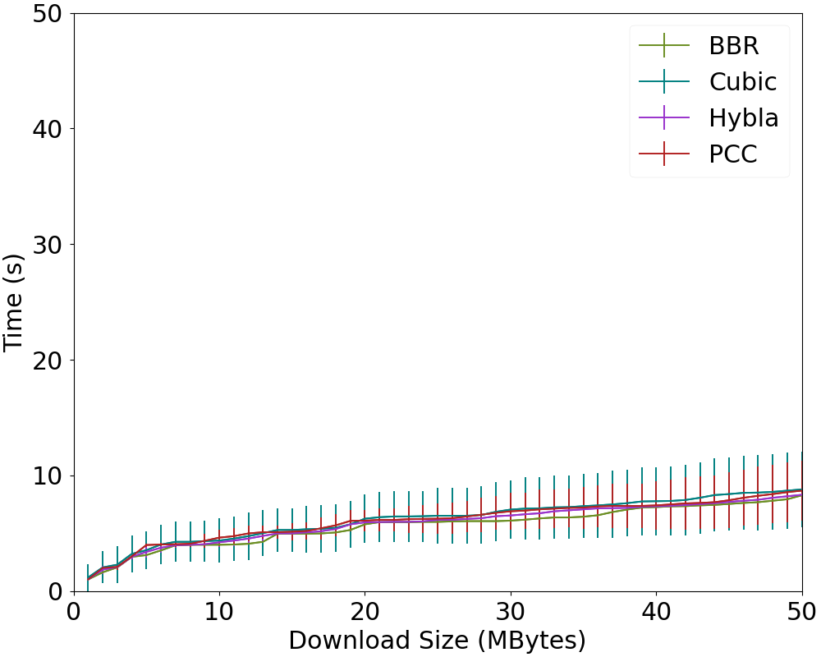
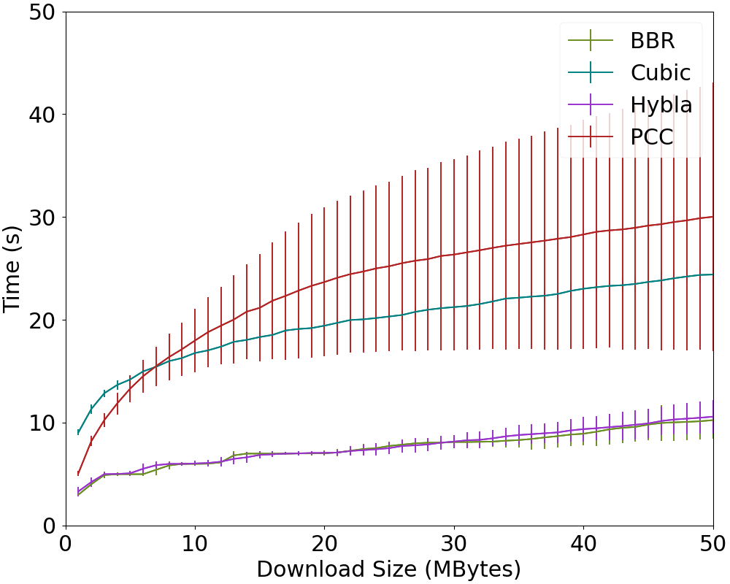
Download time vs. Download object size
Proxy on
Proxy off

Slide 29
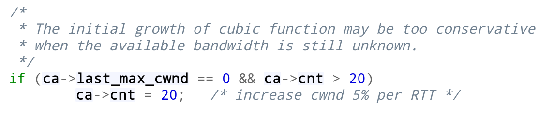
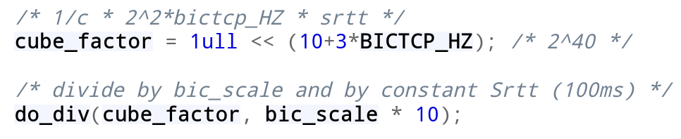
Linux Cubic Observations
During initial growth, an additional 5% growth per RTT should be observed
Ideal center for baseline growth observation lies at 100ms RTT
The default tcp_cubic refresh rate is 2^10 updates/sec. I hypothesize a performance barrier exists at RTT<1/1024 sec
Hystart off initial_ssthresh is ~10^9 bytes

Slide 30
Linux Cubic Observations
Possible that deviations from the expected 100ms lead to premature linear growth (As mentioned in "TCP startup performance in Large Bandwidth Delay Networks") (Observed on our connection RTT~0.5ms).
I'm unsure if this is related to our lower-than-expected growth speed over the satellite connection with respect to init_cwnd. A miscalculation of the cubic_power variable with respect to the RTT.
Testing setup:
Artificially imposed delay ranging from 0ms to 1024ms including tests at 100ms and 600 ms (near Satellite RTT).
Comparisons between cwnd impact in LAN vs link.
Might be possible to modify kernel to include new hardcoded value of cubic_power with standard RTT=600ms.

