Slide 1
Methodology
4 Machines * 2 Proxy modes * 55 rounds
Last about 30 hours

Slide 2
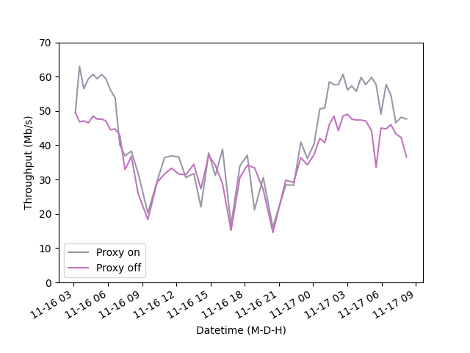
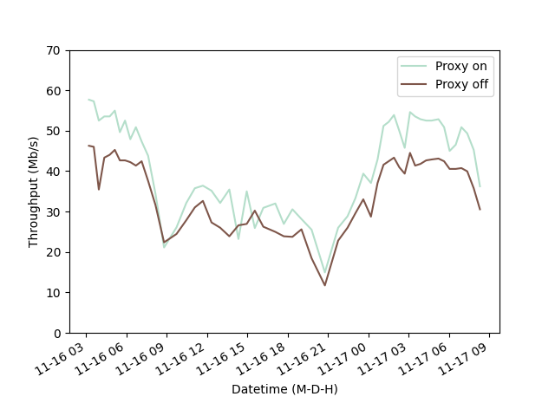
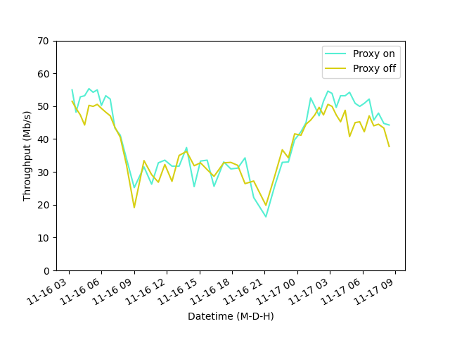
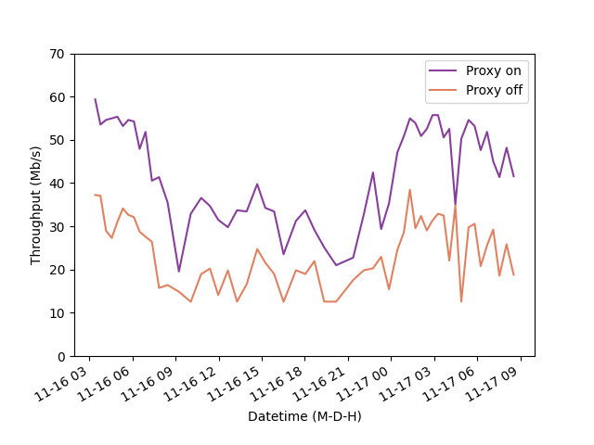
Comparison of congestion control algorithms with proxy on/off
Cubic
BBR
Hybla
PCC

Slide 3
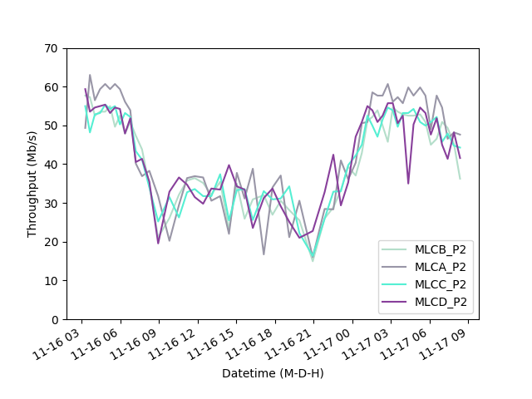
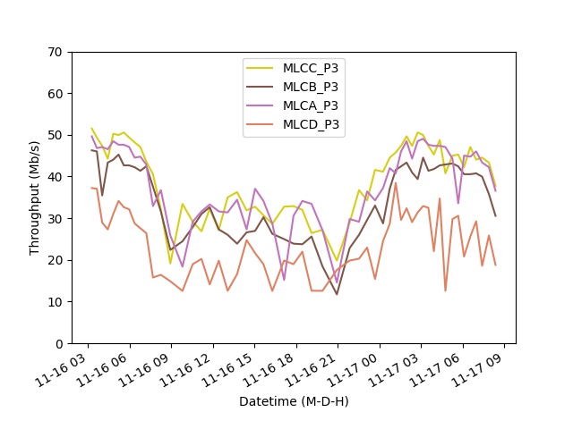
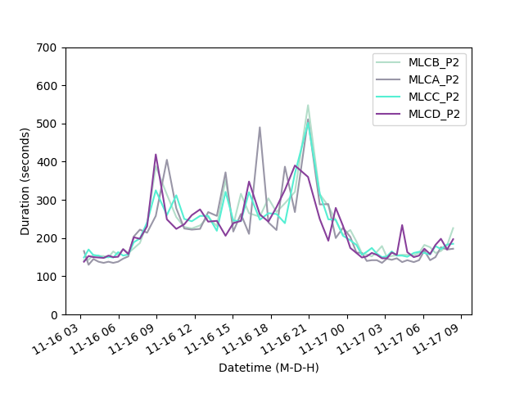
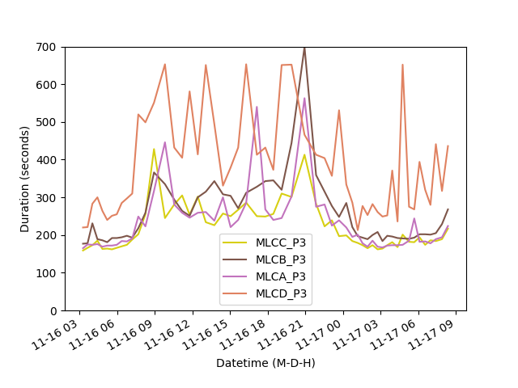
Comparison of proxy on/off across 4 servers
Proxy on
Proxy off
Hybla
BBR
Cubic
PCC
BBR
Cubic
Hybla
PCC
BBR
Cubic
Hybla
PCC
Hybla
BBR
Cubic
PCC

Slide 4
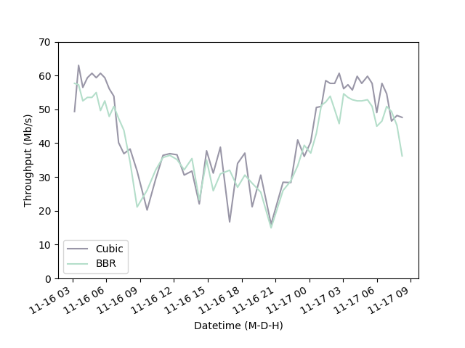
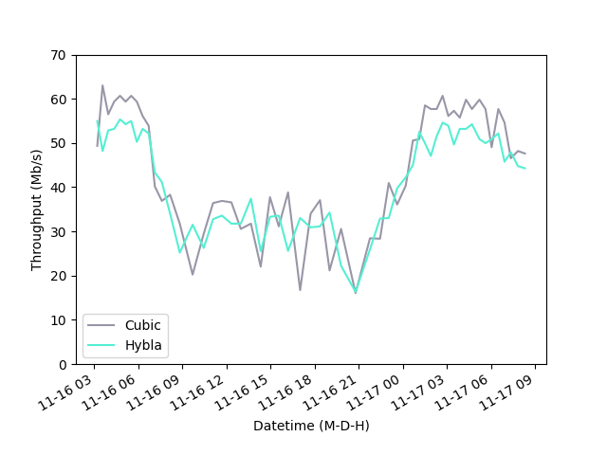
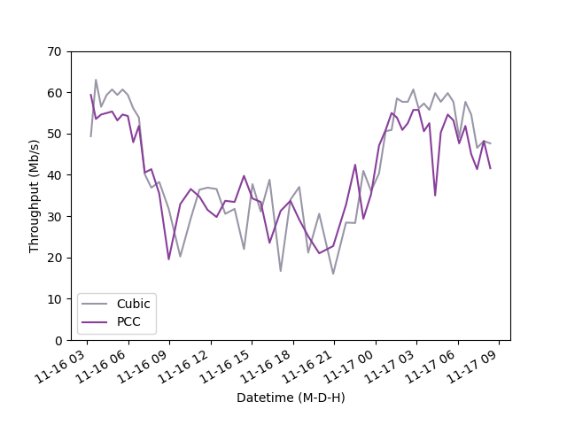
Comparison of cubic vs other with proxy on
Cubic vs BBR
Cubic vs Hybla
Cubic vs PCC

Slide 5
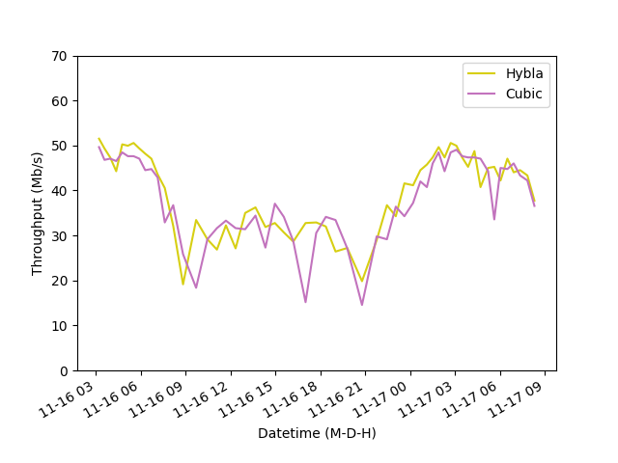
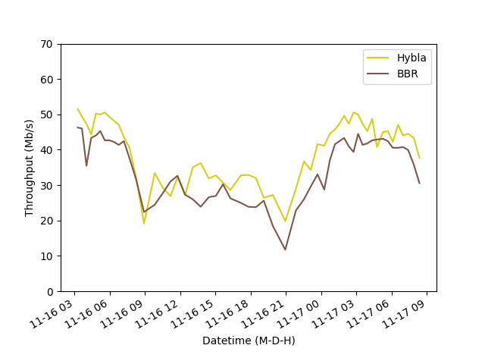
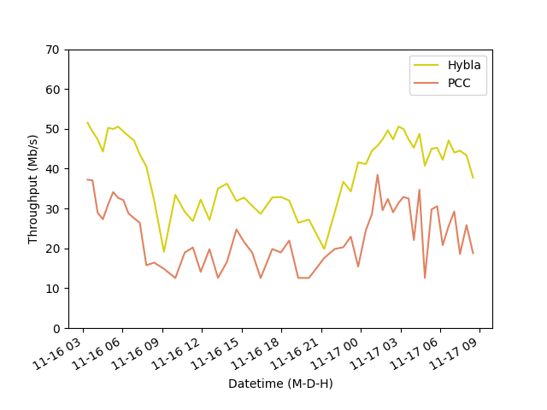
Comparison of cubic vs other with proxy off
Hybla vs Cubic
Hybla vs BBR
Hybla vs PCC

Slide 6
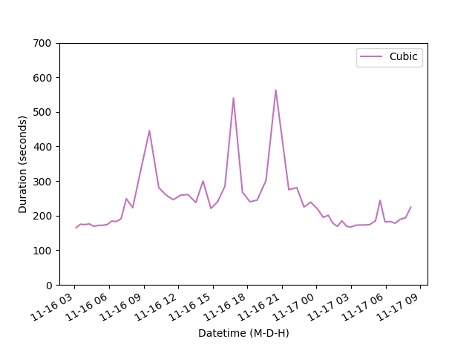
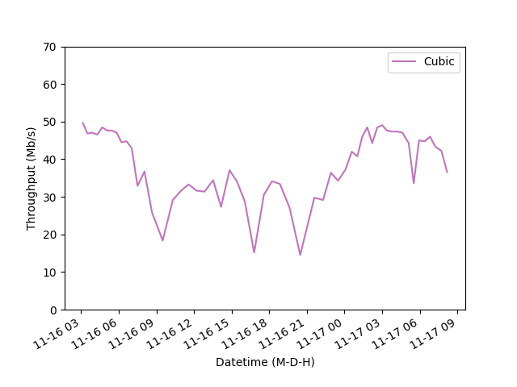
Busy hour traffic
Transmission time
Throughput

Slide 7
Next Step
1. Run more trails with 24 hours time length
2. Calculate average differences (table with avg diff & std dev) between proxy on/off
3. Analyzing busy/non-busy hours/period
4. Statistical significance test (t-test) & effect size(noise)
5. BoxPlots based on summary csv file
6. Hystart off/on
7. Record RTT/Loss
8. Three way hand shake (Tcp.init_rtt)
9. Taking the best & worst case
10. Verify peak in a single trail
11. UDP Ping in script (250ms)
12. Cdf distribution
13. small objects

