Slide 1
Energy-Conscious Prototype for Enabling Multi-Protocol Wireless Communications
Travis Collins, Patrick DeSantis, David Vecchiarelli, Alexander M. Wyglinski Worcester Polytechnic Institute, Worcester, MA, USA

Slide 2
Presentation Overview
Motivation
Problem Statement
Proposed Approach
Experimental Results
Conclusion

Slide 3


Global Energy Crisis
Wireless Communications use 3% of world-wide energy.
Causes the same amount of C0₂ emissions as ¼ of the cars in the world.
Equivalent to annual output of 6,000 coal power plants.

Slide 4
Consumers Demand Battery Life
Smartphone power consumption

Slide 5
Presentation Overview
Motivation
Problem Statement
Proposed Approach
Experimental Results
Conclusion

Slide 6
Problem Statement
Consequently, given the level of energy consumption and its associated impact on the environment, coupled with comparatively slow advances in battery technology, has made energy efficiency and power saving strategies an increasingly important design challenge for modern wireless devices.

Slide 7
Presentation Overview
Motivation
Problem Statement
Proposed Approach
Experimental Results
Conclusion

Slide 8


Proposed Approach
Many mobile devices support several wireless protocols, such as Wi-Fi, Bluetooth, and 3G. Benefits can be gained through a combination of such protocols for several goals including power savings
By utilizing Wi-Fi and ZigBee, this research examined power saving, through the realization of the relatively minimal data utilization of mobile users

Slide 9
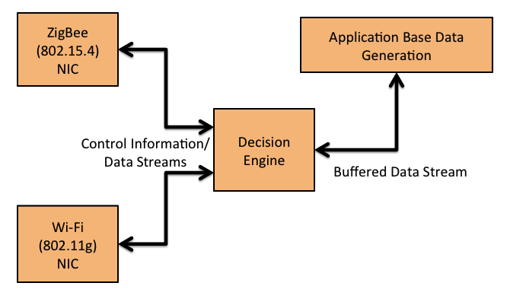
Concept Diagram

Slide 10
Proposed Prototype
The prototype implementation only utilized two nodes, a mobile user and a base station or router. All power savings and adaptive protocol switching focused on the mobile user. Since it was assumed that the base station operated using a stable power source, its energy consumption was neglected in this research.
Each node in the network was equipped with both a ZigBee and a Wi-Fi radio interface such that the appropriate inter-face can be selected by a decision-making algorithm running onboard the system.

Slide 11
Design Goals
Alternating between two complementary wireless standards without sacrificing mobility and throughput, and decreasing communications power consumption over time.
Intelligently monitoring the bandwidth of multiple radios directly and reacting to changes in the bandwidth.
Power consumption aware by making decisions as well as alternating automatically based on power consumption, bandwidth needs, battery level, etc.

Slide 12
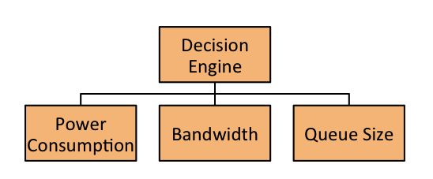
Switching Characteristics
*Queue size as an abstraction used to measure the amount of data pushed to the combined Wi-Fi/ZigBee interface

Slide 13
Physical Prototype
Off-the-shelf parts selected
No physical modifications made to interfaces
Software controls specific attributes of data flows to the interfaces and physical characteristics
Controls were implemented in the physical and networking layers
Both wireless networking interfaces were monitored directly to provide direct information about power consumption, and allow for evaluation of the switching intelligence of the mobile user.

Slide 14
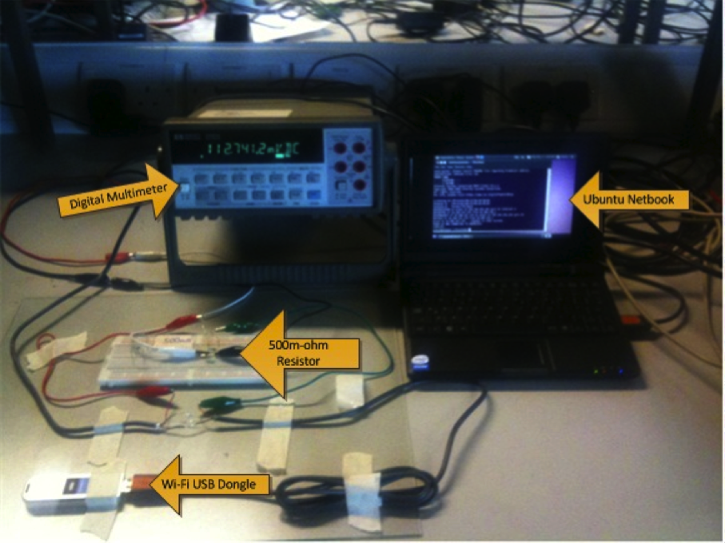
Hardware Implementation

Slide 15
Presentation Overview
Motivation
Problem Statement
Proposed Approach
Experimental Results
Conclusion

Slide 16
Experimental Results
Performance of ZigBee, Wi-Fi (PSM & CAM), and the proposed implementation evaluated with four tests:
File transfer 1, examines the power usage of a transfer that last for 25% of the test duration
File transfer 2, transfers file chunks for 80% of the test.
Web-browsing test, examines common web-browsing usage across a 60 second interval derived from the IMIX web studies of web-browsing habits
Idle test, examines power usages for 20 seconds during active no transfers or an idle state.

Slide 17
Energy Consumed

Slide 18
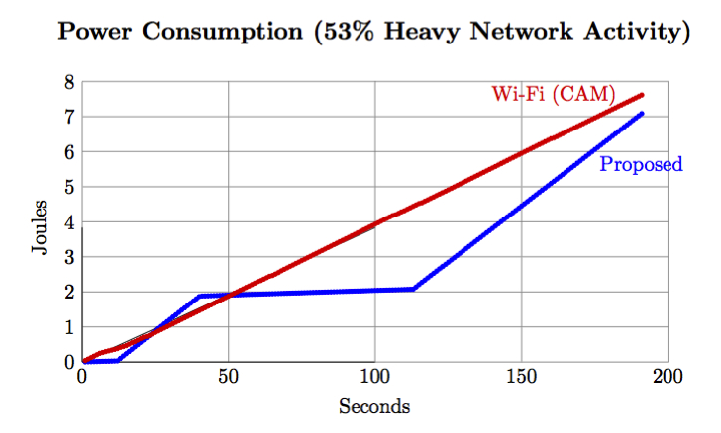
Wi-Fi (CAM) vs. Proposed Network

Slide 19
Presentation Overview
Motivation
Problem Statement
Proposed Approach
Experimental Results
Conclusion

Slide 20
Conclusion
The applications for multiprotocol systems are far ranging, from large scale communication networks, to household appliances and networks. The greatest advantage is the simplicity of the proposed concept.
The prototype implementation achieved the following goals:
A Multi-protocol Networking Device: The system was able to utilize dual radio protocols to transmit data synchronously.
Power Efficiency: The system was able to considerably reduce the communications power consumed compared with a single protocol network.
Performance Transparency: The multiprotocol network performed equally or greater than the a single protocol network as in terms of throughput.
Commercially Available Equipment: This project only utilized off the shelf part in both nodes of the network.

Slide 21
For More Information
Professor Alexander Wyglinski
Department of Electrical and Computer Engineering
Worcester Polytechnic Institute
Atwater Kent Laboratories, Room AK230
508-831-5061
alexw@ece.wpi.edu
http://www.wireless.wpi.edu/

Slide 22
Thank You!

