Slide 1
MSCBD 5002/MSCIT 5210: Knowledge Discovery and Data Mining
Acknowledgement: Slides modified based on the slides provided by Lawrence Page, Sergey Brin, Rajeev Motwani and Terry Winograd, Jon M. Kleinberg

Slide 2
PageRank & HITS: Bring Order to the Web
Background and Introduction
Approach – PageRank
Approach – Authorities & Hubs

Slide 3
Motivation and Introduction
Why is Page Importance Rating important?
  New challenges for information retrieval on the World Wide Web.
      Huge number of web pages: 150 million by1998
      1000 billion by 2008
      Diversity of web pages: different topics, different quality, etc.
Hard to imagine no ranking algorithms in search engine.
Data Mining: Concepts and Techniques

Slide 4
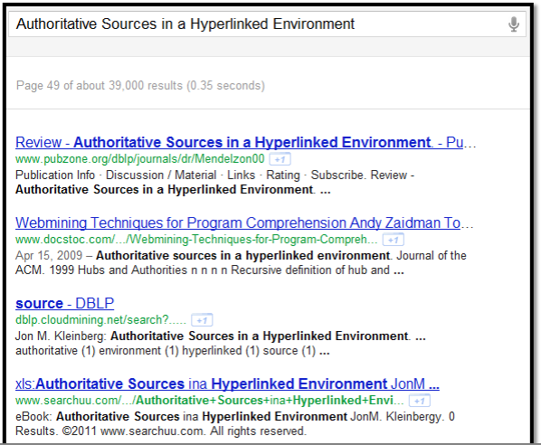
Motivation and Introduction
Hard to imagine no ranking algorithms in search engine.
Data Mining: Concepts and Techniques

Slide 5
Motivation and Introduction
Modern search engines may return millions of pages for a single query. This amount is prohibitive to preview for human users.
Ranking algorithms will process the search results and only show the most useful information to the search engine user.
Data Mining: Concepts and Techniques

Slide 6
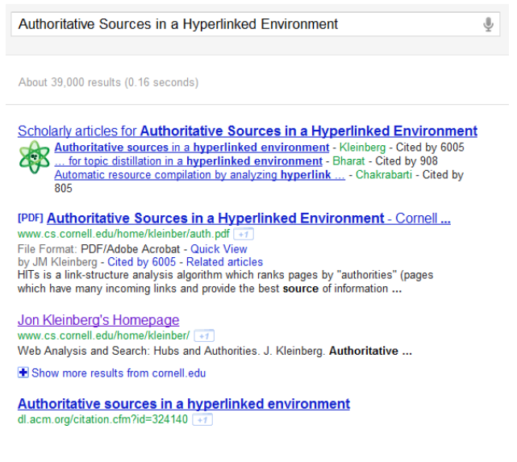

Motivation and Introduction
Data Mining: Concepts and Techniques

Slide 7
PageRank: History
PageRank was developed by Larry Page (hence the name Page-Rank) and Sergey Brin.
It is first as part of a research project about a new kind of search engine. That project started in 1995 and led to a functional prototype in 1998.
Shortly after, Page and Brin founded Google.
Data Mining: Concepts and Techniques

Slide 8
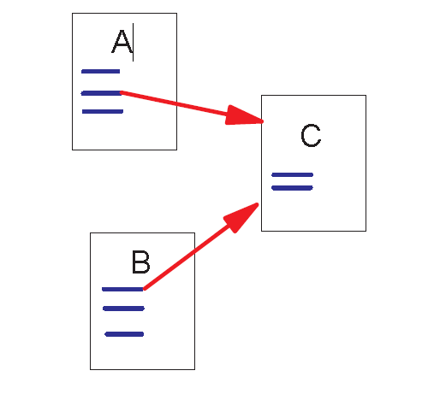
Link Structure of the Web
150 million web pages → 1.7 billion links
Backlinks and Forward links:
A and B are C’s backlinks
C is A and B’s forward link
Intuitively, a webpage is important if it has a lot of backlinks.
What if a webpage has only one link off www.yahoo.com?
Data Mining: Concepts and Techniques

Slide 9
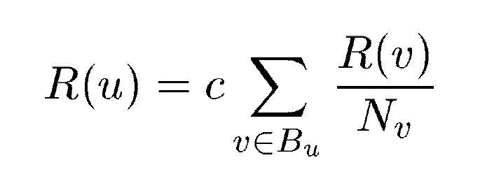
PageRank: A Simplified Version
u: a web page
B_{u}: the set of u’s backlinks
N_{v}: the number of forward links of page v
c: the normalization factor to make ||R||_{L1} = 1 (||R||_{L1}= |R₁ + … + R_{n}|)
Data Mining: Concepts and Techniques

Slide 10
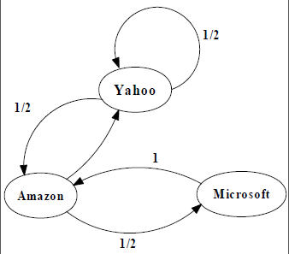
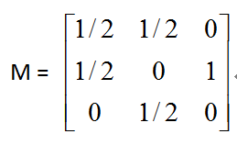
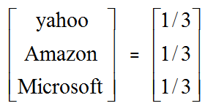
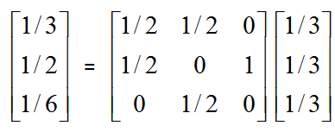
An example of Simplified PageRank
PageRank Calculation: first iteration
Data Mining: Concepts and Techniques

Slide 11
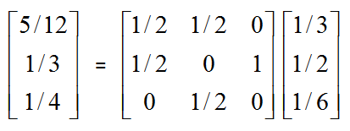
An example of Simplified PageRank
PageRank Calculation: second iteration
Data Mining: Concepts and Techniques

Slide 12
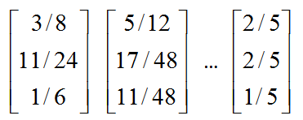
An example of Simplified PageRank
Convergence after some iterations
Data Mining: Concepts and Techniques

Slide 13
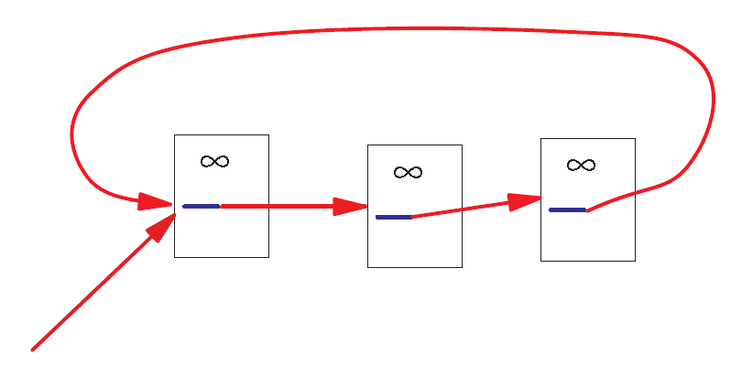
A Problem with Simplified PageRank
A loop:
During each iteration, the loop accumulates rank but never distributes rank to other pages!
Data Mining: Concepts and Techniques

Slide 14
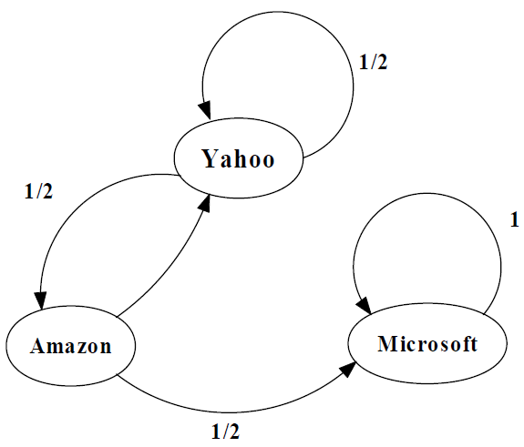
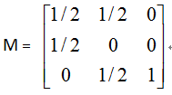
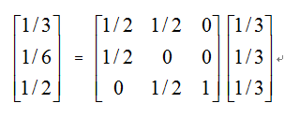
An example of the Problem

Slide 15
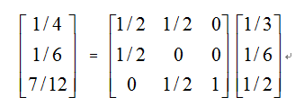
An example of the Problem

Slide 16
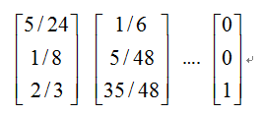
An example of the Problem

Slide 17
Random Walks in Graphs
The Random Surfer Model
  The simplified model: the standing probability distribution of a random walk on the graph of the web. simply keeps clicking successive links at random
The Modified Model
  The modified model: the “random surfer” simply keeps clicking successive links at random, but periodically “gets bored” and jumps to a random page based on the distribution of E

Slide 18
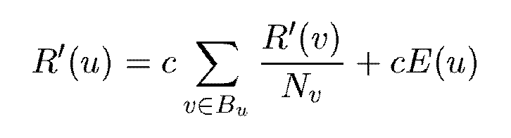


Modified Version of PageRank
E(u): a distribution of ranks of web pages that “users” jump to
when they “gets bored” after successive links at random.

Slide 19

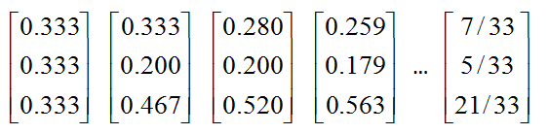
An example of Modified PageRank

Slide 20
Dangling Links
Links that point to any page with no outgoing links
Most are pages that have not been downloaded yet
Affect the model since it is not clear where their weight should be distributed
Do not affect the ranking of any other page directly
Can be simply removed before pagerank calculation and added back afterwards

Slide 21
PageRank Implementation
Convert each URL into a unique integer and store each hyperlink in a database using the integer IDs to identify pages
Sort the link structure by ID
Remove all the dangling links from the database
Make an initial assignment of ranks and start iteration
    Choosing a good initial assignment can speed up the pagerank
Adding the dangling links back.

Slide 22
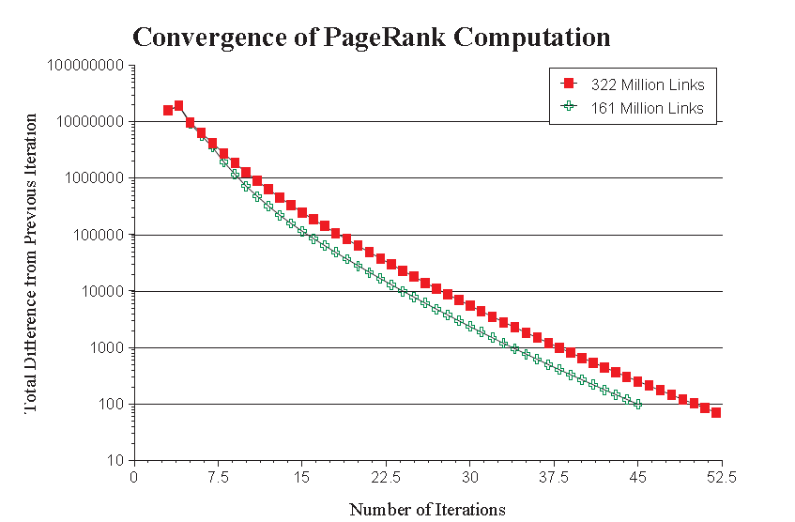
Convergence Property
PR (322 Million Links): 52 iterations
PR (161 Million Links): 45 iterations
Scaling factor is roughly linear in logn

Slide 23
Convergence Property
The Web is an expander-like graph
  Theory of random walk: a random walk on a graph is said to be rapidly-mixing if it quickly converges to a limiting distribution on the set of nodes in the graph. A random walk is rapidly-mixing on a graph if and only if the graph is an expander graph.
  Expander graph: every subset of nodes S has a neighborhood (set of vertices accessible via outedges emanating from nodes in S) that is larger than some factor α times of |S|. A graph has a good expansion factor if and only if the largest eigenvalue is sufficiently larger than the second-largest eigenvalue.

Slide 24
PageRank vs. Web Traffic
Some highly accessed web pages have low page rank possibly because
  People do not want to link to these pages from their own web pages (the example in their paper is pornographic sites…)
  Some important backlinks are omitted
  use usage data as a start vector for PageRank.

Slide 25
Hypertext-Induced Topic Search(HITS)
To find a small set of most “authoritative’’ pages relevant to the query.
Authority – Most useful/relevant/helpful results of a query.
  “java’’ – java.com
  “harvard’’ – harvard.edu
  “search engine’’ – powerful search engines.
Data Mining: Concepts and Techniques

Slide 26
Hypertext-Induced Topic Search(HITS)
Or Authorities & Hubs, developed by Jon Kleinberg, while visiting IBM Almaden
IBM expanded HITS into Clever.
Authorities – pages that are relevant and are linked to by many other pages
Hubs – pages that link to many related authorities
Data Mining: Concepts and Techniques

Slide 27
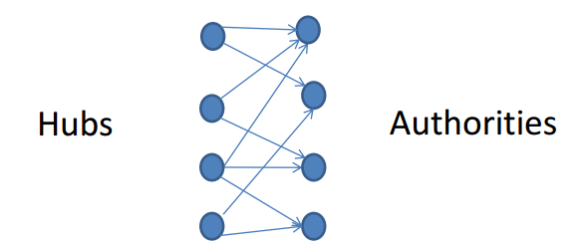
Authorities & Hubs
Intuitive Idea to find authoritative results using link analysis:
  Not all hyperlinks related to the conferral of authority.
  Find the pattern authoritative pages have:
    Authoritative Pages share considerable overlap in the sets of pages that point to them.
Data Mining: Concepts and Techniques

Slide 28
Authorities & Hubs
First Step:
  Constructing a focused subgraph of the WWW based on query
Second Step
  Iteratively calculate authority weight and hub weight for each page in the subgraph
Data Mining: Concepts and Techniques

Slide 29
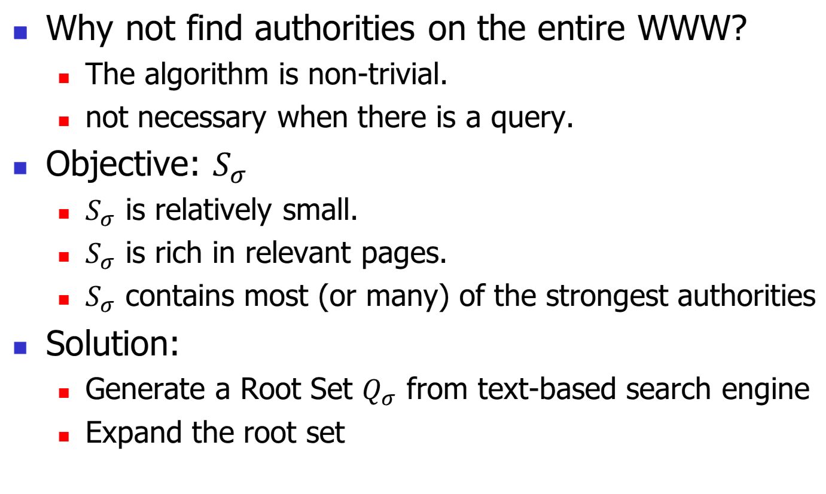
Constructing a focused subgraph
Data Mining: Concepts and Techniques

Slide 30
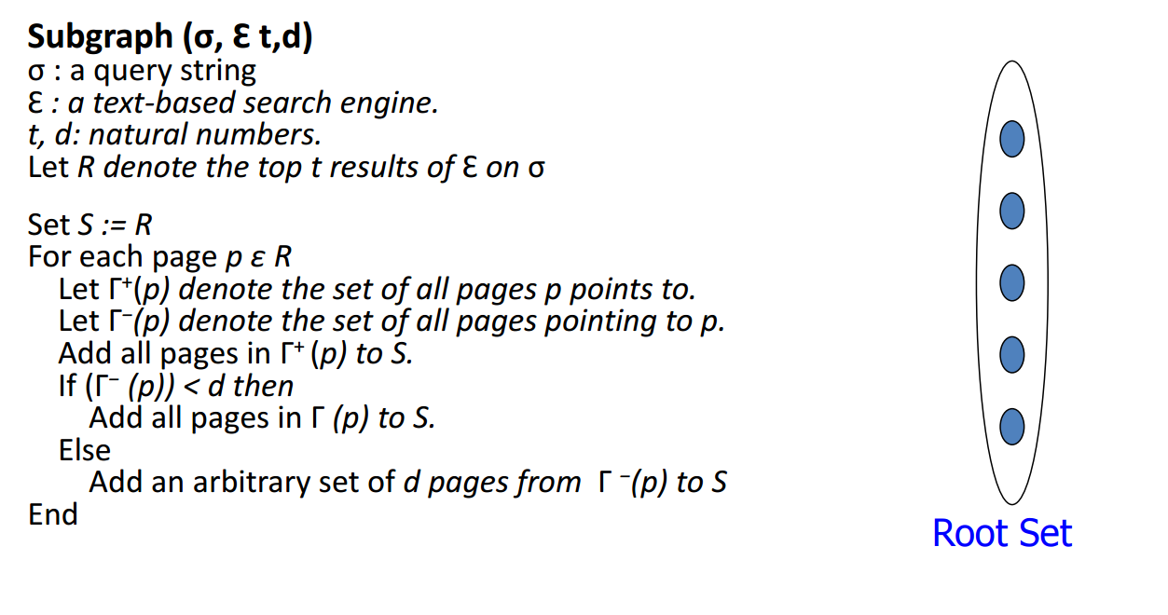
Constructing a focused subgraph
Data Mining: Concepts and Techniques

Slide 31
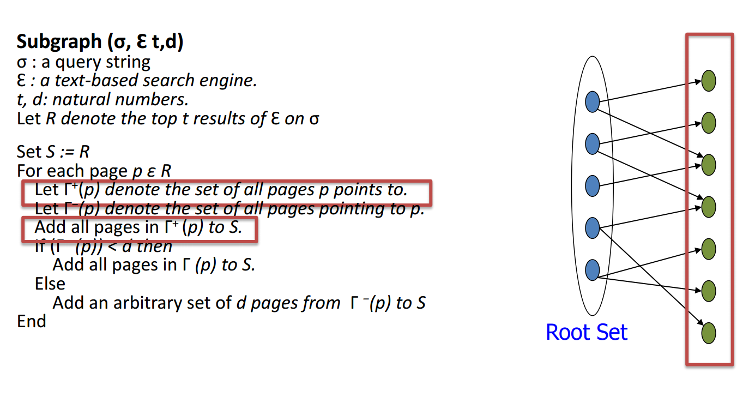
Constructing a focused subgraph
Data Mining: Concepts and Techniques

Slide 32
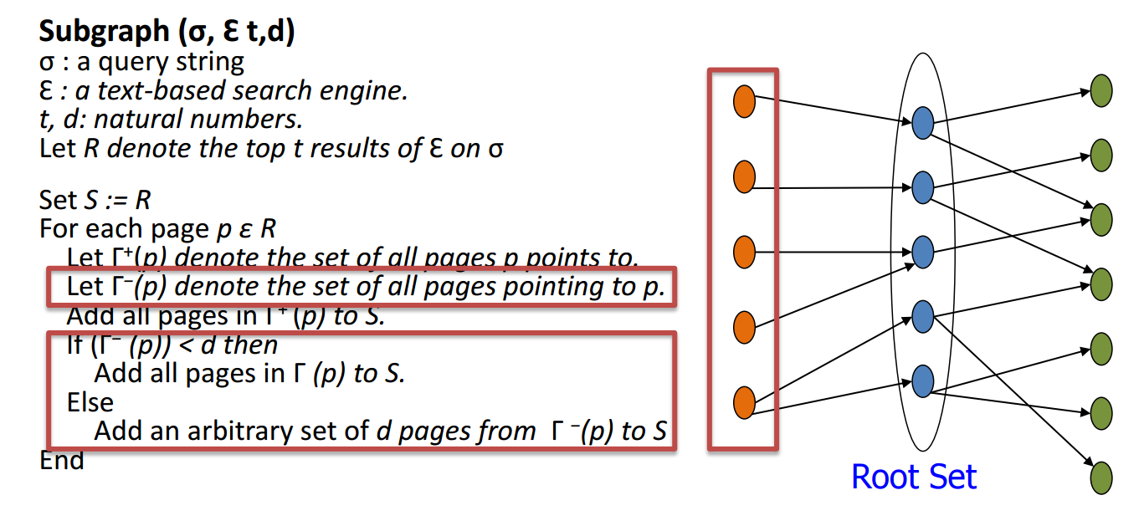
Constructing a focused subgraph
Data Mining: Concepts and Techniques

Slide 33
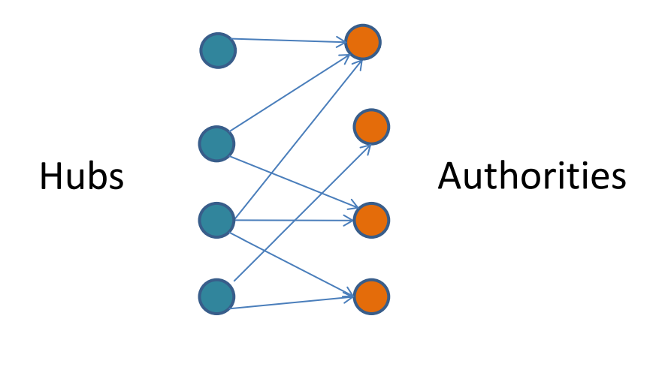
Computing Hubs and Authorities
Rules:
  A good hub points to many good authorities.
  A good authority is pointed to by many good hubs.
  Authorities and hubs have a mutual reinforcement relationship.
Data Mining: Concepts and Techniques

Slide 34
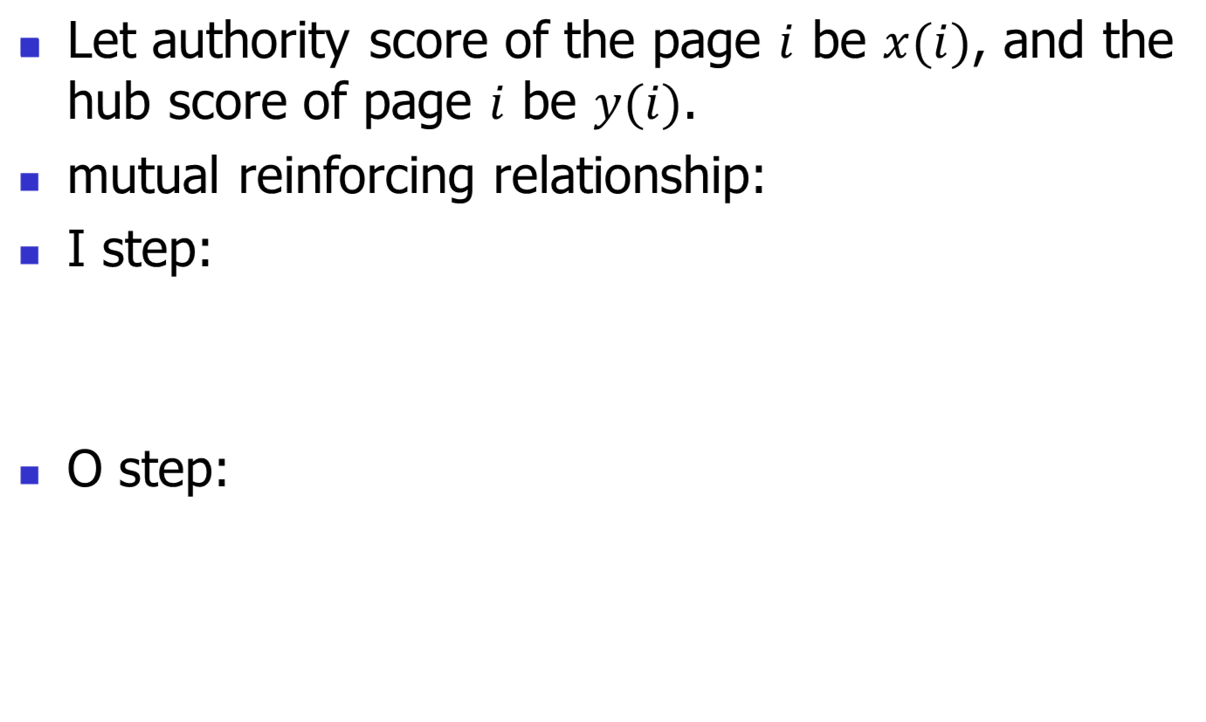
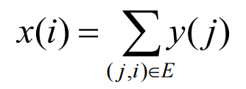
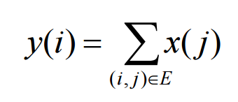
Computing Hubs and Authorities
Data Mining: Concepts and Techniques

Slide 35
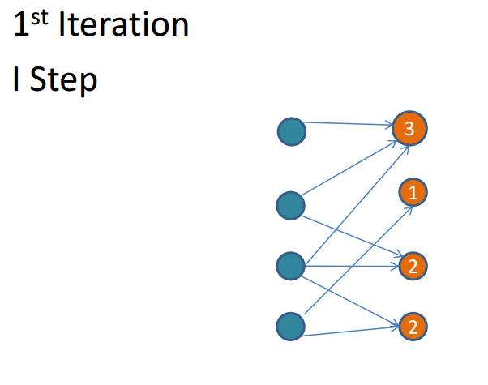
Example (no normalization)
Data Mining: Concepts and Techniques

Slide 36
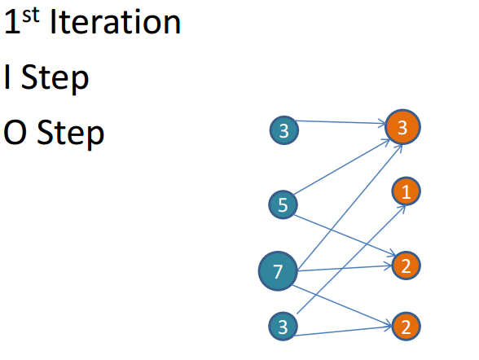
Example (no normalization)
Data Mining: Concepts and Techniques

Slide 37
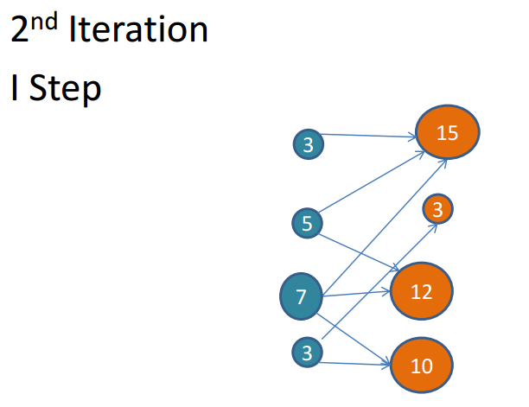
Example (no normalization)
Data Mining: Concepts and Techniques

Slide 38
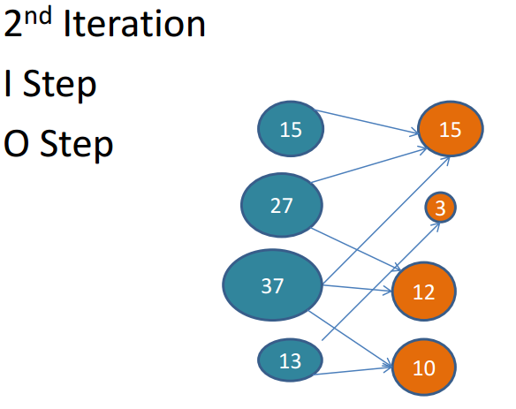
Example (no normalization)
Data Mining: Concepts and Techniques

Slide 39
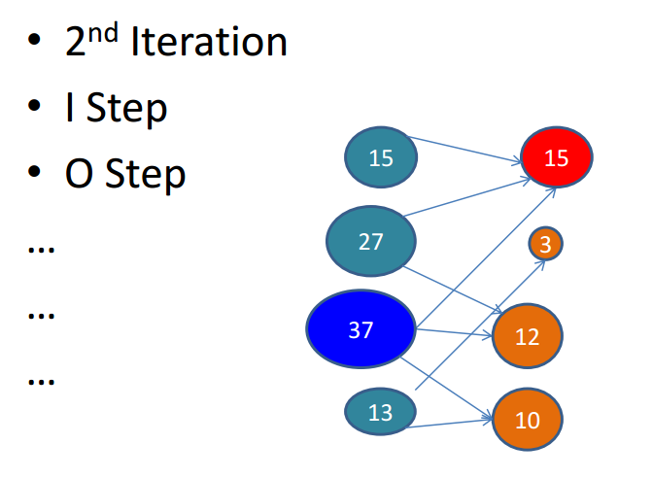
Example (no normalization)
Data Mining: Concepts and Techniques

Slide 40
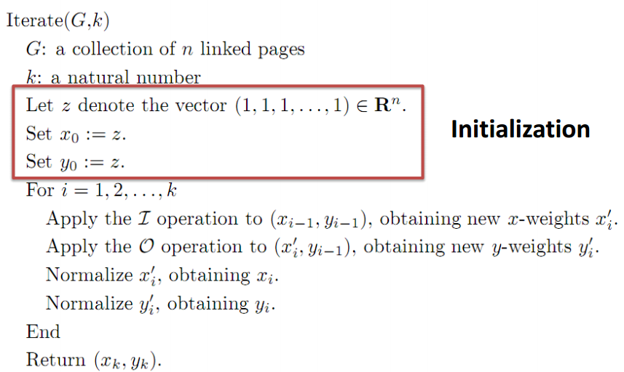
The Iterative Algorithm
Data Mining: Concepts and Techniques

Slide 41
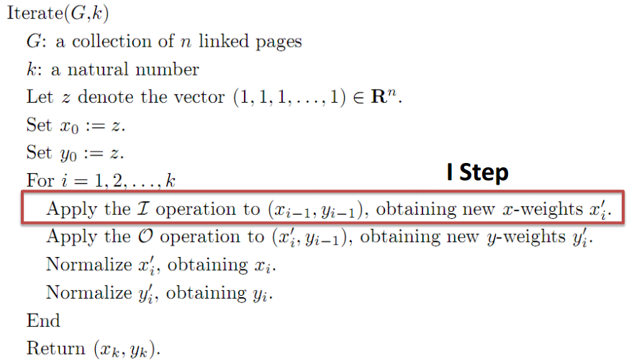
The Iterative Algorithm
Data Mining: Concepts and Techniques

Slide 42
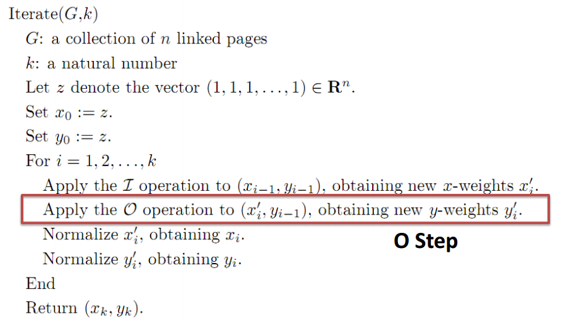
The Iterative Algorithm
Data Mining: Concepts and Techniques

Slide 43
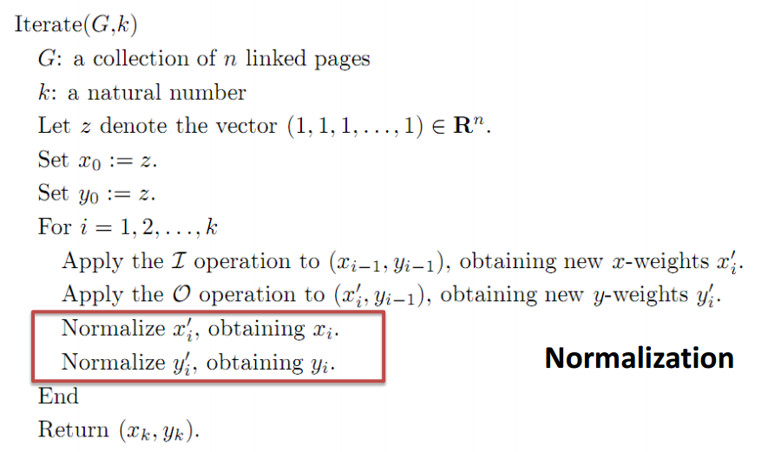
The Iterative Algorithm
Data Mining: Concepts and Techniques

Slide 44
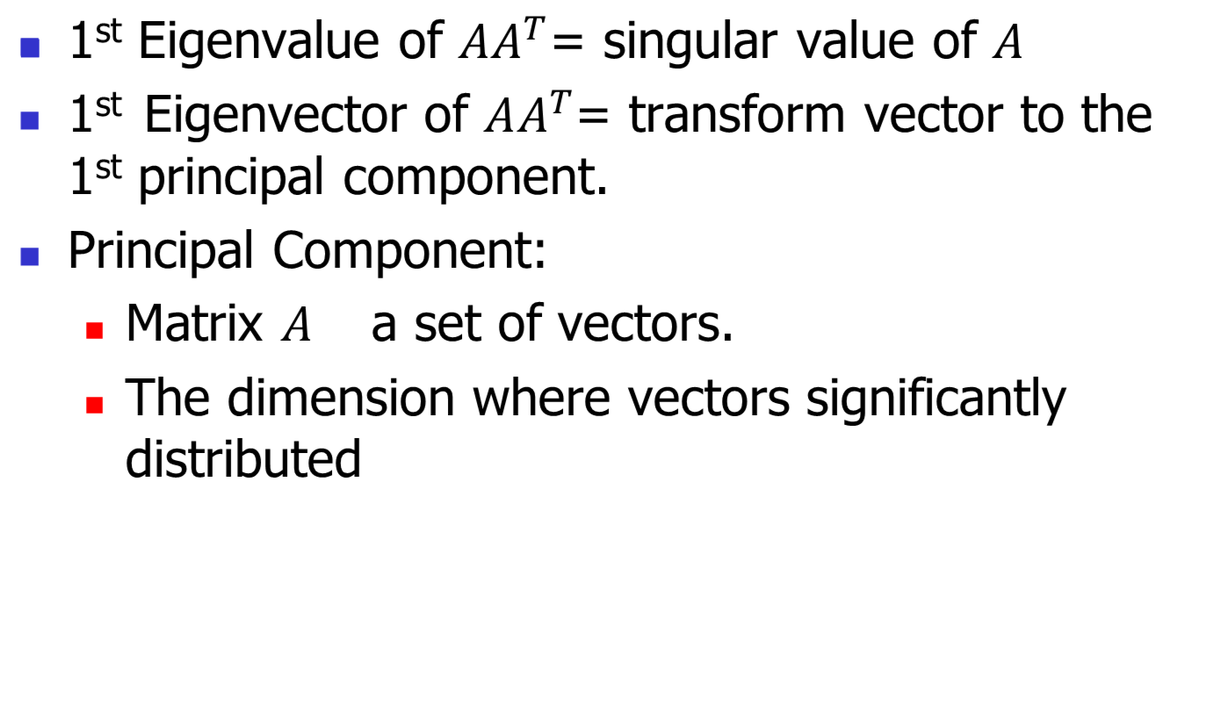
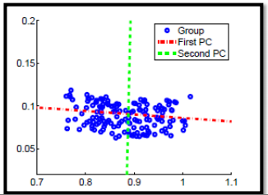
A Statistical View of HITS
Data Mining: Concepts and Techniques

Slide 45
A Statistical View of HITS
The weight of authority equals the contribution of transforming the dataset to first principal component.
  Importance of this vector for the distribution of whole dataset.
From the statistical view:
  HITS can be implemented by PCA
  HITS is different from clustering using dimensionality reduction.
  The number of samples of PCA is limited.
Data Mining: Concepts and Techniques

Slide 46
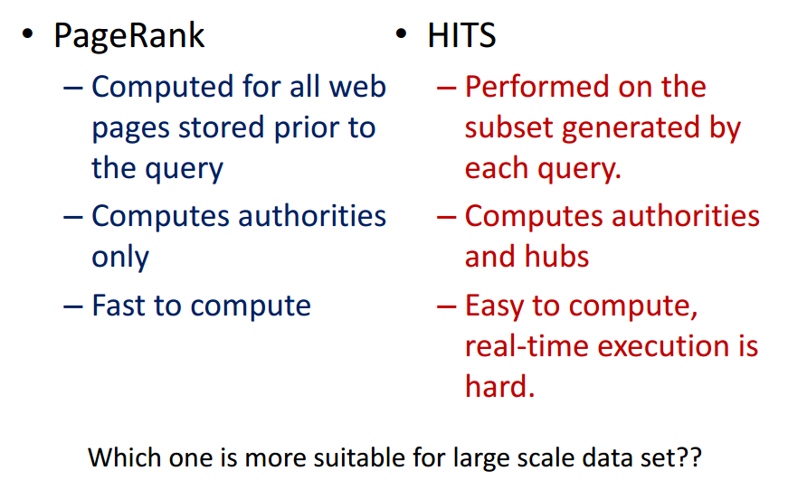
PageRank v.s. HITS
Data Mining: Concepts and Techniques

Slide 47
Summary
PageRank is a global ranking of all web pages based on their locations in the web graph structure
PageRank uses information which is external to the web pages – backlinks
Backlinks from important pages are more significant than backlinks from average pages
The structure of the web graph is very useful for information retrieval tasks.
HITS – Find authoritative pages; Construct subgraph; Mutually reinforcing relationship; Iterative algorithm

