Slide 1
Yuanhang Liu
PhD candidate
Department of Cellular and Structural Biology
Greehey Children’s Cancer Research Institute
Introduction to R

Slide 2
What is R?
R is a language and environment for statistical computing and graphics. It is similar to the S language and environment which was developed at Bell Laboratories
R provides a wide variety of statistical (linear and nonlinear modelling, classical statistical tests, time-series analysis, classification, clustering, …) and graphical techniques, and is highly extensible
R is available as Free Software and runs on a wide variety of UNIX platforms, Windows and MacOS

Slide 3
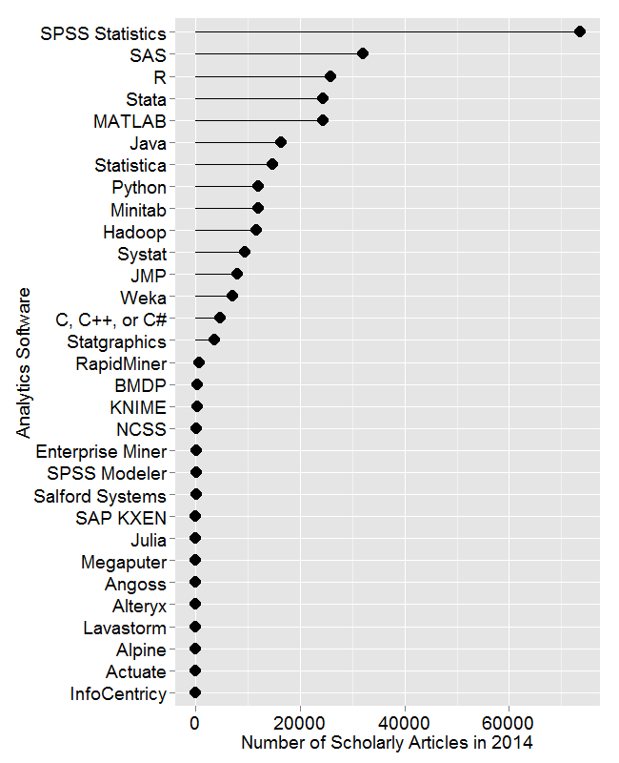
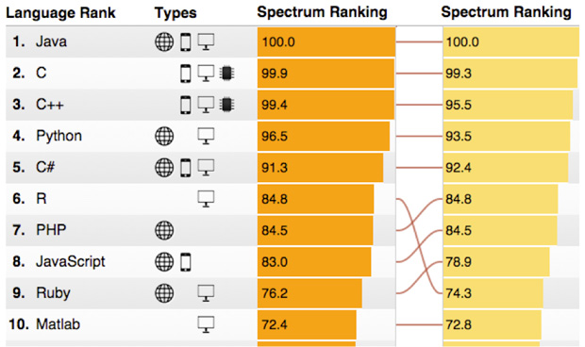
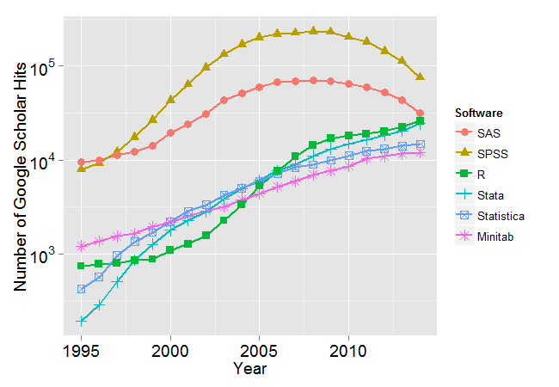
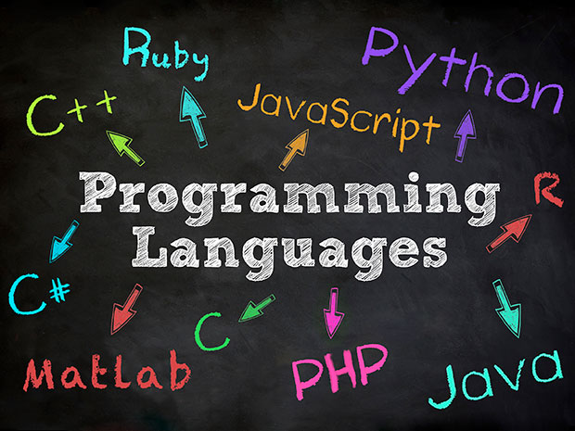
The Rising R
http://r4stats.com/articles/popularity/
http://spectrum.ieee.org/computing/software/the-2015-top-ten-programming-languages

Slide 4
What can I do with R?
A wide variety of statistical techniques
Publication quality figure
Web application with shiny
Machine learning
…...

Slide 5
Limitations and possible solutions
Limitations:
Speed
Memory usage
Interpretability of source codes
Solutions:
Multicore/thread processing; Writing C/C++/Fortran within R
Avoid multiple copies; Memory profiling
Better documentation

Slide 6
R installation
https://cran.r-project.org/mirrors.html
RStudio
https://www.rstudio.com/products/rstudio/download/

Slide 7
R basics
Basic operations
Functions
Data structures
Objects and Classes
Models and Formulas
Charts and Graphics
Getting help

Slide 8
R basics
R basics

Slide 9
R packages
Data import: RMySQL, data.table
Data manipulation: dplyr, data.table, stringr
Data visualization: ggplot2, lattice, rgl, htmlwigets,
Data modeling: lme4/nlme, caret
Data report: shiny, rmarkdown
Bioinformatics: DESeq, DESeq2, edgeR, limma, etc
My packages: XBSeq, MBDDiff

Slide 10
R public repositories
CRAN
Bioconductor
Omegahat
R-Forge

Slide 11
Further resources
Online course:
R programming
Exploratory Data Analysis
Books:
R in a Nutshell: A Desktop Quick Reference by Joseph Adler
R for Dummies by Andrie de Vries and Joris Meys

Slide 12
Q&A

