Slide 1
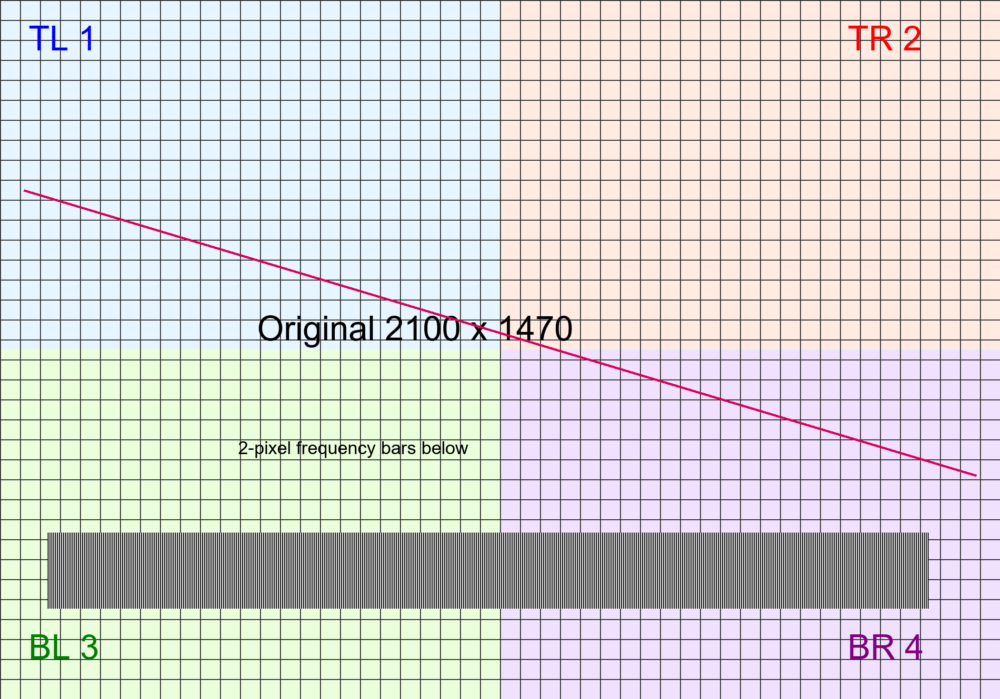


Figure 1 (full width). Source pixels and layout
A plain
B cropped
C rotated + flipped
D alpha + arbitrary rotation
E nested scaled group + foreground
F low source pixels + alpha gradient
Only 52 x 32 px
VECTOR FOREGROUND
Nested group label
All colored labels, rectangles and lines remain native vector objects.

Slide 2
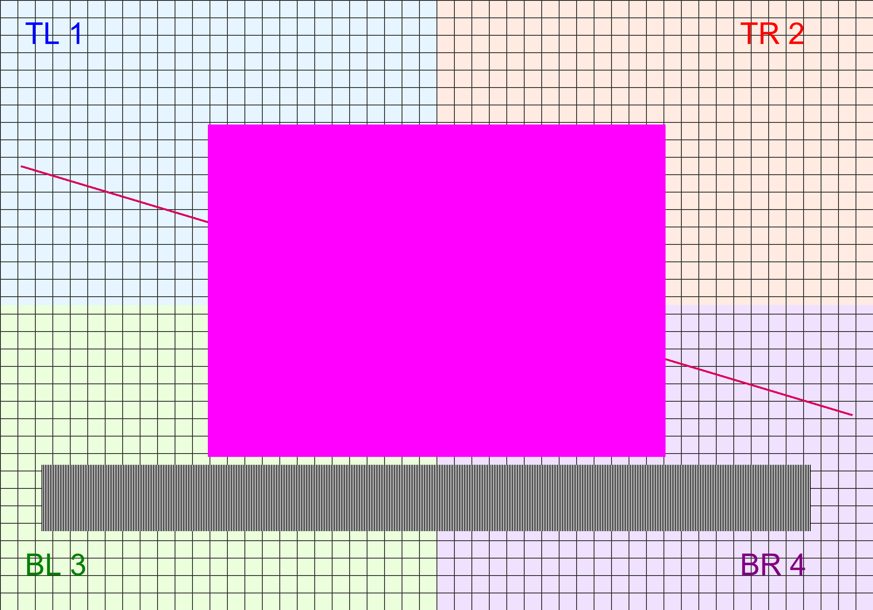
Figure 2 (full width). Effects and clip safeguards
G color-key transparency
H brightness/contrast
I ellipse mask + flipV
J source alpha + 50% object opacity
Effects are intentional: an honest unresolved warning is safer than a visually changed image.

