Slide 1
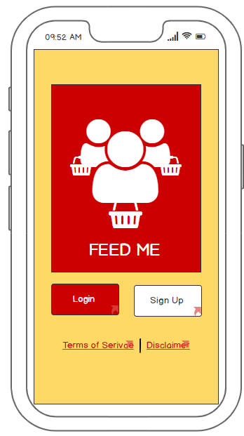
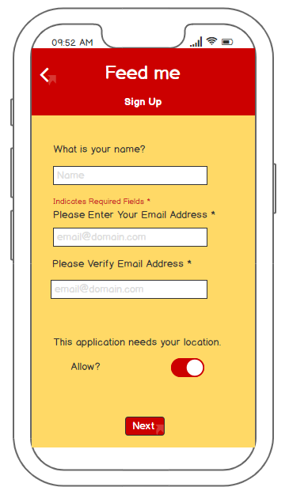
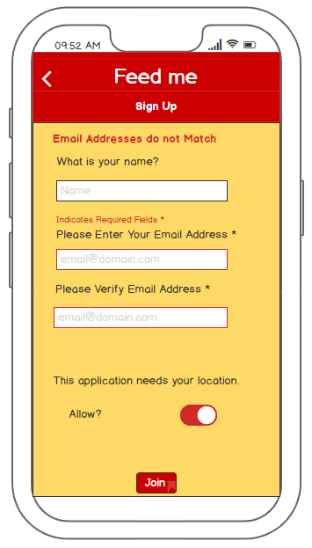
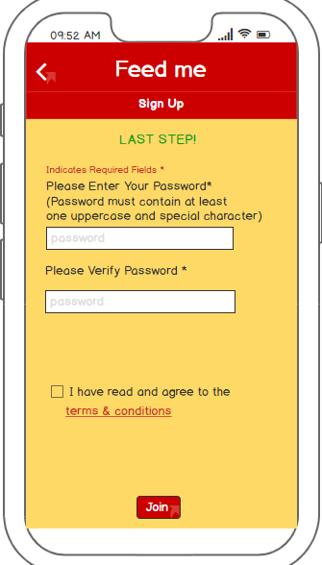
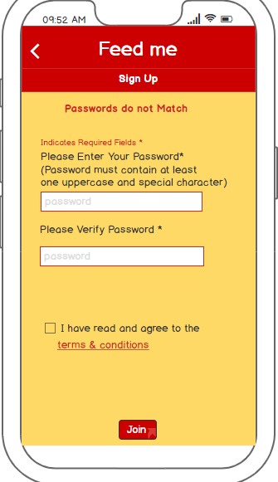
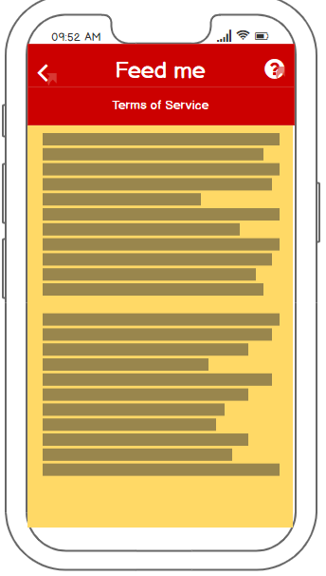
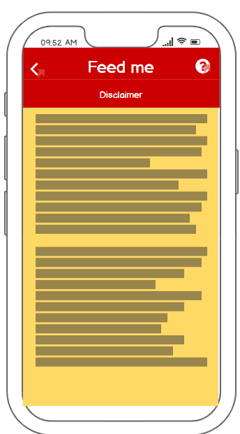
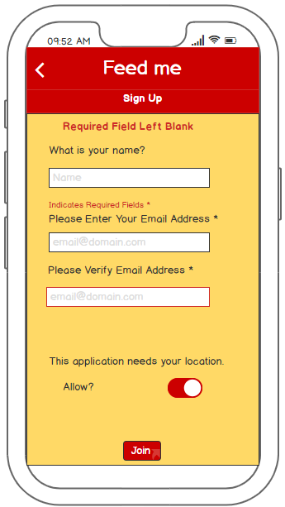
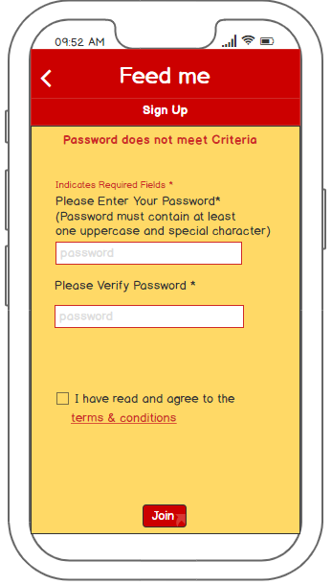
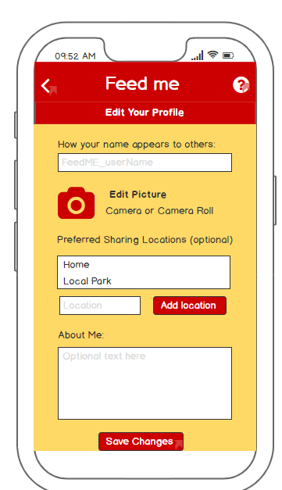
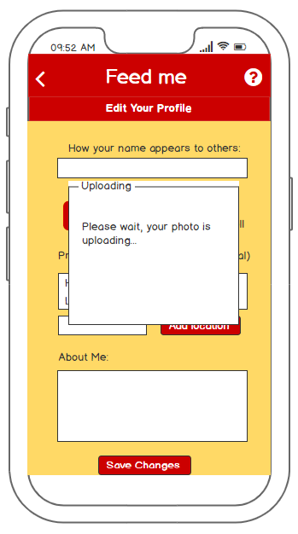
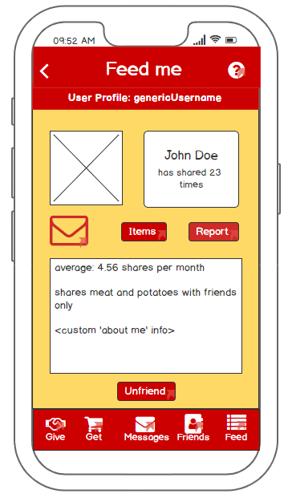

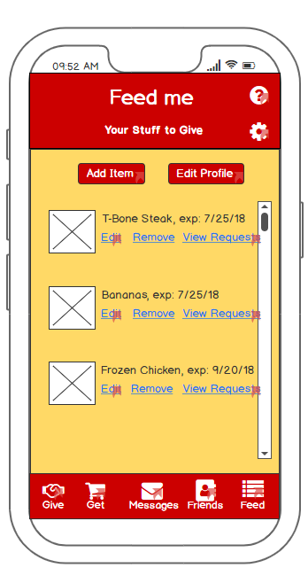
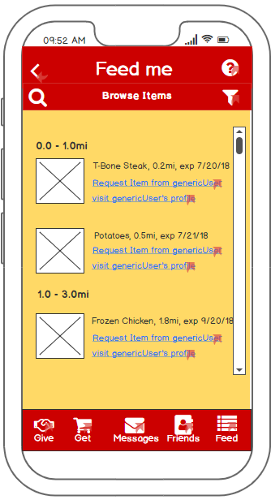
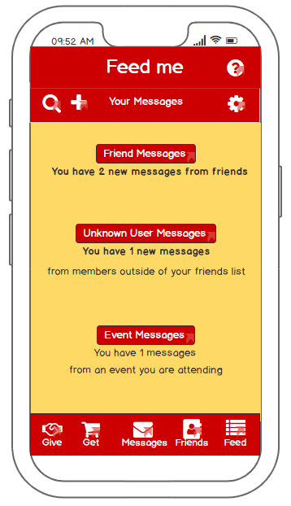
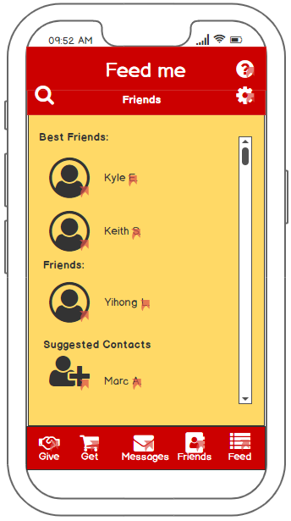
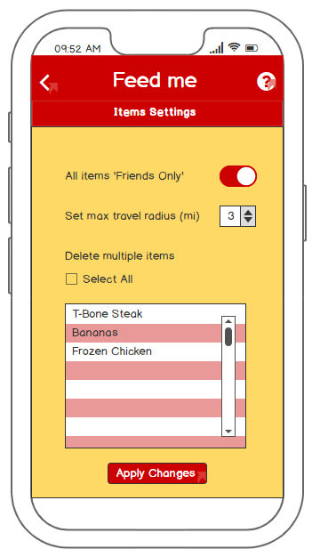
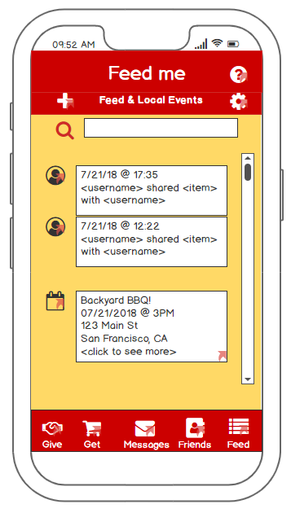
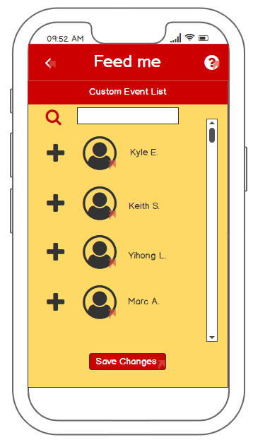
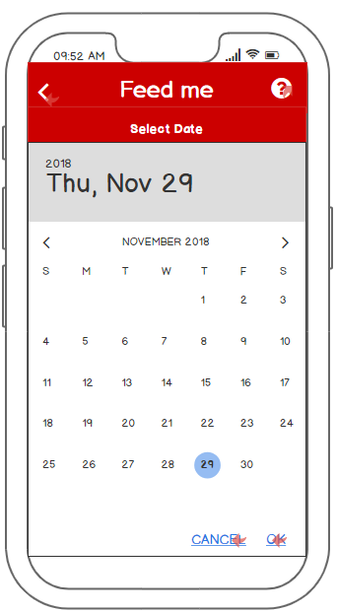
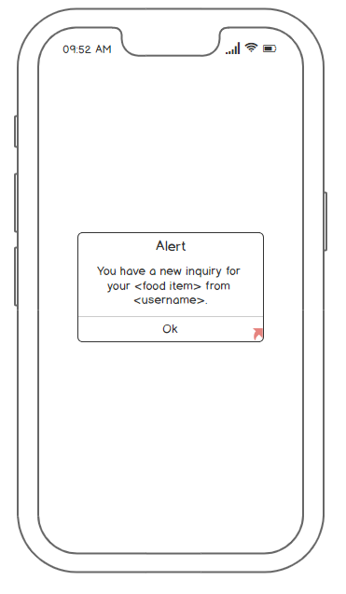
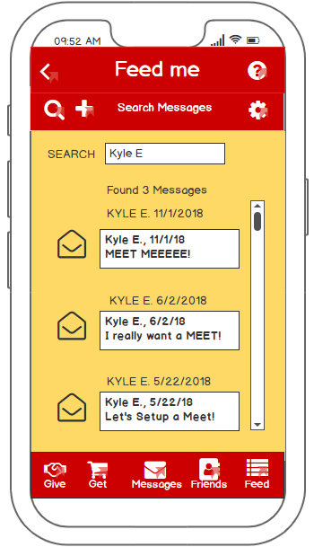
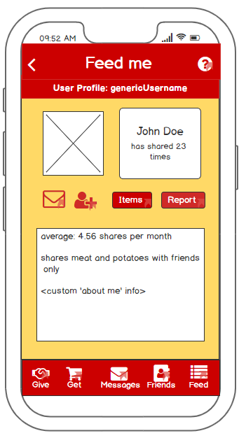
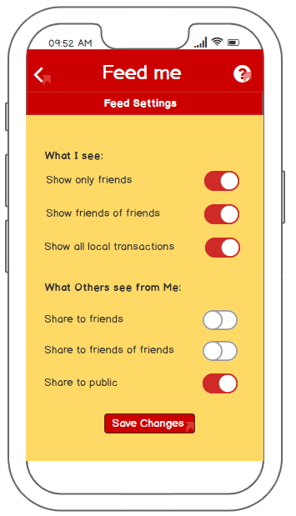
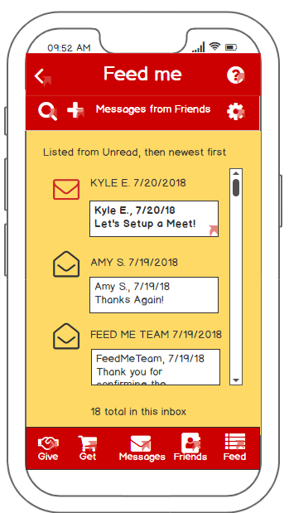
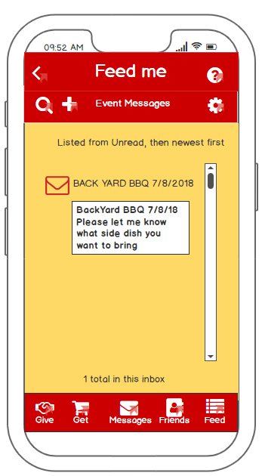

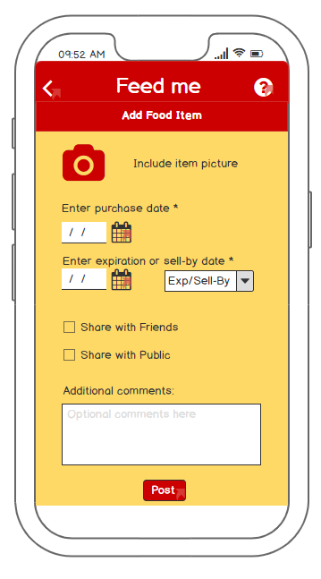
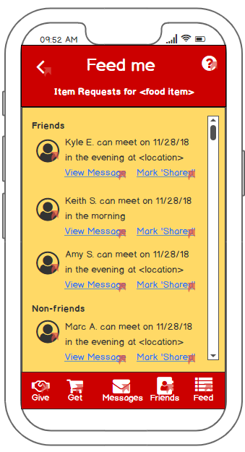
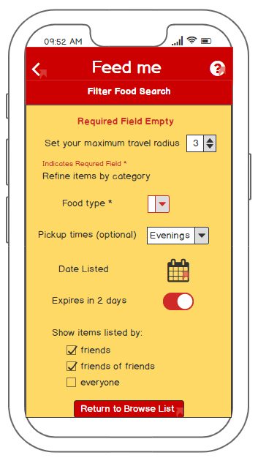
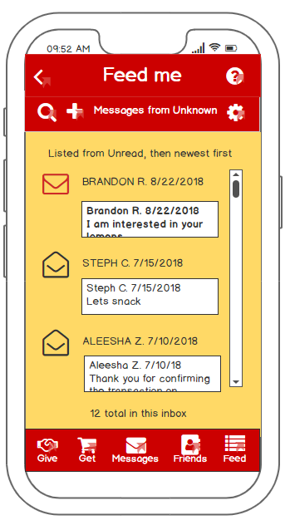
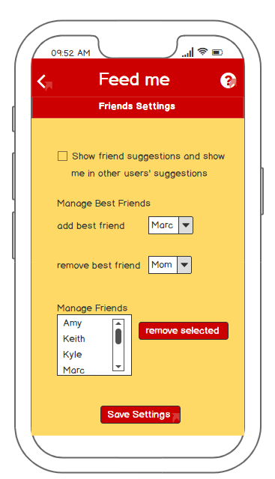
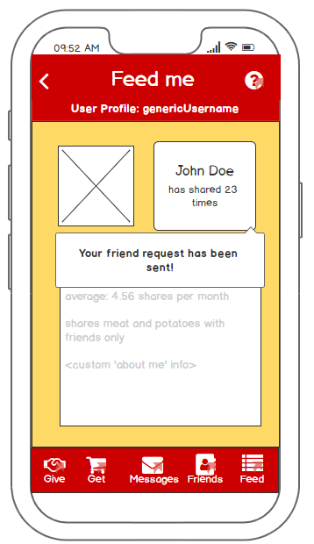
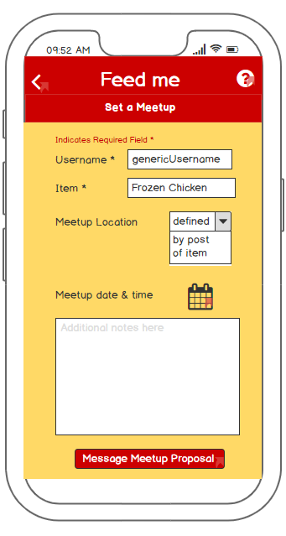
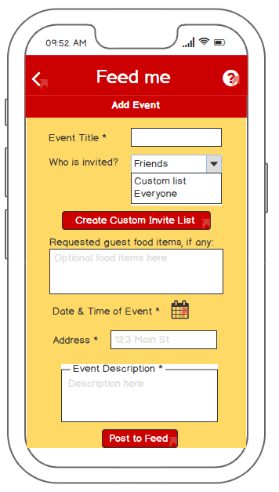
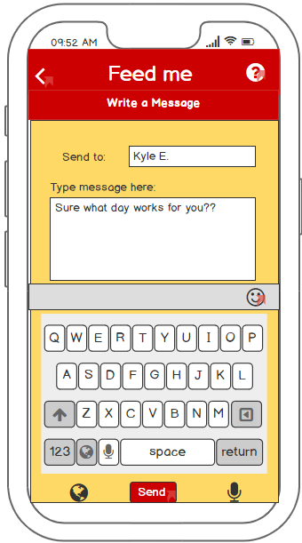
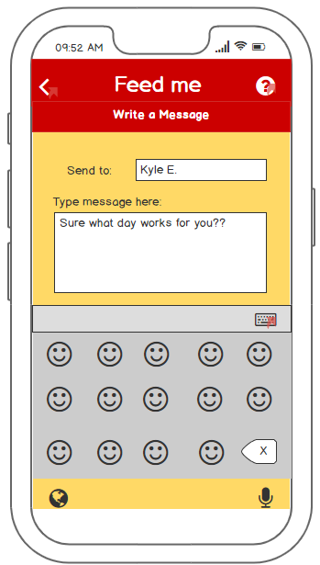
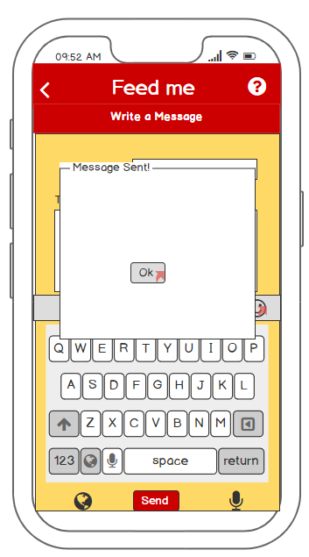
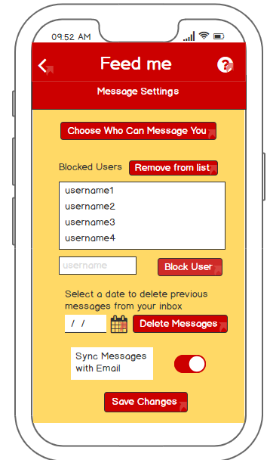
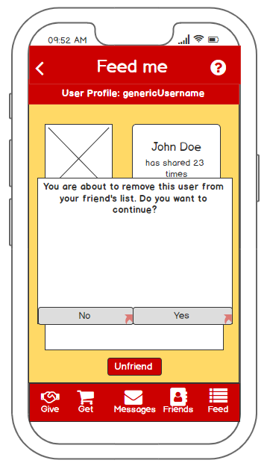
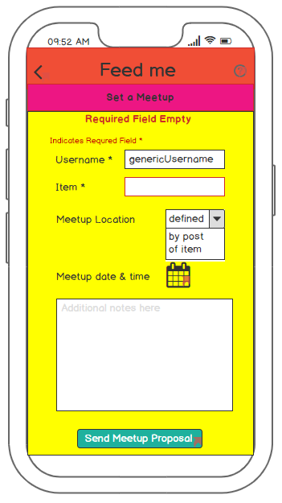
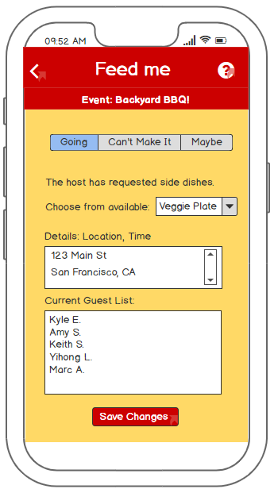
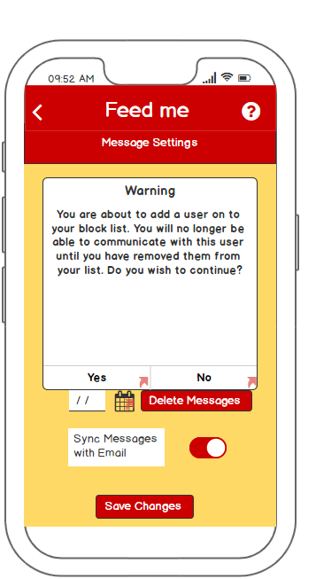
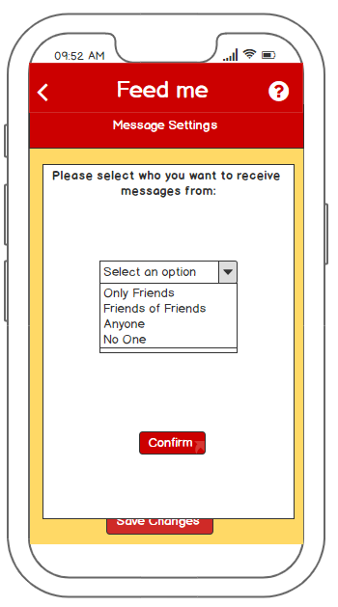
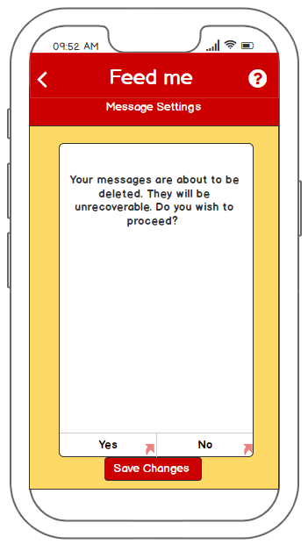
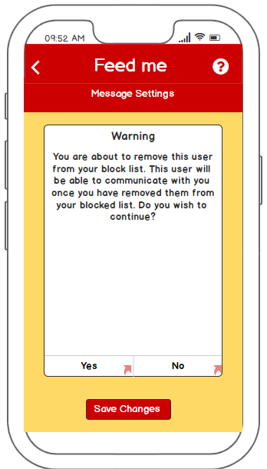
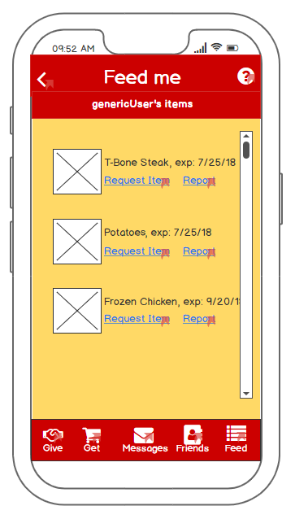
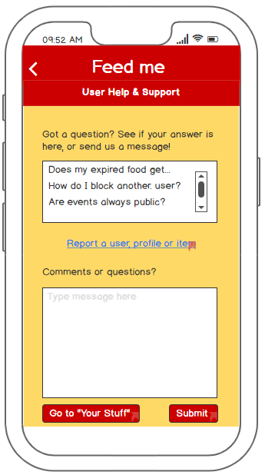
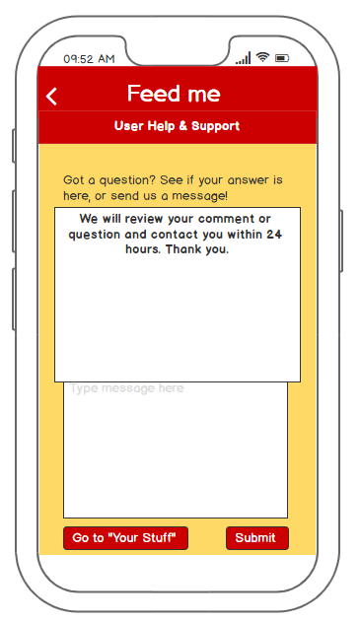
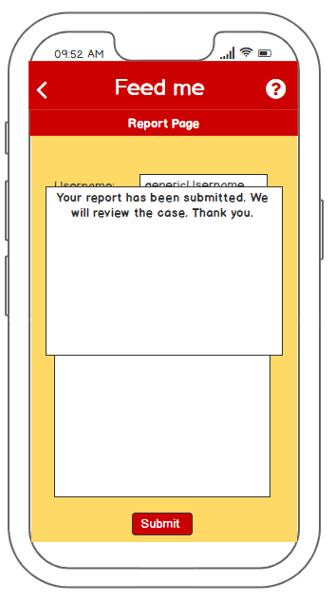
Sign Up, Start Application
Email
address
does not match
Error!
Error Solved
Password
does not
match
Sign Up
Name and Email,
Email Verification
Last Sign up Step
create password,
agree to T&C
Error!
Read Terms of
Service
Read Disclaimer
Error!
Error!
Required field
left blank
Error Solved
Password
does not
meet
criteria
After Login
users are
taken to the
Feed
After signing up
OR
If the user signed up but did not create a profile
Using the footer
menu allows the user
to navigate between
the main tasks of the
application.
Create Profile
Navigation Icons
After a photo is chosen, the photo will upload in
the application
The profile is then previewed after changes are saved.
Available on Some Pages
Available on ALL pages
A filter is available on search pages
The Help Icon navigates to the pages available at all times
Settings are available on specific pages
Available on all but Main Pages
Add events or
messages
Return to previous
page
Search specific
pages
Always available
navigation
The following “Main Pages” are accessible with the footer menu at the bottom of the screen:
Give
Get
Always available
navigation
Messages
Always available
navigation
Friends
Always available
navigation
Feed
And Adding Friends
Edit Items
Search
messages
After the user has created their
profile, they can start browsing
profiles and requesting friends
by clicking the icon in the top right
corner.
Generic alert
when user gets
message but is not
In application
Add Friend
Icon
User chooses
Feed settings
Calendar
User wishes
to add a food
item
List for items
requested for
user to give
Messages from
friends
Messages from
Unknown users
Event
messages
Search Items Filter
Calendar
Friends Settings
User wants to set a
meetup
User wants to
create an event
Sending a
message
After Sending Friend Requests
Calendar for selecting
date for meetup or event
Message
Settings
User Message
is being sent
User decides to
Remove a friend
using friend settings
Error! Required
field left blank.
What invited users see after event or meetup created.
User decides to
add someone to their
block list
User selected
to delete messages
What invited users see after event or meetup created.
User selected
who they want to receive
messages from
Or user decided to
Remove someone from
their block list
Help Pages and Walkthrough
User will choose question
or create one of their own
and then choose submit to
the help process.
If the user does not wish to
continue, they may choose the back
button or choose to return to
“Your Stuff”.
User will then be
notified that their
question will be
reviewed and that
they will be contacted
within 24 hours.
Storyboard for the Feed Me application
Application developed by: Marc Atienza, Kyle East, Yihong Liu, Amy Stockinger, Keith Striby

