Slide 1
Corporate Risk Assessment
TEAM – NUS Pandas
Harsh Sharma | Jia Ye Tey | Li Yunfan | Liuying Huang | Soumya Haridas | Xinyu Lu

Slide 2



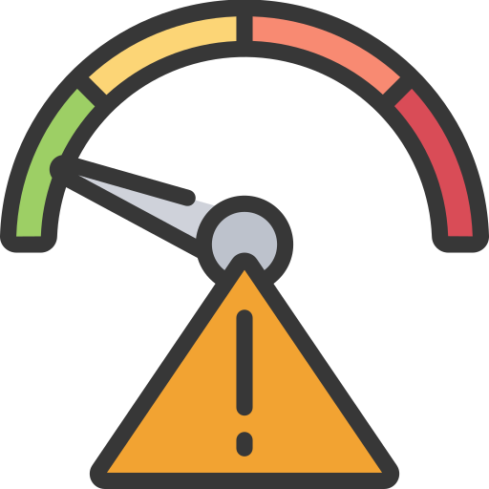



Problem Statement
Corporate risks pose significant challenges to investors, managers, and regulators. As modern corporate activities become more complex, the need to identify and mitigate risks early is critical to avoid potential collapse or failure.
Legal Risk
Fear of lawsuits and penalties reducing value.
Monitoring legal and compliance regulatory issue.
Operational Risk
Concern over profit loss due to inefficiencies.
Loan Risk
Risk of loan defaults affecting returns.
Preventing financial instability.
Types
Investors
Regulators
Managers
Navigating legal complexities and reputational damage.
Maintaining liquidity and credit ratings.
Ensuring operational compliance.
Managing internal failures and disruptions.
Other Risk
Unpredictable external factors affecting operations.
Market volatility impacting investments.
Ensuring companies are prepared for external risk.
Call to Action: A solution that provides early warnings and real-time insights is critical to safeguarding corporate stability and enabling informed decision making.

Slide 3


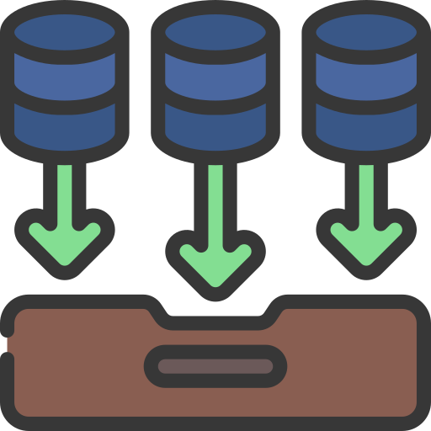


Proposed Solution
Our solution leverages AI to classify, summarize, and score corporate risks in real-time, providing early warnings and actionable insights for better decision-making.
Company News and Stock data ingestion
Risk classification and Summarization for each category
Collated Summary and Risk Scoring
User-friendly interface
Real-time data collection from news sources using News Fetch API.
System uses GPT Turbo to summarize these articles
Condensed view of potential risks based on multiple data points from these sources.
Stock related information is fetched for each company using yfinance API.
Once individual summaries are generated, GPT Instruct is used to create a collated summary across all risk types.
This collated summary provides a holistic view of corporate vulnerabilities and reduces hallucinations.
A risk score is calculated from the summary and displayed in a pie chart for quick risk profile assessment.
UI displays: News classification, summaries, Risk score and its visualization, Time series for stock data
System classifies these news articles to 4 types of corporate risk.
Stock Data Visualization
Stock data is processed and displayed as a time series plot using Highcharts.
Users can view stock performance trends for today, last 7 days or past month offering real time insights about company’s financial stability.

Slide 4
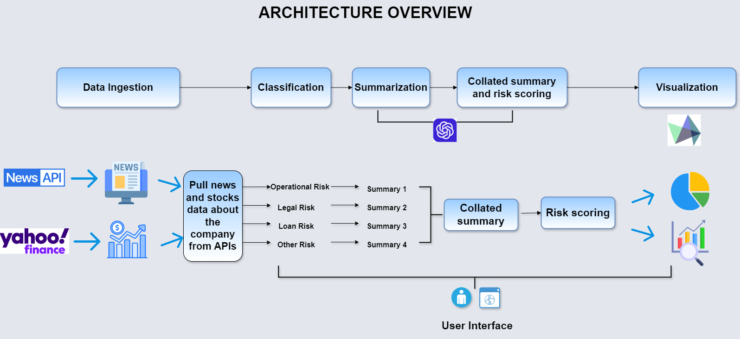
Workflow
News ingestion, leading to classification, then summarization, followed by collated summary and risk scoring, and finally UI display.

Slide 5

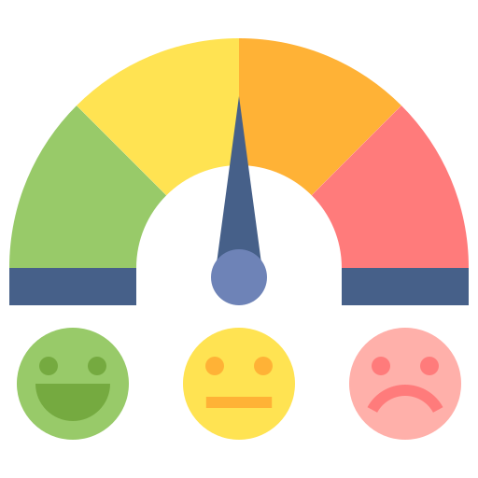

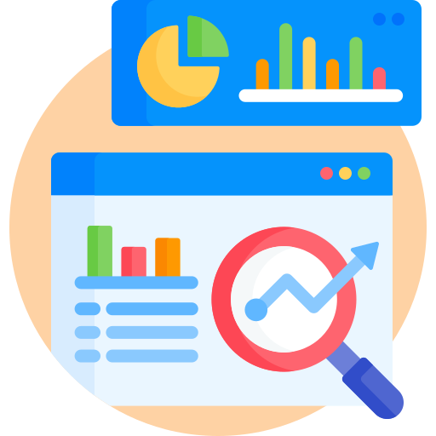

Innovative Differentiators
REAL-TIME DATA INTEGRATION
Integrates risk analysis with stock performance data.
SUMMARIZATION & RISK SCORING USING AI
Generates structured summaries and risk scores using GPT.
COMPREHENSIVE RINK LINKAGE ANALYSIS
Analyzes how different risks are interconnected
DYNAMIC & SCALABLE ARCHITECTURE
INTERACTIVE VISUALIZATIONS
Provides a comprehensive risk profile by mapping cross-risk impacts.
Displays risk scores in pie charts and stock price trends.
Offers customizable timeframes for flexible risk analysis.
Visualizes how risks impact stock trends over time.
Simplifies risk interpretation with combined insights and scores.
Adaptable to any company with adjustable parameters.
Scales for real-time data processing and continuous updates.
User-centric end-to end Interface that is customizable for any company

Slide 6
Demo
Experience our Corporate Risk Assessment platform live, where you can analyze real-time risk insights and stock data visualizations.
Visit the Platform: nuspandas.xyz
Navigation Instructions:
Enter the company name in the search bar at the top of the page.
The system will fetch news articles for the company and categorize them into four risk types: Operational, Legal, Loan, and Other.
Click on each risk type to view a detailed summary, along with the risk score and analysis for that category.
Explore the stock performance data displayed alongside the risk analysis for a complete view of the company’s vulnerabilities.

Slide 7
THANK YOU

Slide 8













Architechture Overview
LLM + Prompt Engineering
Financial Reports
Sentiment
LLM + Prompt Engineering
Prompt Engineering
FAISS
PINCONE
Bing AI
Summary
Preprocessing
Macro & Industry news data
Chunks
Vector Data
LangChain
Hugging Face
UI/UX
Yahoo Finance
FAISS
PINCONE
LLM
Chunks
Impact Analysis
Company news data
Embedding
Development Tracing
Actionable suggestions
Vector Data
Cluster + Prompt Engineering
EODHD API
Value Chain Analysis
Multi-perspective Analysis

Slide 9
Architechture Overview
LLM + Prompt Engineering
Financial Reports
Sentiment
LLM + Prompt Engineering
Prompt Engineering
FAISS
PINCONE
Bing AI
Summary
Preprocessing
Macro & Industry news data
Chunks
Vector Data
LangChain
Hugging Face
UI/UX
Yahoo Finance
FAISS
PINCONE
LLM
Chunks
Impact Analysis
Company news data
Embedding
Development Tracing
Actionable suggestions
Vector Data
Cluster + Prompt Engineering
EODHD API
Value Chain Analysis
Multi-perspective Analysis

Slide 10

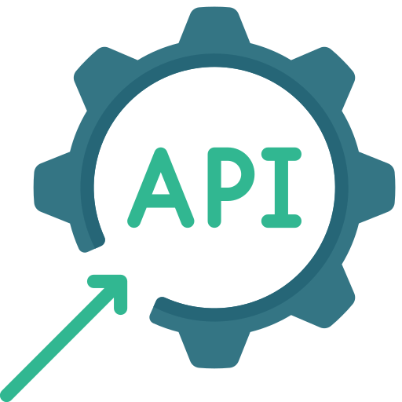






Subscription-based Business Model
News API
Buy/Sell side
traders
Subscription Fee
Data Provider
Payment
Comprehensive news analysis
NUSight
Actionable investment suggestions
Model API
Sell side
traders
Payment
Model Provider

