Slide 1
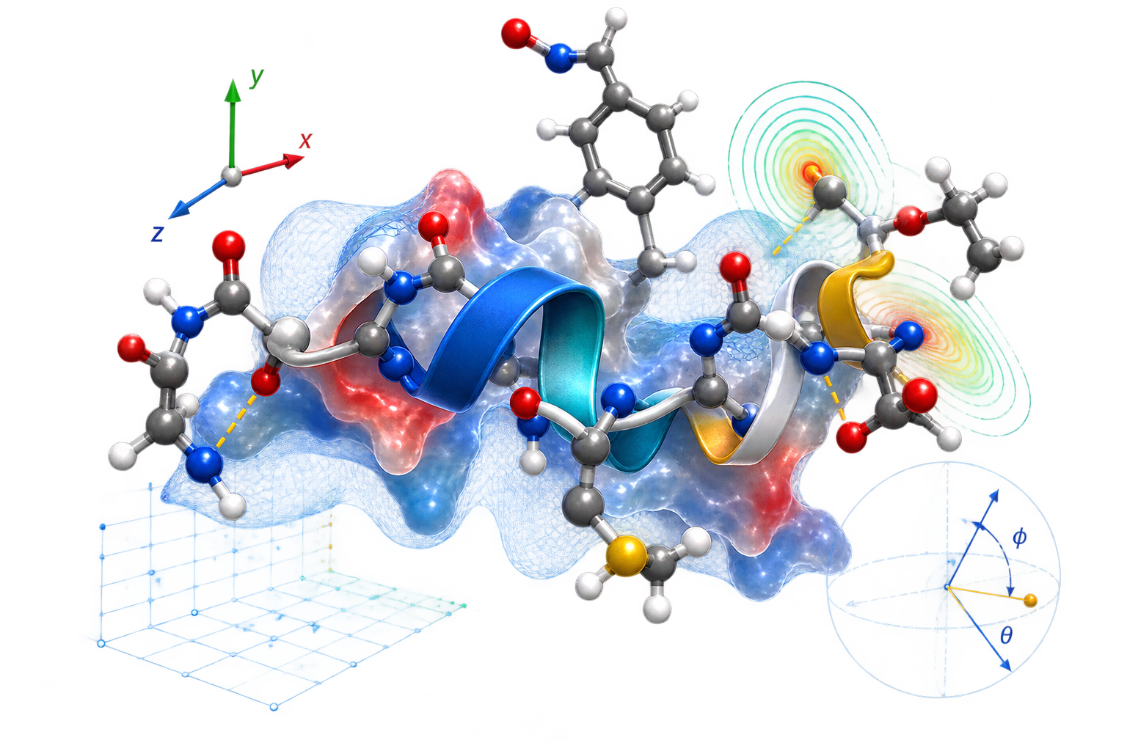
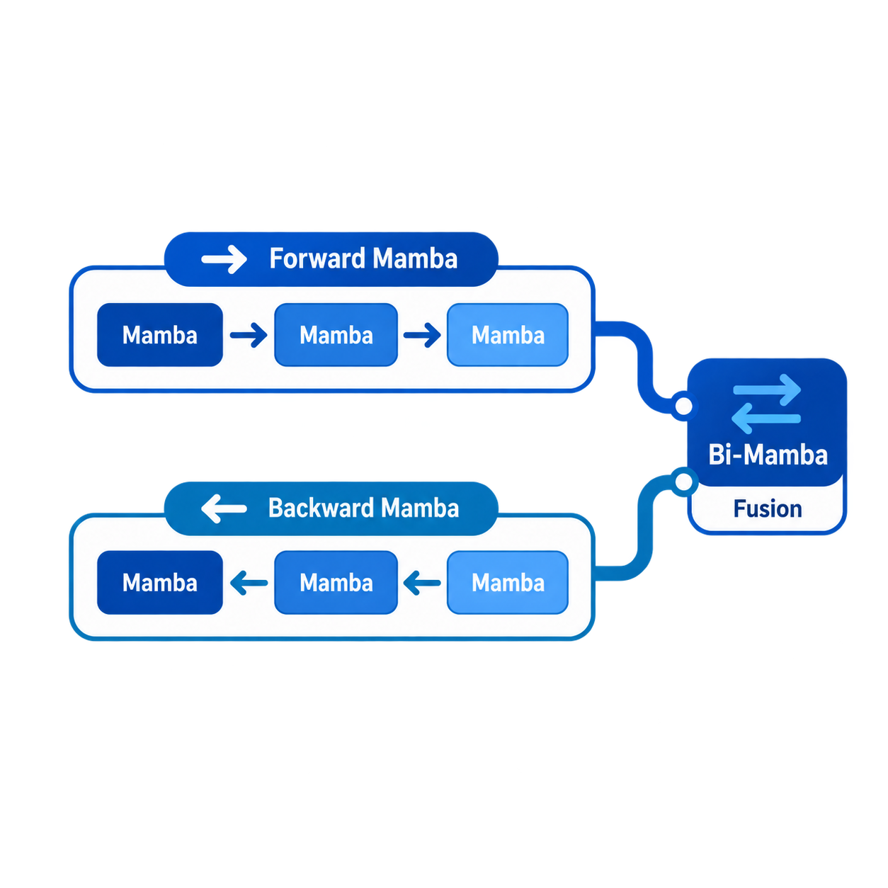
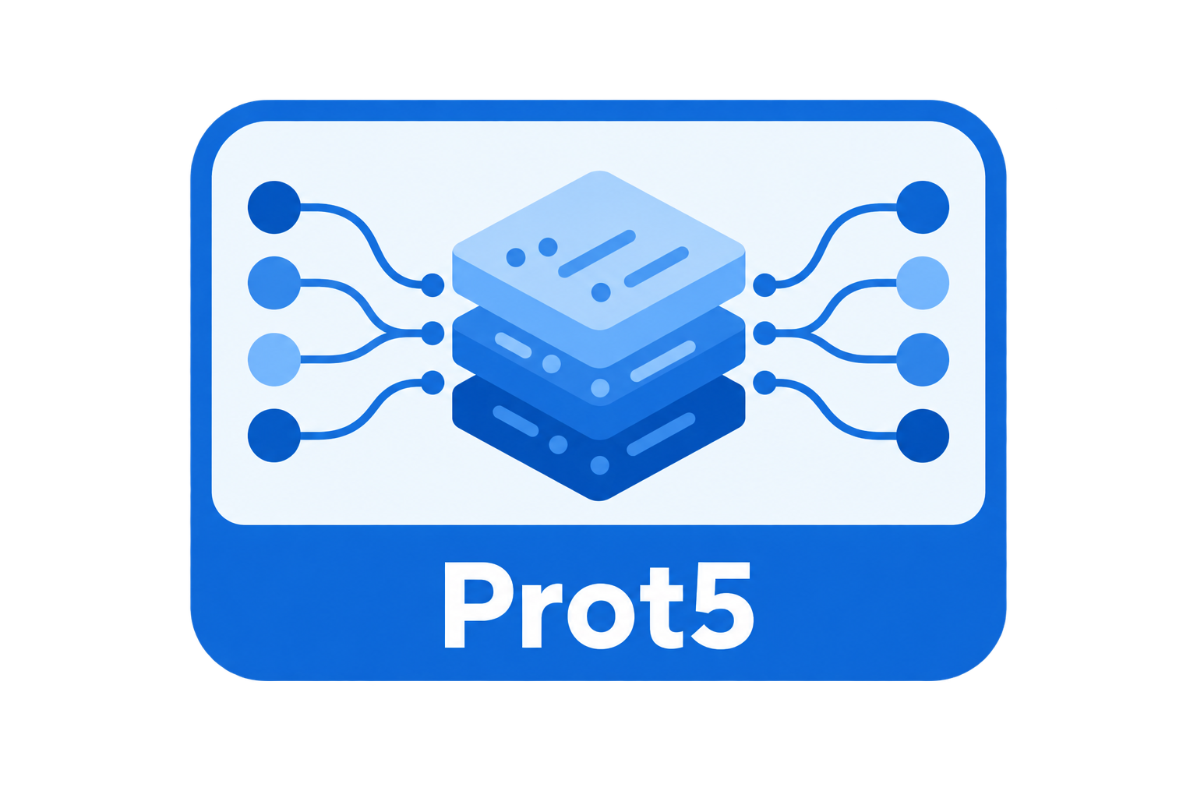
3 dimensional substructure
pLDDT-aware Multi-scale information extraction
Peptide toxicity prediction
Structure model
E
I
pLDDT
T
Probability fusion
sequence
······
1 dimensional substructure
E
A
ProT5+LoRA
Bidirectional Mammba
E
3-seed ensemble
Seed:42/123/2025

