Slide 1
More NP-complete Problems
Costas Busch - LSU

Slide 2


Theorem:
(proven in previous class)
If: Language is NP-complete
Language is in NP
is polynomial time reducible to
Then: is NP-complete
Costas Busch - LSU

Slide 3
Using the previous theorem,
we will prove that 2 problems
are NP-complete:
Vertex-Cover
Hamiltonian-Path
Costas Busch - LSU

Slide 4

Vertex Cover
Vertex cover of a graph
is a subset of nodes such that every edge
in the graph touches one node in
Example:
S = red nodes
Costas Busch - LSU

Slide 5
Size of vertex-cover
is the number of nodes in the cover
Example:
|S|=4
Costas Busch - LSU

Slide 6
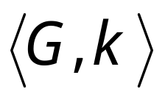




Corresponding language:
VERTEX-COVER = { :
graph contains a vertex cover
of size }
Example:
Costas Busch - LSU

Slide 7
Theorem:
VERTEX-COVER is NP-complete
Proof:
1. VERTEX-COVER is in NP
Can be easily proven
2. We will reduce in polynomial time
3CNF-SAT to VERTEX-COVER
(NP-complete)
Costas Busch - LSU

Slide 8



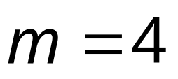
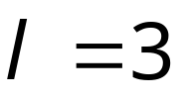
Let be a 3CNF formula
with variables
and clauses
Example:
Clause 1
Clause 2
Clause 3
Costas Busch - LSU

Slide 9

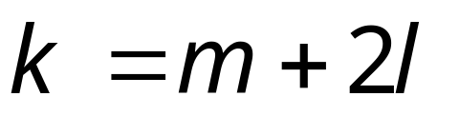
Formula can be converted
to a graph such that:
is satisfied
if and only if
Contains a vertex cover
of size
Costas Busch - LSU

Slide 10











Clause 1
Clause 2
Clause 3
Variable Gadgets
nodes
Clause Gadgets
nodes
Clause 1
Clause 2
Clause 3
Costas Busch - LSU

Slide 11
Clause 1
Clause 2
Clause 3
Clause 1
Clause 2
Clause 3
Costas Busch - LSU

Slide 12
First direction in proof:
If is satisfied,
then contains a vertex cover of size
Costas Busch - LSU

Slide 13

Example:
Satisfying assignment
We will show that contains
a vertex cover of size
Costas Busch - LSU

Slide 14
Put every satisfying literal in the cover
Costas Busch - LSU

Slide 15
Select one satisfying literal in each clause gadget
and include the remaining literals in the cover
Costas Busch - LSU

Slide 16
This is a vertex cover since every edge is
adjacent to a chosen node
Costas Busch - LSU

Slide 17
Explanation for general case:
Edges in variable gadgets
are incident to at least one node in cover
Costas Busch - LSU

Slide 18
Edges in clause gadgets
are incident to at least one node in cover,
since two nodes are chosen in a clause gadget
Costas Busch - LSU

Slide 19
Every edge connecting variable gadgets
and clause gadgets is one of three types:
Type 1
Type 2
Type 3
All adjacent to nodes in cover
Costas Busch - LSU

Slide 20

Second direction of proof:
If graph contains a vertex-cover
of size
then formula is satisfiable
Costas Busch - LSU

Slide 21
Example:
Costas Busch - LSU

Slide 22




To include “internal’’ edges to gadgets,
and satisfy
exactly one literal in each variable gadget is chosen
chosen out of
exactly two nodes in each clause gadget is chosen
chosen out of
Costas Busch - LSU

Slide 23
For the variable assignment choose the
literals in the cover from variable gadgets
Costas Busch - LSU

Slide 24
is satisfied with
since the respective literals satisfy the clauses
Costas Busch - LSU

Slide 25




It is impossible to have this scenario
because one edge wouldn’t be covered
Costas Busch - LSU

Slide 26
The proof can be generalized for arbitrary
The graph is constructed in polynomial
time with respect to the size of
Therefore:
we have reduced in polynomial time
3CNF-SAT to VERTEX-COVER
End of proof
Costas Busch - LSU

Slide 27
Theorem:
HAMILTONIAN-PATH
is NP-complete
Proof:
1. HAMILTONIAN-PATH is in NP
Can be easily proven
2. We will reduce in polynomial time
3CNF-SAT to HAMILTONIAN-PATH
(NP-complete)
Costas Busch - LSU

Slide 28
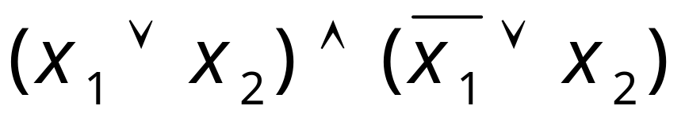
Consider an arbitrary CNF formula
Whatever we will do applies to
3CNF formulas as well
Costas Busch - LSU

Slide 29
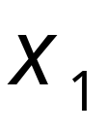
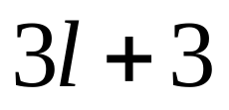

Gadget for
variable
Number of nodes in row:
for clauses
Costas Busch - LSU

Slide 30
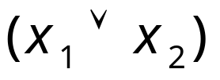
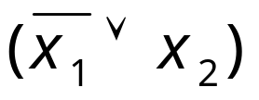
clause node
Gadget for
variable
clause node
pair 1
pair 2
A pair of nodes in gadget for each clause node;
Pairs separated by a node
Costas Busch - LSU

Slide 31
clause node
Gadget for
variable
outgoing
incoming
pair 1
If variable appears as is in clause:
first edge from gadget outgoing (left to right)
second edge from gadget incoming
Costas Busch - LSU

Slide 32
Gadget for
variable
the directions change
clause node
pair 2
outgoing
incoming
If variable appears inverted in clause:
first edge from gadget incoming (left to right)
second edge from gadget outgoing
Costas Busch - LSU

Slide 33
clause node
Gadget for
variable
clause node
pair 1
pair 2
Costas Busch - LSU

Slide 34
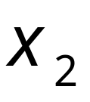
clause node
Gadget for
variable
clause node
pair 1
pair 2
Costas Busch - LSU

Slide 35
Complete Graph
Costas Busch - LSU

Slide 36
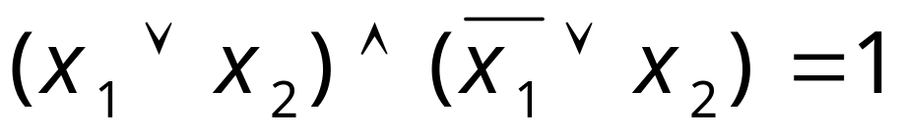
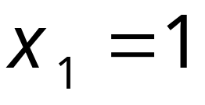
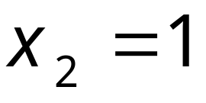
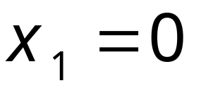
Satisfying assignment:
Satisfying assignment:
Costas Busch - LSU

Slide 37
Hamiltonian
path
Gadget for
If variable is set to 1 traverse its gadget
from left to right
Visit clauses satisfied from the variable assignment
Costas Busch - LSU

Slide 38
Hamiltonian
path
Gadget for
If variable is set to 0 traverse its gadget
from right to left
Visit clauses satisfied from the variable assignment
Costas Busch - LSU

Slide 39
A satisfying
assignment
Hamiltonian
path
Costas Busch - LSU

Slide 40
Another satisfying
assignment
Hamiltonian
path
Costas Busch - LSU

Slide 41
For each clause pick one variable that
satisfies it and visit respective node once
from that variable gadget
Costas Busch - LSU

Slide 42
Symmetrically, it can also be shown:
if the graph has a Hamiltonian path,
then the formula has a satisfying assignment
Basic idea:
Each clause node is visited exactly once
from some variable gadget, and that variable
satisfies the clause
Costas Busch - LSU

Slide 43
It is impossible a clause node to be traversed
from different variable gadgets
Node not visited
Node repeated
Costas Busch - LSU

Slide 44
Therefore:
The formula is satisfied if and only if
the respective graph has a Hamiltonian path
Costas Busch - LSU

Slide 45
The proof can apply to any 3CNF formula
The graph is constructed in polynomial
time with respect to the size of the formula
Therefore:
we have reduced in polynomial time
3CNF-SAT to HAMILTONIAN-PATH
End of proof
Costas Busch - LSU

