Slide 1
(Introduction to the) Theory of Computation

Slide 2
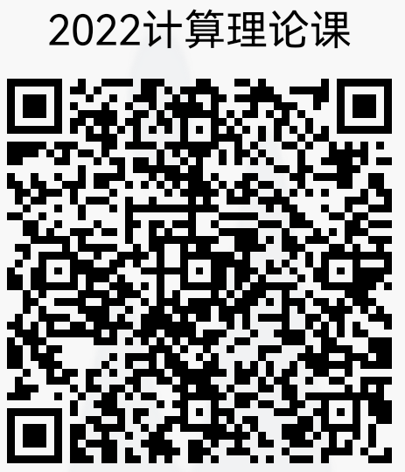
General Info about Course
Instructor: Qiang-Sheng Hua
Room 220, East 5 Building
助教TA：陈祎, QQ: 860081469
Reference Books (电子版仅供内部学习用)
Introduction to the Theory of Computation(3rd edition), Michael Sipser. Cengage Learning, 2013.
Introduction to Automata Theory, Languages, and Computation(3rd edition), John E. Hopcroft, Rajeev Motwani, Jeffery D.Ullman. Pearson, 2006.
Algorithmics-The Spirit of Computing(3rd edition), David Harel with Yishai Feldman. Pearson, 2004.
What Can Be Computed? A Practical Guide to the Theory of Computation, John Maccormick. Princeton Univ. Press, 2018.

Slide 3
Course Goals
Provide computation Models
Analyze power of Models
Answer Intractability questions:
What computational problems
can each model solve?
Answer Time Complexity questions:
How much time we need to
solve the problems?

Slide 4
A widely accepted model of computation
CPU
memory

Slide 5
The different components of memory
temporary memory
input
CPU
output
Program memory

Slide 6



Example:
temporary memory
input
CPU
output
Program memory
compute
compute

Slide 7

temporary memory
input
CPU
output
Program memory
compute
compute

Slide 8


temporary memory
input
CPU
output
Program memory
compute
compute

Slide 9

temporary memory
input
CPU
Program memory
output
compute
compute

Slide 10
Automaton
temporary memory
Automaton
input
CPU
output
Program memory

Slide 11
Automaton
temporary memory
Automaton
input
output
transition
state
CPU+ProgramMem = States + Transitions

Slide 12
Different Kinds of Automata
Automata are distinguished by the temporary memory
  Finite Automata: no temporary memory
  Pushdown Automata: stack
  Turing Machines: random access memory

Slide 13
Memory affects computational power:
More flexible memory
results to
The solution of more computational
problems

Slide 14
Finite Automaton
temporary memory
input
Finite Automaton
output
Example: Elevators, Vending Machines,
Lexical Analyzers
(small computing power)

Slide 15
Pushdown Automaton
Temp.
memory
Stack
Push, Pop
input
Pushdown
Automaton
output
Example: Parsers for Programming Languages
(medium computing power)

Slide 16
Turing Machine
Temp.
memory
Random Access Memory
input
Turing
Machine
output
Examples: Any Algorithm
(highest known computing power)

Slide 17
Power of Automata
Simple
problems
More complex
problems
Hardest
problems
Finite
Automata
Pushdown
Automata
Turing
Machine
Less power
More power
Solve more
computational problems

Slide 18
Turing Machine is the most powerful
known computational model
Question: can Turing Machines solve
all computational problems?
Answer: NO
(there are unsolvable problems)

Slide 19
Time Complexity of Computational Problems:
P problems:
(Polynomial time problems)
Solved in polynomial time
NP-complete problems:
(Non-deterministic Polynomial time problems)
Believed to take exponential
time to be solved

