Slide 1
Pushdown Automata
PDAs

Slide 2
Pushdown Automaton -- PDA
Input String
Stack
States

Slide 3


Initial Stack Symbol
Stack
Stack
stack
head
top
bottom
special symbol
Appears at time 0

Slide 4



The States
Input
symbol
Pop
symbol
Push
symbol

Slide 5
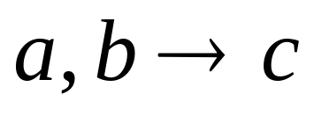






input
stack
top
Replace

Slide 6
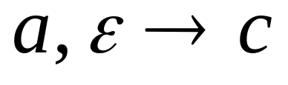
input
stack
top
Push

Slide 7
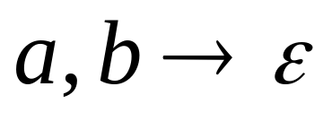
input
stack
top
Pop

Slide 8
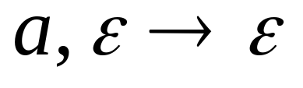

input
stack
top
No Change

Slide 9
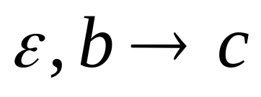
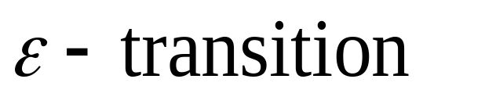

Non-Determinism
PDAs are non-deterministic
Allowed non-deterministic transitions

Slide 10
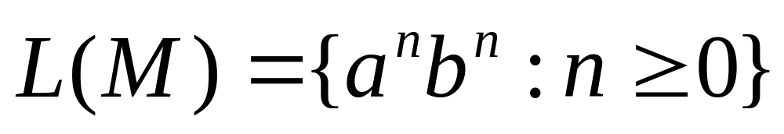

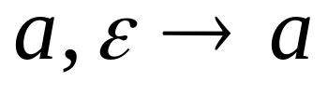
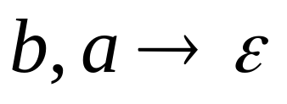
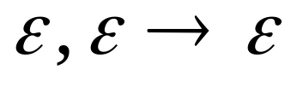
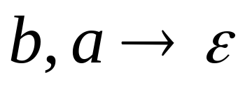
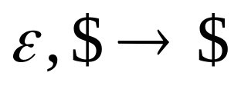

Example PDA
PDA :

Slide 11
Basic Idea:
Push the a’s
on the stack
2. Match the b’s on input
with a’s on stack
3. Match
found

Slide 12

Execution Example:
Time 0
Input
Stack
current
state

Slide 13
Time 1
Input
Stack

Slide 14
Time 2
Input
Stack

Slide 15
Time 3
Input
Stack

Slide 16
Time 4
Input
Stack

Slide 17
Time 5
Input
Stack

Slide 18
Time 6
Input
Stack

Slide 19
Time 7
Input
Stack

Slide 20
Time 8
Input
Stack
accept

Slide 21
A string is accepted if there is
a computation such that:
All the input is consumed
AND
The last state is an accepting state
we do not care about the stack contents
at the end of the accepting computation

Slide 22
Rejection Example:
Time 0
Input
Stack
current
state

Slide 23
Rejection Example:
Time 1
Input
Stack
current
state

Slide 24
Rejection Example:
Time 2
Input
Stack
current
state

Slide 25
Rejection Example:
Time 3
Input
Stack
current
state

Slide 26
Rejection Example:
Time 4
Input
Stack
current
state

Slide 27
Rejection Example:
Time 4
Input
Stack
reject
current
state

Slide 28
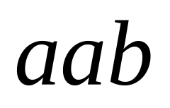
There is no accepting computation for
The string is rejected by the PDA

Slide 29
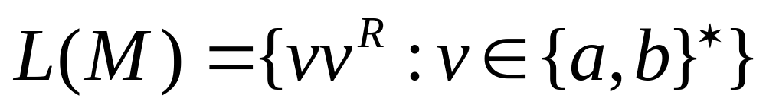
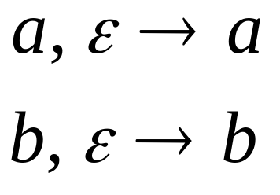
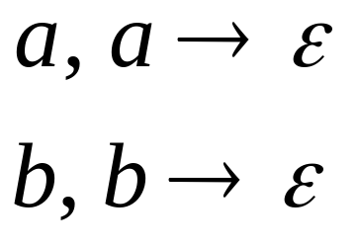
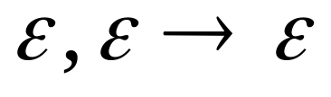
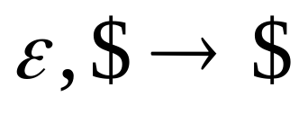
Another PDA example
PDA :

Slide 30
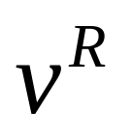
Basic Idea:
Push v
on stack
3. Match on input
with v on stack
2. Guess
middle
of input
4. Match
found

Slide 31
Execution Example:
Time 0
Input
Stack

Slide 32
Time 1
Input
Stack

Slide 33
Time 2
Input
Stack

Slide 34
Time 3
Input
Guess the middle
of string
Stack

Slide 35
Time 4
Input
Stack

Slide 36

Time 5
Input
Stack

Slide 37
Time 6
Input
Stack
accept

Slide 38
Rejection Example:
Time 0
Input
Stack

Slide 39
Time 1
Input
Stack

Slide 40
Time 2
Input
Stack

Slide 41
Time 3
Input
Guess the middle
of string
Stack

Slide 42
Time 4
Input
Stack

Slide 43
Time 5
Input
There is no possible transition.
Input is not consumed
Stack

Slide 44
Another computation on same string:
Input
Time 0
Stack

Slide 45
Time 1
Input
Stack

Slide 46
Time 2
Input
Stack

Slide 47
Time 3
Input
Stack

Slide 48
Time 4
Input
Stack

Slide 49
Time 5
Input
No accept state
is reached
Stack

Slide 50

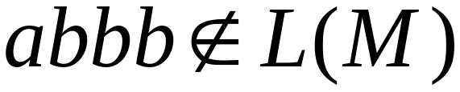
There is no computation
that accepts string

Slide 51
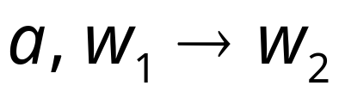
Pushing & Popping Strings
Pop
string
Input
symbol
Push
string

Slide 52
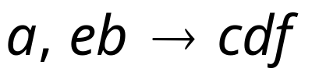



Example:
input
stack
top
push
string
top
pop
string
Replace

Slide 53

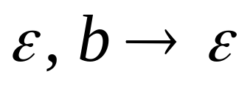

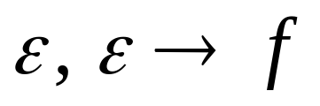
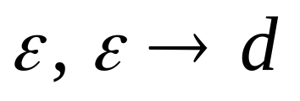

Equivalent
transitions
pop
push

Slide 54
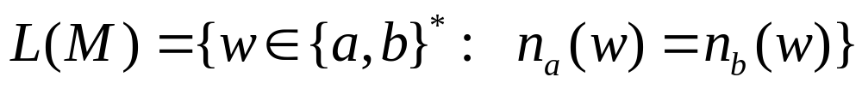




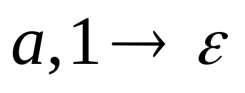
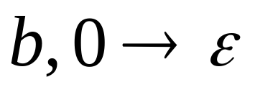
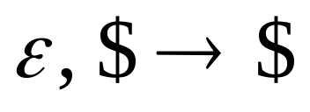
Another PDA example
PDA

Slide 55
Execution Example:
Time 0
Input
Stack
current
state

Slide 56

Time 1
Input
Stack

Slide 57

Time 3
Input
Stack

Slide 58

Time 4
Input
Stack

Slide 59
Time 5
Input
Stack

Slide 60
Time 6
Input
Stack

Slide 61
Time 7
Input
Stack

Slide 62
Time 8
Input
Stack
accept

Slide 63
Formalities for PDAs

Slide 64
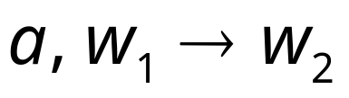
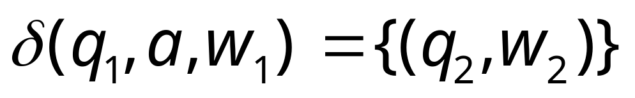
Transition function:

Slide 65
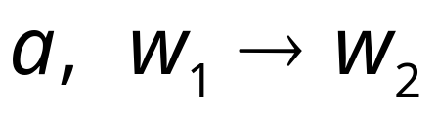

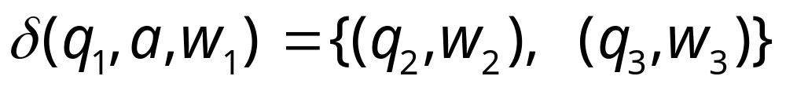
Transition function:

Slide 66
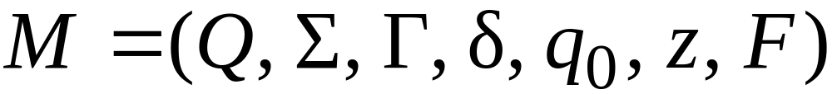
Formal Definition
Pushdown Automaton (PDA)
Accept
states
States
Input
alphabet
Stack
start
symbol
Transition
function
Initial
state
Stack
alphabet

Slide 67
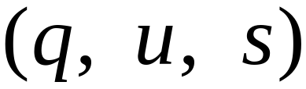
Instantaneous Description
Current
state
Current
stack
contents
Remaining
input

Slide 68
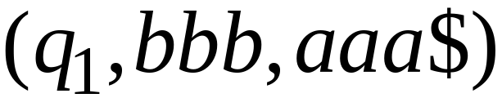
Example:
Instantaneous Description
Time 4:
Input
Stack

Slide 69
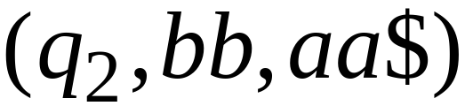
Example:
Instantaneous Description
Time 5:
Input
Stack

Slide 70
We write:
Time 4
Time 5

Slide 71
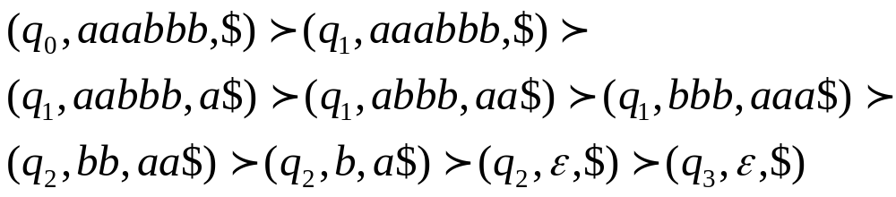
A computation:

Slide 72
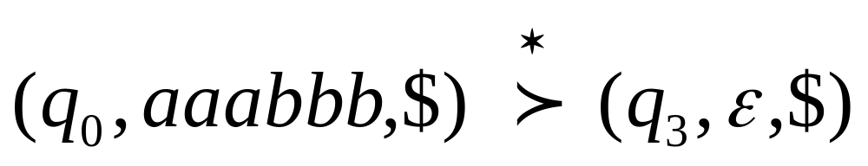
For convenience we write:

Slide 73
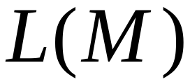

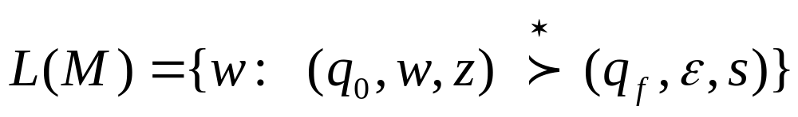
Language of PDA
Language accepted by PDA :
Initial state
Accept state

Slide 74
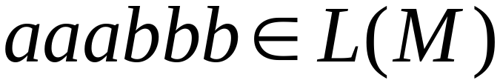
Example:
PDA :

Slide 75
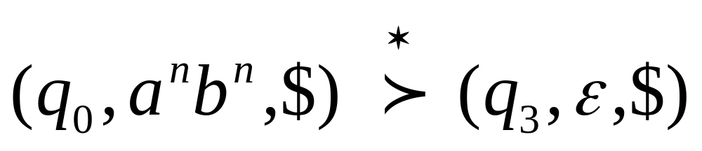
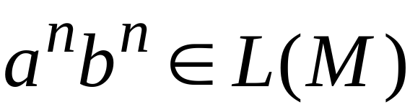
PDA :

Slide 76
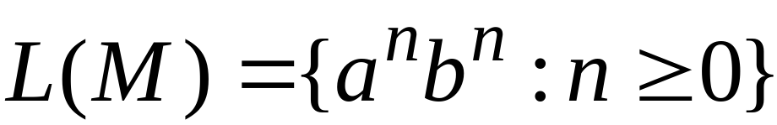
Therefore:
PDA :

