Slide 1
Reductions
Costas Busch - LSU

Slide 2



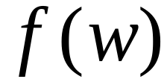
Computable function :
There is a deterministic Turing machine
which for any input string computes
and writes it on the tape
Costas Busch - LSU

Slide 3



Problem is reduced to problem
If we can solve problem
then we can solve problem
Costas Busch - LSU

Slide 4


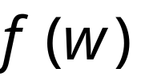



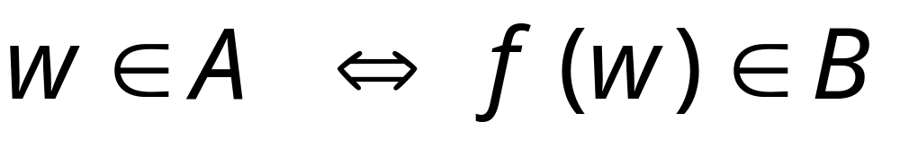
Definition:
Language
is reduced to
language
There is a computable
function (reduction) such that:
Costas Busch - LSU

Slide 5


Theorem 1:
If: Language is reduced to
and language is decidable
Then: is decidable
Proof:
Basic idea:
Build the decider for
using the decider for
Costas Busch - LSU

Slide 6


Decider for
Input
string
YES
accept
YES
accept
Decider
for
(halt)
Reduction
NO
reject
NO
reject
(halt)
From reduction:
END OF PROOF
Costas Busch - LSU

Slide 7
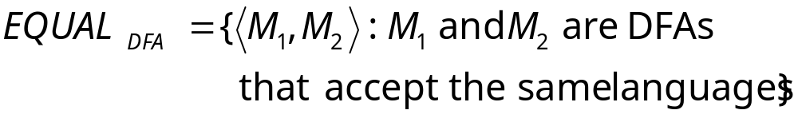
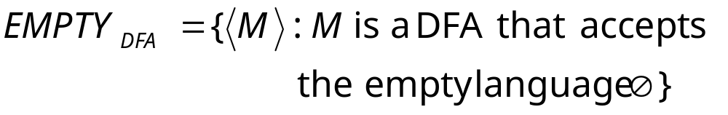
Example:
is reduced to:
Costas Busch - LSU

Slide 8
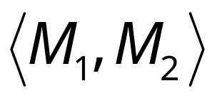
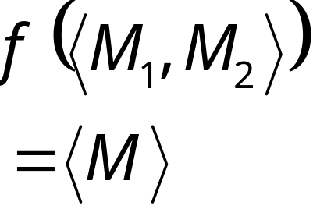

We only need to construct:
Reduction
Turing Machine
for reduction
DFA
Costas Busch - LSU

Slide 9

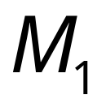

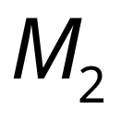

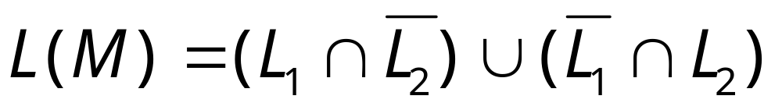
Let be the language of DFA
Let be the language of DFA
Reduction
Turing Machine
for reduction
DFA
construct DFA
by combining and so that:
Costas Busch - LSU

Slide 10
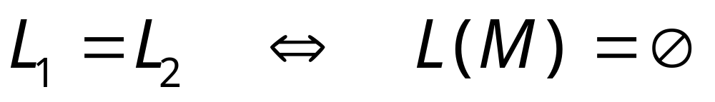
Costas Busch - LSU

Slide 11
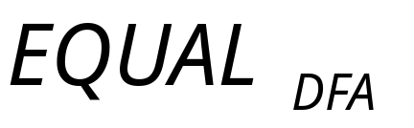
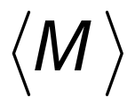
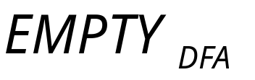
Decider for
Input
string
YES
YES
Decider
Reduction
NO
NO
Costas Busch - LSU

Slide 12
Theorem 2:
If: Language is reduced to
and language is undecidable
Then: is undecidable
Proof:
Suppose is decidable
Using the decider for
build the decider for
Contradiction!
Costas Busch - LSU

Slide 13

If is decidable then we can build:
Decider for
Input
string
YES
accept
YES
accept
Decider
for
(halt)
Reduction
NO
reject
NO
reject
(halt)
CONTRADICTION!
END OF PROOF
Costas Busch - LSU

Slide 14


Observation:
To prove that language is undecidable
we only need to reduce
a known undecidable language to
Costas Busch - LSU

Slide 15



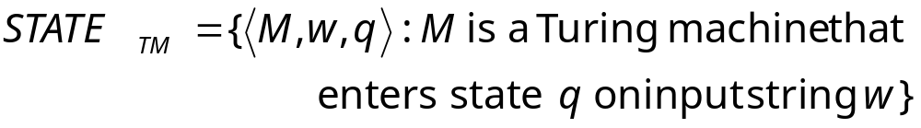
State-entry problem
Input:
Turing Machine
State
String
Question:
Does
enter state
while processing input string ?
Corresponding language:
(while processing)
Costas Busch - LSU

Slide 16

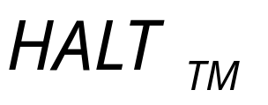
Theorem:
is undecidable
(state-entry problem is unsolvable)
Proof:
Reduce
(halting problem)
to
(state-entry problem)
Costas Busch - LSU

Slide 17
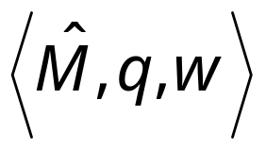
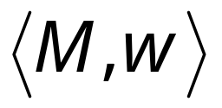
Halting Problem Decider
Decider for
state-entry problem
decider
YES
Decider
YES
Reduction
NO
NO
Given the reduction,
if is decidable,
then is decidable
A contradiction!
since
is undecidable
Costas Busch - LSU

Slide 18
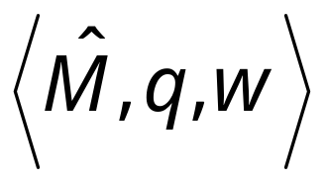
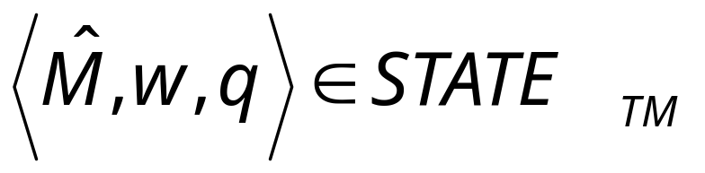
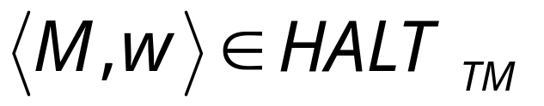
We only need to build the reduction:
Reduction
So that:
Costas Busch - LSU

Slide 19




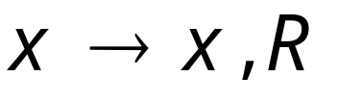

For the reduction, construct from :
special
halt state
halting
states
A transition for every unused
tape symbol of
Costas Busch - LSU

Slide 20


special
halt state
halting
states
halts
halts on state
Costas Busch - LSU

Slide 21
Therefore:
halts on input
halts on state on input
Equivalently:
END OF PROOF
Costas Busch - LSU

Slide 22

Blank-tape halting problem
Input:
Turing Machine
Question:
Does
halt when started with
a blank tape?
Corresponding language:
Costas Busch - LSU

Slide 23

Theorem:
is undecidable
(blank-tape halting problem is unsolvable)
Proof:
Reduce
(halting problem)
to
(blank-tape problem)
Costas Busch - LSU

Slide 24

Halting Problem Decider
Decider for
blank-tape problem
decider
YES
Decider
YES
Reduction
NO
NO
Given the reduction,
If is decidable,
then is decidable
A contradiction!
since
is undecidable
Costas Busch - LSU

Slide 25

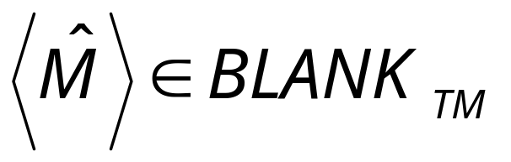
We only need to build the reduction:
Reduction
So that:
Costas Busch - LSU

Slide 26





Construct from :
no
Accept and halt
Tape is blank?
yes
Run
Write on tape
with input
If halts then halts too
Costas Busch - LSU

Slide 27
no
Accept and halt
Tape is blank?
yes
Run
Write on tape
with input
halts on input
halts when started on blank tape
Costas Busch - LSU

Slide 28
halts on input
halts when started on blank tape
Equivalently:
END OF PROOF
Costas Busch - LSU

Slide 29
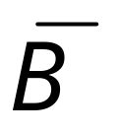
Theorem 3:
If: Language is reduced to
and language is undecidable
Then: is undecidable
Proof:
Suppose is decidable
Then is decidable
Using the decider for
build the decider for
Contradiction!
Costas Busch - LSU

Slide 30


Suppose is decidable
reject
Decider
for
(halt)
accept
(halt)
Costas Busch - LSU

Slide 31

Suppose is decidable
Then is decidable
Decider for
NO
reject
YES
accept
Decider
for
(halt)
YES
NO
accept
reject
(halt)
Costas Busch - LSU

Slide 32

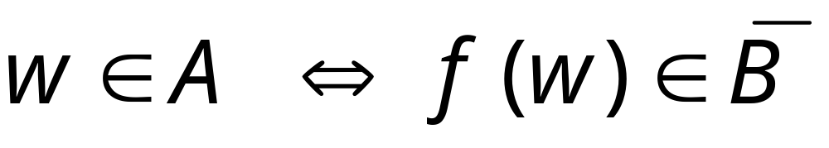
If is decidable then we can build:
Decider for
Input
string
YES
accept
YES
accept
Decider
for
(halt)
Reduction
NO
reject
NO
reject
(halt)
CONTRADICTION!
Costas Busch - LSU

Slide 33
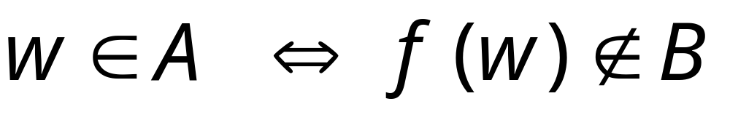
Alternatively:
Decider for
Input
string
NO
reject
YES
accept
Decider
for
(halt)
Reduction
YES
NO
accept
reject
(halt)
CONTRADICTION!
END OF PROOF
Costas Busch - LSU

Slide 34
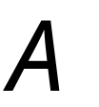

Observation:
To prove that language is undecidable
we only need to reduce
a known undecidable language
to
or
(Theorem 2)
(Theorem 3)
Costas Busch - LSU

Slide 35

Undecidable Problems for
Turing Recognizable languages
Let be a Turing-acceptable language
is empty?
is regular?
has size 2?
All these are undecidable problems
Costas Busch - LSU

Slide 36
Let be a Turing-acceptable language
is empty?
is regular?
has size 2?
Costas Busch - LSU

Slide 37
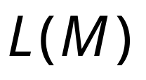
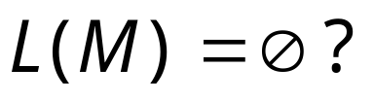
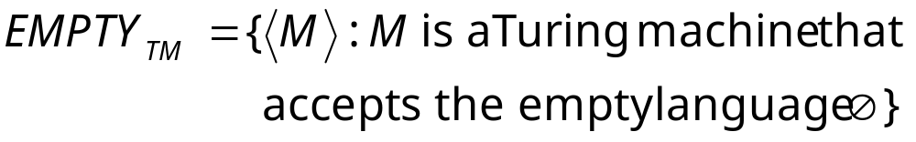
Empty language problem
Input:
Turing Machine
Question:
Is
empty?
Corresponding language:
Costas Busch - LSU

Slide 38
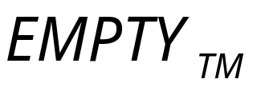
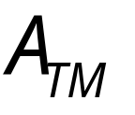
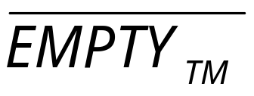
Theorem:
is undecidable
(empty-language problem is unsolvable)
Proof:
Reduce
(membership problem)
to
(empty language problem)
Costas Busch - LSU

Slide 39
membership problem decider
Decider for
empty problem
decider
YES
Decider
YES
Reduction
NO
NO
Given the reduction,
if is decidable,
then is decidable
A contradiction!
since
is undecidable
Costas Busch - LSU

Slide 40
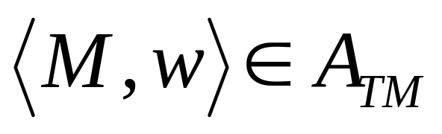
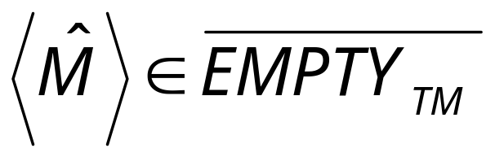
We only need to build the reduction:
Reduction
So that:
Costas Busch - LSU

Slide 41





Construct from :
Tape of
input string
Turing Machine
Accept
yes
yes
Write on tape, and
accepts ?
Simulate on input
Costas Busch - LSU

Slide 42
The only possible accepted string
Louisiana
Turing Machine
Accept
yes
yes
Write on tape, and
accepts ?
Simulate on input
Costas Busch - LSU

Slide 43
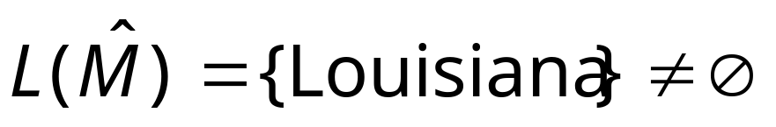
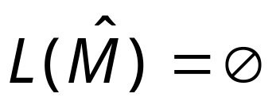
accepts
does not
accept
Turing Machine
Accept
yes
yes
Write on tape, and
accepts ?
Simulate on input
Costas Busch - LSU

Slide 44
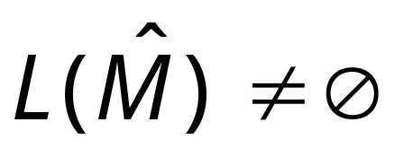

Therefore:
accepts
Equivalently:
END OF PROOF
Costas Busch - LSU

Slide 45
Let be a Turing-acceptable language
is empty?
is regular?
has size 2?
Costas Busch - LSU

Slide 46
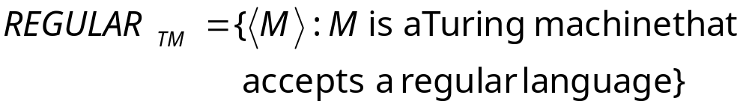
Regular language problem
Input:
Turing Machine
Question:
Is
a regular language?
Corresponding language:
Costas Busch - LSU

Slide 47

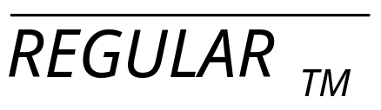
Theorem:
is undecidable
(regular language problem is unsolvable)
Proof:
Reduce
(membership problem)
to
(regular language problem)
Costas Busch - LSU

Slide 48
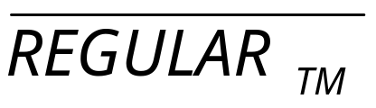
membership problem decider
Decider for
regular problem
decider
YES
Decider
YES
Reduction
NO
NO
Given the reduction,
If is decidable,
then is decidable
A contradiction!
since
is undecidable
Costas Busch - LSU

Slide 49
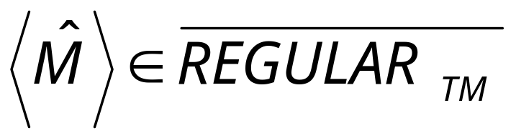
We only need to build the reduction:
Reduction
So that:
Costas Busch - LSU

Slide 50

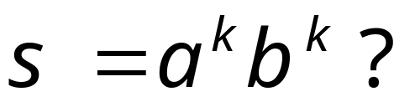
Construct from :
Tape of
input string
Turing Machine
Accept
yes
yes
Write on tape, and
accepts ?
Simulate on input
Costas Busch - LSU

Slide 51
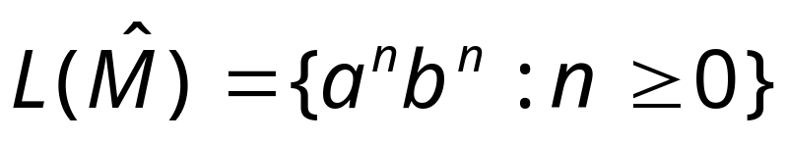
not regular
accepts
does not
accept
regular
Turing Machine
Accept
yes
yes
Write on tape, and
accepts ?
Simulate on input
Costas Busch - LSU

Slide 52
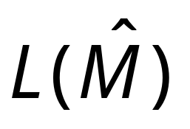
Therefore:
accepts
is not regular
Equivalently:
END OF PROOF
Costas Busch - LSU

Slide 53
Let be a Turing-acceptable language
is empty?
is regular?
has size 2?
Costas Busch - LSU

Slide 54
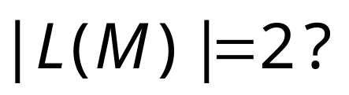
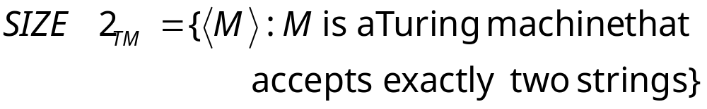
Size2 language problem
Input:
Turing Machine
Question:
Does have size 2 (two strings)?
Corresponding language:
Costas Busch - LSU

Slide 55
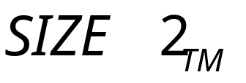
Theorem:
is undecidable
(size2 language problem is unsolvable)
Proof:
Reduce
(membership problem)
to
(size 2 language problem)
Costas Busch - LSU

Slide 56
membership problem decider
Decider for
size2 problem
decider
YES
Decider
YES
Reduction
NO
NO
Given the reduction,
If is decidable,
then is decidable
A contradiction!
since
is undecidable
Costas Busch - LSU

Slide 57
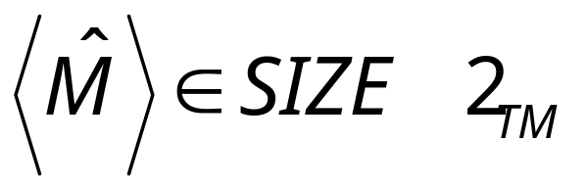
We only need to build the reduction:
Reduction
So that:
Costas Busch - LSU

Slide 58
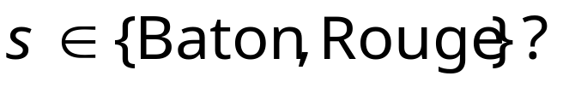
Construct from :
Tape of
input string
Turing Machine
Accept
yes
yes
Write on tape, and
accepts ?
Simulate on input
Costas Busch - LSU

Slide 59

2 strings
accepts
does not
accept
0 strings
Turing Machine
Accept
yes
yes
Write on tape, and
accepts ?
Simulate on input
Costas Busch - LSU

Slide 60
Therefore:
accepts
has size 2
Equivalently:
END OF PROOF
Costas Busch - LSU

