Slide 1
Time Complexity
Costas Busch - LSU

Slide 2


Consider a deterministic Turing Machine
which decides a language
Costas Busch - LSU

Slide 3


For any string the computation of
terminates in a finite amount of transitions
Initial
state
Accept
or Reject
Costas Busch - LSU

Slide 4
Decision Time = #transitions
Initial
state
Accept
or Reject
Costas Busch - LSU

Slide 5

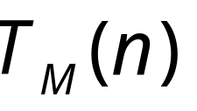
Consider now all strings of length
= maximum time required to decide
any string of length
Costas Busch - LSU

Slide 6







TIME
STRING LENGTH
Max time to decide string of length
Costas Busch - LSU

Slide 7
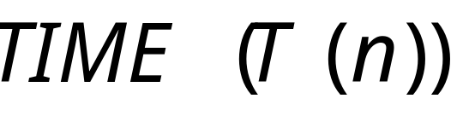
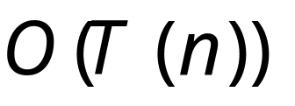



Time Complexity Class:
All Languages decidable by a deterministic Turing Machine
in time
Costas Busch - LSU

Slide 8
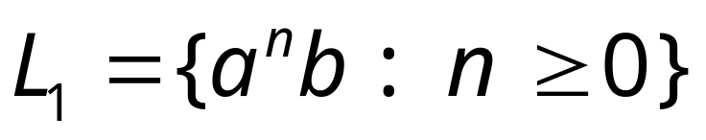
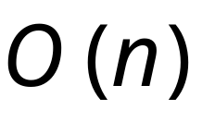
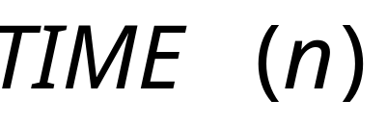
Example:
This can be decided in time
Costas Busch - LSU

Slide 9


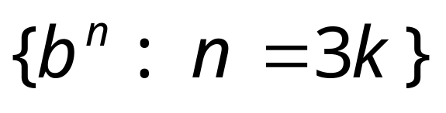
Other example problems in the same class
Costas Busch - LSU

Slide 10
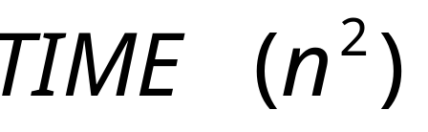
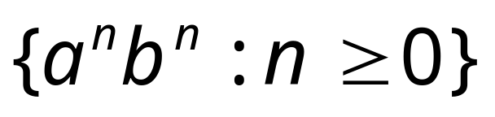


Examples in class:
Costas Busch - LSU

Slide 11
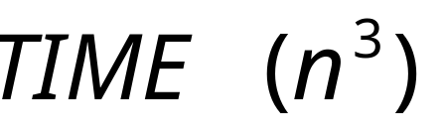
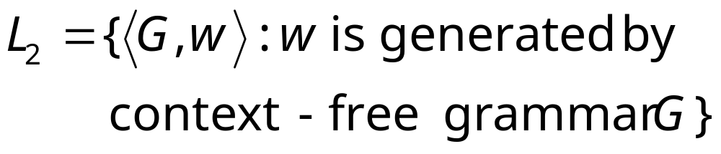
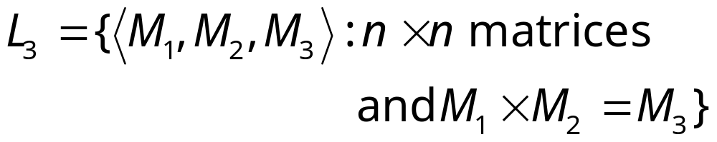
Examples in class:
CYK algorithm
Matrix multiplication
Costas Busch - LSU

Slide 12
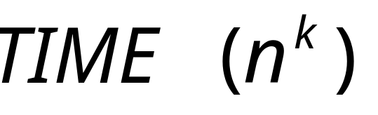
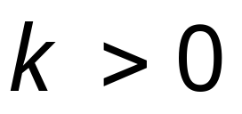
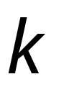
Polynomial time algorithms:
constant
Represents tractable algorithms:
for small we can decide
the result fast
Costas Busch - LSU

Slide 13
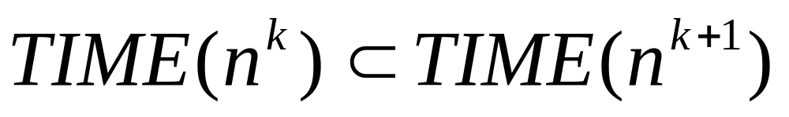
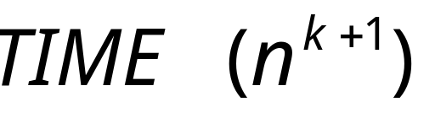

It can be shown:
Costas Busch - LSU

Slide 14

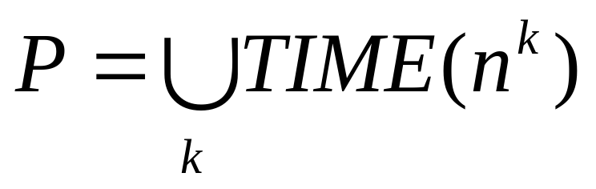
The Time Complexity Class
Represents:
polynomial time algorithms
“tractable” problems
Costas Busch - LSU

Slide 15

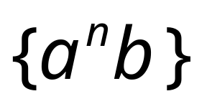
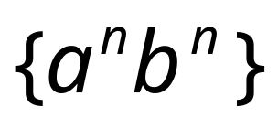

Class
CYK-algorithm
Matrix multiplication
Costas Busch - LSU

Slide 16
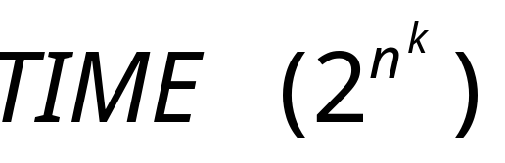
Exponential time algorithms:
Represent intractable algorithms:
Some problem instances
may take centuries to solve
Costas Busch - LSU

Slide 17
Example: the Hamiltonian Path Problem
s
t
Question: is there a Hamiltonian path
from s to t?
Costas Busch - LSU

Slide 18
s
t
YES!
Costas Busch - LSU

Slide 19
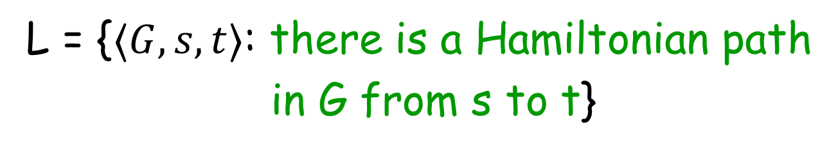
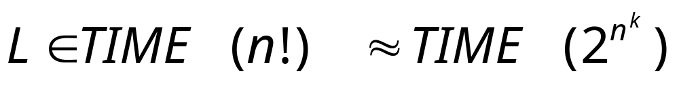
A solution: search exhaustively all paths
Exponential time
Intractable problem
Costas Busch - LSU

Slide 20
The clique problem
Does there exist a clique of size k?
Costas Busch - LSU

Slide 21

The clique problem
Does there exist a clique of size k?
Costas Busch - LSU

Slide 22
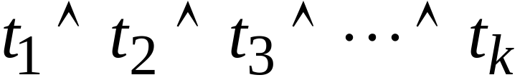
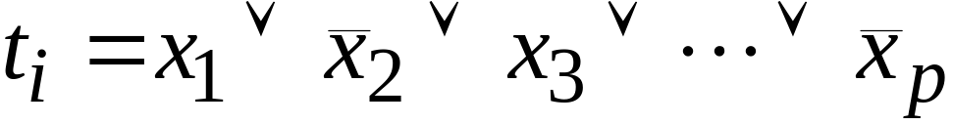
Example: The Satisfiability Problem
Boolean expressions in
Conjunctive Normal Form:
clauses
Variables
Question: is the expression satisfiable?
Costas Busch - LSU

Slide 23
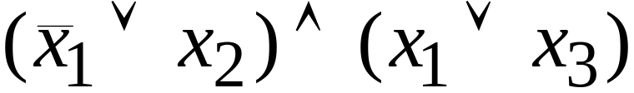
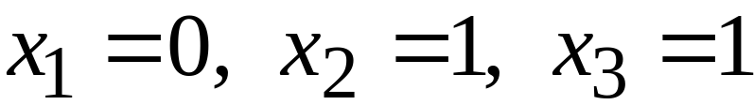
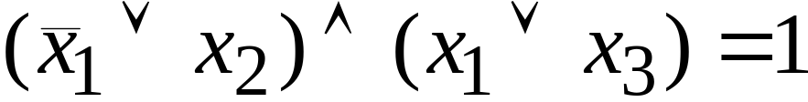
Example:
Satisfiable:
Costas Busch - LSU

Slide 24
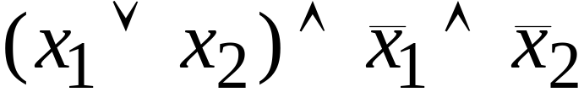
Example:
Not satisfiable
Costas Busch - LSU

Slide 25
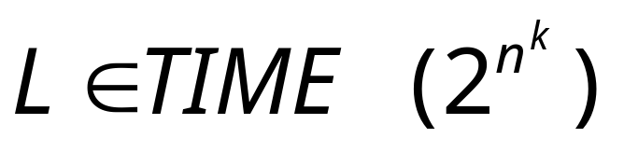
exponential
Algorithm:
search exhaustively all possible
binary values of the variables
Costas Busch - LSU

Slide 26
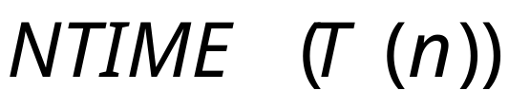

Non-Determinism
Language class:
A Non-Deterministic Turing Machine
decides each string of length
in time
Costas Busch - LSU

Slide 27





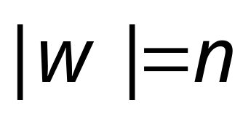
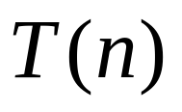
All computations
of on string
…
…
…
depth
…
accept
reject
accept
(deepest leaf)
reject
Costas Busch - LSU

Slide 28
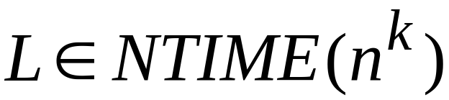
Non-Deterministic Polynomial time algorithms:
Costas Busch - LSU

Slide 29

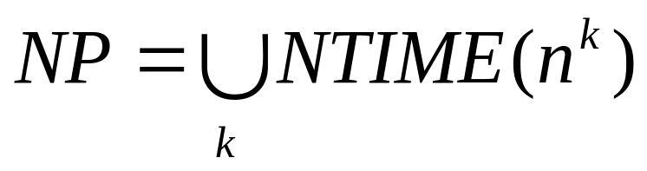
The class
Non-Deterministic Polynomial time
Costas Busch - LSU

Slide 30
Example:
The satisfiability problem
Non-Deterministic algorithm:
Guess an assignment of the variables
Check if this is a satisfying assignment
Costas Busch - LSU

Slide 31
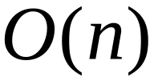
Time for variables:
Guess an assignment of the variables
Check if this is a satisfying assignment
Total time:
Costas Busch - LSU

Slide 32


The satisfiability problem is a - Problem
Costas Busch - LSU

Slide 33

Observation:
Deterministic
Polynomial
Non-Deterministic
Polynomial
Costas Busch - LSU

Slide 34

Open Problem:
WE DO NOT KNOW THE ANSWER
Costas Busch - LSU

Slide 35
Open Problem:
Example: Does the Satisfiability problem
have a polynomial time
deterministic algorithm?
WE DO NOT KNOW THE ANSWER
Costas Busch - LSU

