Slide 1
NP-complete Languages
Costas Busch - LSU

Slide 2




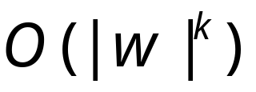
Polynomial Time Reductions
Polynomial Computable function :
There is a deterministic Turing machine
such that for any string computes
in polynomial time:
Costas Busch - LSU

Slide 3
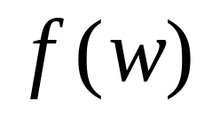
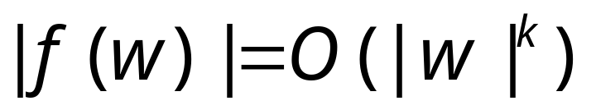
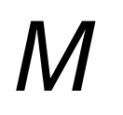
Observation:
the length of is bounded
since, cannot use
more than tape space
in time
Costas Busch - LSU

Slide 4


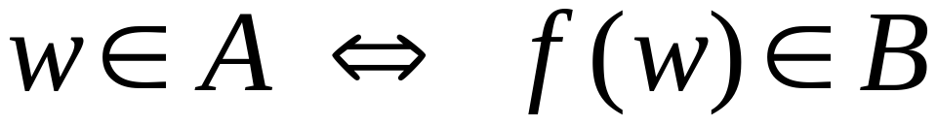
Definition:
Language
is polynomial time reducible to
language
if there is a polynomial computable
function such that:
Costas Busch - LSU

Slide 5





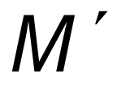
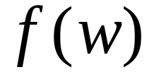
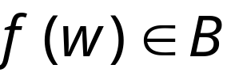

Theorem:
Suppose that is polynomial reducible to .
If then .
Proof:
Let be the machine that decides
in polynomial time
Machine to decide in polynomial time:
On input string :
1. Compute
2. Run on input
3. If acccept
Costas Busch - LSU

Slide 6
Example of a polynomial-time reduction:
We will reduce the
3CNF-satisfiability problem
to the
CLIQUE problem
Costas Busch - LSU

Slide 7
3CNF formula:
literal
variable or its
complement
clause
Each clause has three literals
Language:
3CNF-SAT ={ : is a satisfiable
3CNF formula}
Costas Busch - LSU

Slide 8



A 5-clique in graph
Language:
CLIQUE = { : graph
contains a -clique}
Costas Busch - LSU

Slide 9
Theorem:
3CNF-SAT is polynomial time
reducible to CLIQUE
Proof:
give a polynomial time reduction
of one problem to the other
Transform formula to graph
Costas Busch - LSU

Slide 10










Transform formula to graph.
Example:
Clause 2
Create Nodes:
Clause 3
Clause 1
Clause 4
Costas Busch - LSU

Slide 11


Add link from a literal to a literal in every
other clause, except the complement
Costas Busch - LSU

Slide 12
Resulting Graph
Costas Busch - LSU

Slide 13
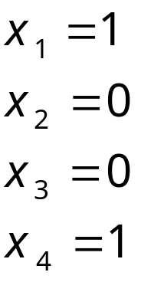
The formula is satisfied if and only if
the Graph has a 4-clique
End of Proof
Costas Busch - LSU

Slide 14
NP-complete Languages
We define the class of NP-complete
languages
Decidable
NP
NP-complete
Costas Busch - LSU

Slide 15

A language is NP-complete if:
is in NP, and
Every language in NP
is reduced to
in polynomial time
Costas Busch - LSU

Slide 16

Observation:
If a NP-complete language
is proven to be in P then:
Costas Busch - LSU

Slide 17
Decidable
NP
P
NP-complete
?
Costas Busch - LSU

Slide 18
An NP-complete Language
Cook-Levin Theorem:
Language SAT (satisfiability problem)
is NP-complete
Proof:
Part1:
SAT is in NP
(we have proven this in previous class)
Part2: reduce all NP languages
to the SAT problem
in polynomial time
Costas Busch - LSU

Slide 19
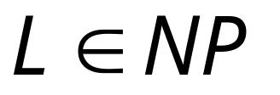

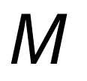
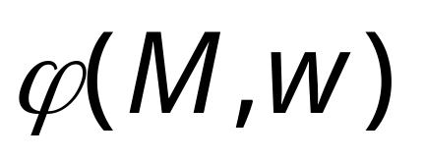
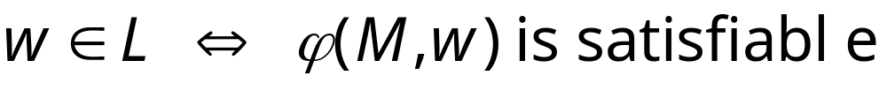
Take an arbitrary language
We will give a polynomial reduction of to SAT
Let be the NonDeterministic
Turing Machine that decides in polyn. time
For any string we will construct
in polynomial time a Boolean expression
such that:
Costas Busch - LSU

Slide 20




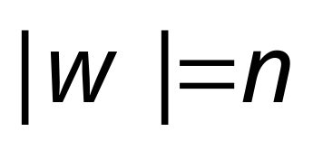
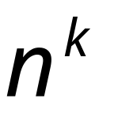
All computations
of on string
depth
…
…
…
…
accept
reject
accept
(deepest leaf)
reject
Costas Busch - LSU

Slide 21
Consider
an accepting
computation
depth
…
…
…
…
accept
reject
accept
(deepest leaf)
reject
Costas Busch - LSU

Slide 22

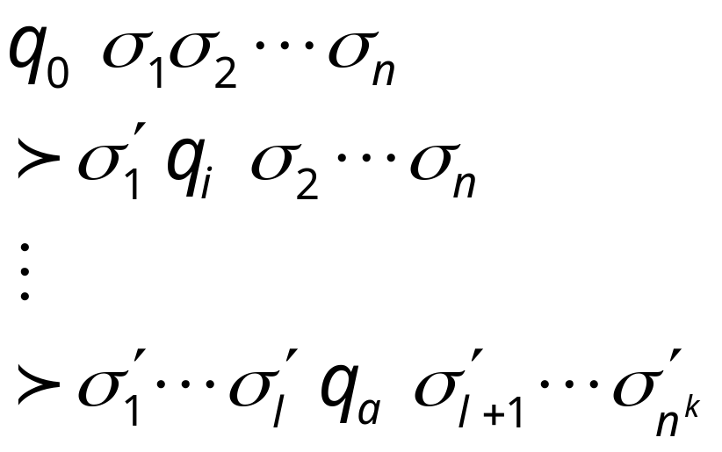



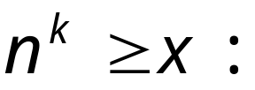

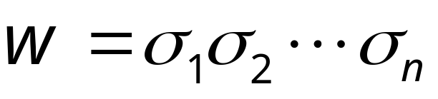
Computation path
Sequence of
Configurations
initial state
…
accept state
accept
Costas Busch - LSU

Slide 23




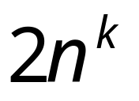
Machine Tape
Maximum working space area on tape
during time steps
Costas Busch - LSU

Slide 24
















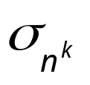


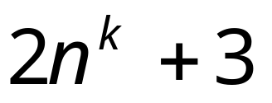
Tableau of Configurations
……
Accept configuration
indentical rows
Costas Busch - LSU

Slide 25
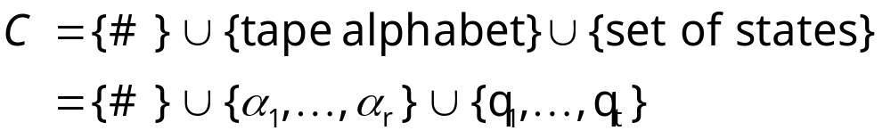
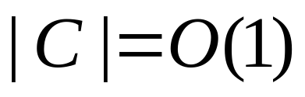
Tableau Alphabet
Finite size (constant)
Costas Busch - LSU

Slide 26
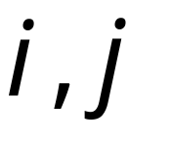
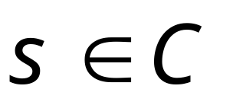
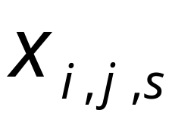

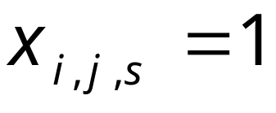
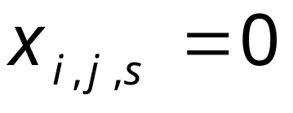
For every cell position
and
for every symbol in tableau alphabet
Define variable
Such that if cell contains symbol
Then
Else
Costas Busch - LSU

Slide 27

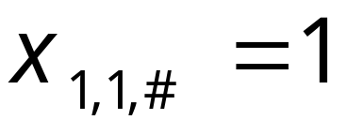
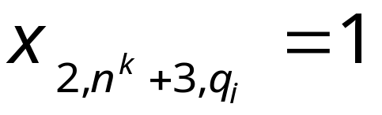
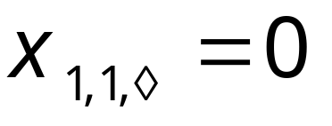
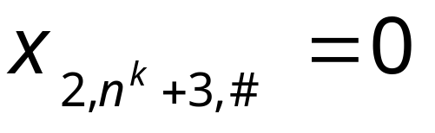
Examples:
Costas Busch - LSU

Slide 28


is built from variables
When the formula is satisfied,
it describes an accepting computation
in the tableau
of machine on input
Costas Busch - LSU

Slide 29

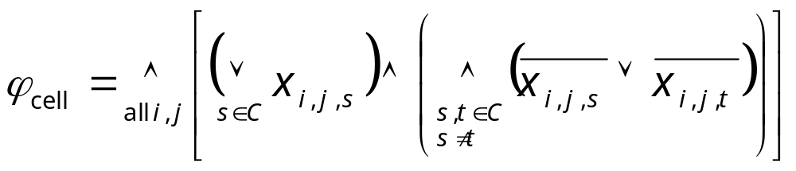
makes sure that every
cell in the tableau contains
exactly one symbol
Every cell contains
at least one symbol
Every cell contains
at most one symbol
Costas Busch - LSU

Slide 30
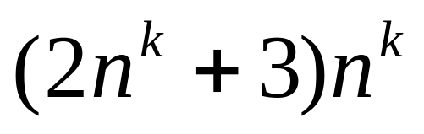



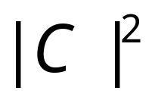


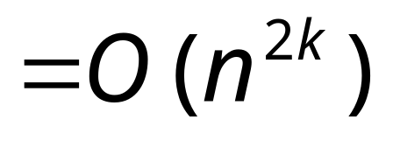
Size of :
Costas Busch - LSU

Slide 31

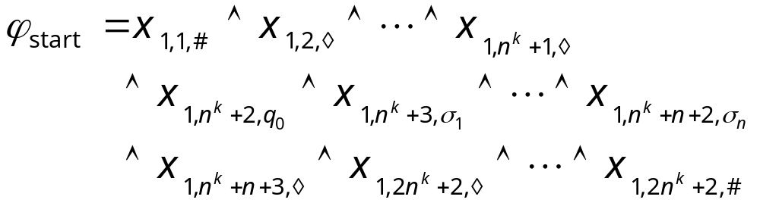
makes sure that the tableau
starts with the initial configuration
Describes the initial configuration
in row 1 of tableau
Costas Busch - LSU

Slide 32
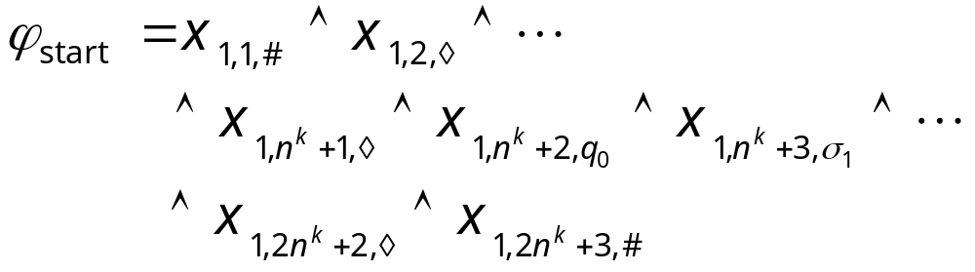
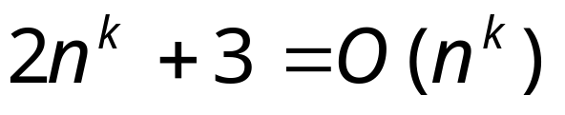
Size of :
Costas Busch - LSU

Slide 33
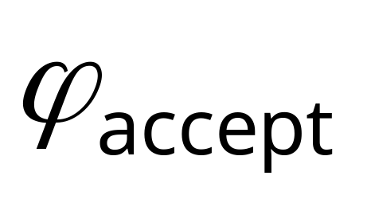
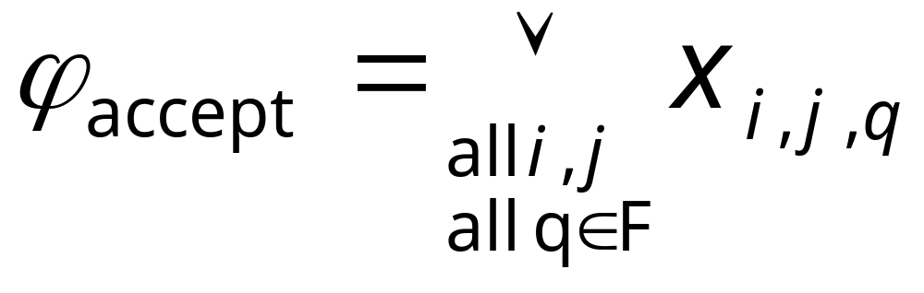
makes sure that the computation
leads to acceptance
Accepting states
An accept state should appear somewhere
in the tableau
Costas Busch - LSU

Slide 34
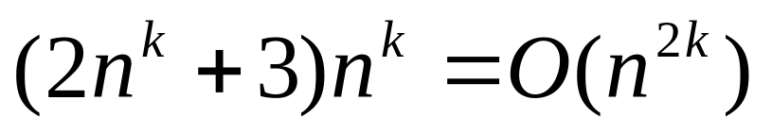
Size of :
Costas Busch - LSU

Slide 35

makes sure that the tableau
gives a valid sequence
of configurations
is expressed in terms of
legal windows
Costas Busch - LSU

Slide 36





Tableau
Window
2x6 area of cells
Costas Busch - LSU

Slide 37



Possible Legal windows
Legal windows obey the transitions
Costas Busch - LSU

Slide 38
Possible illegal windows
Costas Busch - LSU

Slide 39
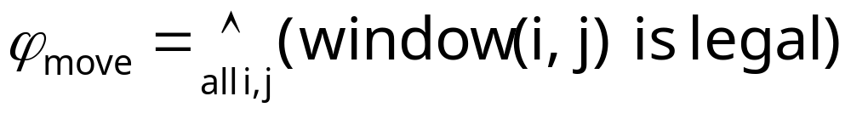




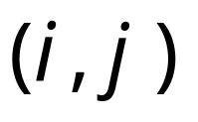
window (i,j) is legal:
((is legal)
(is legal)
(is legal))
all possible legal windows
in position
Costas Busch - LSU

Slide 40
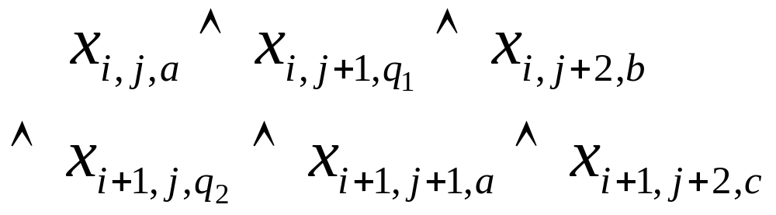
(is legal)
Formula:
Costas Busch - LSU

Slide 41

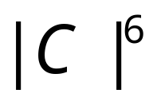
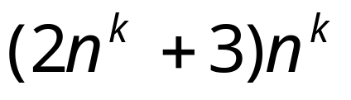

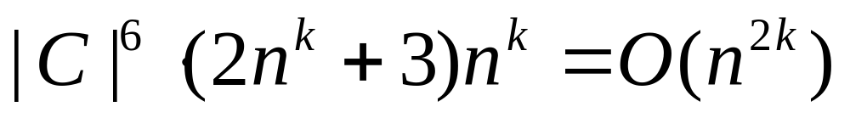
Size of :
Size of formula for a legal window
in a cell i,j:
Number of possible legal windows
in a cell i,j:
at most
Number of possible cells:
Costas Busch - LSU

Slide 42
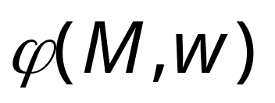
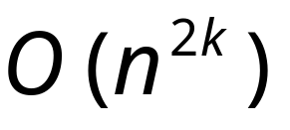


Size of :
it can also be constructed in time
polynomial in
Costas Busch - LSU

Slide 43
we have that:
Costas Busch - LSU

Slide 44

Since,
and
is constructed
in polynomial time
is polynomial-time reducible to SAT
END OF PROOF
Costas Busch - LSU

Slide 45
Observation 1:
The formula can be converted
to CNF (conjunctive normal form) formula
in polynomial time
Already CNF
NOT CNF
But can be converted to CNF
using distributive laws
Costas Busch - LSU

Slide 46


Distributive Laws:
Costas Busch - LSU

Slide 47

Observation 2:
The formula can also
be converted to a 3CNF formula
in polynomial time
convert
Costas Busch - LSU

Slide 48
From Observations 1 and 2:
CNF-SAT and
3CNF-SAT are
NP-complete languages
(they are known NP languages)
Costas Busch - LSU

Slide 49



Theorem:
If: a. Language is NP-complete
b. Language is in NP
c. is polynomial time reducible to
Then: is NP-complete
Proof:
Any language in NP
is polynomial time reducible to .
Thus, is polynomial time reducible to
(sum of two polynomial reductions,
gives a polynomial reduction)
Costas Busch - LSU

Slide 50
Corollary:
CLIQUE is NP-complete
Proof:
a. 3CNF-SAT is NP-complete
b. CLIQUE is in NP
(shown in last class)
c. 3CNF-SAT is polynomial reducible to CLIQUE
(shown earlier)
Apply previous theorem with
A=3CNF-SAT and B=CLIQUE
Costas Busch - LSU

