Slide 1
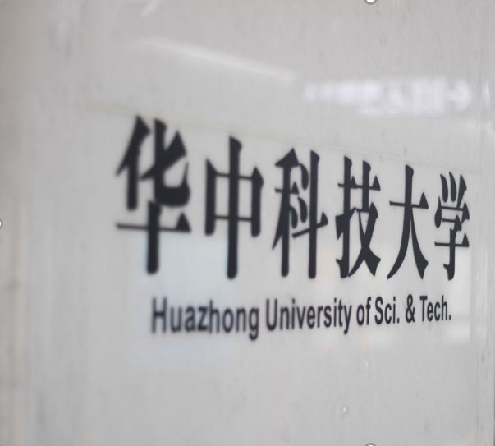

华中大PPT模板
HUAZHONG UNIVERSITY OF SCIENCE AND TECHNOLOGY
答辩学生：研小招
指导老师：X老师
明德厚学 求是创新

Slide 2



目 录
01
请输入标题
contents
PLEASE ENTER THE TITLE
02
请输入标题
PLEASE ENTER THE TITLE
03
请输入标题
PLEASE ENTER THE TITLE
04
请输入标题
PLEASE ENTER THE TITLE

Slide 3
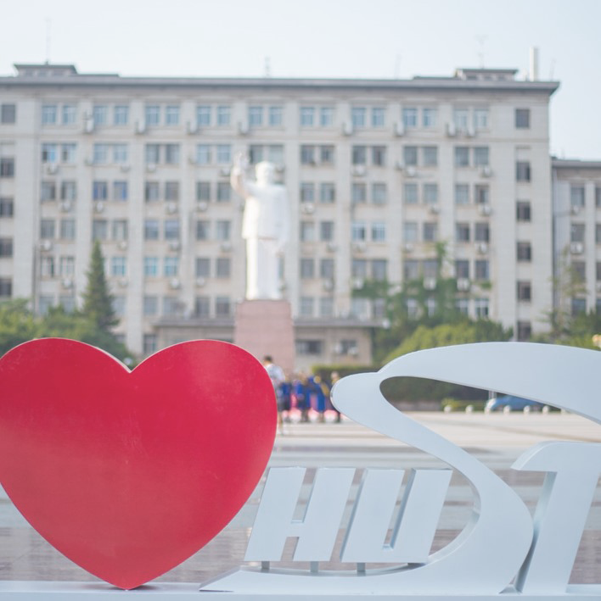
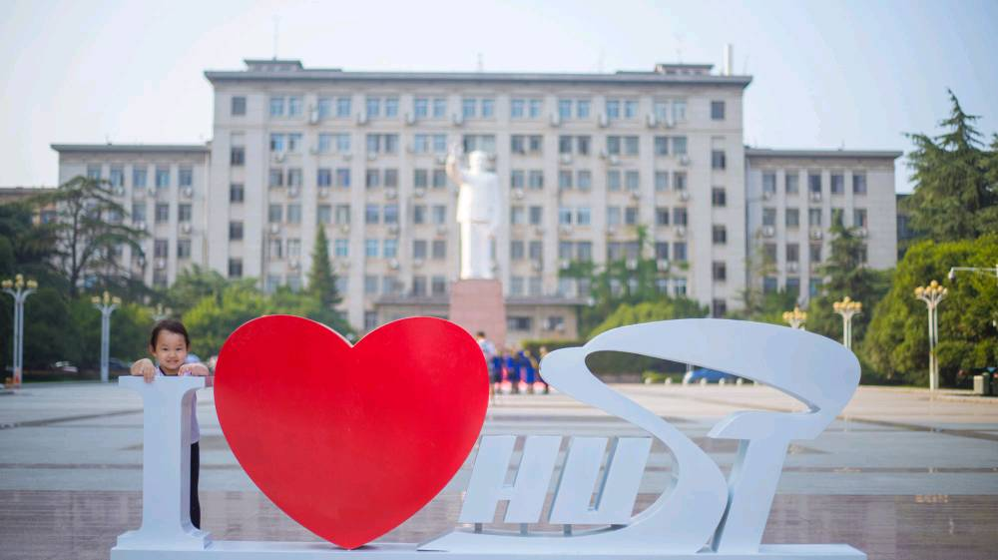
01
输入您需要的主题
PLEASE ENTER THE TOPIC

Slide 4
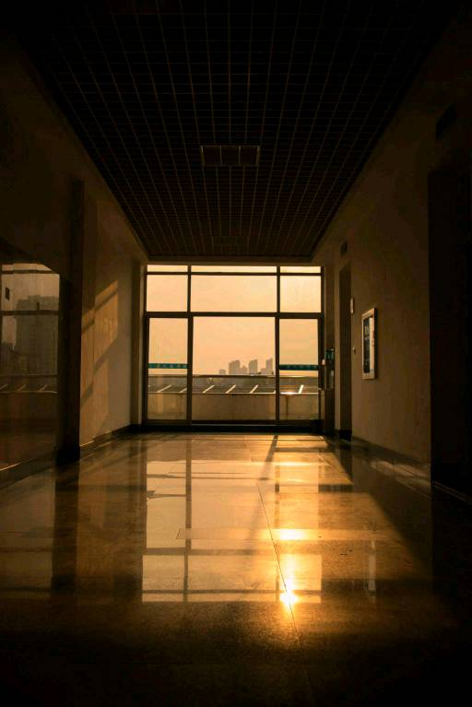

请输入您需要的主题
输入标题
The campus covers an area of more than 7000 mu, with verdant trees, green grass, elegant environment, beautiful scenery and 72% green coverage. It is known as "Forest University". The school has a complete teaching and research support system and complete public service facilities. The campus covers an area of more than 7000 mu, with verdant trees, green grass, elegant environment, beautiful scenery and 72% green coverage. It is known as "Forest University". The school has a complete teaching and research support system and complete public service facilities.

Slide 5
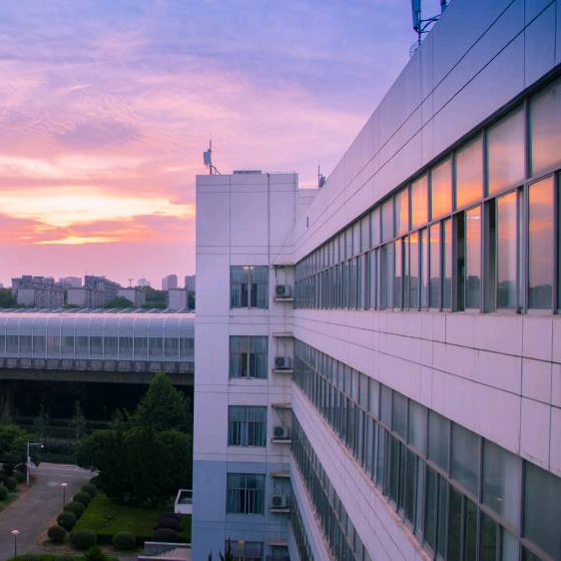
02
输入您需要的主题
PLEASE ENTER THE TOPIC

Slide 6
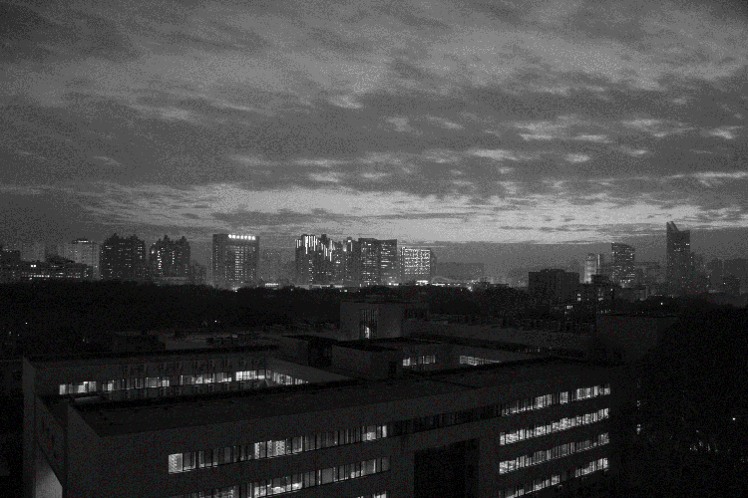
请输入您需要的主题
The campus covers an area of more than 7000 mu, with
It is known as "Forest University". The school has a complete teaching and research support system and complete public service facilities.
The campus covers an area of more than 7000 mu, with verdant trees, green grass, elegant environment, beautiful scenery and 72% green coverage.
输入标题
输入标题
输入标题
It is known as "Forest University". The school has a complete teaching and research support system and complete public service facilities.
The campus covers an area of more than 7000 mu, with verdant trees, green grass, elegant environment, beautiful scenery and 72% green coverage.
It is known as "Forest University". The school has a complete teaching and research support system and complete public service facilities.
The campus covers an area of more than 7000 mu, with verdant trees, green grass, elegant environment, beautiful scenery and 72% green coverage.
It is known as "Forest University". The school has a complete teaching and research support system and complete public service facilities.
The campus covers an area of more than 7000 mu, with verdant trees, green grass, elegant environment, beautiful scenery and 72% green coverage.

Slide 7
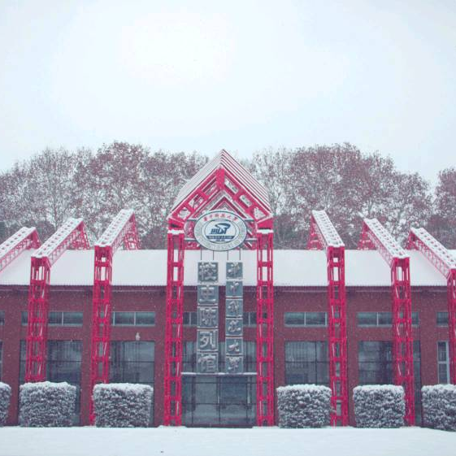
03
输入您需要的主题
PLEASE ENTER THE TOPIC

Slide 8
请输入您需要的主题
 | 标题A | 标题B | 标题C | 标题D | 标题E | 标题F | 标题G | 标题E
内容 | 4.65 | 45.8 | 89.5 | 43.7 | 89.6 | 23.8 | 36.7 | 23.9
内容 | 5 | 32 | 89 | 90 | 57 | 78 | 56 | 46
内容 | 63.6 | 38.3 | 45.6 | 79.3 | 43.6 | 54.4 | 32.4 | 34.3
内容 | 5 | 4 | 26 | 10 | 43 | 23 | 15 | 58
The campus covers an area of more than 7000 mu, with verdant trees, green grass, elegant environment, beautiful scenery and 72% green coverage. The school has a complete teaching and research support system and complete public service facilities. The campus covers an area of more than 7000 mu, with verdant trees, green grass, elegant environment, beautiful scenery and 72% green coverage. The school has a complete teaching and research support system and complete public service facilities.
输入标题

Slide 9
请输入您需要的主题
2021 . 02
2021 . 04
2021 . 07
2021 . 01
2021 . 03
2021 . 06
The campus covers an area of more than 7000 mu, with verdant trees, green grass, elegant environment, beautiful scenery and 72% green coverage. The school has a complete teaching and research support system and complete public service facilities. The campus covers an area of more than 7000 mu, with verdant trees, green grass, elegant environment, beautiful scenery and 72% green coverage. The school has a complete teaching and research support system and complete public service facilities.
输入标题

Slide 10
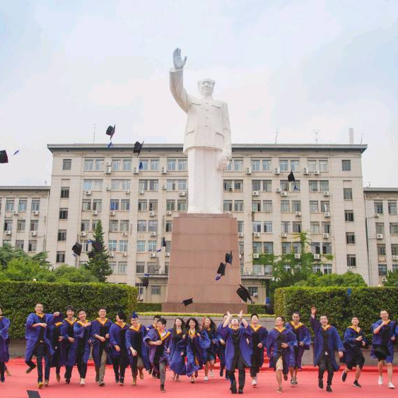
04
输入您需要的主题
PLEASE ENTER THE TOPIC

Slide 11
请输入您需要的主题
01
论文结论
The campus covers an area of more than 7000 mu, with verdant trees, green grass, elegant environment, scenery and 72% green coverage.
02
论文结论
The school has a complete teaching and complete public service facilities. The school has a complete teaching and research support system and complete public service facilities.
03
论文结论
The school has a complete teaching and research support system and complete public service facilities. The campus covers an area of more than 7000 mu.

Slide 12
请输入您需要的主题
输入标题
01
论文结论
02
论文结论
The campus covers an area of more than 7000 mu, with verdant trees, green grass, elegant environment.
The school has a complete teaching and complete public service facilities. The school has a public service facilities.
输入内容
04
论文结论
03
论文结论
The school has a complete teaching and research support system and complete public service facilities.
The school has a complete teaching and research support system and complete public service facilities.

Slide 13
THANKS
华中科技大学2021级 XXXXXX学院
答辩学生：研小招
指导老师：X老师
明德厚学 求是创新

