Slide 1
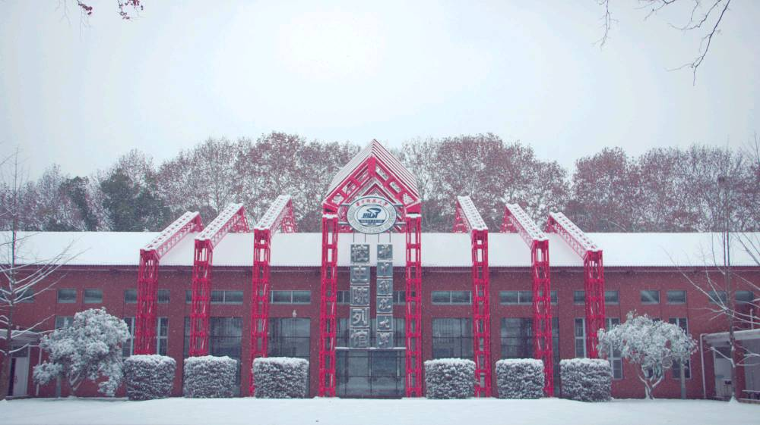


华中大PPT模板
HUAZHONG UNIVERSITY OF SCIENCE AND TECHNOLOGY
答辩学生：研小招
华中科技大学2021级 XXXXXX学院

Slide 2

目录 CONTENTS
01
03
请输入标题
请输入标题
PLEASE ENTER THE TITLE
PLEASE ENTER THE TITLE
02
04
请输入标题
请输入标题
PLEASE ENTER THE TITLE
PLEASE ENTER THE TITLE

Slide 3
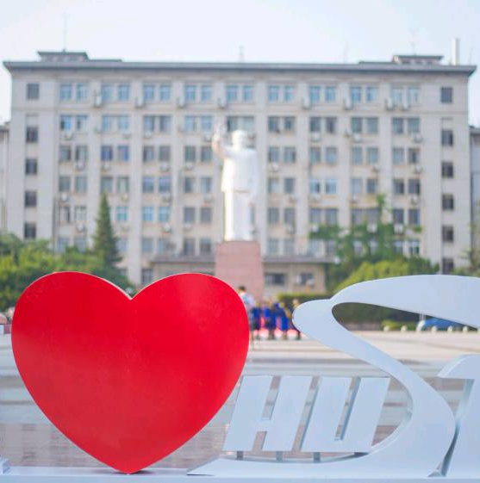
01
输入您需要的主题
PLEASE ENTER THE TOPIC

Slide 4

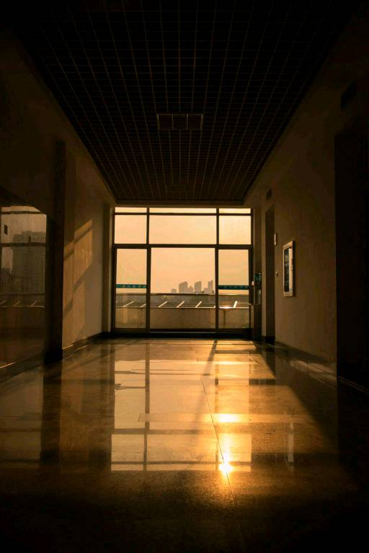
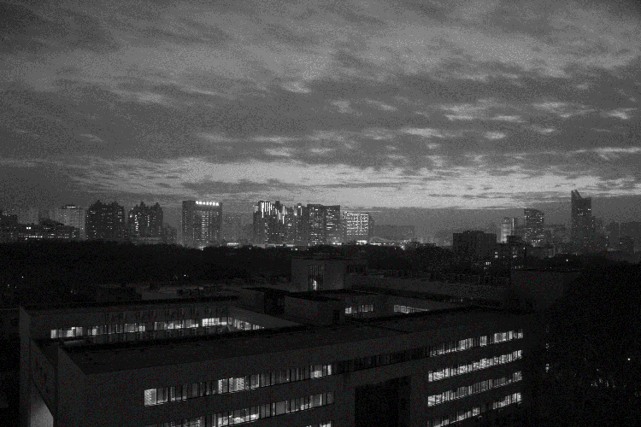
请输入您需要的主题
The campus covers an area of more than 7000 mu, with
It is known as "Forest University". The school has a complete teaching and research support system and complete public service facilities.
The campus covers an area of more than 7000 mu, with verdant trees, green grass, elegant environment, beautiful scenery and 72% green coverage.
输入标题
输入标题
输入标题
It is known as "Forest University". The school has a complete teaching and research support system and complete public service facilities.
The campus covers an area of more than 7000 mu, with verdant trees, green grass, elegant environment, beautiful scenery and 72% green coverage.
It is known as "Forest University". The school has a complete teaching and research support system and complete public service facilities.
The campus covers an area of more than 7000 mu, with verdant trees, green grass, elegant environment, beautiful scenery and 72% green coverage.
It is known as "Forest University". The school has a complete teaching and research support system and complete public service facilities.
The campus covers an area of more than 7000 mu, with verdant trees, green grass, elegant environment, beautiful scenery and 72% green coverage.

Slide 5
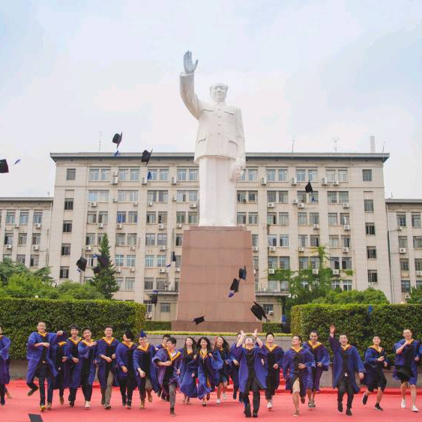
02
输入您需要的主题
PLEASE ENTER THE TOPIC

Slide 6
请输入您需要的主题
在这里输入你的标题
01
02
03
输入标题
输入标题
输入标题
The campus covers an area of more than 7000 mu, with verdant trees, green grass, beautiful scenery and 72% green coverage. It is known as "Forest University". The campus covers an area of more than 7000 mu, with verdant trees, green grass, beautiful scenery and 72% green coverage. It is known as "Forest University". The campus covers an area of more than 7000 mu, with verdant trees, beautiful scenery and 72% green coverage.
The campus covers an area of more than 7000 mu, with verdant trees, green grass, beautiful scenery and 72% green coverage. It is known as "Forest University". The campus covers an area of more than 7000 mu, with verdant trees, green grass, beautiful scenery and 72% green coverage. It is known as "Forest University". The campus covers an area of more than 7000 mu, with verdant trees, beautiful scenery and 72% green coverage.
The campus covers an area of more than 7000 mu, with verdant trees, green grass, beautiful scenery and 72% green coverage. It is known as "Forest University". The campus covers an area of more than 7000 mu, with verdant trees, green grass, beautiful scenery and 72% green coverage. It is known as "Forest University". The campus covers an area of more than 7000 mu, with verdant trees, beautiful scenery and 72% green coverage.

Slide 7

03
输入您需要的主题
PLEASE ENTER THE TOPIC

Slide 8
请输入您需要的主题
2021 . 02
2021 . 04
2021 . 07
2021 . 01
2021 . 03
2021 . 06
The campus covers an area of more than 7000 mu, with verdant trees, green grass, elegant environment, beautiful scenery and 72% green coverage. The school has a complete teaching and research support system and complete public service facilities. The campus covers an area of more than 7000 mu, with verdant trees, green grass, elegant environment, beautiful scenery and 72% green coverage. The school has a complete teaching and research support system and complete public service facilities.
输入标题

Slide 9

请输入您需要的主题
The campus covers an area of more than 7000 mu, with verdant trees, green grass, elegant environment, beautiful scenery and 72% green coverage. The school has a complete teaching and research support system and complete public service facilities. The campus covers an area of more than 7000 mu, with verdant trees, green grass, elegant environment, beautiful scenery and 72% green coverage. The school has a complete teaching and research support system and complete public service facilities.
输入标题

Slide 10
04
输入您需要的主题
PLEASE ENTER THE TOPIC

Slide 11
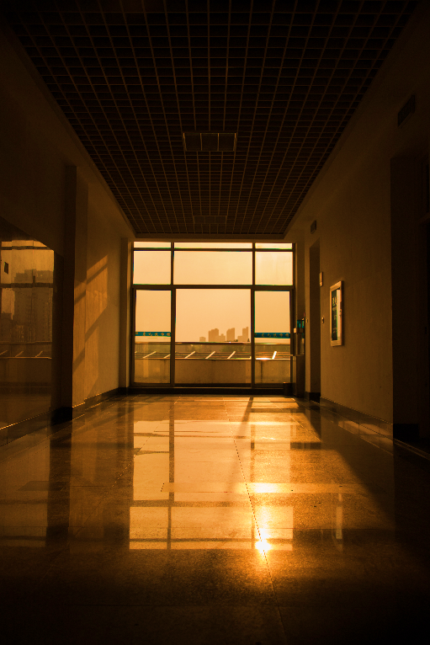
请输入您需要的主题
01
输入标题
The campus covers an area of more than 7000 mu, with verdant trees, green grass, elegant environment, scenery and 72% green coverage.
02
输入标题
The school has a complete teaching and complete public service facilities. The school has a complete teaching and research support system and complete public service facilities.
03
输入标题
The school has a complete teaching and research support system and complete public service facilities. The campus covers an area of more than 7000 mu.

Slide 12
请输入您需要的主题
输入标题
01
输入标题
02
输入标题
The campus covers an area of more than 7000 mu, with verdant trees, green grass, elegant environment.
The school has a complete teaching and complete public service facilities. The school has a public service facilities.
输入内容
04
输入标题
03
输入标题
The school has a complete teaching and research support system and complete public service facilities.
The school has a complete teaching and research support system and complete public service facilities.

Slide 13
THANKS
答辩学生：研小招
华中科技大学2021级 XXXXXX学院

