Slide 1
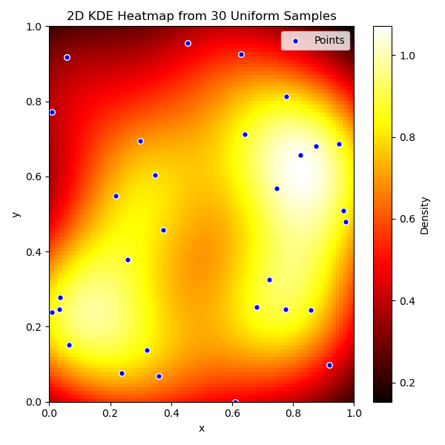
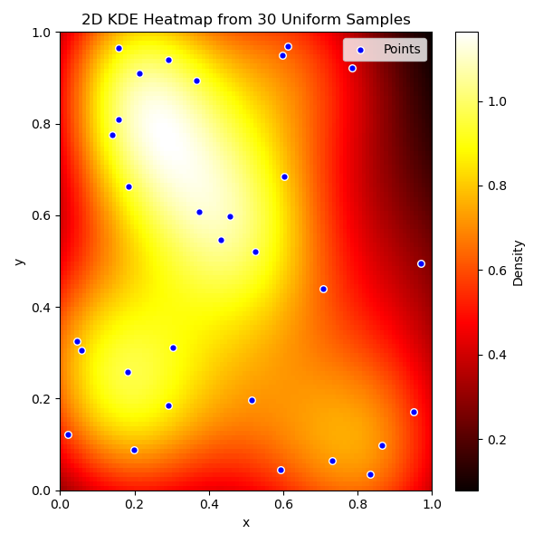
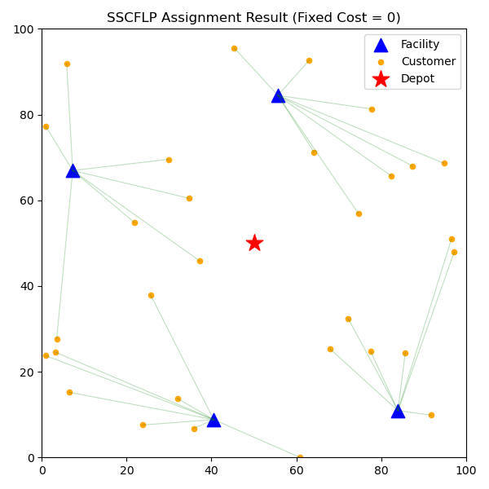
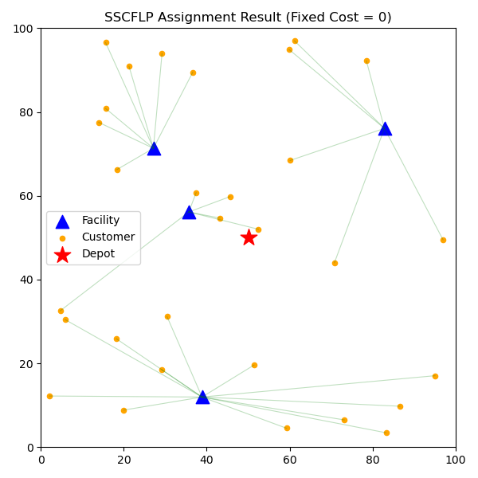

Slide 2
10
3
12
4
할당 문제
15
5

Slide 3
10
3
12
4
할당 문제
15
5

Slide 4
정/정
정/역
2-OPT 루트
역/정
역/역

Slide 5
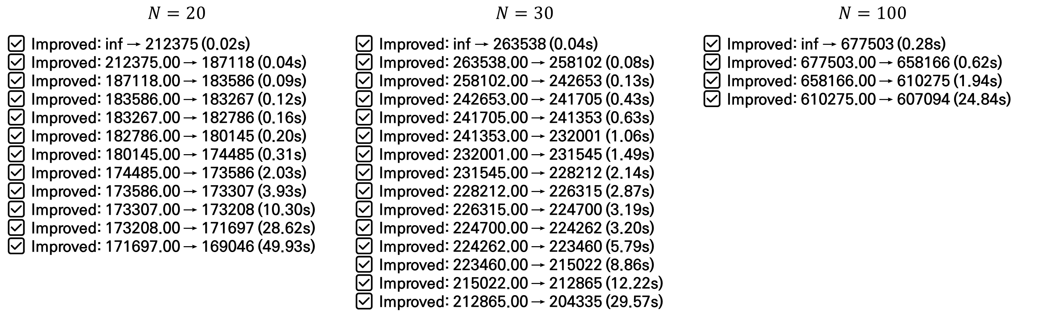
✅ Improved: inf → 212375 (0.02s)
✅ Improved: 212375.00 → 187118 (0.04s)
✅ Improved: 187118.00 → 183586 (0.09s)
✅ Improved: 183586.00 → 183267 (0.12s)
✅ Improved: 183267.00 → 182786 (0.16s)
✅ Improved: 182786.00 → 180145 (0.20s)
✅ Improved: 180145.00 → 174485 (0.31s)
✅ Improved: 174485.00 → 173586 (2.03s)
✅ Improved: 173586.00 → 173307 (3.93s)
✅ Improved: 173307.00 → 173208 (10.30s)
✅ Improved: 173208.00 → 171697 (28.62s)
✅ Improved: 171697.00 → 169046 (49.93s)
✅ Improved: inf → 263538 (0.04s)
✅ Improved: 263538.00 → 258102 (0.08s)
✅ Improved: 258102.00 → 242653 (0.13s)
✅ Improved: 242653.00 → 241705 (0.43s)
✅ Improved: 241705.00 → 241353 (0.63s)
✅ Improved: 241353.00 → 232001 (1.06s)
✅ Improved: 232001.00 → 231545 (1.49s)
✅ Improved: 231545.00 → 228212 (2.14s)
✅ Improved: 228212.00 → 226315 (2.87s)
✅ Improved: 226315.00 → 224700 (3.19s)
✅ Improved: 224700.00 → 224262 (3.20s)
✅ Improved: 224262.00 → 223460 (5.79s)
✅ Improved: 223460.00 → 215022 (8.86s)
✅ Improved: 215022.00 → 212865 (12.22s)
✅ Improved: 212865.00 → 204335 (29.57s)
✅ Improved: inf → 677503 (0.28s)
✅ Improved: 677503.00 → 658166 (0.62s)
✅ Improved: 658166.00 → 610275 (1.94s)
✅ Improved: 610275.00 → 607094 (24.84s)
$N=20$ | $N=30$ | $N=100$
✅ Improved: inf → 212375 (0.02s) ✅ Improved: 212375.00 → 187118 (0.04s) ✅ Improved: 187118.00 → 183586 (0.09s) ✅ Improved: 183586.00 → 183267 (0.12s) ✅ Improved: 183267.00 → 182786 (0.16s) ✅ Improved: 182786.00 → 180145 (0.20s) ✅ Improved: 180145.00 → 174485 (0.31s) ✅ Improved: 174485.00 → 173586 (2.03s) ✅ Improved: 173586.00 → 173307 (3.93s) ✅ Improved: 173307.00 → 173208 (10.30s) ✅ Improved: 173208.00 → 171697 (28.62s) ✅ Improved: 171697.00 → 169046 (49.93s) | ✅ Improved: inf → 263538 (0.04s) ✅ Improved: 263538.00 → 258102 (0.08s) ✅ Improved: 258102.00 → 242653 (0.13s) ✅ Improved: 242653.00 → 241705 (0.43s) ✅ Improved: 241705.00 → 241353 (0.63s) ✅ Improved: 241353.00 → 232001 (1.06s) ✅ Improved: 232001.00 → 231545 (1.49s) ✅ Improved: 231545.00 → 228212 (2.14s) ✅ Improved: 228212.00 → 226315 (2.87s) ✅ Improved: 226315.00 → 224700 (3.19s) ✅ Improved: 224700.00 → 224262 (3.20s) ✅ Improved: 224262.00 → 223460 (5.79s) ✅ Improved: 223460.00 → 215022 (8.86s) ✅ Improved: 215022.00 → 212865 (12.22s) ✅ Improved: 212865.00 → 204335 (29.57s) | ✅ Improved: inf → 677503 (0.28s) ✅ Improved: 677503.00 → 658166 (0.62s) ✅ Improved: 658166.00 → 610275 (1.94s) ✅ Improved: 610275.00 → 607094 (24.84s)

Slide 6
✅ Improved: inf → 263538 (0.04s)
✅ Improved: 263538.00 → 258102 (0.08s)
✅ Improved: 258102.00 → 242653 (0.13s)
✅ Improved: 242653.00 → 241705 (0.43s)
✅ Improved: 241705.00 → 241353 (0.63s)
✅ Improved: 241353.00 → 232001 (1.06s)
✅ Improved: 232001.00 → 231545 (1.49s)
✅ Improved: 231545.00 → 228212 (2.14s)
✅ Improved: 228212.00 → 226315 (2.87s)
✅ Improved: 226315.00 → 224700 (3.19s)
✅ Improved: 224700.00 → 224262 (3.20s)
✅ Improved: 224262.00 → 223460 (5.79s)
✅ Improved: 223460.00 → 215022 (8.86s)
✅ Improved: 215022.00 → 212865 (12.22s)
✅ Improved: 212865.00 → 204335 (29.57s)

Slide 7
✅ Improved: inf → 677503 (0.28s)
✅ Improved: 677503.00 → 658166 (0.62s)
✅ Improved: 658166.00 → 610275 (1.94s)
✅ Improved: 610275.00 → 607094 (24.84s)

