Slide 1




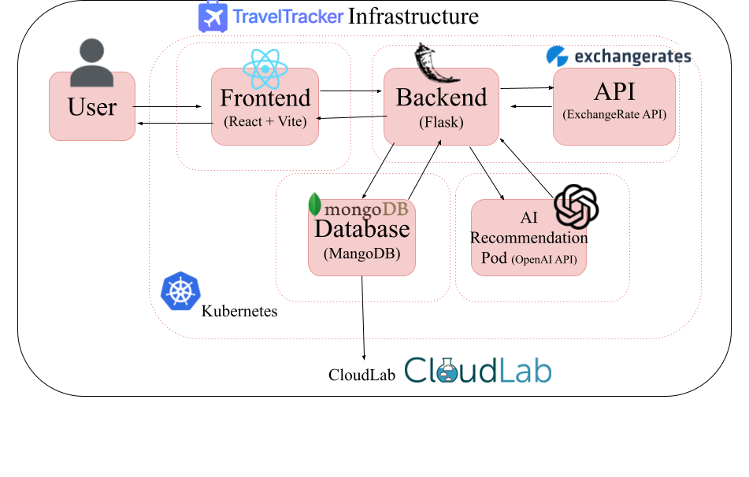


Infrastructure
What Now?
Cloud-native Travel Planning Platform: budgeting, itineraries, expense tracking, and collaboration.
Transitioned from Docker Compose → Kubernetes for scalability, resilience, and production readiness.
Planned AI recommendations (hotels, activities, destinations) powered by OpenAI API.
AI Chatbot to help you with itinerary questions and planning.
Updated UI/UX, more professional rebranding.
Scale the backend: Add more security, autoscaling for pods, and automated testing.
Sharing travel plans with friends, uploading receipts and pictures.
What is it?
Centralized vacation planner for managing all trip logistics.
Tracks budgeting, flights, accommodations, itineraries, excursions, activities, and notes.
Provides real-time currency conversion for international travel.
Advises users on saving money and setting allowances.
Reduces uncertainty and encourages organized, stress-free travel planning.

