Slide 1
Telemetry
Operations UI

Slide 2
History
The current OpsUi was preceded by the RcsGUI.
RcsGUI used a series of client pull requests (polling) to extract status from the RCS control-server on port 9110.
Only services within the RCS were available.
Only continuously changing sources of data were obtainable, i.e. no event-driven feeds.
Initially created to monitor a very limited set of data from RCS.
Developed over a number of years on an ad-hoc basis.

Slide 3
Ops UI
Goal was to have access to all available feeds, both continuous and event-driven from any system capable of being monitored.
Potential systems:-
RCS
Instruments
Environment
Scheduler
Synoptic Models
OSS
TEA
NSO
Skycams

Slide 4
Design – data collection
Each feed source is designated as a service and has a specific ServiceProvider (SP).
Different classes for each feed.
E.g.
ngat.opsgui.services.TelescopeStatusHandlerService
Ngat.opsgui.services.ReactiveSystemHandlerService
Managed by the ServiceManager (SM).
Each provider is a listener for the feed source it is attached to.
E.g. TelescopeStatusHandlerService implements ngat.tcm.TelescopeStatusUpdateListener.
Remote source (or gateway) updates SP which stores the received status in a queue.
SM runs a registration thread and distribution thread for each service.
Registration thread regularly re-connects to the provider (or gateway) incase the registration is lost or source restarts.
Distribution thread broadcasts the status from the queue to any connected handlers.

Slide 5
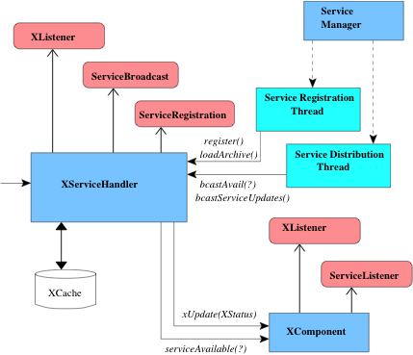
Data Handling

Slide 6
Design - UI
The OpsUI screen is made up of several areas.
Side-bar
Always visible
Contains sub-components which show summary status for different services.
Top-bar
Always visible
Contains sub-components which show summary information.
Perspectives area
A number of tab panels (perspectives) loosely associated with the various SPs.
Perspectives are themselves tab panes and contain data in separate tabs associated with different aspects of the services they display.
Menu bar
Fixed menus and perspective-dependant menus.

Slide 7
Available Services
INSTR
InstrumentStatusHandlerService
implements ngat.icm.InstrumentStatusUpdateListener
METEO
MeteorologyStatusHandlerService
implements ngat.ems.MeteorologyStatusUpdateListener
OPS
OperationsEventHandlerService
implementsngat.rcs.ops.OperationsEventListener
PHASE2
Phase2CacheService
ERS
ReactiveSystemUpdateHandlerService
implements ngat.rcs.ers.ReactiveSystemsUpdateListener
SCHED
SchedulingHandlerService
implements ngat.sms.SchedulingStatusUpdateListener
SKY
SkyModelHandlerService
implements ngat.ems.SkyModelUpdateListener
TASK
TaskLifecycleEventHandlerService
implements ngat.rcs.tms.taskLifeCycleEventListener
TEL
TelescopeStatusHandlerService
implements ngat.tcm.TelescopeStatusUpdateListener

Slide 8
Available Perspectives
Astrometry
Instruments
Meteorology
Operations
Phase2
Reactive
Scheduling
Services
Tracking
Task

Slide 9
Structure
Perspectives display data associated with one or more telemetry feeds. They have several tabs to display different types of information.
Perspectives are grouped into Displays. A display can have one or more perspectives, selected using the tabs on the right. (these are meant to have icons rather than letters, a job for someone with graphic design capabilities.
A collection of displays is a Layout. These can be setup at startup – in principle this should be configurable per user but needs a little more work.
One display has the sidebar and topbar. If only a single display in the layout then it has them.
Individual perspectives can be torn off the display and popup in their own standalone display. Clicking the close or minimize icon will pop them back where they came from.
Some individual tab panels within a perspective can be torn off – this currently only works with the Scheduling perspective.

Slide 10
Perspectives
Perspectives act as handlers for the various service broadcasts.
e.g.TrackingPerspective receives updates from both the Telescope and Scheduling services.
They then distribute the data to their sub-components – i.e. the sub-panels. These in turn update individual components – datafields, status indicators, graphs.
Each perspective has menus associated with it.
When a perspective is selected, the main menu bar contains those menus in addition to those which are always present.

