Slide 1
Scheduling

Slide 2
Purpose
Determine best choice of Group to execute under given sky conditions with reference to priority and observability.
Scheduler on LT is a passive system
It generates schedule only on request by RCS.
RCS then executes or may do something else.
Alternative is an active scheduler.
Generates a schedule or plan and gets rest of system to implement it.
This is what most people seem to assume happens.

Slide 3
Types of scheduler
Despatcher
Selects an individual group on request which is suited to conditions, feasible and in some way optimal.
Always picks the best group at that time.
The executed sequence however may not be optimal.
Look-ahead
Generates a sequence of groups which are then passed back to requestor as needed
Optimal sequence at the time – may not be same as sequence generated by despatcher.
Sequence may break due to environmental changes and become sub-optimal.

Slide 4
Background
Adaptive Optimal Telescope Scheduling
http://1drv.ms/1xx9tBd
Chapters 1 (intro) and 5 (architecture)
The LT scheduling system SMS and the scheduler (BDS) is in the ngat.sms package.
Older schedulers and OSS classes are in the defunct
ltdevsrv:~dev/src/oss/
Current despatch scheduler:-
ngat.sms.bds.BasicDespatchScheduler
Various Look-ahead schedulers also implemented
TLAS
ngat.sms.tlas.TestLookAheadScheduler
QLAS
ngat.oss.simulation.QuantumLookAheadScheduler

Slide 5
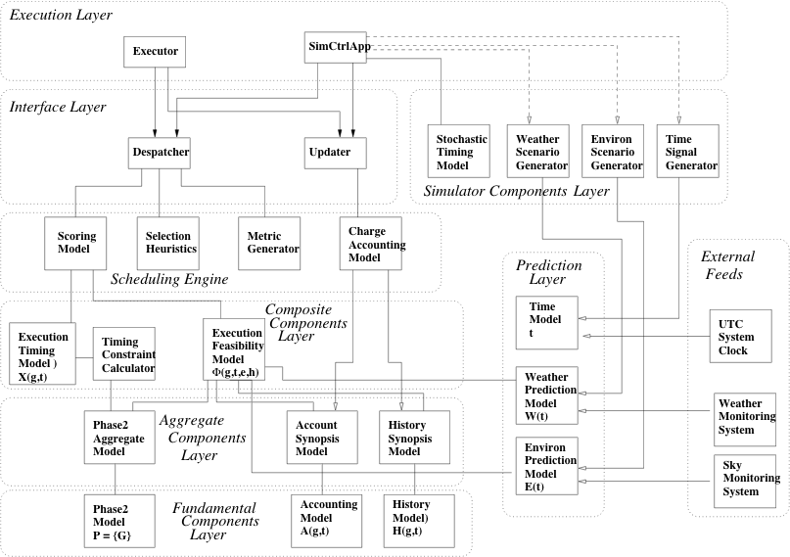
Architecture

Slide 6
Synoptic models
Generally referred to as the cache.
Phase2CompositeModel
Active and unexpired groups and details of:-
Proposal, PI User, TAG, Sequence
AccountSynopsisModel
Details of accounts per group
Just balances, not transactions
HistorySynopsisModel
Details of execution history per group
Last successful exec and count
Individual models are collected together and served by a SynopticModelProvider.
Models are connected to base models.
Phase2Model, AccountingModel, HistoryModel
They receive callbacks when the base models change.

Slide 7
Additional Synoptic Models
InstrumentSynopsisModel
InstrumentSynopsis for each instrument
Connected to InstrumentRegistry to obtain InstrumentStatus and capcabilities.
TelescopeSystemsSynopsis
Details of telescope state and capcabilities
Connected to TelescopeStatusProvider and TelescopeCapabilitesProvider

Slide 8
Computational Models
ExecutionResourceUsageEstimator
Calculates execution time for a group
By reference to its sequence components
Fairly crude – needs improving using gathered statistics – (see: rcs task log)
ngat.sms.bds.StandardExecResourceUsageEstimator
ExecutionFeasibilityModel
Determine if a group can execute:-
At a specified time
Under specified sky conditions
Given its execution history
Given its (Proposal’s) account balance
ngat.sms.models.standard.StandardExecutionFeasibilityModel.

Slide 9
More Models
ChargeAccountingModel
Calculates how much time a group should use
Based on figures published on website (overheads)
Needs keeping upto date as things change
Scoring model
Built in to despatcher but has in the past been extracted as a separate model – would be better.
Used to create group scores.
Selection heuristics
Used to decide which of the scored groups to select.
Currently embedded in despatcher.
In the past several models have been tried.
Currently we select highest ranked from scoring model.

Slide 10
Operation (Sweep)
[Telemetry (sweep starting)]
Find any fixed groups
Determine sky conditions
For each group {
Get execution history synopsis
Get Account synopsis
Check feasibility
Either add to candidates or reject with reason
}
Test each candidate in lists (primary, background, fixed) {
[Telemetry (candidate group)]
Calculate score
Find highest score
}
Highest scoring group is selected
Obtain history ID reference (from history model)
[Telemetry (selected group)]
Return selected group

Slide 11
Feasibility Criteria
StandardExecutionFeasibilityModel
Timing constraints
Inside window, start and end times, repeat count
Observing constraints
SkyBrightness at target(s) location
Airmass
Hour Angle
Seeing
Photometricity
Implicit constraints
Accounts – sufficient time
Enablement (group, proposal)
Target visible
Time to sunrise
Instrument online, functioning, enabled
Rotator settings feasible
Acquisition instrument available

Slide 12
Statistics
Last night (3-10-2014)
Number of groups in cache: 1142
Max candidates per sweep: 160
Time per sweep: 7-9 sec
Number of active groups rises over time
Sweep time also increases
Add graph here….

