Slide 1
Telemetry

Slide 2
Revision
Read the LT Telemetry presentation first, it contains useful background info and various tables and diagrams which I may not reproduce here.

Slide 3
Paradigms
There are basically 2 paradigms used to obtain telemetry:-
Polling
Client sends a request for some sort of data.
Server handles request, obtains data, sends back.
Client is responsible for determining frequency of requests.
Can miss rapid changes.
Can overload system if polling too often.
Pub-sub
Client registers for specific feed(s).
Provider sends data back as soon as available.
Data is always most recent and fresh however fast it is changing.
Provider may loose client registration – client does not know.

Slide 4
Feed types
There are basically 2 types of feed available.
Regular/continuous feeds.
These consist typically of measured values or states which can be sampled at intervals and for which it is not necessary to have every data point.
Mechanism positions, system states etc.
Event-driven feeds.
These feeds consist of events or state-changes for which the full history is needed to make sense of the data i.e. they cannot just be sampled at intervals.
Detection of the start and end of a task or scheduling sweep.
Seeing updates which occur at irregular intervals.

Slide 5
Systems in use
There are 2 different telemetry systems in use at this time.
Old system – based on polling was historically used by the RCSGui.
Due to network features, a modified version of this system is still required to obtain data for the Live Status web pages.
It is limited to providing telemetry from the RCS on a single port.
It is also limited to providing regularly changing feeds rather than event-driven feeds.
New system is based on pub-sub.
Feeds are available from a number of originating systems:-
RCS, Scheduler, EMS, TCM, ICM.
Event-driven feeds are available.

Slide 6
Old system
The RCS provides a JMS based control-server on port 9110.
When a GET_STATUS request is received, the server creates a handler and processes the request.
The category parameter is extracted and used to obtain a reference to a StatusProvider (for that category) from the registry.
E.g. MECH, AUTOGUIDER, METEO, RATCAM
The individual providers having been previously registered against their category names.
The StatusCategory object is packed into a GET_STATUS_DONE and sent back to the client.
The client is responsible for deciding the polling rate.
Providers (running within the RCS) obtain their statuses in various ways:-
Various TcsStatusClients for each TCS category.
InstrumentStatusClients for each instrument.
Certain internal providers within the RCS.
E.g. SM (state model), SEEING (predecessor to SkyModel)
These providers are now defunct due to the way in which status information is collated within the RCS now using TCM, ICM, EMS, ERS, OPS.
However a set of legacy providers are still required to serve LiveStatus.
These are connected to the new telemetry feed sources.

Slide 7
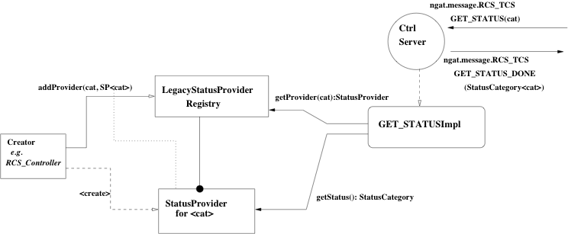
Architecture – Old system

Slide 8
Old Providers
Only of historic interest.
Mostly in ngat.rcs.scm.collation package.
Implement StatusMonitorClient interface.
StatusMonitorThread associated with each
Calls on client to obtain status from its source at configured intervals.
TcsStatusClient (per TCS SHOW category).
InstrumentStatusClient.
RCSInternalStatusClient (statemodel etc).
URLStatusClient – reading from data files e.g. cloud, dust, robodimm created by cron scripts.
Now ALL defunct.

Slide 9
Old Telemetry Network
Old system uses a number of different mechanisms due to network restrictions.
Server push from RCS to RcsGUI and TEA – a form of simple pub-sub.
Client pull – various polled feeds from RCS to RcsGUI.
UDP from LiveStatus requestor to LiveStatus receiver.
A few pub-sub streams using new architecture.
E.g. SkyModel to RcsGUI.

Slide 10
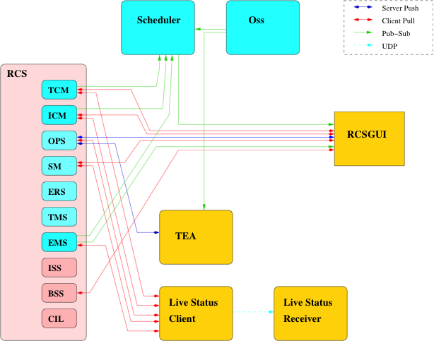
Network Architecture (Old)

Slide 11
New System
The RCS subsystems – TCM, ICM, EMS, ERS, TMS, etc and other systems e.g. SCHED, implement specific providers for the various types of status feed.
These providers act as the publishers which external clients attach to as subscribers.
Internally a provider is part of the running system, i.e. there could be a line of code at the start of some important operation (X) where a call is made to a method which sends out an event notification to subscribers.
startingOperationX(subs); // notify registered subscribers…
It is unwise to have it make the publishing calls out to the clients directly, a slow receiver could potentially block a time-critical operation.
A gateway is introduced to handle the direct publishing from the provider.
Gateway acts as publisher to client
Acts as client to real provider.
Disconnects publisher from actual client.

Slide 12
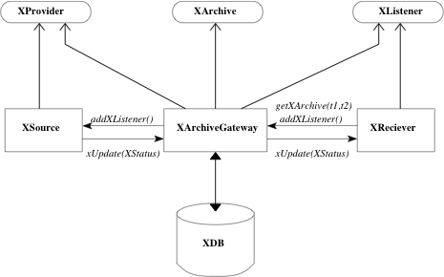
Architecture – New system

Slide 13
Components
Typical components which go to make up a telemetry feed/stream.
Note: Substitute X for relevant acronym e.g Telescope, Scheduler, etc
XProvider – publisher interface
Typically has methods to add and remove subscribers
addXListener(xl), removeXListener(xl)
XSource – an implementation of XProvider
This is probably a class which is an integral part of the running subsystem.
XListener – listener interface
Typically has callback methods like
xUpdated(Xstatus), xEventA(), xEventB(), etc
XReceiver – an implementation of XListener
Could be a GUI component or logging class.
XArchive – archive retrieval interface
Typically has methods to obtain historic status.
XArchiveGateway – a class which implements all the interfaces and acts as both a publisher endpoint for remote clients to connect with and keeps the key activity of the source separate from its publishing commitments to avoid blocking as well as storing historic data.

Slide 14
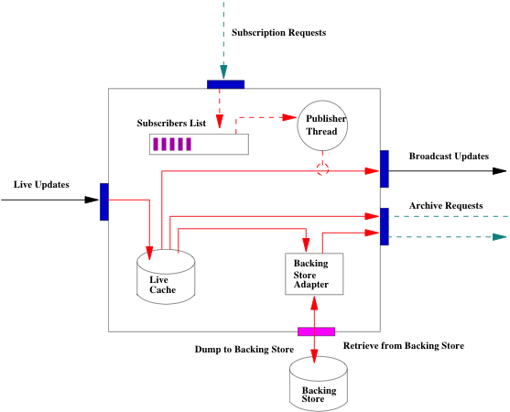
Archive gateway Architecture

Slide 15
Telemetry Sources
ngat.tcm.BasicTelescope
TelescopeStatusProvider
ngat.icm.BasicInstrument
InstrumentStatusProvider
ngat.ems.DefaultMutableSkyModel
SkyModel
ngat.ems.BasicMeteorologyProvider
MeteorologyProvider
ngat.sms.bds.BasicDespatchScheduler
ScheduleStatusProvider
ngat.rcs.tms.BasicTaskMonitor
TaskMonitor
ngat.rcs.newstatemodel.StandardStateModel
StateModel
ngat.rcs.ops.OperationsManager
OperationsMonitor
ngat.oss.impl.mysql.Phase2Model
Phase2Monitor
ngat.oss.impl.mysql.AccountModel
AccountMonitor

Slide 16
Example
Telescope system telemetry feed.
BasicTelescope is the primary publisher and implements TelescopeStatusProvider.
It is the class which collates status from the TCS and Autoguider.
TelescopeArchiveGateway subscribes to Telescope as a TelescopeStatusUpdateListener. It stores the received statuses and then posts these out to real clients under control of a processing thread.

Slide 17
Ideal Telemetry System
Ideally all network telemetry should be via the new pub-sub feeds.
RCS, Sched, TEA, NSO, OSS all feeding to clients such as OpsUI and LiveStatus.
Live Status is still however restricted to the old system but the source providers are now linked to the normal pub-sub feeds within RCS rather than collecting their own status info.
E.g. Legacy Instrument providers are fed by the real ICM Instrument status providers.

Slide 18
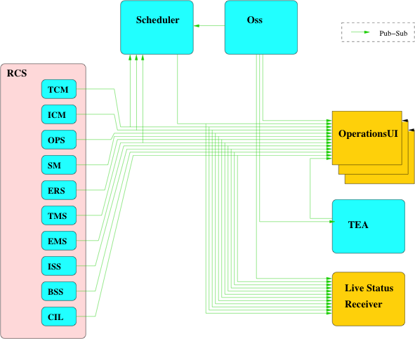
Network Architecture (Ideal)

Slide 19
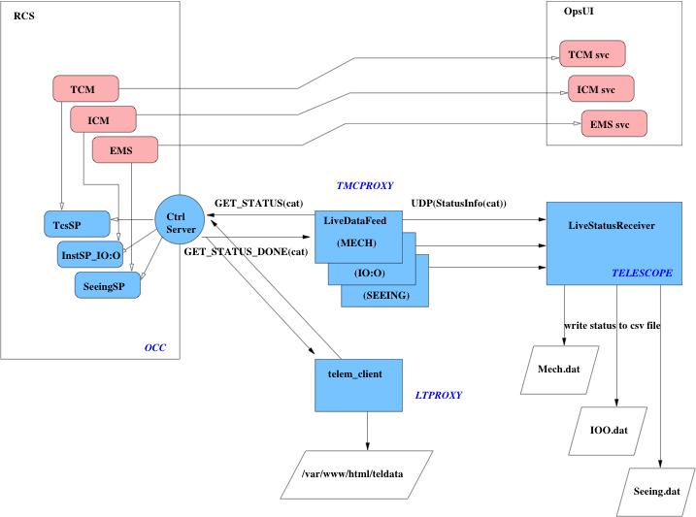
Telemetry Network (Actual)

Slide 20
Legacy providers
These provide status information on demand via GET_STATUSImpl invoked from CtrlServer on port 9110 on receiving a command of one of the classes:-
ngat.message.GUI_RCS.GET_STATUS
also GET_STATE_MODEL, ID and GET_SEEING.
They are attached to various raw telemetry providers (new architecture) as listeners i.e as various types of XListener.
In the case of the TCS providers this is via another hop as it still utilizes the legacy StatusPool. (see TCM document).
ngat.rcs.scm.collation.StatusPoolProvider
TCS_Status.Segment
ngat.rcs.scm.collation.InstrumentStatusProvider
InstrumentStatus.
ngat.rcs.scm.collation.BcsCloudStatusProvider
MappedStatusCategory
ngat.rcs.scm.collation.TngDustStatusProvider
MappedStatusCategory
ngat.rcs.scm.collation.AgActiveProvider
AgActiveStatus
ngat.rcs.scm.collation.SkyModelProvider
SeeingHistoryStatus

Slide 21
Gateways
The various archive-gateways are mostly in the package ngat.rcs.telemetry.
InstrumentArchiveGateway
MeteorologyArchiveGateway
OperationsArchiveGateway
ReactiveSystemArchiveGateway
SkyModelArchiveGateway
StateModelArchiveGateway
TaskArchiveGateway
TelescopeArchiveGateway
Scheduler status archive is in the package ngat.sms.
public class SchedulingArchiveGateway extends UnicastRemoteObject implements
SchedulingStatusUpdateListener,
SchedulingStatusProvider,
SchedulingStatusArchive

Slide 22
Gateway Operation
Gateways accept incoming status from the raw source and store the data in a live-cache i.e. a FIFO queue.
Data older than a specified age is dumped to a secondary cache.
This may be null in which case the data is lost.
The archive aspect of the gateway allows external clients to retrieve historic data – this should be from the secondary cache if one exists.
This is an aspect which has not really been addressed yet.
For (the only) example of a secondary cache see:-
ngat.rcs.telemetry.InstrumentBackingStoreHelper
The gateways operate a processing thread, the function of which follows this template.
Repeat forever {
Sleep (interval)
Cull aged items to backing store (if any)
Process pending statuses, send to subscribers
}

