Slide 1
Robotic Control System
Top Level Overview

Slide 2
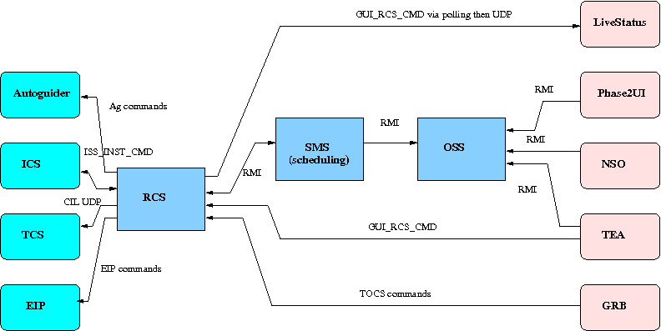
RCS within overall system
Communications paths and message types passed between systems. Note the variety of different mechanisms.

Slide 3
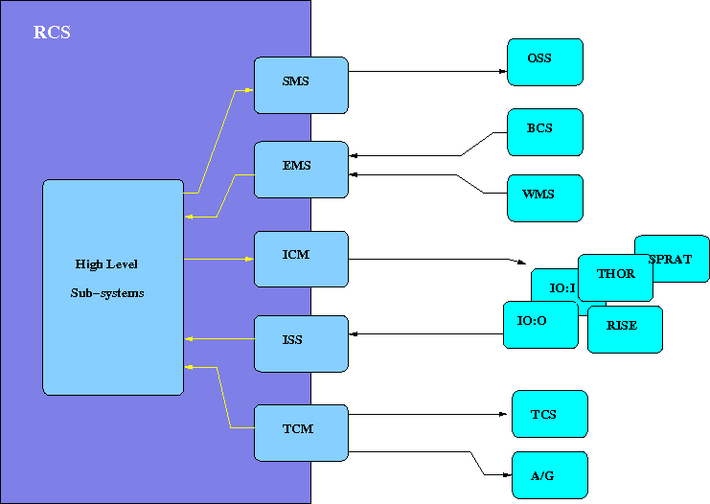
Systems controlled and monitored by RCS.
High level sub-systems not shown in detail.

Slide 4
Sub-systems - low level
TCM (Telescope Control and Monitoring)
Provides information about telescope capabilities and a hook to attach status listeners. Monitors TCS and Autoguider.
ICM (Instrument Control and Monitoring)
Provides information about instrument capabilities and hooks to attach status listeners. Monitors instruments for health and connectivity.
EMS (Environmental Monitoring System)
Provides information about sky conditions (seeing, photom) and weather (WMS, BCS, Dust).Updated using DPRT results.

Slide 5
Sub-systems - high level
ERS (Environmental Reactive System)
Accepts telemetry from the EMS, TCM, ICM.
Filtering of inputs.
Triggers rules which feed into State Model.
TMS (Task Management System)
Controls the operations of the telescope.
Makes decisions on what to do, when and how.
OPS (Operations subsystem)
Finite state-model fed from ERS environmental change events .
Operations Manager performs actions through TMS.

Slide 6
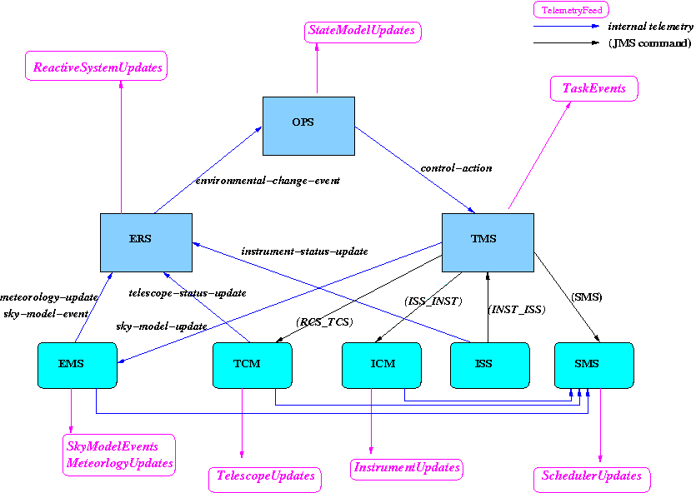
Interconnections
Comms with external systems
via JMS - serialized objects and CIL.
Recent sub-systems
communicate via RMI through..
EnvironmentChangeListener
MeteorologyUpdateListener
TelescopeUpdateListener
InstrumentUpdateListener
SkyModelListener
ControlActionImplementor
others....
Most sub-systems generate external telemetry feeds.

Slide 7
Packages
(rcs packages are found under: ltdevsrv: ~dev/src/rcs/java)
High Level
Low level
(Semi)-Obsolete
ngat/rcs/
ngat/rcs/tms
ngat/rcs/tms/events
ngat/rcs/tms/manager
ngat/rcs/tms/executive
ngat/rcs/ers
ngat/rcs/ops
ngat/rcs/newstatemodel
ngat/rcs/calib
ngat/rcs/sciops
ngat/rcs/tocs
ngat/rcs/pos
ngat/rcs/comms
ngat/rcs/control
ngat/rcs/telemetry
ngat/rcs/iss
ngat/rcs/emm
ngat/rcs/oldstatemodel
ngat/rcs/oldscience
ngat/rcs/scm
ngat/rcs/scm/collation
ngat/rcs/sc m/detection
External sub-systems
(not under rcs source tree)
ngat/tcm
(~dev/src/ntcm)
ngat/ems
(~/dev/src/ems)
ngat/icm
(~dev/src/icm)
ngat/net/cil
(~dev/src/cil)

