Slide 1
ROBOTIC CONTROL SYSTEM
ENVIRONMENTAL REACTIVE SYSTEM

Slide 2
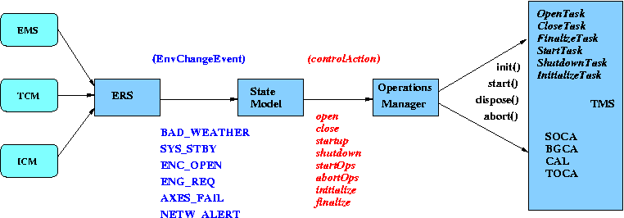
High level interactions

Slide 3
Flow of control
Feeds from EMS, TCM, ICM into the ERS are processed and can trigger EnvironmentChangeEvents which are received by the StateModel.
The StateModel maintains a set of condition or state variables to keep track of environment changes - (see OpsUI at the lower left corner) and include:-
System
Weather
Axes
Intent
TimeOfDay
Network
When in the OPERATIONAL state, there is a secondary OperationalStateModel which handles the fine detail of initialization and finalization of observing and switching between modes.
The current state and set of conditions in force determines whether to change state and which ControlAction(s) if any to perform via the OperationsManager.
E.g. In OPERATIONAL state and Weather is bad -> execute AbortOps action and Close action.
ControlActions are performed by the OperationsManager. They may involve starting transient or mode controller tasks or may involve aborting an operational task.

Slide 4
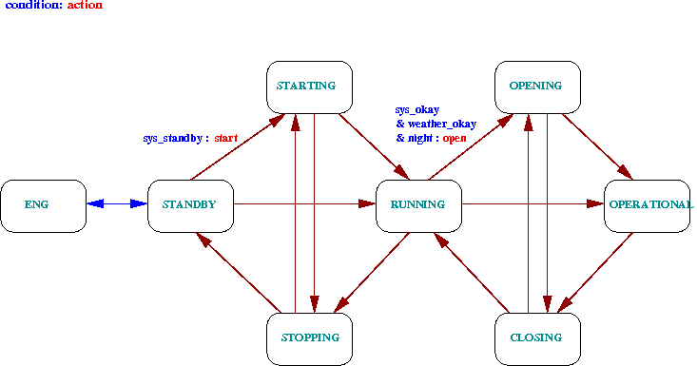
State Model

Slide 5
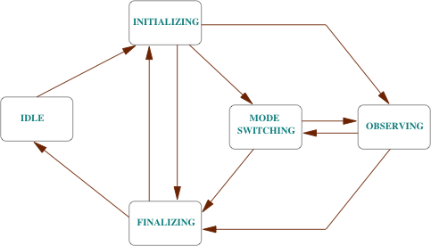
Operations State Model

Slide 6
Environmental Reactive System
The ERS is made up from various components:-
Filters receive input from telemetry feeds from each of the low level systems:-
EMS (meteo, seeing, cloud, dust)
TCM (axes, enclosure, mirror-cover, mcp)
ICM (instruments)
Criteria are attached to filters – a criterion can only be attached to a single filter but a given filter may feed many criteria.
Criteria provide simple boolean conditions on the state of the feed:-
Equals
Greater
Less
One-of
Rules are attached to criteria
Indicate a period of time for which the criterion must be satisfied.
Rules can be combined via AND and OR operations. Potentially others could be added like FUZZY.

Slide 7
ERS Configuration
The ERS is configured from a file: rules.xml
Structured with sections for:-
Filters (name, type, feed-ID)
Criteria (name, filter-ID, condition)
Rules (name, class, class-config)
Rules can be nested to any depth as
Conjuncts (AND)
Disjuncts (OR)

Slide 8
Filter config
Filter example:-
<filter name = "M_HUM_SLOW" class = "AVERAGE">
<source> METEO </source>
<category> WMS </category>
<item> humidity </item>
<period unit = "mins"> 5 </period>
</filter>
Name: M_HUM_SLOW
Type: Averaging, period 5 mins
Feed: METEO / WMS / humidity

Slide 9
Criterion config
Criterion example:-
<criterion name = "C_WS_HI" class = "GREATER">
<minimum> 15.0 </minimum>
<filter> M_WS_FAST </filter>
</criterion>
Name: C_WS_HI
Filter: M_WS_FAST
Condition: value > 15.0

Slide 10
Rule config
Rule example:-
<rule name = "CLOUD_HI" class = "timed">
<period unit = "mins"> 10 </period>
<criterion>…….</criterion>
</rule>
Name: CLOUD_HI
Class: timed (condition must be true for specified amount of time)
Class-config: period = 10 minutes

Slide 11
Combination rule config
Combination (CONJUNCT) example:- (internal detail hidden)
<rule name = "ENC_OPEN" class = "CONJUNCT">
<rule name = "EN1_OPEN" class = "timed"> … </rule>
<rule name = "EN2_OPEN" class = "timed"> … </rule>
<rule name = "EN1_IN_POSN" class = "timed"> … </rule>
<rule name = "EN2_IN_POSN" class = "timed"> …</rule>
</rule>
Rule ENC_OPEN is triggered only if ALL the enclosed rules are also triggered, i.e. their enclosed criteria must all satisfied for the required amount(s) of time.

Slide 12
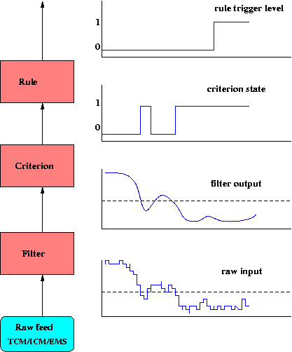
Flow through ERS layers

