Slide 1
Robotic Control System
Low Level Subsystems and Infrastructure

Slide 2
Low Level infrastructure
Communications infra-structure
CIL
JMS
Primary component sub-systems
ICM
TCM
EMS
(ISS)
Utilities
Astrometry
Logging
Configuration

Slide 3
CIL
Communications Interface Layer
TTL’s protocol used to communicate between various nodes in system (AMN, MCP, AZM...)
Transport - uses UDP.
Various headers and routing information.
Each node has a single port assigned.
Can only use this port – configured somewhere in the system (MCC, SCC ?).
Used between RCS and TCS (via Network interface) – something that receives CIL packets containing TCS commands and forwards them to the TCS.

Slide 4
RCS to TCS
Outgoing CIL packets contain TCS commands.
RCS-TCS: send command packet.
TCS-RCS: send actioned packet on receipt.
TCS-RCS: send completed or error packet when TCS is deemed to have completed.
It is believed that the Network layer monitors the TCS/SDB to see if relevant status entries support the success of actions expected from performing the command have occurred:-
one reason why seemingly simple commands sometimes take a while to complete – the Network layer is waiting for its configured timeout to see if the system is in the expected state.
Sometimes strange results occur and have to be handled by the TMS.

Slide 5
CIL service
CIL is accessed by the RCS through a rmi based service provider.
ngat.net.cil.CilService (ltdevsrv: ~dev/src/cil/)
All comms go through a single datagram port – incoming and outgoing.
There is some internal buffering but it is not controllable from java layer.
Incoming messages have to be read quickly or they can be lost.
RCS sends commands to control the telescope.
TCM sends commands to monitor telescope status.
EMS sends commands to monitor weather.
These can all be happening at the same time with intermingled replies.

Slide 6
CIL implementation
Incoming messages are assigned a unique sequence number and mapped against a supplied handler to accept a completion callback.
Message is packed into UDP packet along with timestamp, sequence number and some headers, then sent out to TCS (network interface).
Returns are read by a ReaderThread and placed into a queue.
DespatcherThread reads from queue matches sequence number to handler and makes either an actioned, completed or error callback

Slide 7
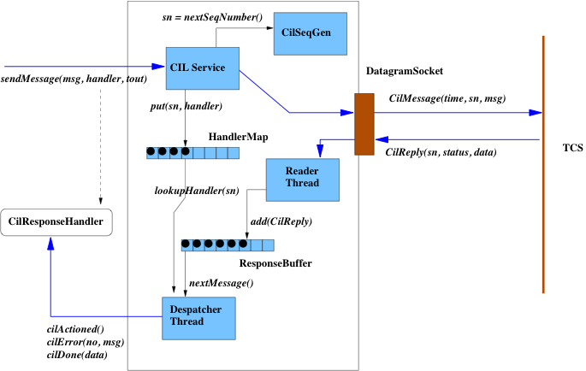
CIL service

Slide 8
JMS
Java Message System – passes java serialized objects over ObjectStreams between client and server systems.
Communications between high level robotic systems.
RCS, ICS (RatCam, IO:O, RISE, FRODO,etc), SMS, BSS, ISS, POS. Also used by RcsGUI, IcsGUI.
Protocol
Client-Server: COMMAND.
Server-Client: ACK (with timeout) 1 or more.
Server-Client: DONE (with success/data/error).
Detailed documentation: http://ltdevsrv/~dev/

Slide 9
JMS classes
Server (ngat.net.Server) and subclasses…
TOC_Server, ISS_Server, POS_Server, Ctrl_Server
Provides socket or similar endpoint
Creates IConnection when client connects.
Uses ProtocolImplFactory to create an instance of ProtocolServerImpl.
JMS is just one protocol supported by this architecture.
Also CAMP, POS and TOCS.
ProtocolServerImpl reads command
Uses RequestHandlerFactory to create appropriate RequestHandler for the specified command.
RequestHandler processes command and sends Acks and Done messages to client, e.g.
ISS: GET_FITSImpl processes a GET_FITS command.
BSS: BEAMSTEERImpl process BEAM_STEER command.

Slide 10
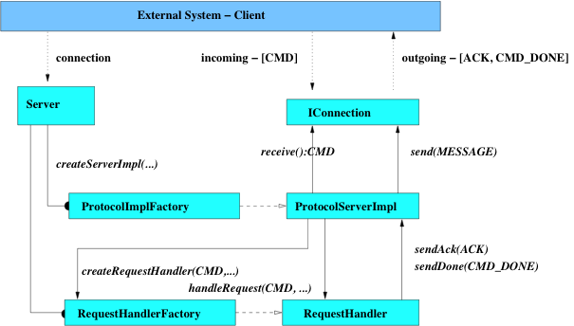
JMS Implementation

Slide 11
CIL meets JMS
Within TMS, the executive tasks communicate with external systems via JMS.
The TCS is accessed via CIL which is not a TCP based protocol.
CIL_Proxy layer, ngat.rcs.comms package, is used to emulate a TCP like service.
From the point of view of an executive task the TCS looks the same as any instrument other than having different commands available.

Slide 12
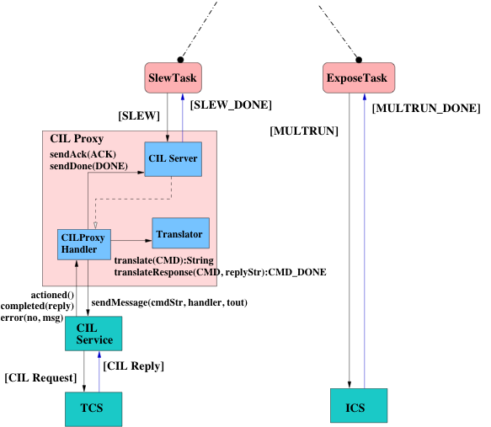
CIL Proxy layer

Slide 13
TCM
Main access point interface is Telescope implemented by ngat.tcm.BasicTelescope.
Provides model of system TelescopeSystem.
Axes, enclosure, focus, guidance, payload.
Access hook for attaching status listeners
TelescopeStatusProvider and TelescopeStatusListener
Provides calibration requirements and stores calibration history.
TelescopeCalibrationProvider
Configured via telescope.xml.

Slide 14
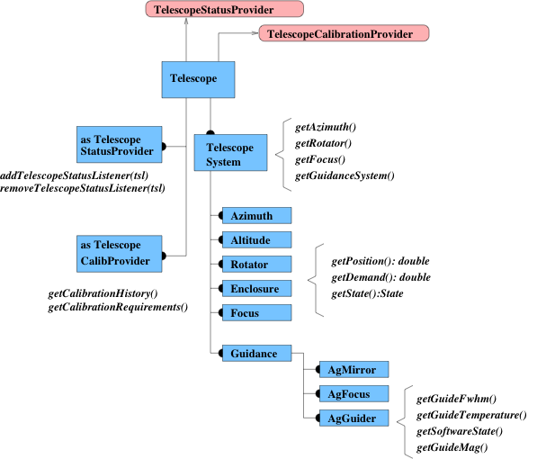
Telescope Model

Slide 15
status from TCS: Old system
Old System based on classes in ngat.rcs.scm.
A class StatusPool acts as the repository for all TCS status information.
It holds data about each of the segments of the TCS status, divided up according to the logic of the available TCS SHOW commands.
Status information is pulled from the TCS via a series of TcsStatusClients. These send the relevant SHOW X commands and push the returned data into StatusPool as TCS_Status.Segments.
Mech, State, Meteo, Astrom, Limits, Time, Autoguider...
StatusPool then disseminates this information to other classes which have registered with it via the java.util.Observer interface.
FitsHeaderInfo
various Monitors used in the predecessor to ERS.

Slide 16
Status from TCS: New system
Based on ngat.tcm.
Various Collators (one per TCS status category) send SHOW X commands to TCS via CIL service.
A CollatorResponseProcessor acts as handler for the returned CIL completed message.
It translates the content into a TCSStatusPacket Segment representing the appropriate TCS status category.
Mech, meteo, autoguider, state, limits…
These are passed to the Telescope (as CollatorResponseListener via calls to tcsStatusPacketUpdate(TcsStatusPacket).
Internally the Telescope updates its model of the TelescopeSystem and passes the information out to registered listeners via TelescopeStatusListener interface.
The status objects sent out have been reconstructed into types which represent the logical structure of the telescope systems…
Azm, Alt, En1, En2, Pmc, Pms, Smf, Agf, Tim, Env, Agg, Scf…
Telescope status is sent out to various interested parties..
ERS, TrackingMonitor, AgMonitor, Tweaker, Livestatus, OpsUI and for now StatusPool to allow FITS headers to update.

Slide 17
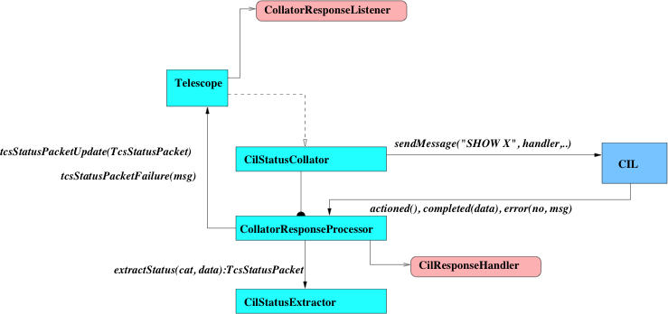
Collecting tcs status

Slide 18
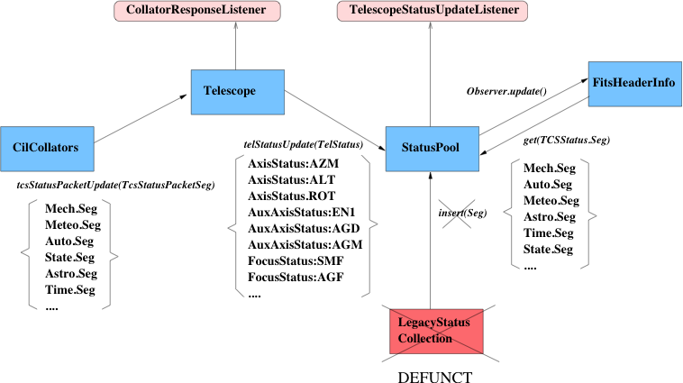
Propagation of TCS status

Slide 19
ICM
Main access point interface is InstrumentRegistry implemented by ngat.icm.BasicInstrumentRegistry.
Provides access to a list of available instruments and instrument services, which then provide..
Access hooks for attaching status listeners
InstrumentStatusProvider and InstrumentStatusListener
Calibration requirements and storing calibration history InstrumentCalibrationProvider.
Capabilities providers based on BasicInstrument which allow properties of the instruments to be discovered..
getRotatorOffset() : double
getWavelength(InstConfig) : Wavelength
isValidConfig(InstConfig) : boolean
canAcuire(instID) : boolean
getAcquisitionOffsets(instID) : XPositionOffset
isFocusInstrument() : boolean
Configured via ireg.xml.

Slide 20
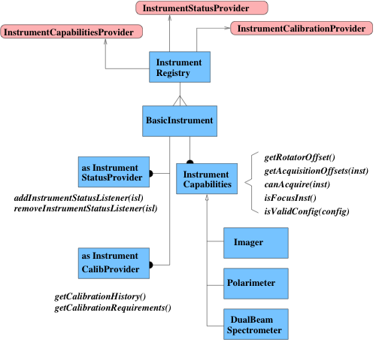
Instrument Model

Slide 21
Instrument Status
Instrument status is collected by the object modeling the instrument within the Instrument registry (ireg).
Imager, Polarimeter, DualbeamSpec, TipTiltImager..
Uses an internal monitor thread per instrument which send out GET_STATUS commands and processes the results into an InstrumentStatus.
Interested parties can subscribe to the status feed by InstrumentStatusProvider interface…
Scheduler, OpsUI, LiveStatusProviders…
Many tasks within TMS need instrument status but they are ephemeral so not worth subscribing to feeds. Access models directly…
// get offsets for acquiring FRODO from IO:O
InstDesc ioID = ireg.getDescriptor(“IO:O”);
InstrumentCapabilitiesProvider iop = ireg.getCapabailitiesProvider(ioID);
InstrumentCapabilities io = iop.getCapabilities(); // instance of ngat.icm.Imager
InstDesc frodoID = ireg.getDescriptor(“FRODO”);
IPositionOffset io_acq_frodo = io.getAcquisitionOffsets(frodoID);
// find out if IO:O is online and not reporting as faulty
InstrumentStatusProvider iosp = ireg.getStatusProvider(ioID);
InstrumentStatus iostat = iosp.getStatus();
boolean io_is_ok = iostat.isOnline() && iostat.isFunctional();

Slide 22
EMS
Main access points are:
SkyModel – seeing and photometricity.
MeteoProvider – weather from various sources.
SkyModel is updated using seeing extracted from reduced images. RATCam, IO:O, future…
MeteoProvider is updated using information provided by the TCS, BCS cloud camera and via the TNG Dust monitor website.

Slide 23
SkyModel
When an exposure is made using an instrument which is linked to the DPRT the ExposureTask receives updates:-
When an image (i) within a multrun is taken the ExposureTask receives notification via a MULTRUN_ACK which allows the telescope’s altitude alt_{i} to be recorded along with the time of the actual exposure t_{i}.
At the end of the multrun each image is reduced and the ExposureTask receives MULTRUN_DP_ACKs containing the seeing s_{i}.
The wavelength wav_{i} of the exposure is obtained from the InstCapabilities of the instrument using e.g. Imager.getWavelength(currentConfig)
SkyModel is then updated using a call to:-
SkyModel.updateSeeing(t_{i}, s_{i}, alt_{i}, azm_{i}, wav_{i}…)
The SkyModel processes the update, rejecting seeing which is too large, ignoring updates which are from non-standards unless they improve the prediction, correcting for altitude and wavelength and finally performing an exponential weighted average.
There are exceedingly detailed notes on the calculation and much more in the telescope wikiwords SelectingSeeingCuts and LTSeeing).

Slide 24
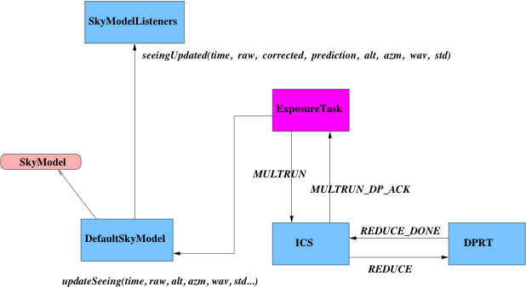
SkyModel

Slide 25
MeteoProvider
MeteoProvider obtains details of the WMS status from the TCS via a CilStatusCollator similarly to the way the TCM gets TCS status updates.
The TCS segments are re-arranged into MeteoStatus objects and sent out to any interested subscribers:-
ERS, OpsUI, LiveDataFeed.
BCS cloud data and TNG Dust data are obtained via separate Collators which grab data from specific files on the occ and parse these to extract DustStatus and CloudStatus objects.
The BCS and Dust files have previously been generated by cron scripts running on occ and ltproxy and can be found here:-
/occ/data/tng_dust.dat
/occ/data/cloud.dat

Slide 26
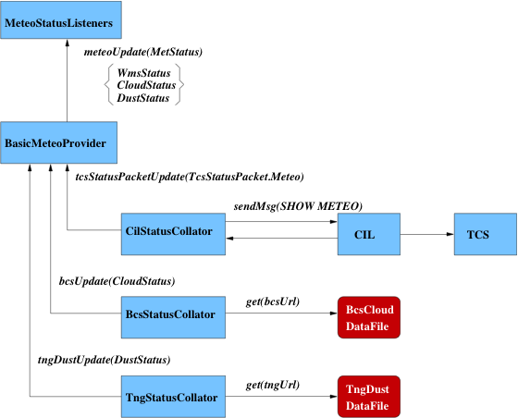
MeteoProvider

