Slide 1
ROBOTIC CONTROL SYSTEM
TASK MANAGEMENT SYSTEM

Slide 2
Task Management System
The TMS is made up of a large number of Tasks.
They are all either managers or executives.
Arranged in a vertical control hierarchy.
Horizontal control of sequencing.
Executive tasks perform some sort of action.
Generally on an external system.
Using a socket connection or similar.
Typically they send a command and receive and process a reply.
Manager tasks control other managers and executives.

Slide 3
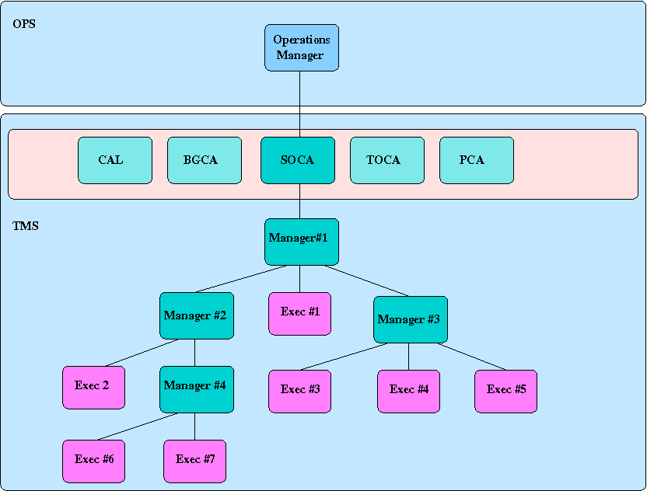
TMS Hierarchy
Notes:
Operations manager is the top of the hierarchy. It receives action commands from the StateModel. These are implemented by creating suitable top-level manager tasks.
There are 2 types of top-level task effectively.
Transient tasks:-
CloseTask, OpenTask, StartTask, ShutdownTask, InitializeTask, FinalizeTask
are invoked during transitions between states.
ModeControlTasks:-
SOCA, BGCA, CAL, TOCA
are invoked when the StateModel is in the OPERATIONAL state and determine what sort of observing will be performed.

Slide 4
Top level tasks
OperationsManager
receives action commands from StateModel.
creates and manages top-level TMS tasks.
Types of top-level task
Transients - invoked during state-model state changes.
Open, Close, Startup, Stop, Initialize, Finalize.
Run once, then disposed of when complete.
Mode controllers - invoked while state-model in OPERATIONAL state.
BGCA, SOCA, TOCA, CAL, PCA.
Run several jobs one after another on request from OperationsManager

Slide 5
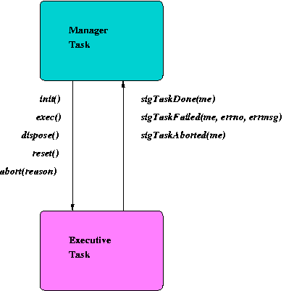
Task Control

Slide 6
Task Control - (downstream)
init ()
initialize task.
exec()
assigns worker thread to task and executes.
abort()
task stops what its doing.
dispose()
task disposes any resources e.g. sockets.
reset ()
resources reset to pre INIT values so can be re-run under new worker .

Slide 7
Task Control - (upstream)
sigTaskDone ()
notification that task has completed successfully.
sigTaskFailed (errno, errmsg)
notification that task has failed with error-code and reason.
sigTaskAborted ()
notification that task has completed aborting.
sigMessage(msgtype, msgvalue)
notification of some useful information.

Slide 8
Task information
A manager has not completed until all its sub-tasks are completed.
On sub-task failure, a manager can decide to:-
skip or restart a failed subtask.
take some corrective action.
fail itself.
When a manager is aborted, it must abort any pending sub-tasks before signalling to its own manager that it has completed aborting.

Slide 9
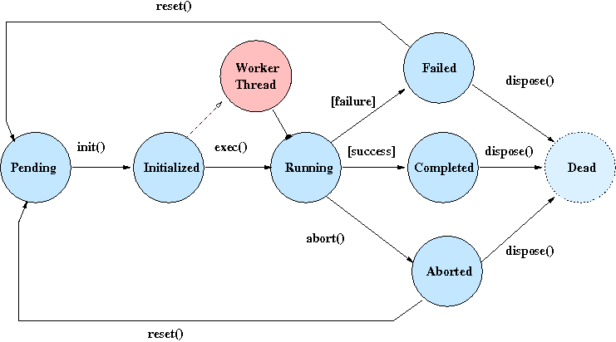
Task Life-cycle

Slide 10
Life-cycle detail (executive)
Manager creates task -> PENDING
Init () -> INITIALIZED
setup connection and command.
Exec () -> RUNNING
worker thread assigned.
send COMMAND
await and process ACK(s)
await and finally process COMMAND_DONE
close streams and socket.
signal completion or failure to manager.
Abort () -> ABORTED
break connection if open.
signal abort completed to manager.
Dispose ()
resources cleared up.

Slide 11
Life-cycle detail (manager)
Manager creates task -> PENDING
Init () -> INITIALIZED
pre-init behaviour.
create list of immediate sub-tasks.
link sub-tasks in sequence.
post-init behaviour.
Exec () - RUNNING
worker thread assigned.
loop until all sub-tasks are done, failed or aborted.
process notifications from sub-tasks. onSubtaskFailed, onSubtaskCompleted, onSubtaskAborted behaviours.
dispose of failed and completed subtasks.
start ( i.e. int () and worker.exec() ) any sub-tasks in sequence which are pending and for which all predecessors are done.
Abort () -> ABORTING
send abort () to any PENDING sub-tasks.
Dispose ()
destroy task list.

Slide 12
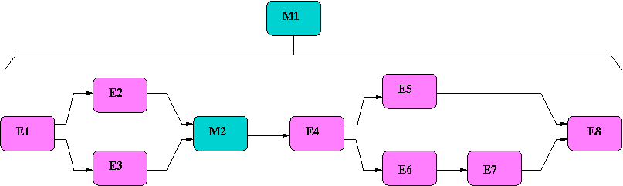
Sequencing

Slide 13
Sequencing
Sub-tasks under a manager can be run sequentially or in parallel or a complex combination.
Sometimes it is easier to create a new sub-manager to handle part of the sequence.
e.g. on the previous slide the tasks E2, E3 could have been put under a manager M1.1 which runs them in parallel. The sequence would then be:- E1 -> M1.1 -> M3 ...
This is more useful when the number and type of sub-tasks to sequence is variable and dependant on some parameter passed to the manager.
See:- ~dev/src/rcs/java/ngat/rcs/oldscience/ObservationSequenceTask.java
Use of BarrierTask to act as an assembly point for task sequences.
Does nothing much except wait until its predecessors have completed.
Very little used nowadays but still useful.
See: ~dev/src/rcs/java/ngat/rcs/tms/manager/InitializeTask.java

Slide 14
Manager task implemention
Most managers extend an abstract base class:-
ngat.rcs.tms.manager.ParallelTaskImpl
Provides skeleton behaviour to create and manage the sequencing of sub-tasks.
Life-cycle points where specialized behaviour can be performed:-
onAborting()
onCompletion()
onDisposal()
onFailure()
onInit()
onStartup()
onSubtaskAborted()
onSubtaskDone()
onSubtaskFailure()

Slide 15
Executive task implementation
Most executives extend an abstract base class:-
ngat.rcs.tms.executive.JMSTaskImpl
Provides a basic skeleton for connecting to an external server via JMS protocol, handling ACKs and receiving the final DONE reply.
Life-cycle methods provide a means of adding specialized behaviour:-
calculateTimeToComplete()
canAbort()
handleAck(ACK)
handleDone(COMMAND_DONE)
onCompletion()
onDisposal()
onInit()
For an example of what might need doing in the handleAck() and handleDone() methods.
See:- ~dev/src/rcs/java/ngat/rcs/tms/executive/Exposure_Task.java

Slide 16
Observing
Once the StateModel has gone into the OPERATIONAL state, substate OBSERVING, the OperationsManager interrogates each of the ModeControllers in priority order using a call to.
wantControl() : boolean
Whichever (highest priority) controller replies in affirmative is then selected to take control and that task is inserted at the top of the task hierarchy.
It is then requested to perform a single job, one of its own top level tasks, via a call to:-
nextJob() : void
Once that job (a high level task) is completed or failed the controller task yields to the Operationsmanager via:-
yield() : void
The cycle then continues. If the same top-level controller is picked, it is simply told to do another job. If a different (higher priority) controller is picked, the current controller is aborted and the new controller installed in its place.

Slide 17
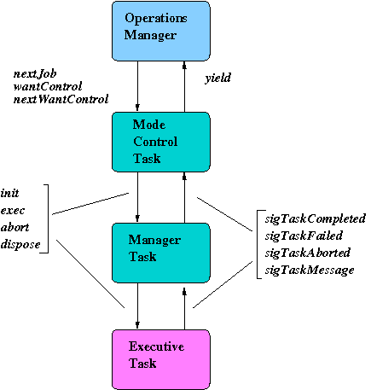
Task Control – (Observing)

Slide 18
Observing Mode priority
The top-level Mode Control Tasks are, in priority order:-
TOCA (ngat.rcs.tocs.TOControlAgent)
only requests control when a TO interrupt has occured and does so without waiting to be asked, it sends a yield() immediately to take control.
CAL (ngat.rcs.calib.CalibrationControlAgent)
only requests control at predefined times for Skyflats, Telfocus, previously also for Standards
SOCA (ngat.rcs.sciops.ScienceControlAgent)
always requests control except very early in the evening, very late in the morning and for a minute or two after a failed scheduling attempt.
BGCA (ngat.rcs.tms.manager.BackgroundControlAgent)
Always requests control except when the sun is too high.

