Slide 1
RTML and NSO Interfaces

Slide 2
Telescope Embedded Agent
The TEA was written several years ago and has gone through several iterations.
Originally used estarIO as comms layer.
Now uses RTML requests from the NodeAgent.
Requires potentially rapid telemetry from the RCS to make asynch callbacks to remote agents.
At the time of writing there was no suitable pub-sub telemetry system.
Existing ports/holes were used to make a fudged solution – CAMP.
Code is in ~dev/src/estar/tea/ and is under svn or maybe rcs ?

Slide 3
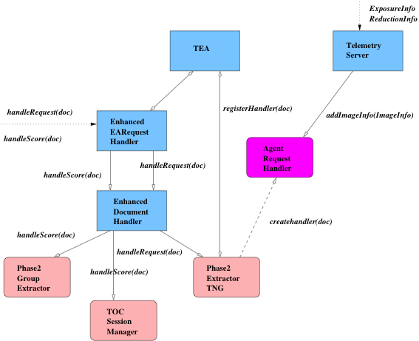
Architecture

Slide 4
Operation
Requests from the NA are passed to the EmbeddedAgentRequestHandler via calls to:-
handleScore(RtmlDoc) - scoring
handleRequest(RtmlDoc) – request to observe
The observation, timing and constraint information is extracted and either a scoring decision or observation request may be made.
TO requests are handled by
TOCSessionManager.
Scheduled requests are handled by
Phase2ExtractorTNG.
In the case of a scheduled request, an observation request is created and entered into the Phase2 ODB via the OSS. (rmi calls to Phase2Model etc).
An AgentRequestHandler (ARQ) thread is started for each document currently in the Phase2 ODB to monitor for execution and make callbacks to the remote agent.
Updates to the ARQ are received by the TelemetryServer in the form of:
ObservationInfo (a group has started)
ObservationCompletionInfo (a group has completed)
ExposureInfo (an image was taken)
ReductionInfo (a reduced image is ready)
ARQ handlers are persisted over restarts by a simple serialization mechanism.

Slide 5
Problems
The TEA is not very efficient – it was originally written to handle a few observation requests.
The ARQs are separate threads – it would be better to have a single thread handle all the documents in round-robin fashion – much more scalable.
The Telemetry mechanism is crude – there are modern feeds which could do this job anyway - OPS feed.
The TEA keeps a local cache of proposals, groups and instrument-configs – this could be done nowadays via the Phase2 cache via rmi.
RTML is structured like the old phase2 system.
It is therefore neccessary to translate from groups of observations to sequences and a certain amount of deduction is needed.

Slide 6
NSO Interface
This is an XML based interface.
Phase 2 markup language (P2ML).
Version (1) – based on the old phase2 with observations inside groups.
Most NSO observations still use this model.
They have to be translated into new sequences and constraint types.
Version (2) – based on modern sequences.
Some NSO observations use this.
All code is in the misc-systems repository and is in the default package.
V1 uses a SAX parser – it is evil. Implemented via XMLParser class.
V2 uses JDOM – it is great. Implemented via P2mlParser class

Slide 7
Operation
Something on the NSO site generates XML documents. These are read by a client and sent via TCP to a server on ltproxy.
Offline Control Relay (OCR) – cant recall where the name came from.
Started using: /etc/init.d/ocr_init start
All the code is deployed to
/proxy/misc/misc_systems.jar.
Scripts are in
/proxy/bin/
Like the RTML interface – V1 requests need to be translated to sequences – a fair amount of deduction is needed.

