Slide 1
Benchmarking Large-Language-Model performance for Word-Sense disambiguation
25.11.2025

Slide 2
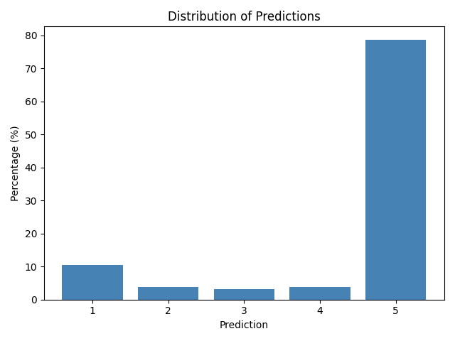
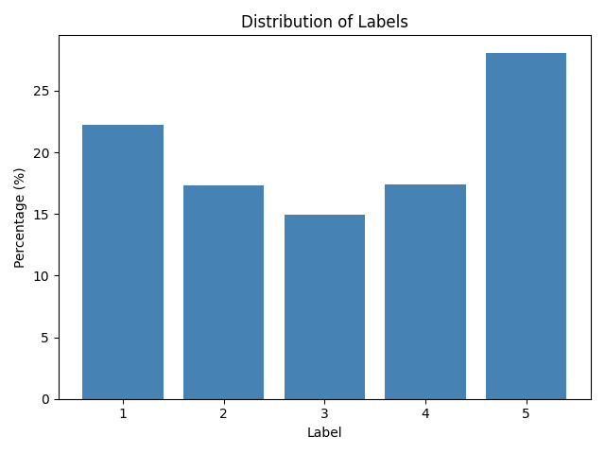
Meta-Llama-3.1-8B-Instruct
Sample data (Human generated)
→ Unhesitant and a little overconfident in their answer.

Slide 3
Majority vote approach
Goal: make the LLM more uncertain to qualify the result
Basically make the LLM aware that 2, 3 or 4 aren’t invalid numbers
How is it working:
Edit golden data for training with the majority vote for each situation
Edit prompt to make the model aware of this new data and prompt it to reflect the uncertainty
Drawbacks:
- We have to be really careful as to how mention it in the prompt because we don’t want this number to influence directly the result gave by the LLM as the LLM shouldn’t have access to ground truth at this point.

Slide 4
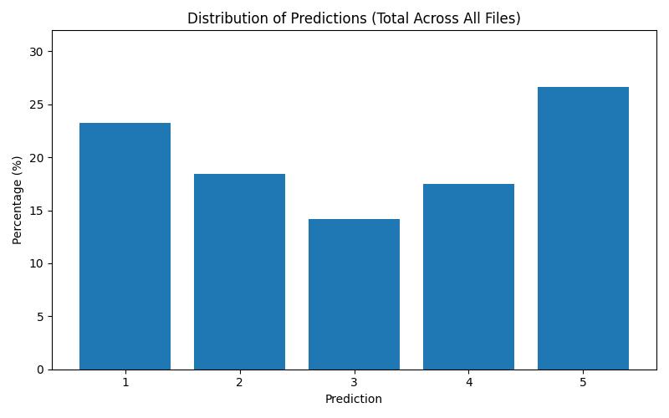
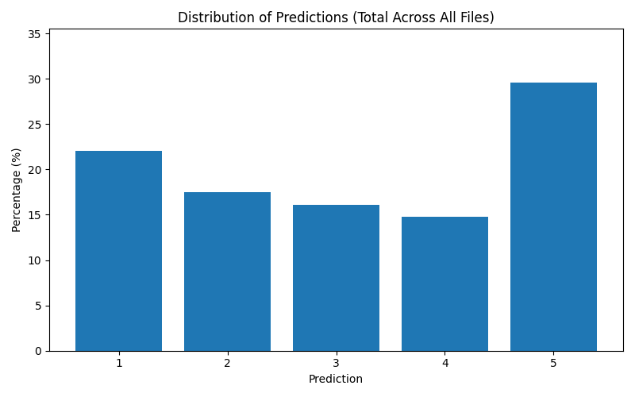
Result of majority voting approach :
We managed to have a bit more for middle results
Last time QWEN answered “3” less than 0.5% of the time and GPT only 2% of the time.
QWEN
GPT

Slide 5
Progress regarding Fine-tuned LLM regression head
One of the biggest issue is coming with labels, building the training target.
No average result.
Need to keep the human approach (vector and no scalar only)
Then:
Input text (template Homonym/Judged/Context/…)
Tokenizer → LLaMA-3.1-8B-Instruct (4-bit, frozen, device_map="auto")
last_hidden_state → Mean Pooling (sur attention_mask)
Embedding vector (dim = 4096)
Regressor Head (seul trainable – 3 couches)
Prédiction scalaire (1–5)

Slide 6
Thanks for your attention

Slide 7
Recap
Restructure data for low-hallucination/
  Minifying the json results in a hallucinations/unwanted artifacts
Ingest every json entry one-by-one
Use the training dataset (3000 entries) in order to further optimize performance
Test different models and approaches
  LLMs (prompt engineering, data manipulation)
  LLMs (fine-tuning)
  Classification models

Slide 8
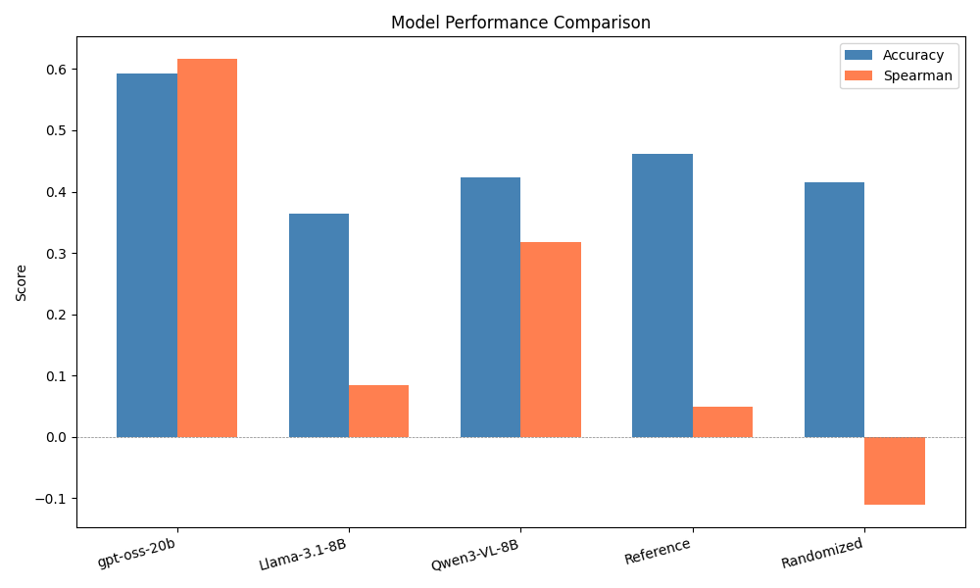
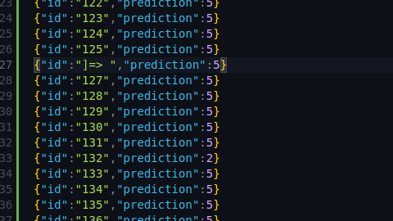
Benchmarks/Observations(1)
OpenAI’s model shows alignment with data
Models vary greatly
  Each one has obvious weaknesses
Hallucination rate can be rather high
Sample rate is too low for evaluating prompt efficacy
Deviation from the dataset doesn’t imply that the model is bad at WSD
  Human data is very polluted
Models tend to rate very confidently
An example of a hallucination

Slide 9
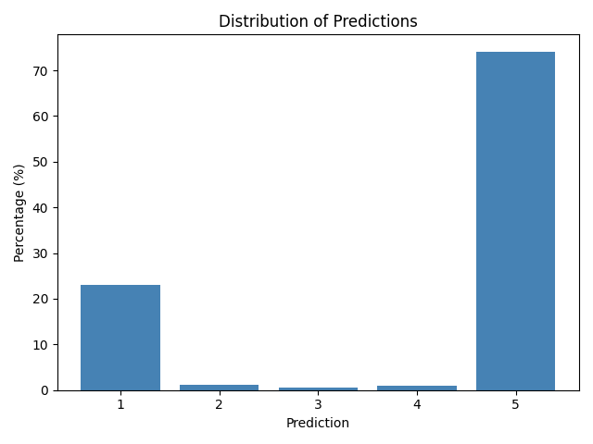
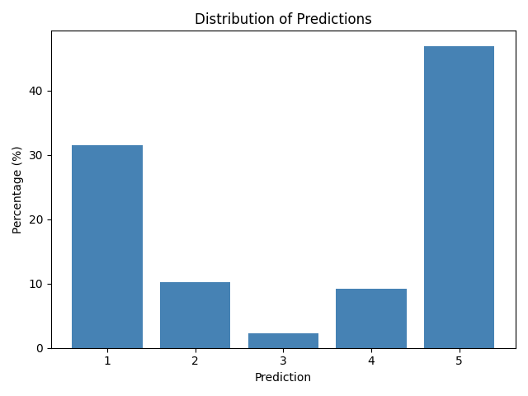
Benchmarks/Observations(2)
Meta-Llama-3.1-8B-Instruct
Qwen3-VL-8B-Instruct
openai/gpt-oss-20b
Sample data (Human generated)

Slide 10
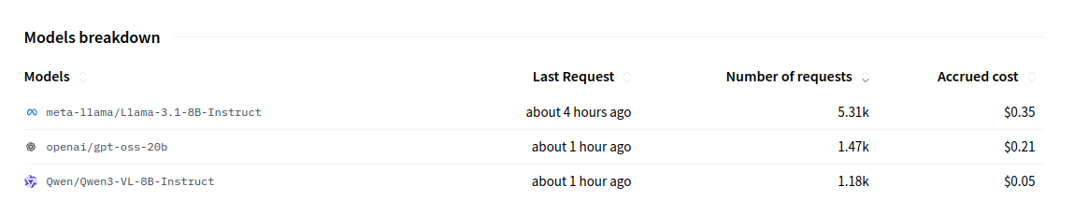
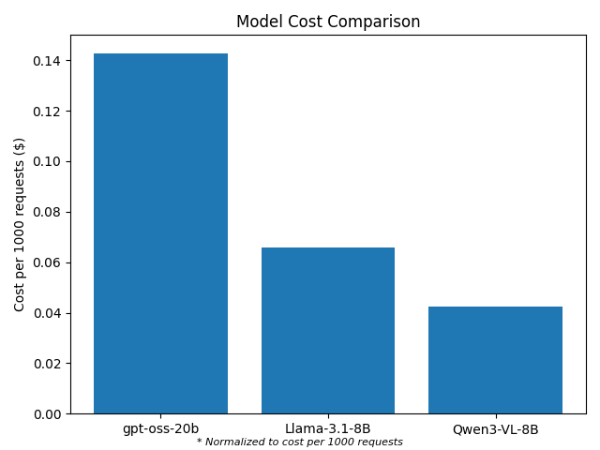
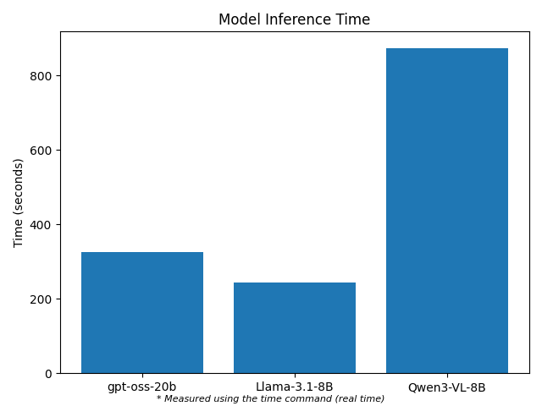
Benchmarks/Observations(3)
Lower hallucination rate comes at a cost
Cost can be prohibitive for testing more advanced models
Slow inference reduces sample size
Consistency of the output plays the biggest role
  Qwen
  Gpt
  LLama

