Slide 1
Benchmarking Large-Language-Model performance for Word-Sense disambiguation
Ivan Lomakov, 18.11.25

Slide 2
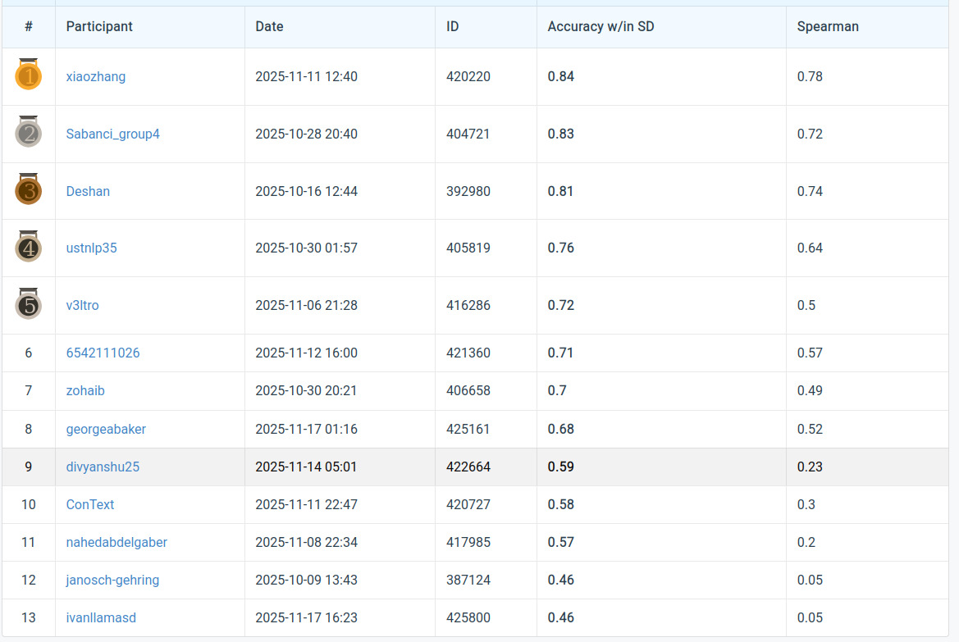
Objectives
Asses the performance of SOTA LLM’s on WSD within our dataset
Compare it to the top result within the leaderboard
Can we close the gap without any finetune/optimisations
  Better prompts?
  Optimize the way the data is passed to the model
Fine tune or train a separate regression model on our specific dataset

Slide 3

Approach
Use an inference external API (Groq, Huggingdace, OpenRouter)
Use structured outputs in order to directly output the data
Test multiple models without any initial configuration/knowledge of the dataset
What is the best way to ingest data?
  Sequentially vs all at once?
Progressively increase the knowledge of the model of the preexisting dataset

Slide 4
Short Demo and further Notes
Models performing will within our dataset != models being good at WSD
Benchmarking sequential inputs is very token-intensive and will require a paid account/api

