Slide 1
Benchmarking Large-Language-Model performance for Word-Sense disambiguation
25.11.2025

Slide 2
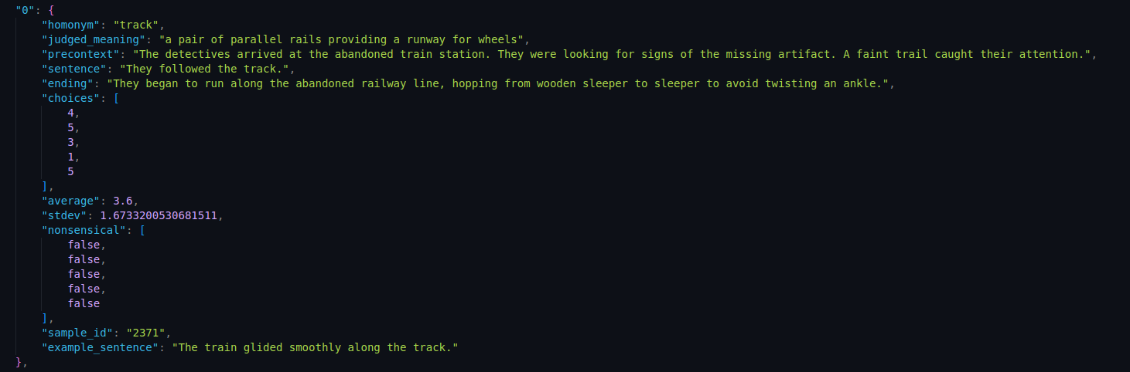
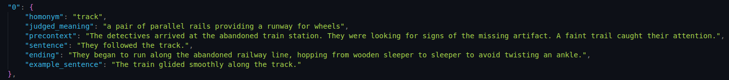
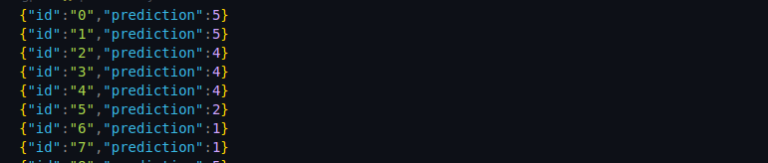
Recap/Methodology
Restructure data for low-hallucination/
  Minifying the json results in a hallucinations/unwanted artifacts
Ingest every json entry one-by-one
Use the training dataset (3000 entries ) in order to further optimize performance
Test different models and approaches
  LLMs (prompt engineering, data manipulation)
  LLMs (fine-tuning)
  Classification models

Slide 3
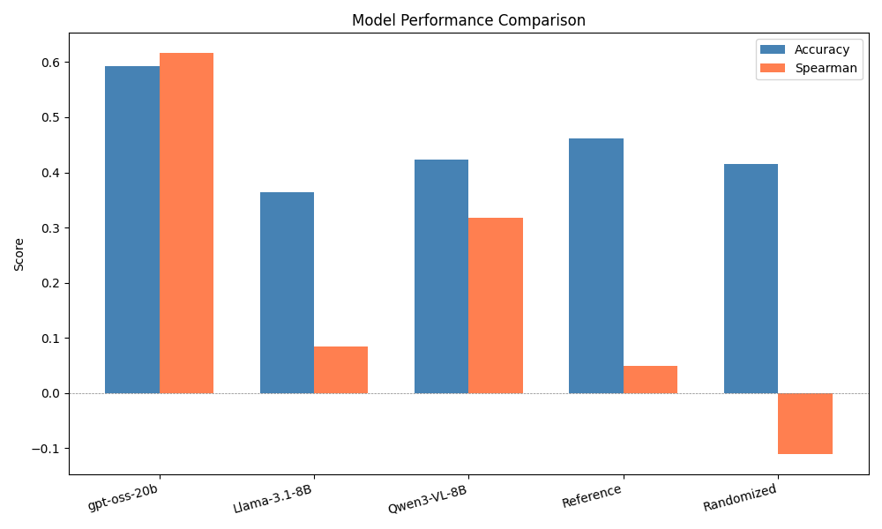
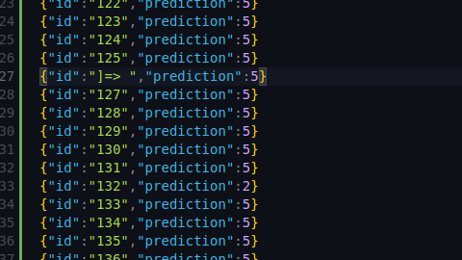
Benchmarks/Observations(1)
OpenAI’s model shows alignment with data
Models vary greatly
  Each one has obvious weaknesses
Hallucination rate can be rather high
Sample rate is too low for evaluating prompt efficacy
Deviation from the dataset doesn’t imply that the model is bad at WSD
  Human data is very polluted
Models tend to rate very confidently
An example of a hallucination

Slide 4
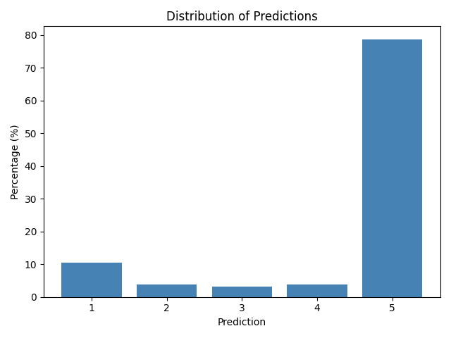
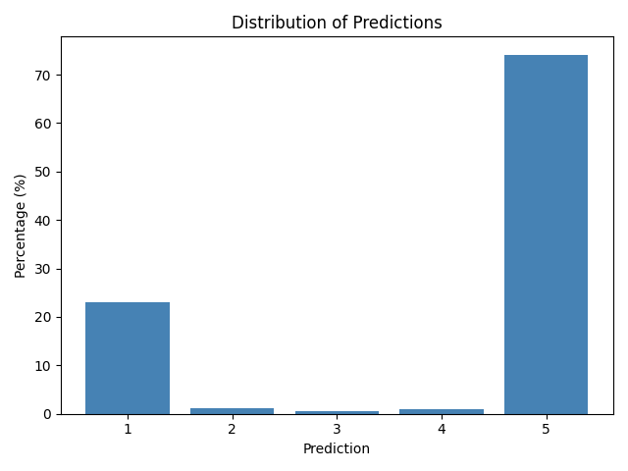
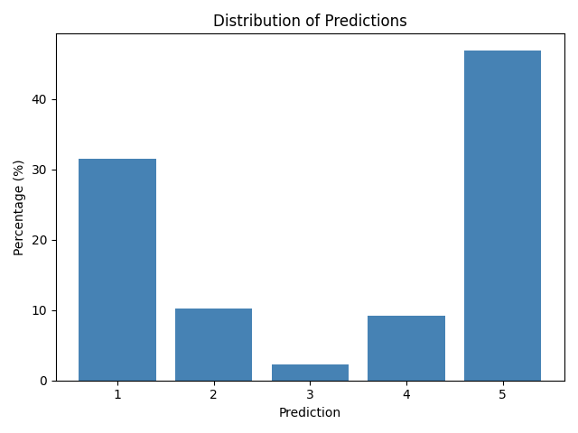
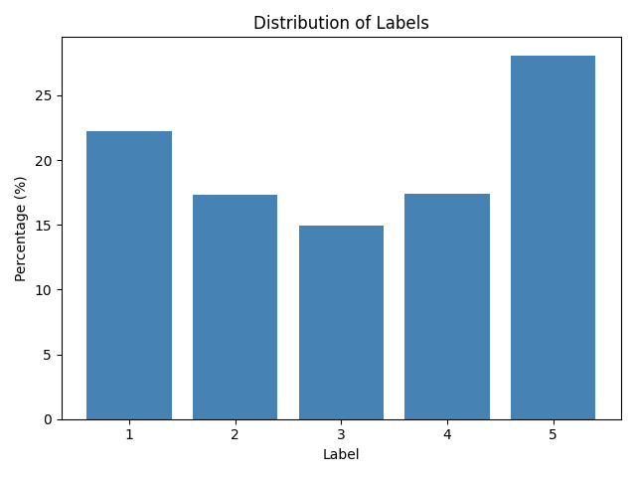
Benchmarks/Observations(2)
Meta-Llama-3.1-8B-Instruct
Qwen3-VL-8B-Instruct
openai/gpt-oss-20b
Sample data (Human generated)

Slide 5
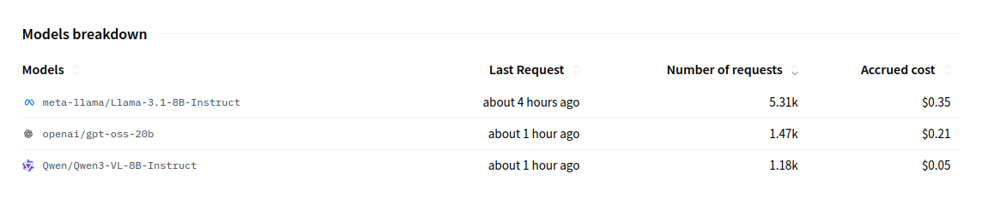
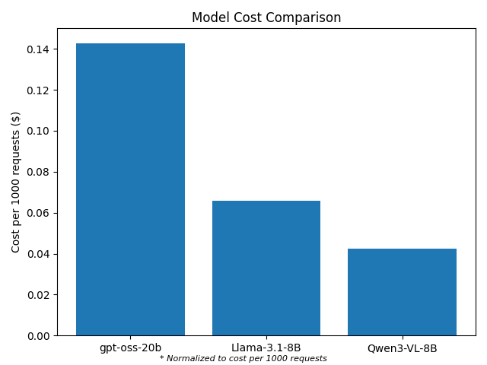
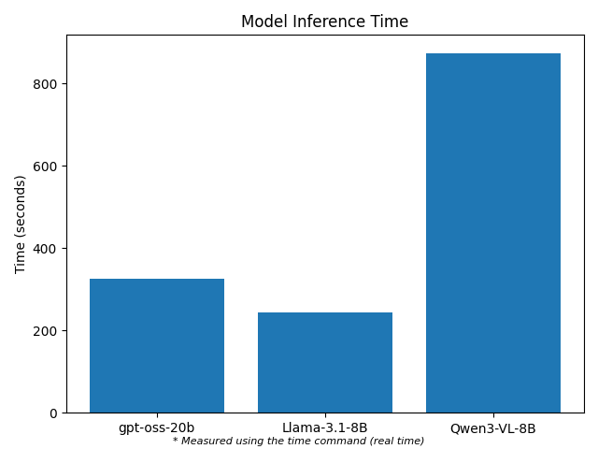
Benchmarks/Observations(3)
Lower hallucination rate comes at a cost
Cost can be prohibitive for testing more advanced models
Slow inference reduces sample size
Consistency of the output plays the biggest role
  Qwen
  Gpt
  LLama

Slide 6
Further improvements
Fine-tuning

Slide 7
Fine-Tuning only approach
Method: Take a pre-trained model (e.g., BERT, RoBERTa) and update all its parameters on the WSD task using the 1-5 plausibility scores.
Pros:
  The entire model specializes in the task.
  Can achieve peak performance by adapting all knowledge.
Cons:
  Computationally expensive (GPU required).
  High risk of overfitting on small datasets.
  Can suffer from "catastrophic forgetting."

Slide 8
Further improvements
Fine-tuning
Regression +/- Fine-tuning

Slide 9
Types of Regression Approaches for WSD
Linear / Tree-Based Regression
  Method: Use sentence embeddings as features for models like Linear Regression, Random Forest, or XGBoost.
  Pros: Fast, interpretable, no GPU needed. Perfect for a strong baseline.
  Cons: Limited ability to capture complex semantic nuances.
→ For a quick sanity check and to establish a performance lower bound.
2. Fine-Tuned LLM Regression Head
Method: Use a pre-trained LLM (e.g., LLaMA, Qwen) to generate embeddings, then fine-tune a small regression head on top.
Pros: Leverages deep semantic knowledge from the LLM. Best for capturing subtlety and context. Highest potential accuracy.
Cons: Requires GPU; risk of overfitting on small datasets.

