Slide 1
NlsyLinks: An R Package Facilitating BG Research with the NLSY
Behavior Genetics Association Edinburgh, UK June 25, 2012
William Beasley Howard Live Oak, LLC Joseph Rodgers OU Norman David Bard OU Health Science Center Kelly Meredith OU Norman
Notes:
Hi, I’m Will Beasley. Today I’m discussing how the family relationships in the NLSY79 were inferred, and how these connections can assist research.

Slide 2

Part 1: Creating the kinship links
Part 2: Using the NlsyLinks package
Notes:
The talk’s first part describes how the kinship links were created. It’s work that you won’t need to replicate, but understanding it may help you use the links. The resulting dataset stands by itself and can be used by SAS, R, or any statistical software.
The presentation’s second part describes the package we’ve developed to assist R users.

Slide 3
Convert from Wide to Long
One row per Subject
Subject ID | Date 2000 | Weight 2000 | Height 2000 | Date 2002 | Weight 2002 | Height 2002 | Date 2004 | Weight 2004 | Height 2004
101 | A | B | C | D | E | F | G | H | I
102 | J | K | L | M | N | O | P | Q | R
103 | S | T | U | V | W | X | Y | Z | AA
Subject | Year | Item | Value
101 | 2000 | Date | A
101 | 2000 | Weight | B
101 | 2000 | Height | C
101 | 2002 | Date | D
101 | 2002 | Weight | E
101 | 2002 | Height | F
101 | 2004 | Date | G
101 | 2004 | Weight | H
101 | 2004 | Height | I
102 | 2000 | Date | J
102 | 2000 | Weight | K
102 | 2000 | Height | L
…
Variable Code | Item | Generation | Extract Source | Survey Source | Survey Year | Loop Index
….
R0000156 | 1 | 1 | 3 | 1 | 1979 | 4
R0000158 | 1 | 1 | 3 | 1 | 1979 | 5
R0000151 | 2 | 1 | 3 | 1 | 1979 | 1
R0000153 | 2 | 1 | 3 | 1 | 1979 | 2
R0000155 | 2 | 1 | 3 | 1 | 1979 | 3
R0000157 | 2 | 1 | 3 | 1 | 1979 | 4
R0000159 | 2 | 1 | 3 | 1 | 1979 | 5
R0000300 | 13 | 1 | 3 | 1 | 1979 | 0
R0000500 | 14 | 1 | 3 | 1 | 1979 | 0
C0000100 | 100 | 2 | 6 | 2 | 2008 | 0
C0005500 | 13 | 2 | 4 | 2 | 2008 | 0
C0005700 | 15 | 2 | 4 | 2 | 2008 | 0
Y1708400 | 10 | 2 | 4 | 3 | 2006 | 1
Y1708500 | 10 | 2 | 4 | 3 | 2006 | 2
Y1708600 | 10 | 2 | 4 | 3 | 2006 | 3
…
One row per Subject-Response
Notes:
Many steps were necessary to create the links, and I’ll describe the ones that might influence you. Extracted NLSY data has one row per subject. In database terminology, our first step was to normalize the data, so each response gets its own row. This is possible by first creating a static lookup table that contains metadata for every extracted NLSY variable.

Slide 4
Create Table of Response Categories and Compare Across Siblings
Table containing mother’s responses about her children’s biological father(s):
Child ID | Survey Year | In House | Alive | Ever Live In House | Left House Date | Death Date | Miles From House
101 | 1991 | - | - | - | - | - | -
101 | 1992 | 0 | 1 | 1 | 7/1982 | - | 5
101 | 1993 | 0 | 1 | 1 | 7/1982 | - | -
101 | 1994 | 1 | 1 | - | - | - | -
101 | 1996 | 0 | 1 | 1 | 3/1982 | - | 5
102 | 1991 | - | - | - | - | - | -
102 | 1992 | 0 | 1 | 1 | 7/1982 | - | 5
102 | 1993 | 0 | 1 | 1 | 7/1982 | - | -
102 | 1994 | 1 | 1 | - | - | - | -
102 | 1996 | 0 | 1 | 1 | 3/1982 | - | 5
103 | 1991 | - | - | - | - | - | -
103 | 1992 | 1 | 1 | - | - | - | -
103 | 1993 | 1 | 1 | - | - | - | -
103 | 1994 | 1 | 1 | - | - | - | -
103 | 1996 | 0 | 1 | 1 | 1/1995 | - | 15
One row per Subject-Year
Bill & George appear to share same biodad as each other
Jane appears to have a different biodad
All these variables have different rules for inferring shared biodad.
Notes:
Then we denormalize the data and group the responses around a few topics. The topic on this slide shows how their mother responded about her children’s biological father. There are three subjects displayed (blue, red, and yelllow), each with five years of surveys. See how the blue and red subjects have a similar pattern, suggesting the same biological father. While the yellow rows have a much different pattern, implying that the mother believes there’s a different biological father.

Slide 5
Create Table of Markers
Older Subject ID | Younger Subject ID | Year | Marker Type | Evidence of MZ | Evidence of Share Biodad
101 | 102 | 1991 | LeftHHDate | Missing | Missing
101 | 102 | 1992 | LeftHHDate | Consistent | StronglySupports
101 | 102 | 1993 | LeftHHDate | Consistent | StronglySupports
101 | 102 | 1994 | LeftHHDate | Consistent | Missing
101 | 102 | 1996 | LeftHHDate | Consistent | StronglySupports
101 | 103 | 1991 | LeftHHDate | Missing | Missing
101 | 103 | 1992 | LeftHHDate | Ambiguous | Unlikely
101 | 103 | 1993 | LeftHHDate | Ambiguous | Unlikely
101 | 103 | 1994 | LeftHHDate | Ambiguous | Ambiguous
101 | 103 | 1996 | LeftHHDate | Disconfirms | Disconfirms
…
101 | 102 | 1991 | Alive | Consistent | Consistent
101 | 102 | 1992 | Alive | Consistent | Consistent
…
One row per SubjectPair-Marker-Year
Notes:
Then those clustered responses are arranged to create “Markers” for each pair. Each marker is assigned how strongly it supports or disconfirms sharing the same biological father. Each assignment is an informal synthesis of a prior base rate and it’s observed likelihood. Two Dads having asthma isn’t as convincing as two Dads dying or leaving a household in the same month. We’ll return to this issue later.

Slide 6
Create Table of R Coefficients
Older Subject ID | Younger Subject ID | Twin or Trip | Is Mz | R Implicit Pass1 | R Implicit Pass2 | R Explicit Pass1 | R Explicit Pass2 | R Pass1 | R Pass2
101 | 102 | 0 | 0 | .50 | .50 | .50 | .50 | .50 | .50
101 | 103 | 0 | 0 | .25 | .25 | .25 | .25 | .25 | .25
102 | 103 | 0 | 0 | - | .25 | - | - | - | .25
One row per SubjectPair
Interpolation between Passes 1 & 2
Susceptible to
Pass 1: | Knowledge Error
Pass 2: | Knowledge Error | + | Response Error
Notes:
Finally the markers are combined to make decision about a pair’s R coefficient. Based on the responses we’ve seen, the first two kids are full sibs, while the third is their half-sib.
There are three categories of classification, those using only implicit information, those using only explicit information, and a combination. Today I’ve focused only implicit.
Each category gets two passes. The first pass is very stingy with assignments, and hopefully will be wrong only when the subject’s knowledge is wrong. The second is more inclusive.
When possible, we fill-in missing R coefficients using the other relationships in the family.

Slide 7
Two Primary Sources of Subjectivity in the Algorithm
Assigning “evidence strength” to a marker
Should biodad death dates separated by 2 months be “Strongly Supports” or “Supports”?
Are 10 years of mostly consistent answers better than 3 years of perfectly consistent answers?
Combining markers
Should a child’s “Strongly Supports” marker trump a mother’s “Supports” marker?
Should BiodadDeathDate trump BiodadLiveInHH?
Notes:
We’ve tried to design the algorithm so that the subjectivity is isolated to two areas. First, how strong should a marker’s evidence be? Second, how should the markers be combined? A lot of our subjective decisions can be reasonably justified by face validity. But we want to be more systematic.

Slide 8
Three Strategies for Tuning & Training Algorithm
Create “Gold Standard” families
R Values are hard coded into unit & integration tests.
Verify that all future algorithm versions match the 20+ gold standard families.
Reports & graphs
Track how current version differs from previous versions.
Track how different perspectives agree/disagree.
Automated pipeline
Rich information summaries don’t require brainpower.
Quick feedback for the effect my subjective decisions.
Notes:
One way to be more systematic was creating gold standard families from records that we went through manually. We identify families that no future version of the algorithm should be allowed to contradict.
Another way was to develop a reporting system (using R and Sweave) that immediately provided feedback on how the assignments changed after the algorithm changed.

Slide 9
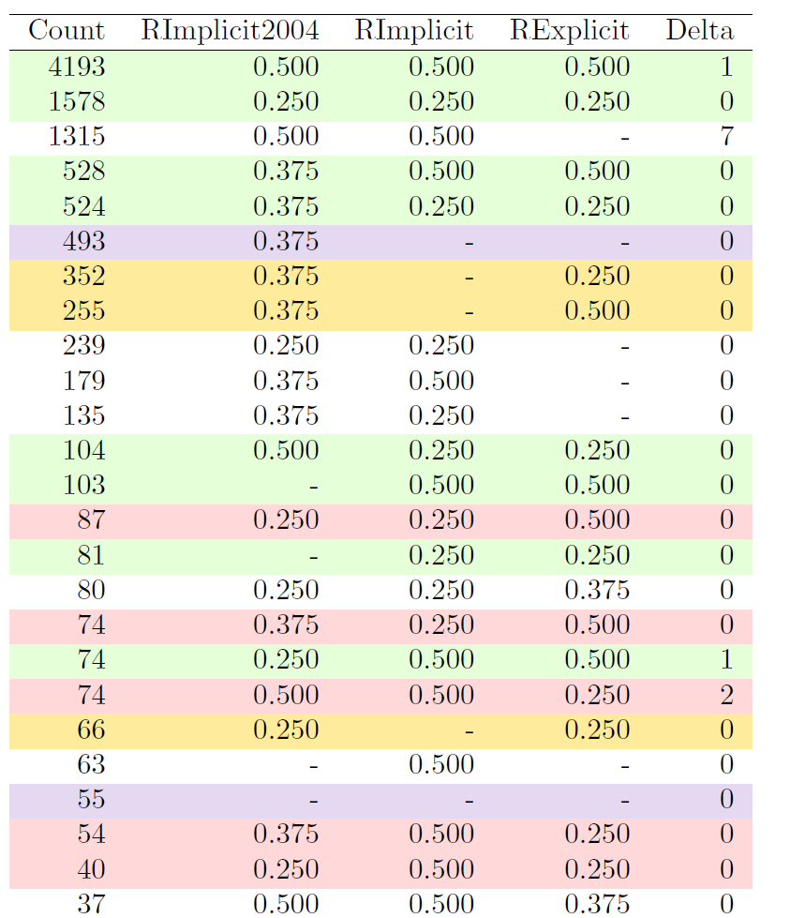
Notes:
Here is just one of the comparisons that we monitor. Green is when the Implicits and Explicits agree. Red is where they don’t. The Delta column (in the far right) is how the current version differs from the previous. Another comparison (not shown) is how the mother’s beliefs differ from her children’s.
The first graph is an ROC-like graph, where you want to be in the top left corner. The vertical axis is the number of agreements; the horizontal is the disagreement. The lower graph zooms in on the interesting part, showing the progression of the most recent versions.
Our goal was not to be in the top left corner at all costs, but rather to approach the corner with subjective, yet defensible, decisions that possess high face validity.

Slide 10
Product of the Algorithm
The result is a single file with three important columns.
Subject1 ID | Subject2 ID | R
1201 | 1202 | .50
1301 | 1302 | .50
1301 | 1303 | .50
1302 | 1303 | .50
1401 | 1402 | .25
…
Notes:
The final file has three important columns. The pair’s R coefficient and the two IDs, so you, the applied researcher, can combine our Rs with your outcomes. The R coefficient that we recommend and circulate is informed by both implicit and explicit items.

Slide 11
Part 2: Using the NlsyLinks package
Experienced Researchers
Researchers repeatedly write the same code that contributes no direct value to their substantive conclusions.
This package assumes & automates tedious, error-prone code.
Fresh Researchers
Documentation and functions for basic BG manipulations & analyses.
Forums and support staff.
Notes:
Part 2 of the talk… Until now, all of the discussed complexity can be hidden from the applied researcher. But this second part describes the things that you DO interact with directly.
To use an ACE metaphor, our package soaks up a lot of the common variability in NLSY and BG programming code. This package provides many functions that you would write ordinarily. After using our package, hopefully your remaining code is mostly unique expressions of your substantive research.
I think the package is equally compelling for less experienced researchers, but that’s less relevant for today’s audience. We’ll go through a scenario that shows how both audiences benefit.

Slide 12
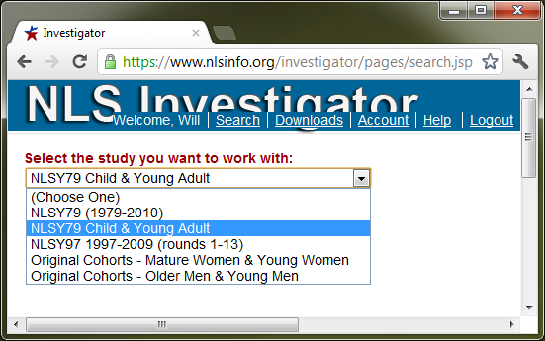
Step 1a: Extract Dataset
Notes:
The first step is to download the variables from the NLSY website. Their site has good documentation, and we have a thorough vignette. So I’m just going to jam through the steps.
First you select your cohort. Here’s we’re selecting the 2nd generation of the NLSY79

Slide 13
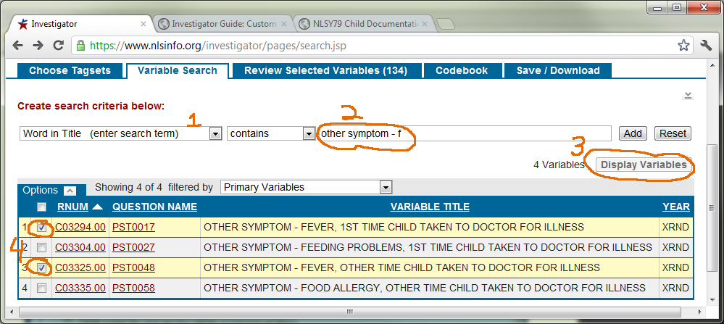
Step 1b: Extract Dataset
Notes:
Then you search for your variables. If you know what you want, it takes minutes. But rarely is it adequate to look at only isolated variable titles. If you’re new to the variables, you should study the documentation and response patterns. This takes a long time to do well –hours at least. But it also can be fun. It’s an important part of the process of operationalizing your constructs. And keep in mind that this process is much quicker and cheaper than conducting your own 30-year survey.

Slide 14
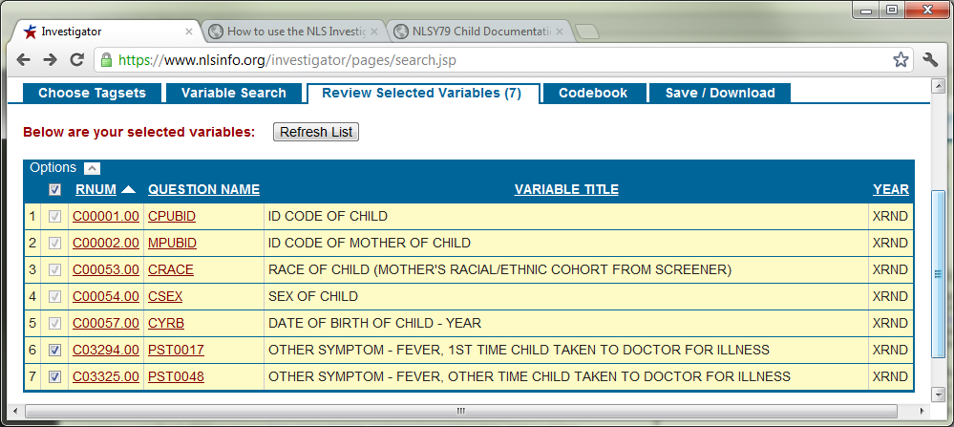
Step 1c: Extract Dataset
Notes:
Next you review the selected variables.

Slide 15
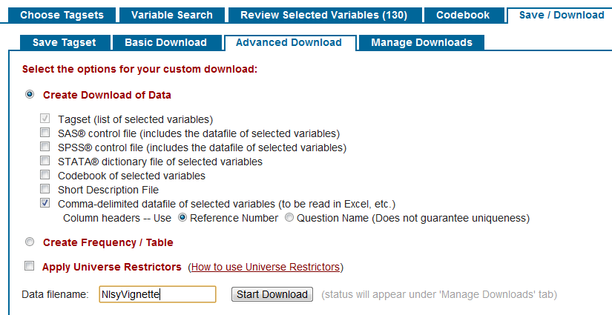
Step 1d: Extract Dataset
Notes:
And click a few options to download the CSV of responses…

Slide 16
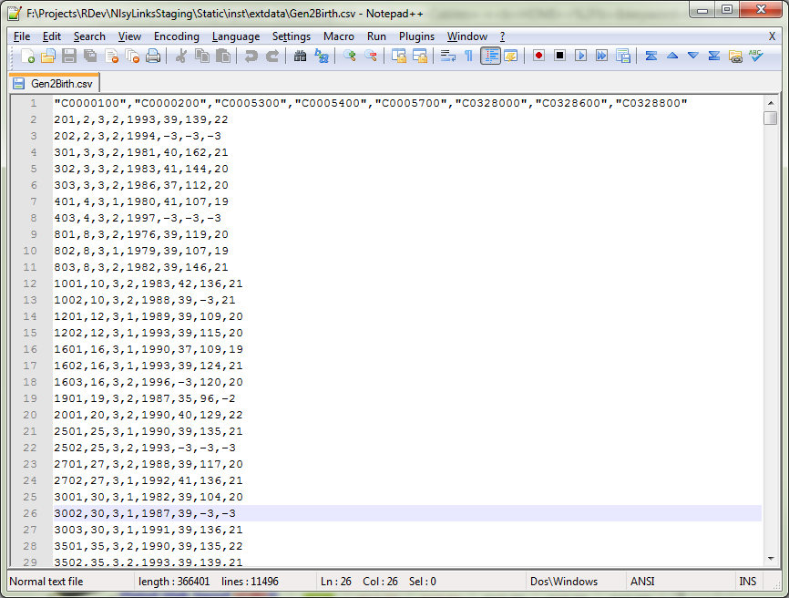
Step 1: Extract Dataset
Notes:
…which is simple text like this.

Slide 17
Steps 2, 3, & 4
#Step 2: Load the package containing the linking routines. require(NlsyLinks)
#Step 3: Load the linking dataset; filter for the Gen2 subjects. dsLinking <- subset(Links79Pair, RelationshipPath=='Gen2Siblings')
#Step 4: Load the outcomes dataset from the hard drive. filePathOutcomes <- 'C:/BGResearch/Gen2Birth.csv'
dsOutcomes <- ReadCsvNlsy79Gen2(filePathOutcomes)
Notes:
Now you open R and type the following code. First you load our package. Next you filter the kinship links to only siblings in the 2nd generation. Next you provide the path to the text file that we just looked at. Our next function will read that CSV, do some plumbing manipulations, and return a data.frame of your outcomes which will look something like this…

Slide 18
Inspecting Intermediate Dataset
Plumbing variables that our package added or renamed
Unaltered NLSY variables
Notes:
…where the blue plumbing variables were either added or renamed by our function. The red variables are unique to your applied question. Their serial numbers aren’t very salient to humans …

Slide 19
Steps 5 & 6
#Step 5: Verify and rename an existing column.
VerifyColumnExists(dsOutcomes, 'C0328600')
dsOutcomes <- RenameNlsyColumn(dsOutcomes, 'C0328600', 'BirthWeightInOunces')
#Step 6: A negative value indicates refusal, don't know, invalid skipped, or was missing for some other reason. For our present purposes, treat these responses equivalently.
isNegative <- (dsOutcomes$BirthWeightInOunces < 0)
dsOutcomes$BirthWeightInOunces[isNegative] <- NA
Notes:
…so we recommend renaming the variables in the next step. Today, our phenotype of interest is birth weight. This is an actual variable from an NLSY extract.
And this single variable contains two sources of information. First, their weight, if it exists, is a positive value. But if it’s missing, a negative value indicates the type of missingness. For this presentation, we’ll assuming all missingness is equivalent, and assign all of them the special value “NA”.

Slide 20
Inspecting Intermediate Dataset
Notice one row per subject
Renamed variable
Recoded missing value
Notes:
Now you can see our two modifications. The variable has a better name, and the missingness has been recoded to a value that the SEM won’t misinterpret.

Slide 21
Step 7
#Step 7: Create the single-entered dataset.
dsSingle <- CreatePairLinksSingleEntered( dsOutcomes, dsLinking, 'BirthWeightInOunces' )
Notes:
This next little snippet is deceptively important. It merges your outcomes with our kinship links.
Even if you already have the R coefficients, this line saves you several hours of writing & debugging at least 30 lines of code.
This example uses only one variable (BirthWeight), but the function accomodates an arbitrary number of variables.

Slide 22
Subject | Weight
201 | 139
202 | -
301 | 162
302 | 144
303 | 112
401 | 107
403 | -
R | Weight_1 | Weight_2
.50 | 139 | -
.50 | 162 | 144
.50 | 162 | 112
.50 | 144 | 112
.25 | 107 | -
Subject1 | Subject2 | R
201 | 202 | .50
301 | 302 | .50
301 | 303 | .50
302 | 303 | .50
401 | 402 | .25
Notes:
What it does isn’t conceptually difficult, but the actual implementation can get tripped up easily.

Slide 23
Steps 8 & 9
#Step 8: Declare outcome variable names. oName_1 <- 'BirthWeightInOunces_1' oName_2 <- 'BirthWeightInOunces_2'
#Step 9: Summarize the R groups. dsGroupSummary <- RGroupSummary( dsSingle, oName_1, oName_2 )
Notes:
Then the package assumes some familiar inspection and cleaning tasks that should be done before an ACE model. This saves roughly 30 minutes and 20 lines of code. Here we’re looking at covariances within groups.

Slide 24
Steps 10 & 11
#Step 9: Create a cleaned dataset. dsClean <- CleanSemAceDataset( dsSingle, dsGroupSummary, oName_1, oName_2 )
#Step 10: Run the single-outcome ACE SEM. ace <- AceLavaanGroup(dsClean)
Notes:
Now, the groomed dataset is ready for the SEM software of your choice: OpenMx, WinBUGS, SAS, Mplus. We tried to be entirely agnostic.
If you’re starting with a typical univariate ACE, consider using our function that defines and estimates the model in lavaan (lavaan is a new latent variable package with similar syntax as Mplus). This line saves you 5-10 minutes because, you don’t explicitly define a single path or variance. The function takes care of that.
And here below are the ACE estimates.
Most of you will want to run a more complex models, and you’re stlil free to do that now.

Slide 25
Inspection of SEM details
library(lavaan) #Load to access lavaan methods.
GetDetails(ace)
#Examine fit stats like Chi-Squared, RMSEA, CFI, etc. fitMeasures(GetDetails(ace))
#Examine low-level details, like each group's individual parameter estimates and SEs. summary(GetDetails(ace))
#Extract low-level details. inspect(GetDetails(ace), what="converged")
inspect(GetDetails(ace), what="coef")
Notes:
What is returned is simply a lavaan object. You can inspect the output just as easily if you had run lavaan yourself.

Slide 26
Review of Major Steps
Select variables with NLS Investigator.
Read the CSV into R using ReadCsvNlsy79Gen2.
Manipulate & groom outcome variable(s).
Use CreatePairLinksSingleEntered to merge the (a) outcome and (b) linking datasets.
Create a GroupSummary to inspect the R groups.
Create a cleaned dataset for the SEM.
Estimate ACE with the AceUnivariate function.
Inspect the output.
Notes:
Here’s a review of what we covered. Of the eight bullets, I’d argue ideally, only the three blue bullets should require significant human intervention to run a univariate ACE with NLSY subjects. The other five are primarily rote tasks that don’t contribute towards your unique goals. Don’t let the rote tasks distract and slow you down.
Regarding the last bullet, suppose with your recovered time, you run some more histograms, and find…

Slide 27
There is a 768 ounce newborn (48 pounds) (22 kg)
Notes:
…that in those 11,000 births was a 20 kg newborn. Either a blue whale slipped through the screening processes, or more likely a mother lost a decimal somewhere. Either way, I feel safe truncating that value to something more reasonable…

Slide 28
Further cleaning
#Truncate scores to 300 ounces (19 lbs or 8.5 kg).
dsOutcomes$BirthWeightInOunces <- pmin( 300,
dsOutcomes$BirthWeightInOunces )
Before truncating, it was:
Notes:
…like 8 or 9 kg. The heritability estimates change drastically as the C- and E-squareds are halved.

Slide 29
Automation will never be able to detect and handle these situations.
Hopefully, by automating most plumbing tasks, your attention and time will be more available for subtle and conceptual issues.
Notes:
Planning this package, we tried to identify and automate the common tasks …which would allow researchers to concentrate on code that’s unique to them. If you have suggestions for additional tasks that could help you, feel free to contact us.

Slide 30
#Step 2: Load packages. require(NlsyLinks); require(lavaan) #Steps 3-4: Load the linking and outcomes datasets. dsLinking <- subset(Links79Pair, RelationshipPath=='Gen2Siblings') dsOutcomes <- ReadCsvNlsy79Gen2('C:/BGResearch/NlsExtracts/Gen2Birth.csv') #Step 5: Verify and rename an existing column. VerifyColumnExists(dsOutcomes, 'C0328600') dsOutcomes <- RenameNlsyColumn(dsOutcomes, 'C0328600', 'BirthWeight') #Step 6: Manipulate, groom, & inspect variables. dsOutcomes$BirthWeight[dsOutcomes$BirthWeight < 0] <- NA dsOutcomes$BirthWeight <- pmin(dsOutcomes$BirthWeight, 300) hist(dsOutcomes$BirthWeight, breaks=500) #Steps 7-8: Merge outcome & linking datasets; Declare outcome variable names. dsSingle <- CreatePairLinksSingleEntered(dsOutcomes, dsLinking, 'BirthWeight') oName_1 <- 'BirthWeight_1'; oName_2 <- 'BirthWeight_2' #Step 9-10: Create GroupSummary & cleaned dataset. dsGroupSummary <- RGroupSummary(dsSingle, oName_1, oName_2) dsClean <- CleanSemAceDataset(dsSingle, dsGroupSummary, oName_1, oName_2) #Steps 11-12: Run the model; inspect the output. ace <- AceLavaanGroup(dsClean) GetDetails(ace)
~14 lines of code
Notes:
Everything we accomplished going from a raw CSV extract to the SEM results took 14 lines of code.
Typically Step #6 requires more manipulation, but no more than if you weren’t using the package.

Slide 31
Features not discussed today
Other helpful data, such as
Subject’s last completed survey
Subject’s date of death
Spatial models (wait 5 minutes)
Mixed models (wait 6 minutes)
Notes:
Embedded in the package are several other datasets that may help manipulate your outcome variables.
And David’s about to discuss spatial and mixed models.

Slide 32
Applicability
Kinship links are not restricted to
R
NlsyLinks
NlsyLinks is not restricted to
Traditional BG research
NLSY
Notes:
To reiterate, the kinship links will work in any software, even if your not using our package or R
And our package has features that should help beyond BG and the NLSY.

Slide 33
Support Staff
User forums on R-Forge r-forge.r-project.org/forum/?group_id=1330
Specific NlsyLinks issues
General BG issues
OpenMx, lavaan, SAS, Mplus
CRAN cran.r-project.org/web/packages/NlsyLinks
Help over email Joe Rodgers (jrodgers@ou.edu) Will Beasley (whb4@ou.edu)
Notes:
Finally, we have online forums intended for kinship users, regardless if you use R.

Slide 34
Thank you

Slide 35
Take me out to ball game, take me out with the crowd. Buy me some peanuts and Cracker Jack, I don’t care if I never get back. Let me root, root, root for the home team, if they don’t win, it’s a shame. For it’s one, two, three strikes, you’re out, at the old ball game.

Slide 36
Exact Steps (page 1 of 2)
Select & download variables with NLS Investigator.
Open R and load the NlsyLinks package.
Load linking dataset, selecting only Gen2 subjects.
Read the CSV into R using ReadCsvNlsy79Gen2.
Verify the desired outcome column exists and rename it something meaningful: BirthWeightInOunces
Manipulate & groom outcome variable(s).

Slide 37
Exact Steps (page 2 of 2)
Use CreatePairLinksSingleEntered to merge the (a) outcome dataset and the (b) linking dataset.
Declare the outcome variable names.
Create a GroupSummary to inspect the R groups.
Create a cleaned dataset for the SEM.
Estimate ACE with the AceUnivariate function.
Inspect the output.

